Slide 1
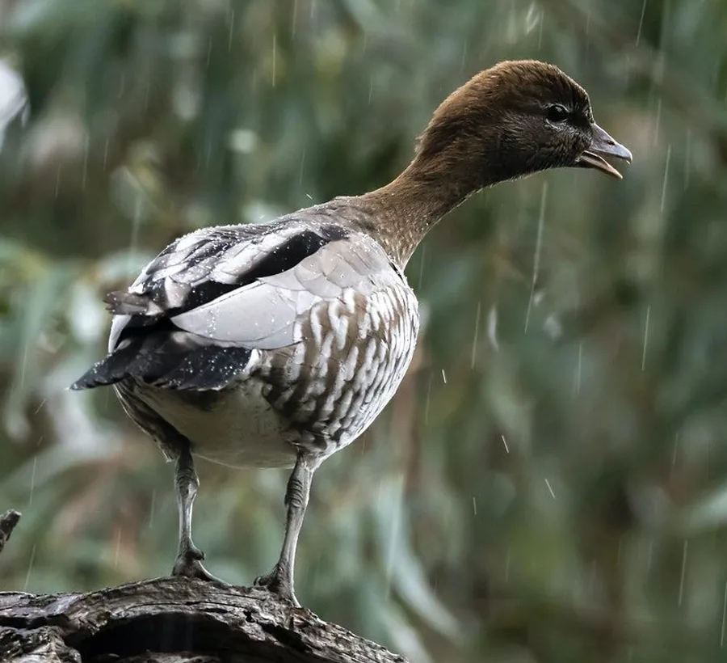
Inquiry into Victoria’s recreational native bird hunting arrangements
Dr Liz Walker - CEO
Ms Rebecca Cook – Head of Prevention
Ms Mhairi Roberts – Policy & Advocacy Manager

Slide 2
Regulatory framework
Wildlife Act 1975
Wildlife (Game) Regulations 2012
Prevention of Cruelty to Animals Act 1986
Prevention of Cruelty to Animals Regulations 2019
Code of Practice for the Welfare of Animals in Hunting (revision no. 1)

Slide 3
Compliance and enforcement
Over 20,000 natural wetlands in Victoria
69% of wetlands are on private land
1% of natural wetlands attended during 2023 duck season
~90% of quail hunted on private land

Slide 4
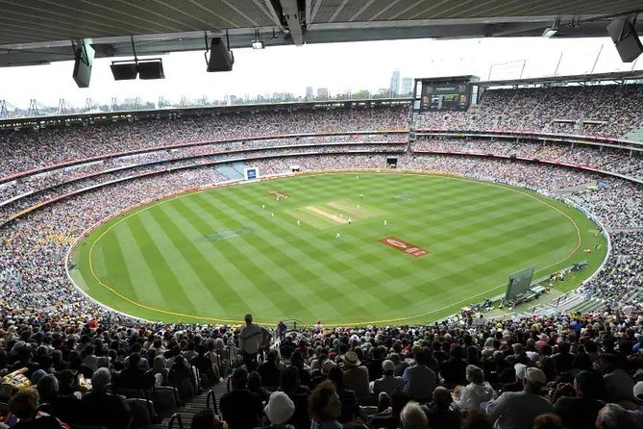
Wounding
Wounded birds suffer from:
Pain and disabling effects of injuries
Sickness due to wound infection
Thirst or starvation
Wing fractures
Predation
Inhumane dispatch methods

Slide 5
