Slide 1
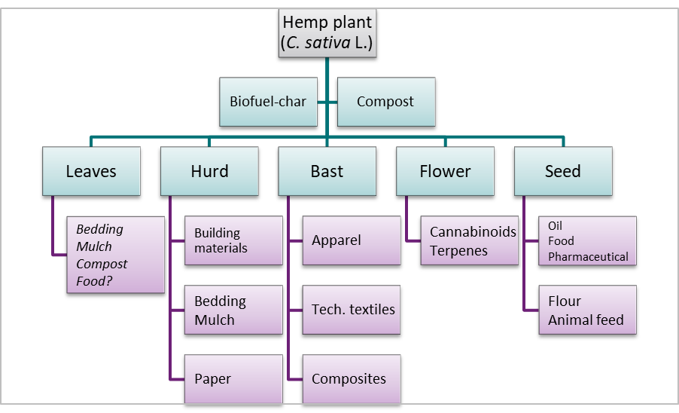

Slide 2
2021 FAO world crop areas for hemp (hectares) sans North America

Slide 3
2021 FAO hemp producing countries (percent area of world – 74K Ha) sans North America

Slide 4
Australian industrial hemp production areas since 2016-17 (ha) – source Australian Hemp Council (AHC) and the Australian Association of Hemp Regulators

Slide 5
Product yields per ha
CROP | Grain (t/ha) | Flower (t/ha) | Fibre (t/ha) | Hurd (t/ha)
Grain | 0.5 – 3 | - | 0.3 – 0.9 <100 Kt/yr | 0.9 – 3
Biomass | - | - | 1.5 – 2.5 | 3 – 5
Dual (grain/biomass) | 0.5 – 1.5 | - | 0.5 – 1 | 2.5 – 3.5
Dual (flower/biomass) | - | 1 – 1.5 (10 – 50 kg of CBD/ha) | 0.5 – 1 | 2.5 – 3.5
Cotton | 4 | - | 2.7 (average) 25 Mt/yr | -

Slide 6
World natural fibre (vegetable) production

