Slide 1


So you think you can pass a bill?
Click anywhere to start

Slide 2
Instructions
Good luck!
You are about to attempt to pass a bill into law.
It will need to pass the bill through both the Legislative Assembly and Legislative Council before it receives final sign-off, or Royal Assent, from the Governor of Victoria.
You’ll start in the Legislative Assembly, the house where government is formed (the government have the majority of members).
Start the game

Slide 3
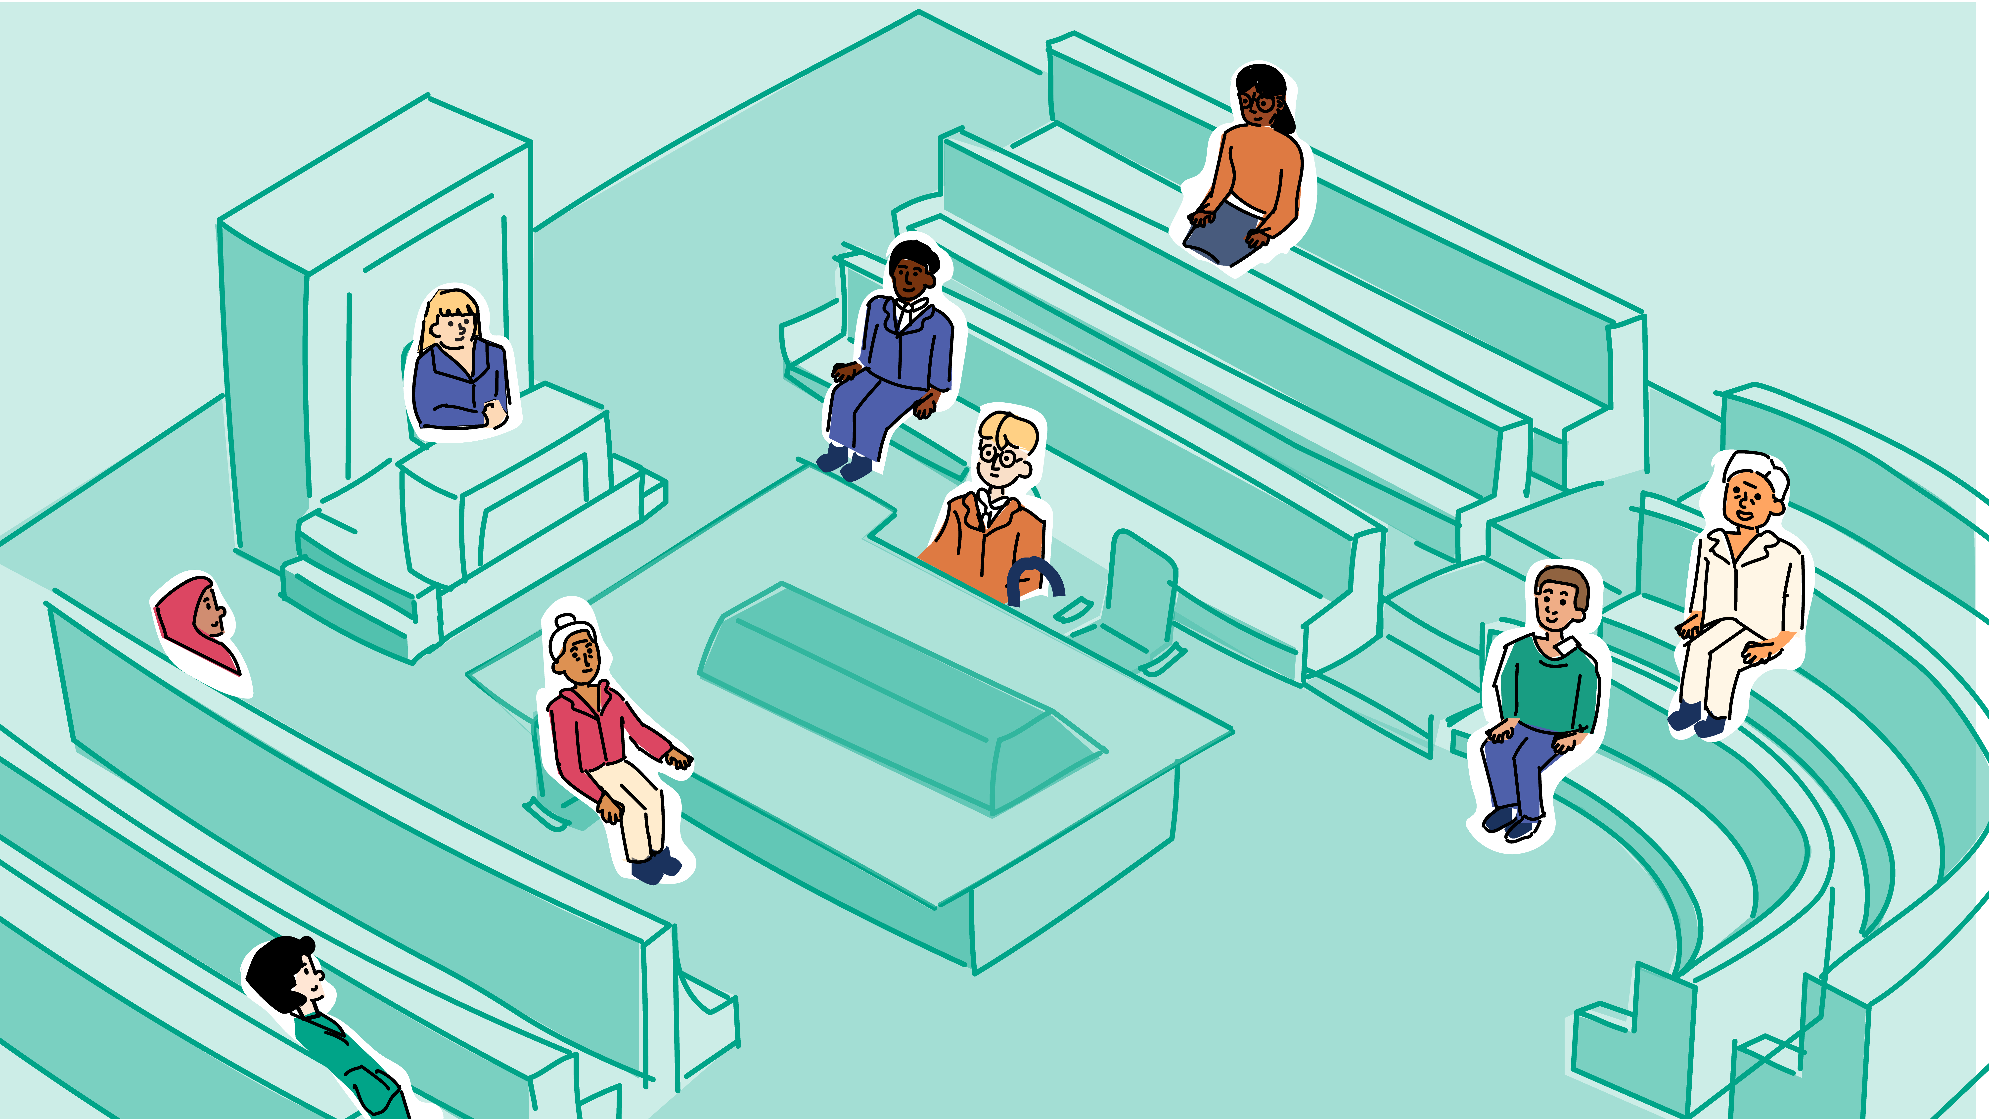
Choose your role
LEGISLATIVE ASSEMBLY
LEGISLATIVE ASSEMBLY
Opposition backbencher
Who is going to introduce the bill into the Legislative Assembly?
Shadow Minister
Speaker
Opposition Leader
Independent
Minister
Premier
Member of a minor party
Government backbencher

Slide 4
A government backbencher
LEGISLATIVE ASSEMBLY
You don’t usually introduce bills. Introducing bills is usually the job of a minister or occasionally the Premier.
However, if you really want to introduce a bill, you can introduce a private member’s bill. These bills are usually introduced to highlight an important issue for yourself and/or your electorate.
Choose one option
Introduce a private member’s bill
Find another way to highlight important issues
Have a minister introduce the bill

Slide 5
A member of a minor party
LEGISLATIVE ASSEMBLY
As a member of a minor party, you don’t often introduce bills, but you could if you wanted to. You could introduce a private member’s bill.
Choose one option
Introduce the bill anyway
Introduce a private member’s bill
Find another way to highlight important issues

Slide 6
A minister
LEGISLATIVE ASSEMBLY
As a minister you have areas of responsibility such as education, health or transport. It’s your role to introduce any bills that might relate to your areas of responsibility.
After talking to maybe your colleagues, experts and the community, you’ve put all your ideas into a bill and your ready to introduce the bill into the Legislative Assembly.
Choose one option
Introduce a government bill

Slide 7
A shadow minister
LEGISLATIVE ASSEMBLY
As a shadow minister you are interested in specific areas such as education, health or transport. Your job is mostly to ask questions and come up with different ideas to strengthen these areas.
You don’t often introduce bills, but you could if you wanted to. You could introduce a private member’s bill.
Choose one option
Introduce a private member’s bill
Find another way to highlight important issues

Slide 8
An independent
LEGISLATIVE ASSEMBLY
As an independent, you don’t often introduce bills, but you could if you wanted to. You could introduce a private member’s bill.
Choose one option
Introduce the bill anyway
Introduce a private member’s bill
Work with a minister to introduce the bill

Slide 9
An opposition backbencher
LEGISLATIVE ASSEMBLY
As an opposition backbencher, you don’t often introduce bills, but you could if you wanted to. You could introduce a private member’s bill.
Choose one option
Introduce the bill anyway
Introduce a private member’s bill
Work with a minister to introduce the bill

Slide 10
The Opposition Leader
LEGISLATIVE ASSEMBLY
As the Opposition Leader your job is mostly to ask questions of the government. You don’t often introduce bills, but you could if you wanted to. You could introduce a private member’s bill.
Choose one option
Introduce the bill anyway
Introduce a private member’s bill
Work with a minister to introduce the bill

Slide 11
The Premier
LEGISLATIVE ASSEMBLY
As leader of the state, one of your jobs is to oversee the work of the Executive (the ministers). You don’t often introduce bills, but if you do, it’s usually a bill that is considered very important to the people of Victoria.
Choose one option
Introduce the bill anyway
Introduce a government bill
Work with a minister to introduce the bill

Slide 12
The Speaker
LEGISLATIVE ASSEMBLY
The Speaker’s role is to manage debate and make sure everyone is following the rules or the standing orders. The Speaker does not introduce bills.
Choose one option
Introduce the bill anyway
Introduce a government bill
Work with a minister to introduce the bill
Find another way to highlight important issues

Slide 13
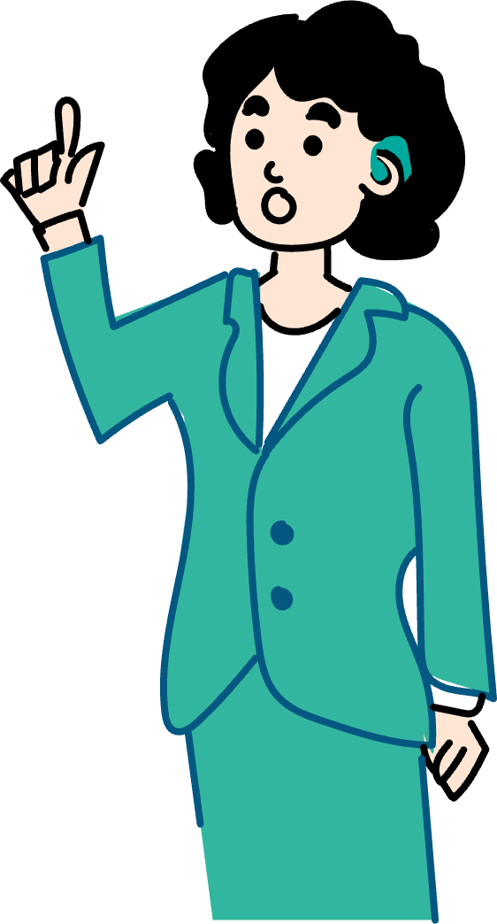

Introduce a private member’s bill
LEGISLATIVE ASSEMBLY
Choose one option
You have introduced a private member’s bill as a government backbencher.
The bill is on an issue that is really important to you and the people you represent.
But did your party know you were going to introduce this bill?
Yes, the party were aware
No, I did this all by myself
Return to beginning

Slide 14
Yay, you have your party’s support
Choose one option
Phew! It’s good to let your government party colleagues know what you’re up to and get their support.
Letting them know means the government has had the chance to read the bill, and they have all agreed you’re the best person to introduce the bill.
Introduce the bill and find out what happens next
On second thought, let a minister introduce the bill

Slide 15
Oh no…
LEGISLATIVE ASSEMBLY
Choose one option
While you can introduce a private member’s bill, it’s probably important to let your party know beforehand so they can read the bill and support you .
The government has the majority of members (50%+1) in the Legislative Assembly. So, if your party doesn’t support the bill, there is no debate and it does not pass.
Try again (and maybe let people know)
Let a minister introduce the bill
Find another way to highlight important issues
Return to beginning

Slide 16
Introduce a private member’s bill
Choose one option
If you decide to introduce a bill, it’s called a private member’s bill.
Private members’ bills are usually introduced to highlight an important issue for yourself and/or your electorate.
Introduce a private member’s bill
Find another way to highlight important issues

Slide 17
Introduce a private member’s bill
Choose one option
You’ve prepared the bill and prepared your speech, and you’re ready to introduce your private member’s bill.
Does the bill have the support from the government?
Yes, and a few other MPs
No, but I think I have support from the opposition and crossbench
Not sure, so I'll find another way to highlight important issues

Slide 18
Are you sure the government supports the bill?
Choose one option
The government does think the bill is a great idea and want to work with you to create a new bill that combines their ideas with yours.
What do you do?
Don't introduce the bill, at least for now
Try introduce the bill, without the government's help
Work with the government and let a minister introduce the bill
Find another way to highlight important issues

Slide 19
Don’t introduce the bill, at least not for now
Choose one option
All that hard work need not go to waste. You can always reintroduce the bill some other time, perhaps when you might have more support.
Come back to it later
Find another way to highlight important issues

Slide 20
Try again
Choose one option
Maybe, in another parliament, if there was a minority government, you might be able to convince the opposition, minor party members and the opposition to support you.
But unfortunately, in this parliament, you just don’t have the support of the majority of members to the pass the bill.
Work with the government and let a minister introduce the bill
Find another way to highlight important issues

Slide 21
Work with the government
Choose one option
Congratulations, the government liked the sound of your bill, and had some ideas of their own that they wanted to include.
You’ve met with some government MPs, and you now have a choice to make.
Accept the government’s ideas and let a minister introduce the bill
Reject the government's ideas and introduce the bill

Slide 22
Oh no…
LEGISLATIVE ASSEMBLY
Choose one option
Unfortunately, the government has the majority of members (50%+1) in the Legislative Assembly. So, if your bill doesn’t have the support of the government, there is no debate and the bill does not pass the house.
Come back to it later
Find another way to highlight important issues
Try again
Return to beginning

Slide 23

It was worth a try…
Choose one option
No one can say you didn’t try.
The good news is by introducing the bill, you’ve let your electorate and the other members of parliament know you are passionate about issue.
Introduce another private member’s bill

Slide 24
Oh no…
LEGISLATIVE ASSEMBLY
You can
Not introduce the bill, at least for now
You gave it shot, but unfortunately without the support of the government, there is no debate and the bill does not pass the house.
Try again
Work with the government to include your ideas in another bill
Find another way to highlight important issues
Return to beginning

Slide 25
Point of Order
Do you
It was worth a shot, but an MP has yelled “Point of order!" and has pointed out, as Speaker you’re not allowed to introduce bills.
Resign as Speaker and introduce the bill
Work with the party to introduce the bill through a minister
Find another way to highlight important issues

Slide 26
Speaker resigns
Choose one option
This bill must be super important to you to decide to quit.
The members in the Legislative Assembly vote for a new Speaker and you go back to your role as an MP who can introduce bills and participate in debate.
Choose another role

Slide 27
Highlighting important issues as the Speaker
Choose one option
The role of Speaker means that they can’t introduce bills or make speeches in the chamber. But the Speaker can still highlight important issues to their electorate, to parliament and Victorians by:
Working with their party to highlight issues on their behalf
Inviting community organisations to attend events and briefings at parliament
Continuing their work as an MP out in their communities
Try again

Slide 28
Introduce a government bill
Choose one option
As part of the Executive (a minister or the Premier) you’ve prepared the bill and prepared your speech.
You’re ready to introduce the government bill.
You read the title of the bill. The members of your party shout “Hear, hear!” and the bill is one step closer to passing the Legislative Assembly.
Follow the rest of the process

Slide 29
Come back to it another time
Choose one option
Sometimes it is worth revisiting a bill at a different time. This gives you a chance to:
Work with the government to see if there are different parts of the bill they do support
Continue to highlight important issues in the community and in the chamber
Try again

Slide 30
Other ways for MPs to highlight important matters
Choose one option
Making laws is the main role of parliament and the members of parliament, but there are many ways they can highlight important issues in the chamber and in their community:
Make speeches, such as a member’s statement
Ask questions of the government if an opposition member or crossbencher (minor party member or independent)
Host or attend events in the community
Meet with different parts of the community and organisations
Try again

Slide 31
Passing the bill process
The opposition and crossbench
Now that you’ve introduced the bill (the first reading) it’s time to move on to the next two readings. You kick off the debate (second reading) by explaining why this bill is important. You can hear members from your party muttering their support.
Members are given a chance to share their opinions on the bill. Some of them you agree with, some of them are interesting and there are a few points you’re not sure about.
The members vote (third reading) on whether to pass the bill and send it to the Legislative Council.
DO support passing the bill
DO NOT support passing the bill

Slide 32
The bill passes the Legislative Assembly
Choose one option
You’ve introduced the bill, participated in some debate, answered questions and addressed concerns (mostly from opposition).
The great news is, that at the final vote, the majority of members in the Legislative Assembly agree that the bill is a good idea.
You’re super excited and you’re one step even closer to your bill becoming a law. But what will happen in the Legislative Council…
Follow the bill to the Legislative Council

Slide 33
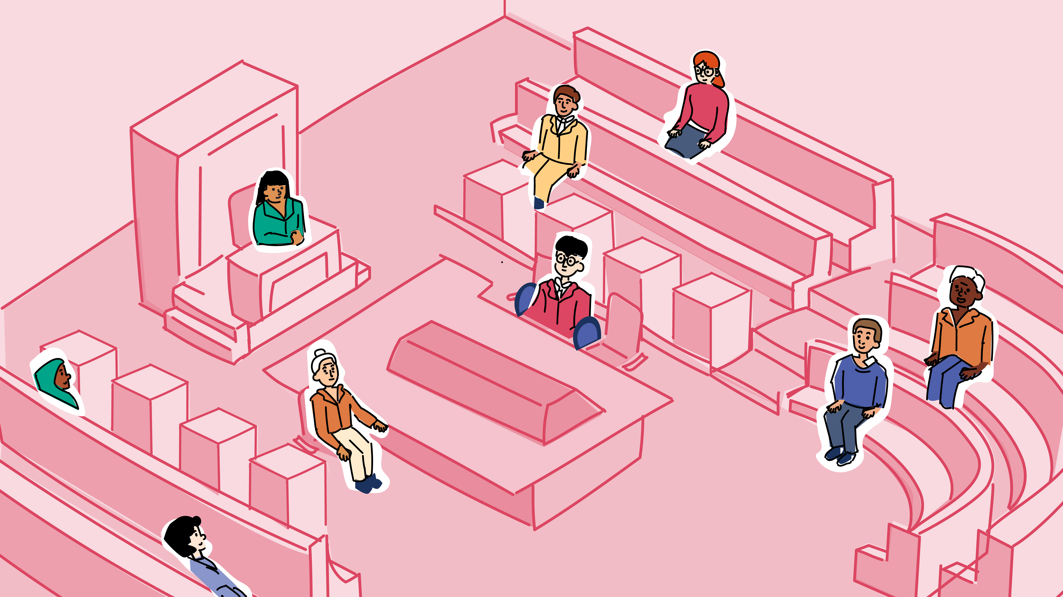
Welcome to Legislative Council
LEGISLATIVE COUNCIL
The Legislative Council is often referred to as the ‘house of review’. The government doesn’t need a majority in this chamber. The Legislative Council is often where non-government members are able to suggest amendments and make recommendations.
Let’s go
Introduce the bill into the Legislative Council

Slide 34
What is the composition of the Legislative Council?
The Legislative Council has
Before you introduce the bill, it is worth thinking about whether there is a majority of government members or not. This can help to determine, not just what path the bill will take, but what changes might be made.
More than half government members
Less than half government members

Slide 35
Introduce the bill into the Legislative Council
It’s clear the bill has
You’ve been designated as the person to introduce the bill into the Legislative Council (first reading).
It’s now time for debate (second reading).
Everyone has the opportunity to speak on the bill.
Lots of support from members across the chamber
Support from the government members and other members
Only support from government members

Slide 36
The bill has lots of support
Choose one option
As the debate goes on, it is clear the bill has a lot of support.
Most of the members are happy with all aspects of the bill, so there are no changes. Come the vote (third reading) the majority of members in the chamber agree to pass the bill.
The bill has now passed both the Legislative Assembly and Legislative Council.
Find out what happens next

Slide 37
The bill has some support
Which process does the chamber follow
The debate continues, and while there is lots of support, some members raise a few concerns and would like to review the bill.
Suggest amendments (changes) to the bill
Use the committee inquiry process to explore the bill in more detail
Continue debate regardless

Slide 38
Amendments (changes) are suggested
After lots of discussion the changes are
The majority of members agree that there is an opportunity to make some changes to the bill through a process called Committee of the Whole.
Each clause (dot point) of the bill is read. Members suggest changes, ask questions and debate the changes, and vote on whether each change should be made or not.
Agreed to and the changes are made
Defeated and no changes are made

Slide 39

Amendments are made to the bill
The Legislative Assembly
The majority of members have agreed to make some amendments and change parts of the bill. And in the third reading the majority of members agree to pass the bill.
Problem is, the bill is now different to the bill that passed the Legislative Assembly.
A note is sent to the Legislative Assembly to ask if they agree to the changes.
Likes and agrees to the changes
Doesn't like or agree to the changes

Slide 40
Parliamentary committee inquiries
Choose one option
Parliamentary committees are a group of members who conduct research into issues or areas of interest.
Once they have finished their research, the committee put together a report with their findings and recommendations. The report is presented to parliament.
Send the bill to committee
I’ve changed my mind, don’t send the bill to committee

Slide 41
The committee process
Do you
The committee report is in and has been presented to parliament. There are lots of interesting findings and recommendations. Some of it you already knew, but there are some new ideas and perspectives that may be worth considering.
Take some recommendations and create a new bill
Take some recommendations and suggest new policy
Thank the committee for their time and return to debate

Slide 42
Create a new bill
Choose one option
Sometimes committee reports highlight things that might have been missed in the original bill or suggest new ideas for laws.
It does not mean the work you’ve done on this bill has been a waste. All the debate and research will hopefully help make better laws.
Create a new bill

Slide 43

Suggest a new policy
Choose one option
Policy is a set of guidelines that can help organisations and people to make decisions about actions to take, such as budgets, resources and priorities.
Some of the recommendations in the committee report suggests the need for some new policy. And you agree.
Follow what happens to the bill

Slide 44
The second reading debate continues
At the vote (third reading) it’s clear that
The committee report is really interesting; good findings and good recommendations. But you feel like the bill already has all of it covered, and you’d like to keep debating the bill.
The chamber continues with debate (second reading) and everyone is given an opportunity to share their thoughts.
Most members support the bill
There are still members with concerns
10/10!

Slide 45
Introduce the bill into the Legislative Council
It’s clear the bill has
You’ve been designated as the person to introduce the bill into the Legislative Council (first reading).
It’s now time for debate (second reading).
Everyone has the opportunity to speak on the bill.
Lots of support
Some support
No support

Slide 46
The bill has lots of support
Choose one option
As the debate goes on, it is clear the bill has a lot of support.
Most of the members are happy with all aspects of the bill, so there are no changes. Come the vote (third reading) the majority of members in the chamber agree to pass the bill.
The bill has now passed both the Legislative Assembly and Legislative Council.
But it’s not a law just yet.
Find out what happens next

Slide 47
The second reading debate continues
Choose one option
The chamber continues with debate (second reading) and everyone is given an opportunity to share their thoughts.
At the vote (third reading) it’s clear that the majority of members still think the bill is a great idea, even if there might be a few questions and concerns.
Find out what happens next
10/10!

Slide 48
The bill has some support
The chamber votes and decides to
Without a majority of government members in the Legislative Council, you need to start negotiating with the opposition and crossbenchers. You’ll need their support to pass the bill.
Suggest and debate some amendments (changes)
Send the bill to committee
Continue to debate (second reading)

Slide 49
Amendments (changes) are suggested
After lots of discussion the changes are
The majority of members agree that there is an opportunity to make some changes to the bill through a process called Committee of the Whole.
Each clause (dot point) of the bill is read. Members suggest changes, ask questions and debate the changes, and vote on whether each change should be made or not.
Agreed to and the changes are made
Defeated and no changes are made

Slide 50
The second reading debate continues
At the vote (third reading) it’s clear that
Some of the amendments that were suggested sounded okay, and there was lots of discussion and debate about possible changes, but not a lot of agreement.
The chamber continues with debating the bill (second reading) and everyone is given another opportunity to share their thoughts.
Many members still have concerns
10/10!

Slide 51
Parliamentary committee inquiries
Does the chamber
Parliamentary committees are made up of a group of members who conduct research into issues or areas of interest.
Once they have finished their research, the committee put together a report with their findings and recommendations. The report is presented to parliament.
Send the bill to committee
Does not send the bill to committee

Slide 52
Committee process
Do you
The committee report is in and has been presented to parliament. There are lots of interesting findings and recommendations. Some it you already knew, but there are some new ideas and perspectives that may be worth considering.
Decide on new bill
Create a new policy
Return to debate

Slide 53
Create a new bill
Choose one option
Sometimes committee reports highlight things that might have been missed in the original bill or suggest new ideas for laws.
It does not mean the work you’ve done on this bill has been a waste. All the debate and research will hopefully help make better laws. And hopefully the new bill will have a lot more support.
Back to the beginning

Slide 54
Suggest a new policy
Choose one option
Sometimes committee reports highlight things that might have been missed in the original bill or suggest new ideas for laws.
It doesn’t mean the work you’ve done on this bill has been a waste. All the debate and research will hopefully help make better laws.
Follow what happens to the bill

Slide 55
Debate continues still concerns
Choose one option
The chamber continues with debate (second reading) and everyone is given an opportunity to share their thoughts.
As the vote (third reading) is called, it’s clear that many members still have questions and concerns.
Find out what happens next
10/10!

Slide 56
Amendments are made to the bill
The Legislative Assembly
After a very long debate, with lots of suggested changes and questions, a number of changes have been made to the bill. That’s great, because there now seems like there is a lot more support of the bill.
And when the time comes to vote (third reading) the majority of members agree to pass the bill.
The problem is, the bill is now different to the bill that passed the Legislative Assembly. A note is sent to the Legislative Assembly to ask if they agree to the changes.
Agree to the amendments
Disagree with the amendments

Slide 57
Congratulations
Choose one option
Even without a government majority in the Legislative Council, the bill has passed.
Many of the members agree that this bill is needed and is in the best interest of the people of Victoria.
The bill has now passed both the Legislative Assembly and the Legislative Council.
But it’s not a law just yet.
Find out what happens next

Slide 58
Come back to it another time
Choose one option
Sometimes it is worth revisiting a bill at a different time. This gives you a chance to:
Work with the government to see if there are different parts of the bill they do support
Continue to highlight important issues in the community and in the chamber
Try again

Slide 59
Oh no…
LEGISLATIVE COUNCIL
Choose one option
The bill has been defeated. There just was not enough support.
While the bill can’t be introduced again until after the next election (unless there are some significant changes), you can continue to highlight the issue through member statements, other speeches, and working with people and organisations in your community.
Try again
Return to beginning

Slide 60
Congratulations…
Choose one option
The bill has gone through the three readings in the Legislative Council and passed with no changes.
Whether there was lots of support or some members still had concerns and questions, when it came to the vote (third reading), the majority of members thought the bill was a good idea.
The bill has now passed the Legislative Assembly and the Legislative Council.
But it’s not law just yet.
Find out what happens next

Slide 61
The Legislative Assembly vote on amendments
Choose one option
The Legislative Assembly received the note telling them that the Legislative Council has made amendments to the bill.
They have seen the changes, have had some discussion, but the majority of members agree that the changes, and therefore the bill, is still a good idea.
Congratulations, the bill has now passed the Legislative Assembly and the Legislative Council.
But it’s not law just yet.
Find out what happens next

Slide 62
Negotiations
Both Houses
The Legislative Assembly received the note telling them that the Legislative Council has made amendments to the bill.
They have the changes, have had some discussion, and unfortunately the majority of members do not agree to the changes.
The bill is sent to a committee to discuss further. After much discussion, the Legislative Assembly and the Legislative Council come to a conclusion.
Agree to the changes, but it’s not law yet
Can’t agree on the changes

Slide 63
Oh no…
LEGISLATIVE COUNCIL
You can
The bill needs to pass both the Legislative Assembly and Legislative Council in exactly the same form.
Continue to discuss and try and agree on the changes
Redraft the bill, with some major changes
Return to beginning

Slide 64


Congratulations, your bill is now law!
Start again?
Now the bill has passed both the Legislative Assembly and Legislative Council, it’s time to take the final copy over to the Governor for Royal Assent.
The Governor, with the authority of the Crown, signs the bill…
The bill is now an Act of Parliament and a law.
Return to beginning

