Slide 1

Urban development perspective on the Supply of Homes in Regional Victoria
Linda Allison
CEO, UDIA
Jack Vaughan
Director of Policy, UDIA
Brad Paddon
Board of Directors, UDIA
Director & Founder, APD Projects
4 April 2025

Slide 2
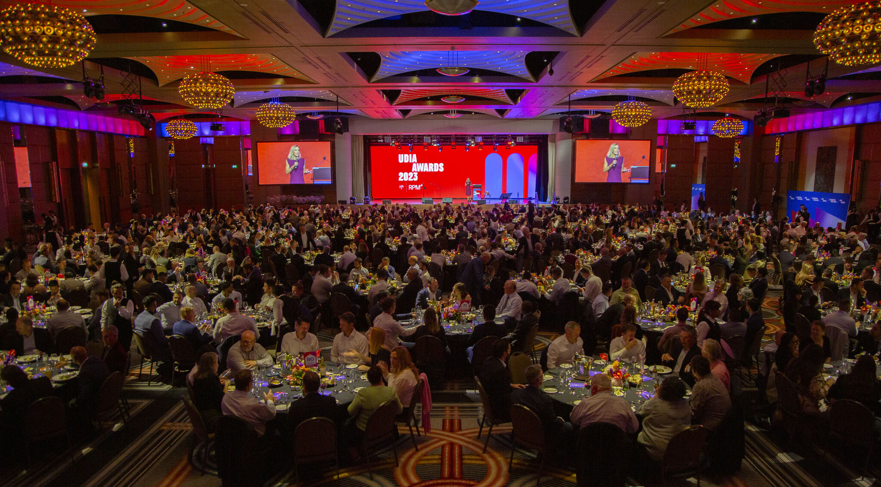

UDIA Victoria
UDIA Victoria is a non-profit, peak industry body. We are supported by a membership of land use and residential property development organisations, across the private sector and Victoria’s public service.
Key contributor to the Victorian Housing Statement and signatory of the Affordability Partnership
Committed to unlocking housing supply and removing barriers across planning, infrastructure and policy
320+ member organisations, 7,500-strong community
200+ committee members including regional committees in Geelong and Bendigo

Slide 3
UDIA agrees that regional Victoria has a strong role to play in solving the current housing shortage
The targets in Plan for Victoria for regional cities are highly ambitious
Regional areas need more support to play its role in delivering more housing for Victorians
Housing policies and regulatory settings should facilitate people’s desire to live in the type housing and the location they wish to live in.
The development industry stands ready to play its role in addressing housing challenges in regional Victoria.
KEY THEMES

Slide 4
Regional migration surged during COVID but has since reversed net internal migration dropped from over 6,000 to just over 1,000 per quarter (ABS).
This reversal demonstrates that regional population growth is not self-sustaining—it relies on planning, infrastructure and housing being ready.
The Victorian Government’s Plan for Victoria sets a target of 28,000 infill homes in Ballarat by 2051, or around 1,100 per year. Only 95 infill homes per year are currently being delivered (Pricefinder).
Greenfield development is more closely aligned with buyer demand and remains the most affordable pathway to home ownership, but is increasingly constrained by tax, planning and infrastructure settings.
CoreLogic data shows regional sales activity is slowing: volumes are down 3.9% year-on-year and 12.4% below the five-year average (March 2025).
In Bendigo, active lot supply in residential estates may be exhausted within three years (Ethos Urban).
CURRENT MARKET CONDITIONS

Slide 5
01
Review Windfall Gains Tax
Cap or abolish the Windfall Gains Tax in regional areas to ensure tax settings don’t disincentivise rezoning and development, undermining housing supply and affordability.
02
Streamline rezoning and strategic planning
Establish faster, more certain rezoning pathways and complete regional settlement strategies to ensure a reliable pipeline of developable land.
03
Reform CHMP and post-PSP approvals
Review Cultural Heritage Management Plan processes to reduce delays and costs, while maintaining protection aboriginal cultural heritage
04
Fast-track PSPs and DCPs
Accelerate the preparation and approval of Precinct Structure Plans and Development Contributions Plans to unlock housing supply in designated growth areas.
RECOMMENDATIONS
05
Strengthen local planning and engineering capacity
Provide dedicated funding and third-party accreditation options to resolve skills shortages in regional planning departments and improve approval timelines.
06
Develop integrated servicing strategies
Coordinate water, sewerage, drainage and power planning across government and utilities to ensure timely infrastructure delivery in growth corridors.
07
Align transport infrastructure and land use
Develop Integrated Transport Strategies that prioritise early investment in road, rail, and active transport to support regional housing growth.
08
Deliver UDFs and infill frameworks
Prioritise Urban Design Frameworks and infill planning controls to support higher-density housing in regional areas near services and jobs.

Slide 6

Questions/Discussion

