Slide 1
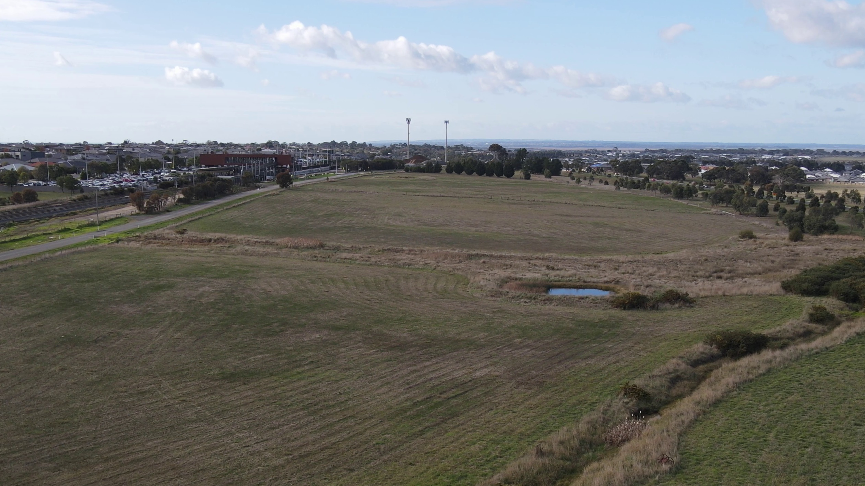
LEGISLATIVE ASSEMBLY ​
ENVIRONMENT AND PLANNING COMMITTEE ​
Regional Housing Inquiry
Waurn Ponds, Geelong

Slide 3

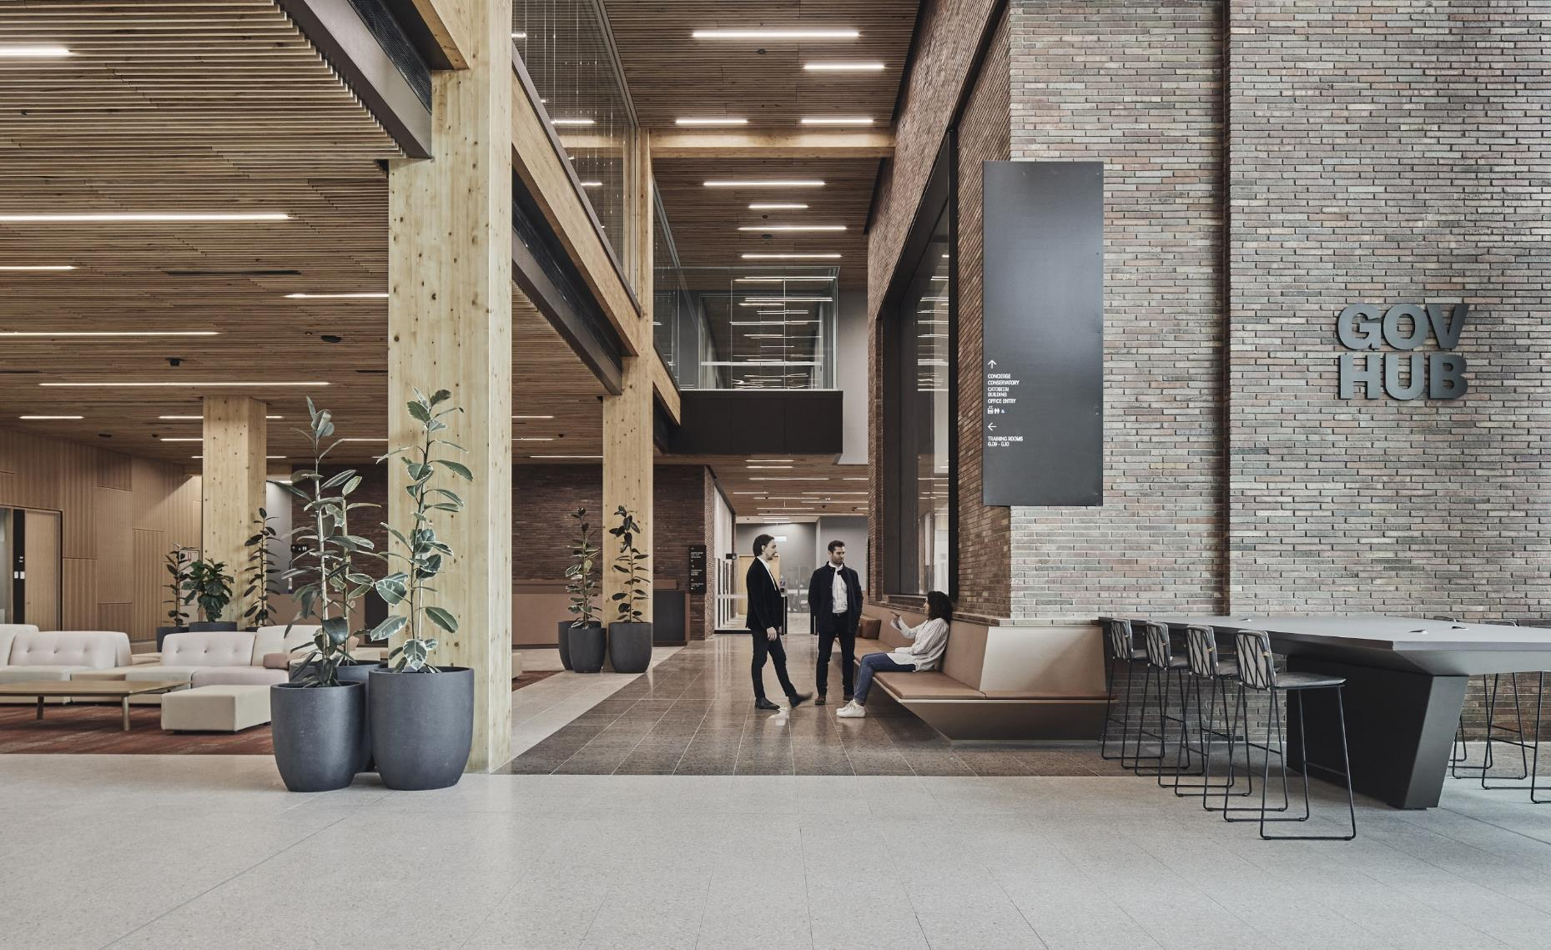
Development Victoria
Government’s development arm, delivering policy through property development and urban renewal to achieve social and economic outcomes for the Victorian community.
We partner with government, industry and community to revitalise urban areas and unlock public land, create important cultural and recreational facilities, and build diverse, affordable and sustainable communities.
Last financial year, we invested more than $681 million across more than 30 major developments and infrastructure projects, supporting almost 8,000 Victorian jobs.
Ballarat GovHub

Slide 4
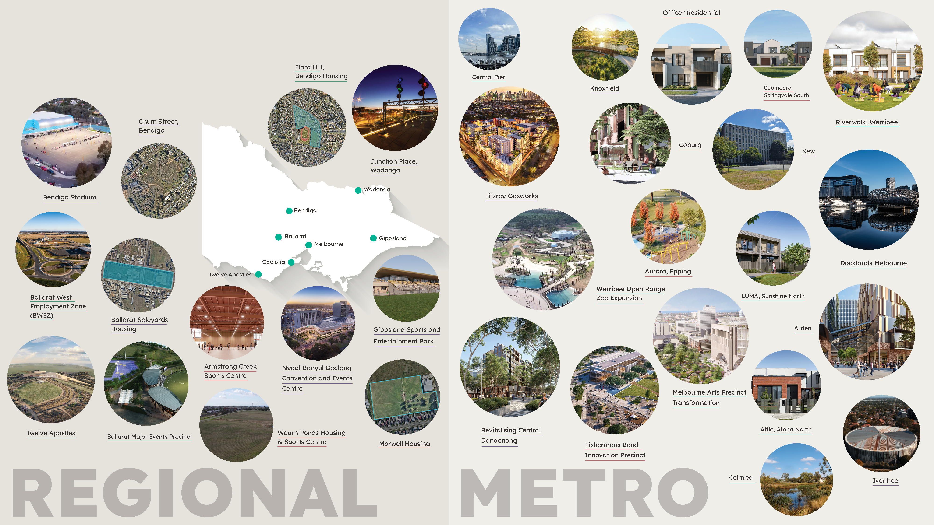
Our projects

Slide 5
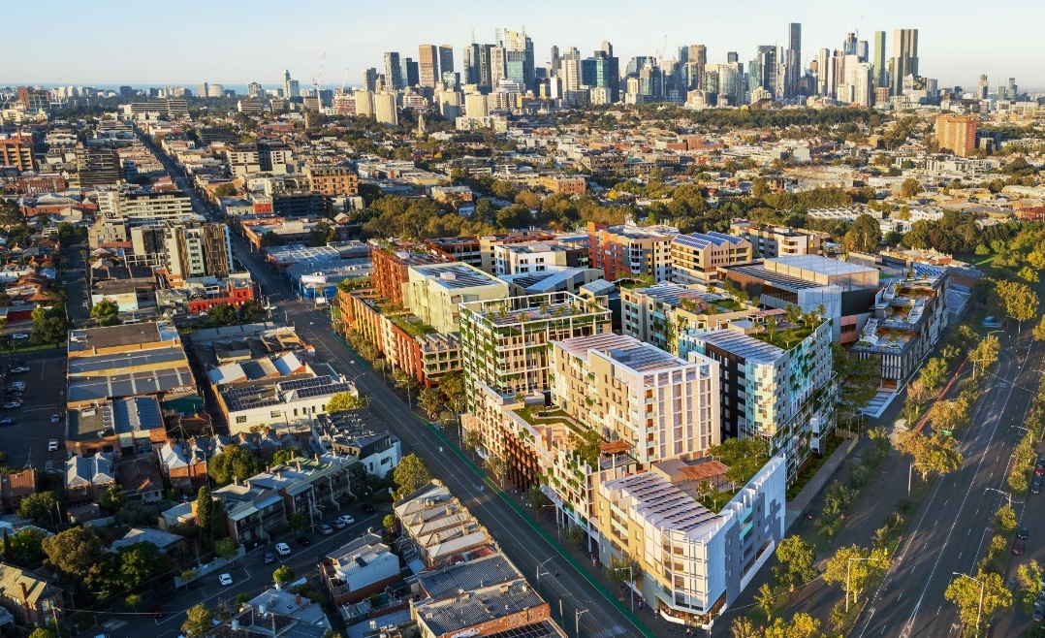
Balancing commercial returns and policy outcomes
We are a self-funding agency which generates revenue from the sale of property and fees from providing project management and advisory services to other government agencies.
Guided by policy ambitions, we undertake our projects using commercial discipline, unless otherwise given a specific request or direction by the government.
Artist Impression: Fitzroy Gasworks

Slide 6
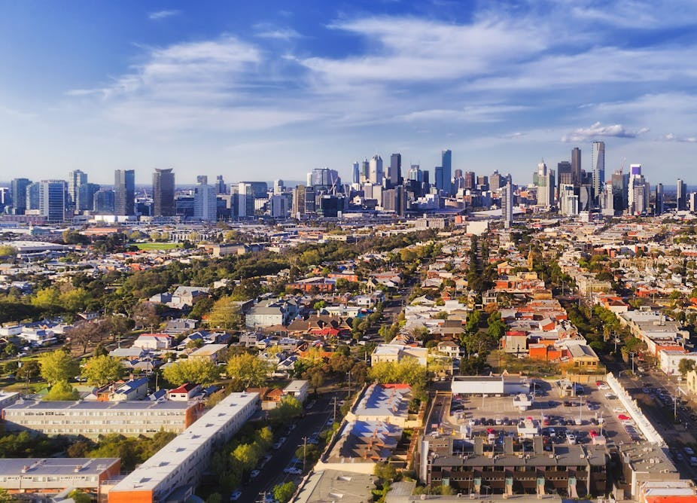
Officer and Werribee).
Supporting housing delivery
We are delivering 25 housing projects across metropolitan Melbourne and regional Victoria, with a minimum 10% affordable housing targets including:
5 precinct areas in Arden, Central Dandenong, Fitzroy Gasworks, Docklands and Wodonga
14 sites across metropolitan Melbourne, with three sites in active delivery
7 sites in regional Victoria located in Geelong, Bendigo, Ballarat, Gippsland and Wodonga.

Slide 7
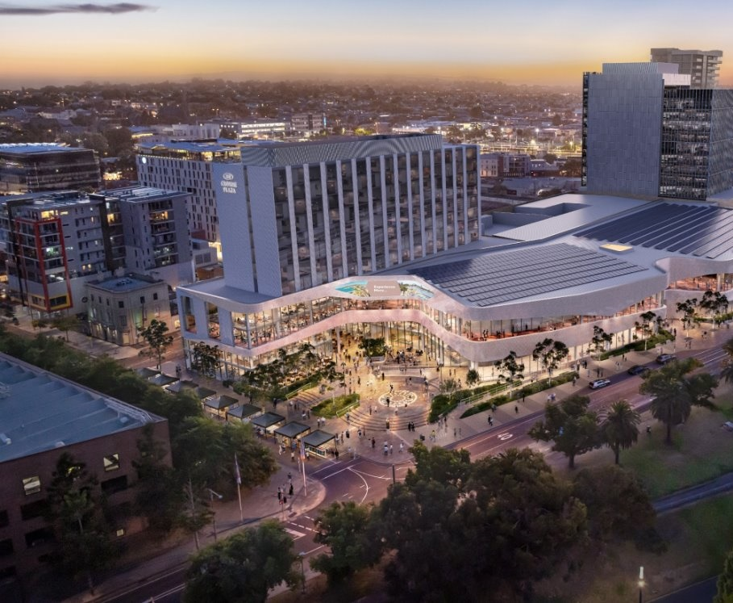
Building a thriving regional Victoria
Investing in regional Victorian housing projects and community sporting, recreational and cultural infrastructure to improve social outcomes and enhance community participation and liveability.
Providing local jobs including apprenticeships to increase capacity and skills to help grow the next generation of skilled workers.
Prioritising local businesses, First Peoples and social procurement for local and regional economic growth, in line with the Economic Growth Statement.
Artist Impression: Nyaal Banyul Geelong Convention and Events Centre

Slide 8
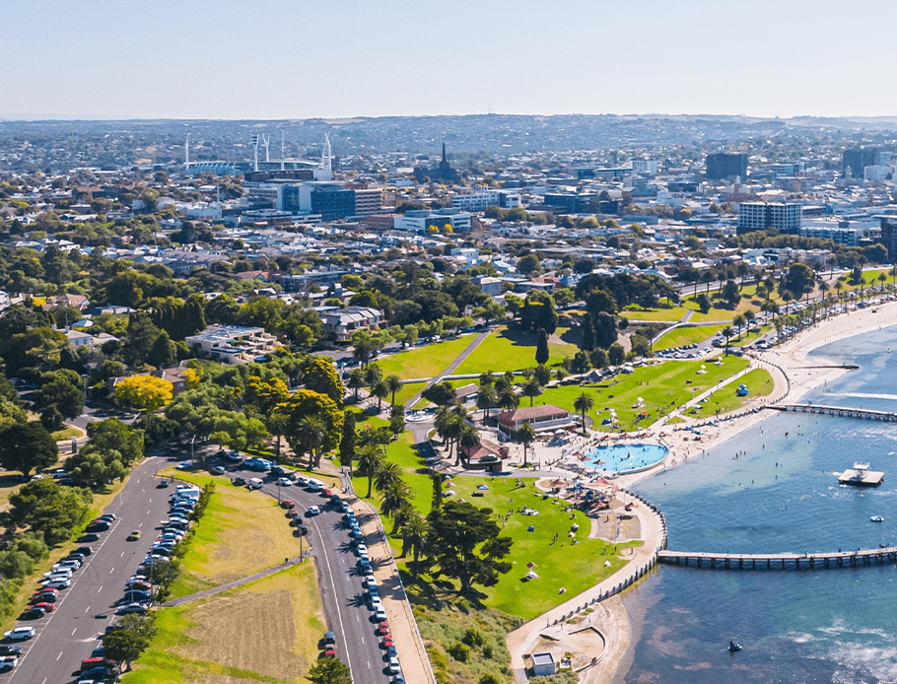
Geelong
Waurn Ponds
400 homes including 72 social and affordable homes for Homes Victoria.
Under-utilised land located beside Waurn Ponds Train Station.
Open space and connection to new sporting complex.
Other local projects:
Nyaal Banyul Geelong Convention and Events Centre
Twelve Apostles Precinct Redevelopment
Armstrong Creek Sports Centre
Stead Park Hockey Redevelopment
Waurn Ponds Sporting Complex
Geelong Arts Centre [completed]

Slide 9
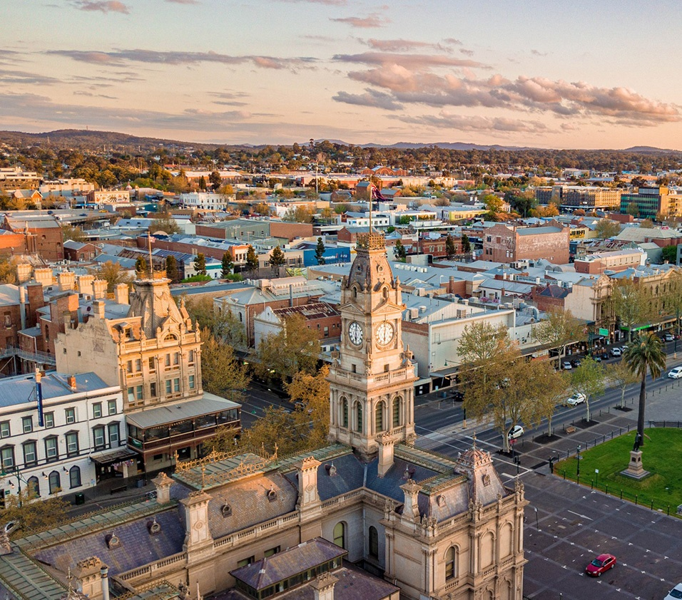
Bendigo
Flora Hill
160 homes offering a range of housing types and lot sizes, including 56 new social and affordable homes for Homes Victoria. ​
Historic Eumana House retained and incorporated into the new residential community while the predominately vacant former site of the Bendigo Teachers’ College will be repurposed.
Early works starting by mid-year.
Chum Street
Significant rehabilitation required to unlock the former mining site and restore the health of the land.
Investigations underway to inform future remediation and healing of Country.
Other local projects:
Bendigo Stadium
Bendigo Showgrounds
Galkangu [complete]

Slide 10
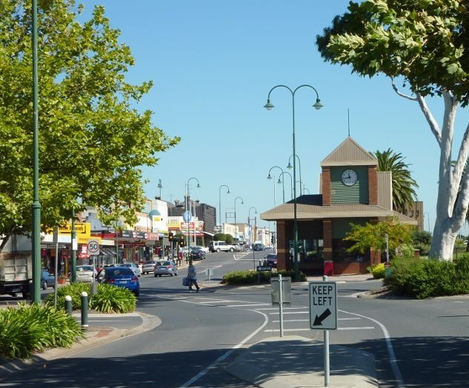
Morwell
English Street Morwell
Unlocks surplus government land to help deliver more home across Gippsland close to jobs services, schools and transport.
Site features:
delivery of 70 land lots
10% social and affordable homes
close to jobs, service and transport
early works to commence in 2026.
Other local projects:
Gippsland Sports and Entertainment Park
Morwell Gun Club

Slide 11
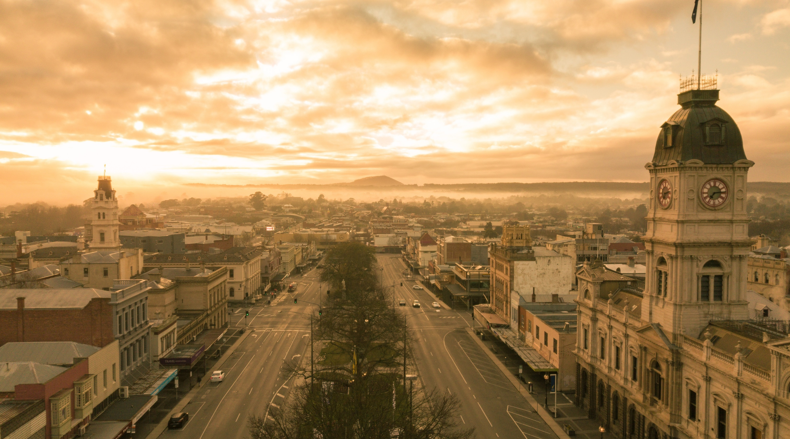
Ballarat
Ballarat Saleyards
Unlocking the former Ballarat Saleyards for future development.
Remediation is expected to begin mid 2025 and take up to 12 months, subject to site conditions.
The future use of the site, including potential for housing, will be identified following a strategic planning process led by the City of Ballarat.
Other local projects:
Ballarat Major Events Precinct
Ballarat West Employment Zone
Acacia residential land development [complete]
GovHub [complete]
Ballarat Off-site Storage [complete]

Slide 12
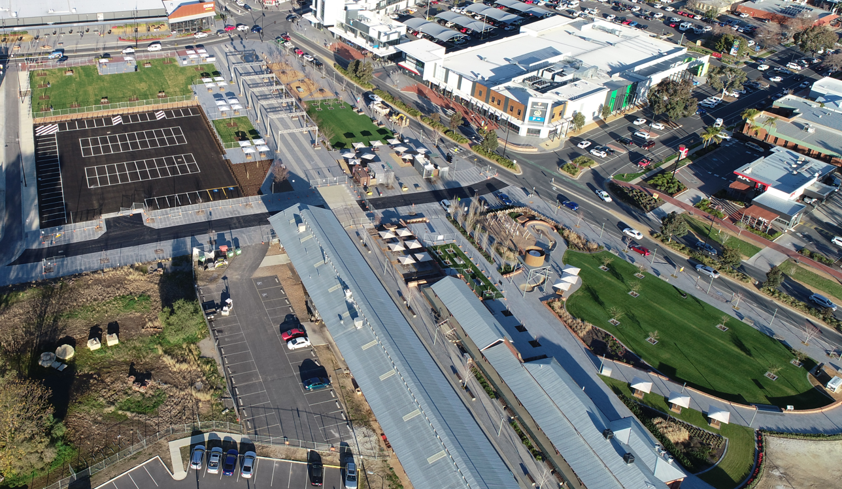
Wodonga
Junction Place
One of Australia’s largest regional urban renewal precincts, which will double the size of Wodonga's CBD, provide homes and support local jobs.
Features:
local regional developer appointed
short stay accommodation and combination of mixed use and residential developments, including approximately 200 homes
project will support more than 1,000 local jobs and boost economic growth.

Slide 13
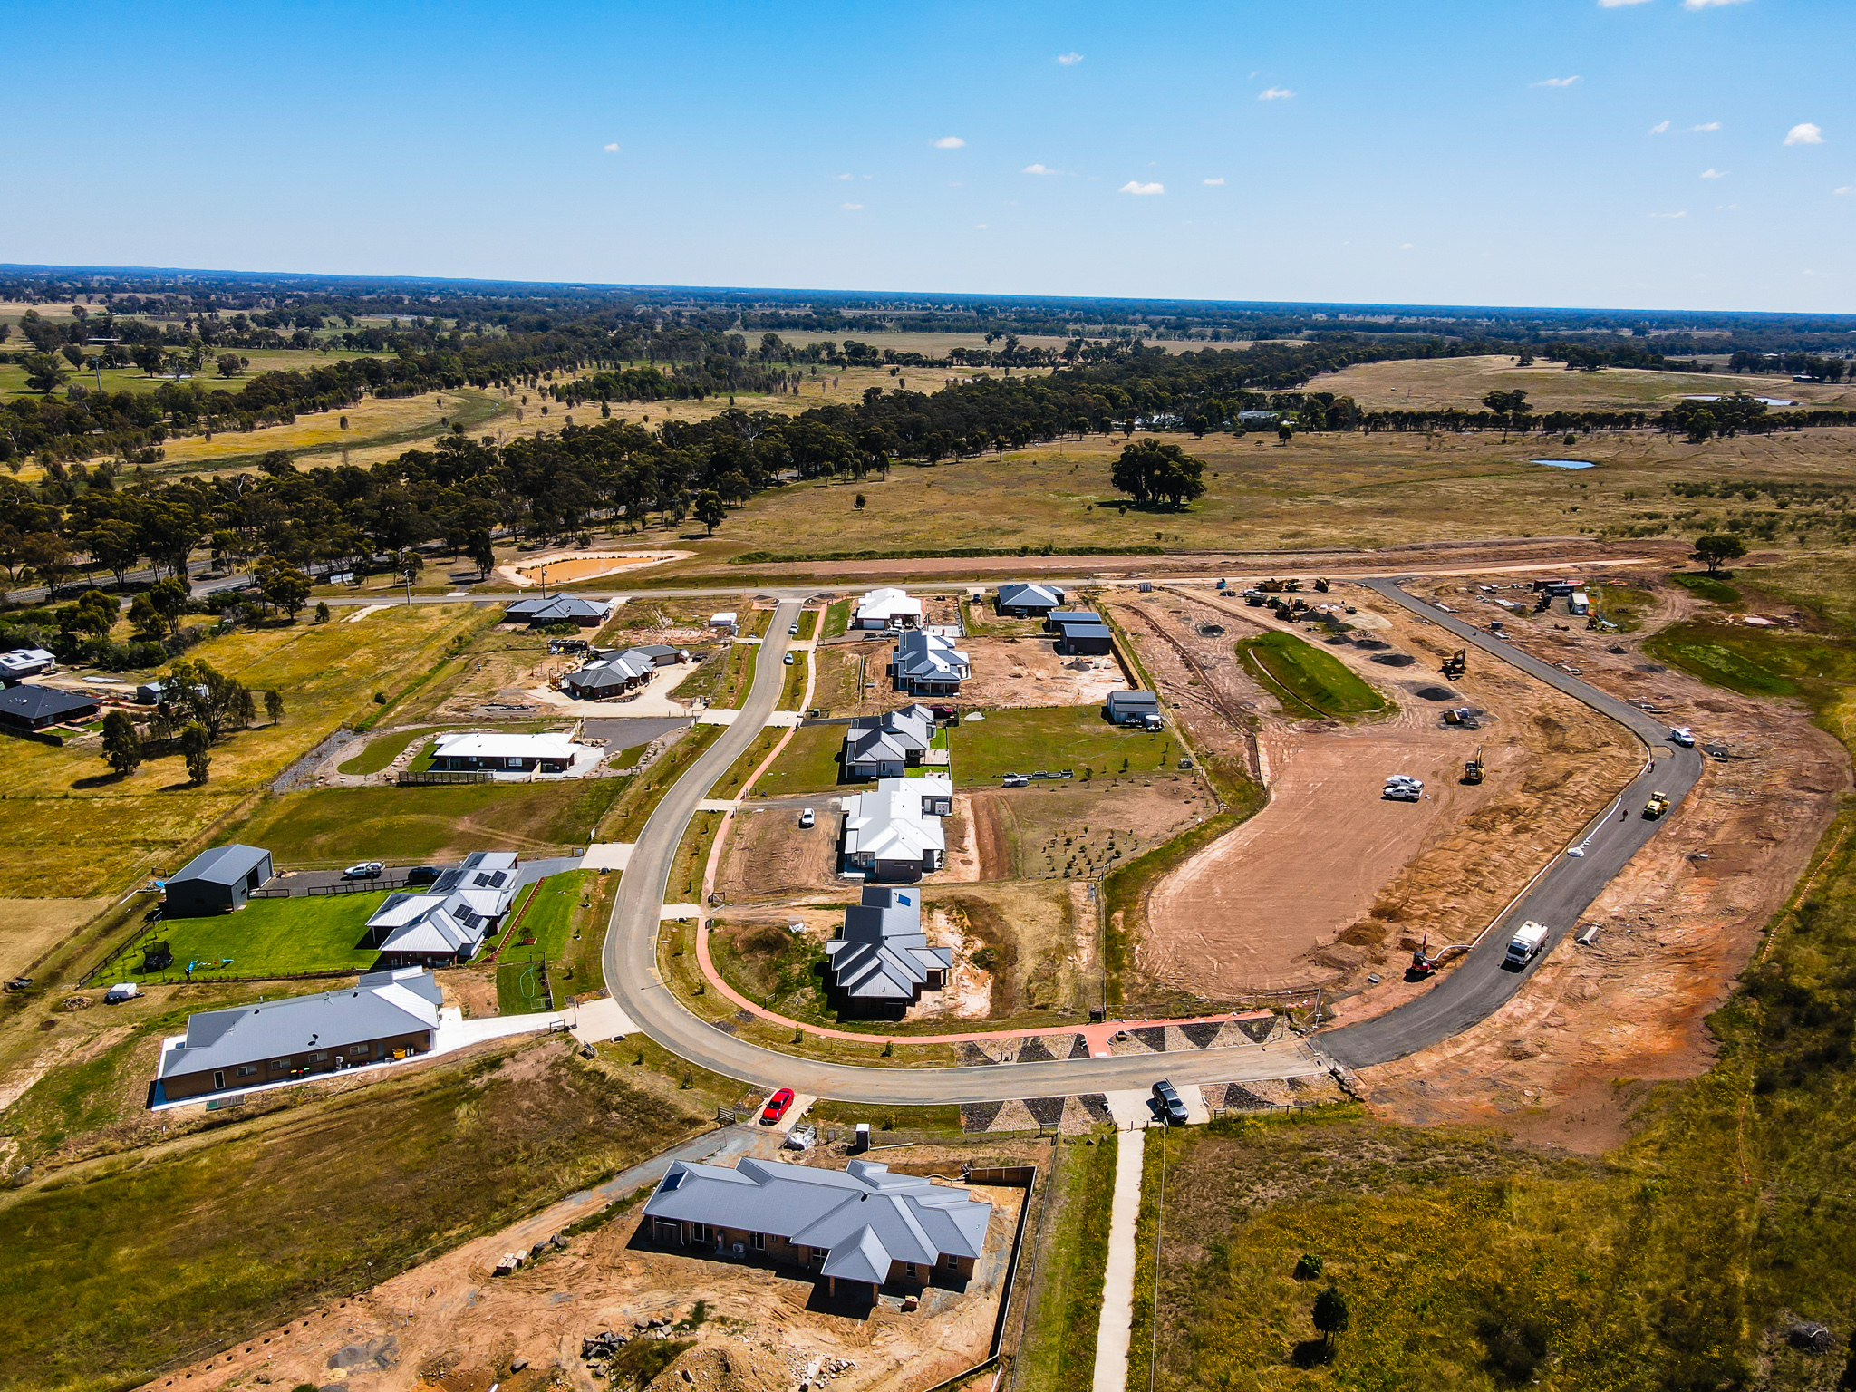
Managing current challenges
Regional housing supply and demand challenges are leading to shortages.
The current market is driving impacts on overall demand, sales rates and revenue, material and labour costs escalation, and builder and settlement risks.
Development Victoria is acting counter cyclically to deliver projects that the private sector simply would not undertake.
We are delivering through:
  unlocking surplus land to fast-track housing supply
  delivering minimum 10% affordable homes
  partnering with the community housing sector
  exploring new and innovative ways to deliver housing.

Slide 14
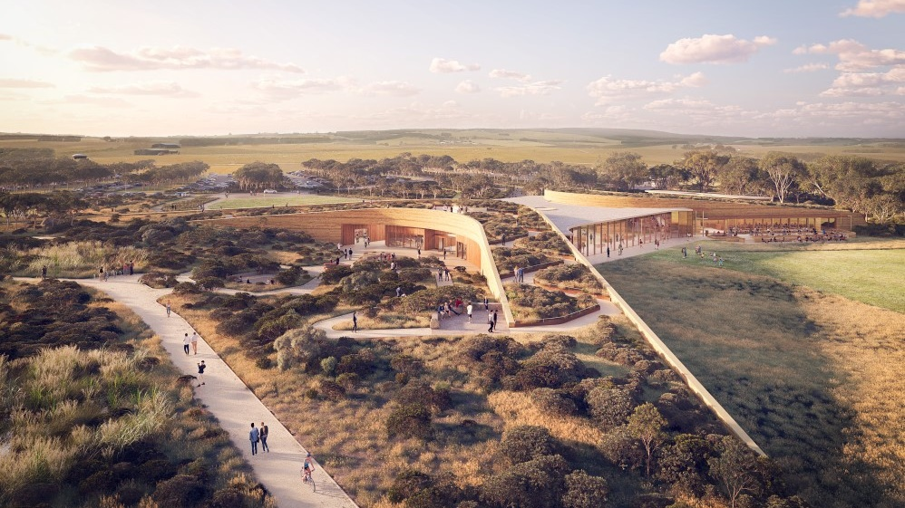
Questions
Artist impression: Twelve Apostles Visitor Experience Centre

