Slide 1
Parliament of Victoria
Legislative Assembly Environment and Planning Committee
Inquiry into the supply of homes in regional Victoria
Surf Coast Shire Submission presented by Chris Pike and Kate Sullivan
24 February 2025

Slide 2

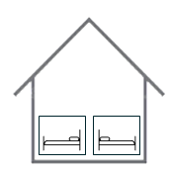


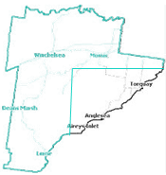


Surf Coast Shire challenges
UNDER-UTILISED STOCK
One third of houses don’t have permanent residents (holiday houses, short term rental)
55% of houses have at least two spare bedrooms
Cost of infrastructure for new areas is 2-4 times more than utilising existing housing/areas.
LACK OF DIVERSITY
85% 3+ bedrooms which don't match our changing population
Development industry generally reluctant to explore diversity e.g. 1 & 2 bedroom.
CONSTRAINED DEVELOPABLE LAND
Three-quarters of the Shire is National Park, Coastal Marine Park, Distinctive Area, agricultural land. Future growth directed to remainder of land within Torquay and Winchelsea.
HOUSING IS UNAFFORDABLE
Long-term rental is unavailable at affordable price points – since 2019, vacancy rates dropped to 0.6% median rent increased by 33%, median house price increased by 50%.
Surf Coast Shire fastest growing municipality in Victoria recording an annual average pop. growth rate of 4.1% between 2016 and 2021 (Vic ~2%).
$

Slide 3


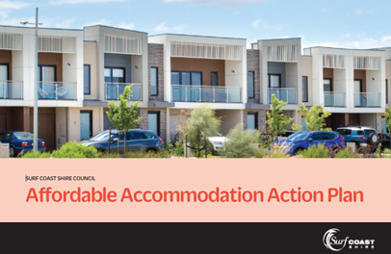
Current activities under way
Council Plan (2021-2025) priority to ‘improve access to affordable residential accommodation’ and resource dedicated to housing
Key Worker Accommodation Crisis Declaration (2021)
Completing Urban Futures Strategy guiding location and type of future housing
  Winchelsea Place Plan/ Structure Plan ( will grow from 2,800 up to 18,000 residents)
  Messmate Road, Torquay Precinct Plan (~ 5-6,000 residents)
  Torquay infill housing development e.g. Torquay CBD ( ~2,000 residents)
Affordable Accommodation Action Plan (2024)
  Partnership Projects on council land in Winchelsea (10 dwellings), Aireys Inlet (20 dwellings) , Anglesea (~ 15-19 dwellings) and Lorne (TBD)
Draft Urban Future Strategy

Slide 4
Opportunities for action
Reform of the planning system to help deliver diversity and more affordable housing.
Introduce financial incentives to increase supply of affordable housing and long-term rental.
Provide enabling infrastructure that encourages housing growth.

