Slide 1
Inquiry into the supply of homes in regional Victoria
Department of Transport and Planning presentation to the Legislative Assembly Environment and Planning Committee
  4 April 2025

Slide 2

Acknowledgement of Country
We acknowledge the Traditional Owners of the Land we are meeting on today and pay my respects to their Elders past, present and extend that respect to all Aboriginal and Torres Strait Islander people here today.
Notes:
Colleen
Acknowledgement of Country
I would like to acknowledge we are on the traditional lands of the Wurundjeri Woi-wurrung and Bunurong / Boon Wurrung peoples of the Kulin Nation and pay my respects to all Elders past and present and extend that respect to all Aboriginal and Torres Strait Islander people here today.

Slide 3
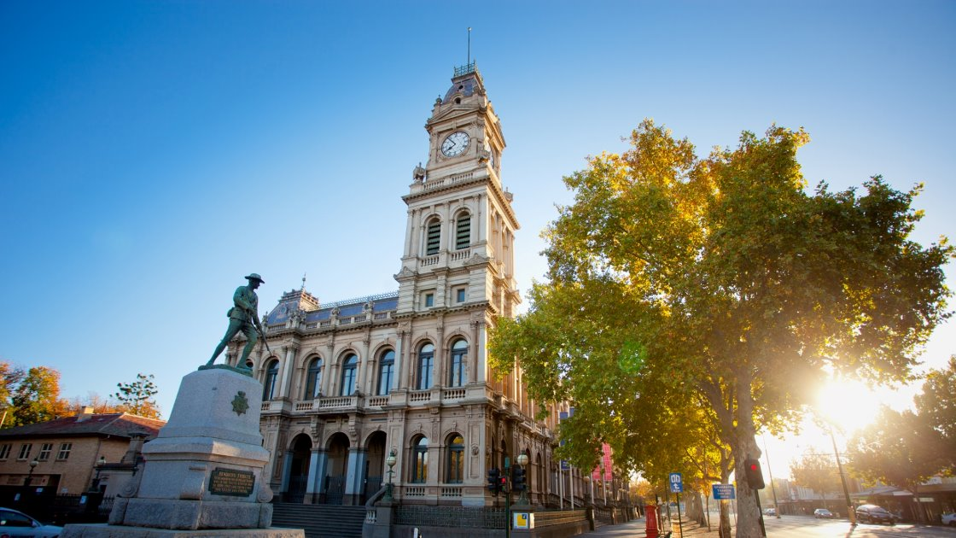
Purpose
We will provide information on:
DTPs’ role in regional housing supply
The trends and land supply forecasts for regional Victoria
Housing and infrastructure challenges in regional Victoria
The specific programs and initiatives seeking to increase regional housing supply
The planning legislation the guides delivery of land for homes in regional Victoria
Note that the DTP will provide a written submission after this hearing.
Notes:
Colleen
Thank you for the invitation to present to the Committee today. We note that the committee has expressed an interest in hearing from DTP on:
How DTP is involved in regional housing supply?
Context in the regions: on housing supply, demand, forecasts, roadblocks and challenges
Victoria’s Housing Statement
Key pieces of planning legislation that guides delivery of regional housing supply
Policies, programs and initiatives – including Plan for Victoria
Multi-dwelling residential development
DTP will provide a written submission to cover off on any other questions

Slide 4
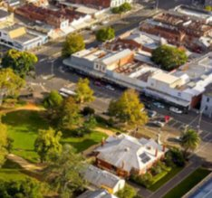
Department of Transport and Planning
Goal: Thriving places and connected communities.
DTP activities that support thriving places and connected regional communities
Set state policy and strategy on housing and land use
Create capacity – zoned and available – for development in designated areas​​
Build better – consumer confidence in the building system and better design quality​​
Secure landholdings to deliver housing funded through State and Federal mechanisms
Assist and support councils to update and streamline their planning schemes
4
Notes:
Colleen
DTP was set up in 2023 to bring the transport and planning functions together.
Further recent organisational change has brought the Victorian Planning Authority (VPA) into the DTP structure.
This brings all four major components of Victoria’s planning system – strategic, transport, statutory and spatial – together with the aim of cutting delays and duplication and deliver faster and better structure planning.
The VPA prepares the strategic 'blue print' for where the housing needs to go and the amenities and other infrastructure that Victorians need to live.
DTP planning functions support activities for thriving places and connected regional communities:
Create capacity
Build better
Unlock government land
DTP is assisting councils and other partners identify and secure landholdings in regional Victoria to deliver housing funded through State and Federal mechanisms, including the Victorian Government's Regional Worker Accommodation Fund and the Commonwealth's Housing Support Program.

Slide 5
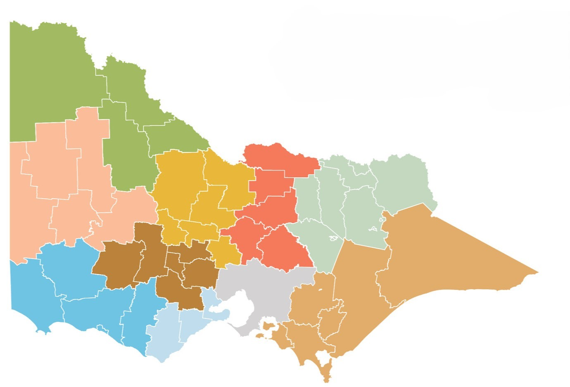


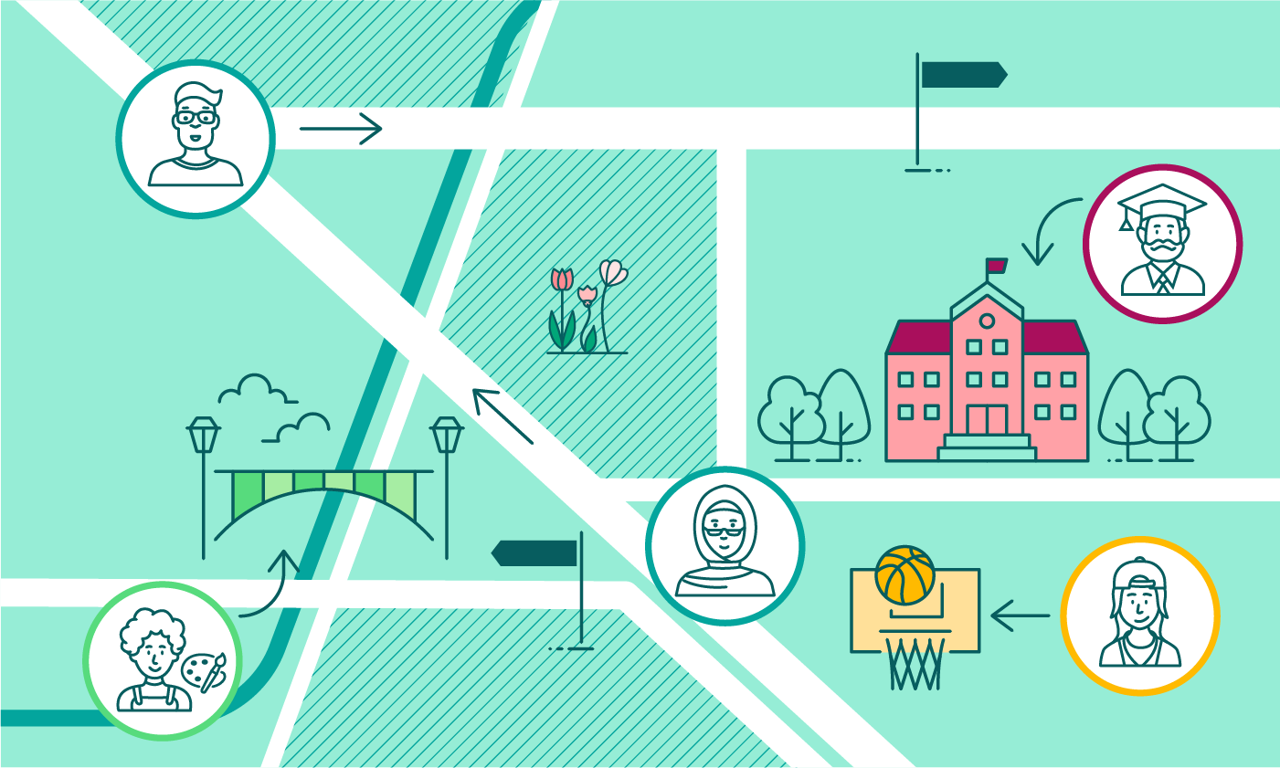






Department of Transport and Planning
Stakeholders, collaboration and partnerships
Victorian government departments and agencies, e.g. DEECA, DJSR
Traditional Owners & Registered Aboriginal Parties
Other stakeholders, e.g., landowners, utilities providers, catchment management authorities
Local government & peak bodies
Notes:
Colleen
DTP works across all levels of government in the State and with peak bodies, industry, landowners and other agencies to enable home in the regions.
Development Victoria (DV) is a key partner and I understand that the Committee will be hearing from them later today.
Through the Wurrek-al ‘Talking with Purpose’ First Peoples Engagement Framework, DTP engages with Traditional Owners and Registered Aboriginal Parties.

Slide 6
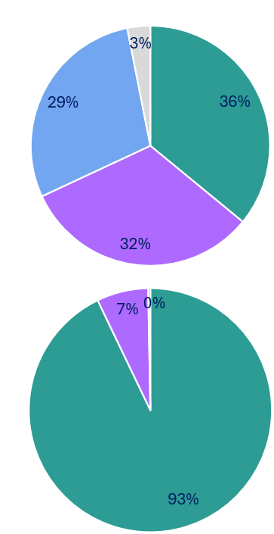
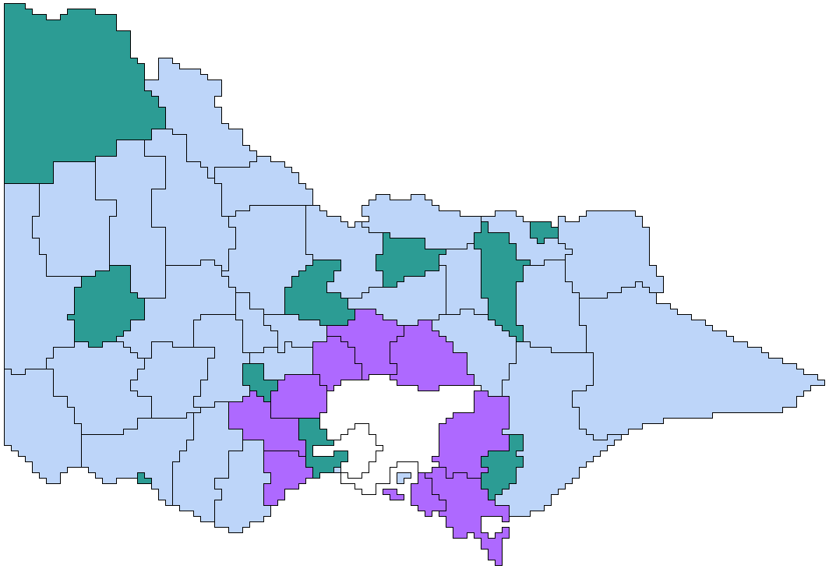
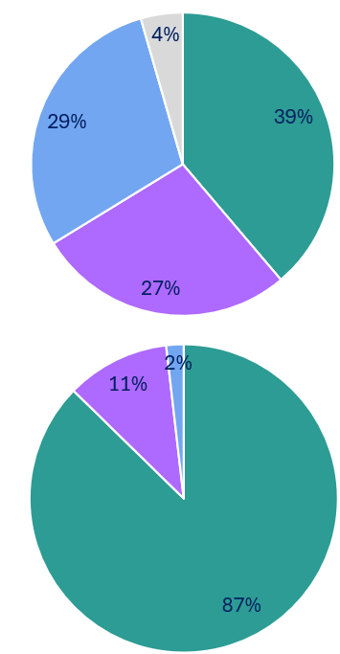
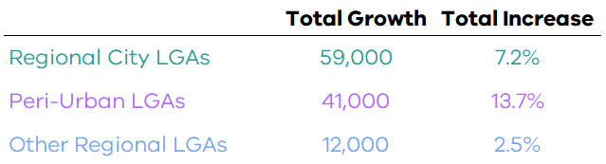
Regional Victoria today
TOTAL POPULATION 2024
1.72m
Regional Victoria usually adds between 11,000 and 13,000 dwellings each year.
Current dwelling stock is not diverse, with a preponderance of separate houses – this may be a challenge in housing an ageing population which will form many smaller households.
Residents of Regional LGAs @ 2024
CHANGE OVER LAST 5 YEARS
+112k
Household Types by LGA Group, 2021
Geographic Definition by LGA
Regional City LGAs
Peri-Urban & Other Regional LGAs
Regional City LGAs
Additional residents since 2019
Families with children
Peri-Urban LGAs
6.9%
Other Regional LGAs
Couples w/out children
Total increase 2019-2024
Lone persons
Other households
PROJECTED OVER NEXT 5 YEARS
+132k
Dwelling Types by LGA Group, 2021
Regional City LGAs
Peri-Urban & Other Regional LGAs
Separate houses
Population growth 2019-24 by LGA groups
Additional residents by 2028
Semi-detached and low-rise apartments
7.7%
Total increase 2024-2029
Mid-rise and high-rise apartments
Source: ABS Regional Population
Note for this analysis Mitchell Shire is considered Peri-Urban though most of its growth occurs within Melbourne’s Urban Growth Boundary
Notes:
Colleen (Dave for support)
As of March 2025:
Regional Victoria is home to over 1.72 million residents
We have seen regional Victoria grow in population at 112 thousand residents per year, or at a rate of 6.9%
The projection for the next 5 years is for this number to grow beyond 132 thousand additional regional residents, or at a rate of 7.7%
Regional Victoria also sees an addition between 11 thousand and 13 thousand dwellings each year
Almost 90% of all regional dwellings are separate houses
Household types in regional Victoria are almost equally split in three: catering for families with children, Couples (with or without children), and lone person households

Slide 7
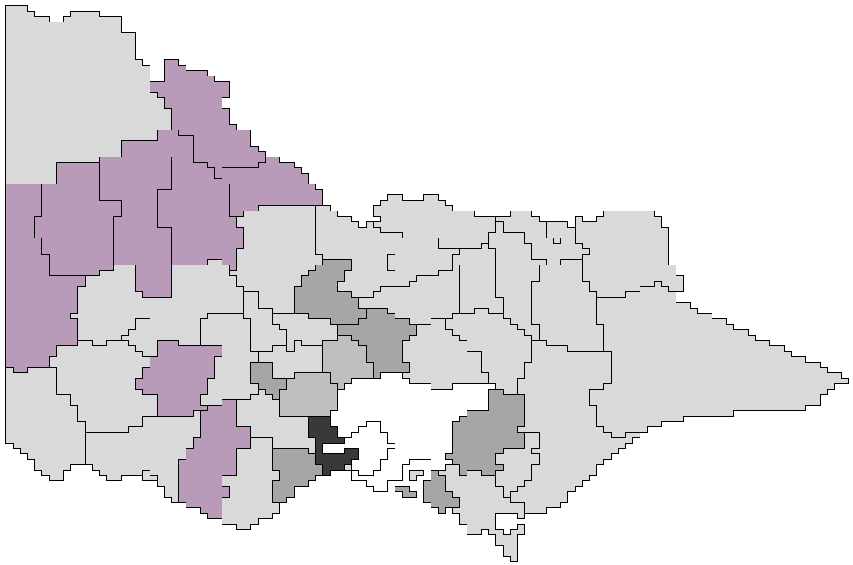
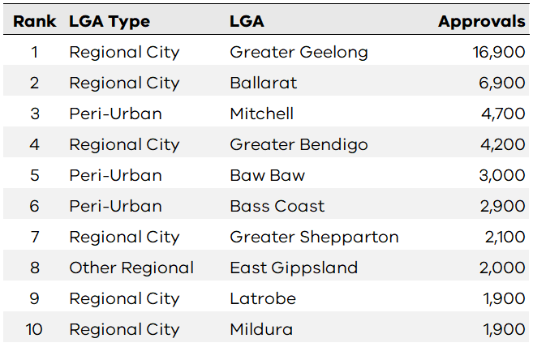

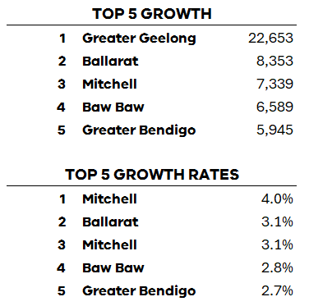
Housing and growth trends in different parts of regional Victoria
Population change by Local Government Area, 2019-24
Top 10 total residential building approvals by LGA, 5 years to end 2024
Pop. change
20,000
10,000
5,000
2,500
0
Decrease
to
to
to
to
to
30,000
20,000
10,000
5,000
2,500
Source: ABS Building Approvals Australia
Note for this analysis Mitchell Shire is considered Peri-Urban though most of its growth occurs within Melbourne’s Urban Growth Boundary
Absolute population change and annual average rate of change
Source: ABS Regional Population Growth
Note for this analysis Mitchell Shire is considered Peri-Urban though most of its growth occurs within Melbourne’s Urban Growth Boundary
Notes:
Colleen (Dave for support)
Strongest population growth and housing construction occurs in the main Regional Cities and in the Peri-Urban areas close to Melbourne.
During the pandemic there was a notable spike in construction in the regions, particularly in the largest three regional centres.
Construction delays and backlogs meant many homes approved during this period took longer to complete than the usual 12 months.

Slide 8
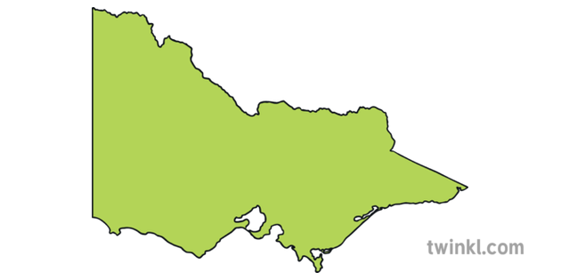
Regional Victoria today – zoned land supply
Bendigo
Capacity for 6,400 residential lots on zoned land (16 to 17 years supply)
4,100 residential lots on land planned to be rezoned (a further 10 to 11 years supply)
Ballarat
Capacity for 11,000 residential lots on zoned land (7-8 years supply)
24,000 residential lots on land planned to be rezoned (a further 16-19 years supply)
Latrobe
Capacity for 9,500 residential lots on zoned land (26 to 42 years supply)
Geelong
Capacity for 18,900 residential lots on zoned land (8 to 9 years supply)
42,700 residential lots on land planned to be rezoned (a further 19 to 21 years supply)
8
Notes:
Colleen
DTP monitors greenfield land supply through the Urban Development Program.
The most recent reports from 2022 indicate land supply of over 10 years for the major regional cities of Ballarat, Bendigo, Geelong.
LaTrobe has land supply of up to 42 years.

Slide 9

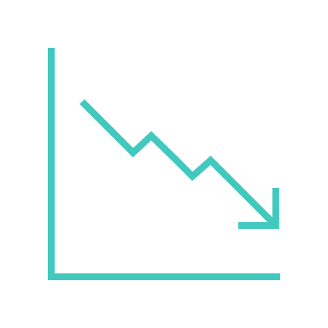





Regional Victoria today – Key challenges
Strong population growth in major regional centres close to Melbourne
Lower population growth in smaller regional towns
Regional cities have good residential land supply
Lack of affordable and available housing for workers needed to support regional growth
Construction supply chain & skills shortages
Broader economic conditions affecting housing supply
Infrastructure and services
9
Notes:
Colleen
Challenges
Strong population growth in major regional cities and places close to metro Melbourne
Smaller regional and rural towns have lower population growth
Regional cities have adequate residential land supply
Lack of affordable and adequate key worker housing to support regional development and industry
Construction supply chain and skills shortages
Broader economic conditions are affecting housing supply:
- materials and construction costs
- higher interest rates and cost of finance
- skills shortages
Infrastructure and services:
- drainage
- transport

Slide 10
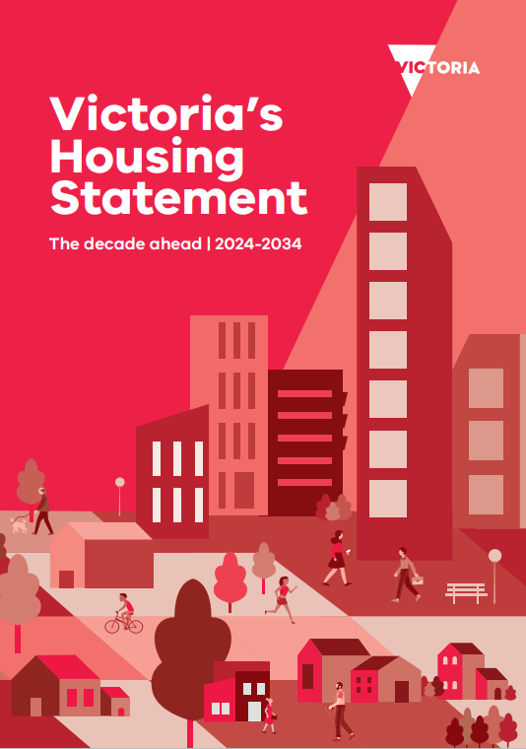
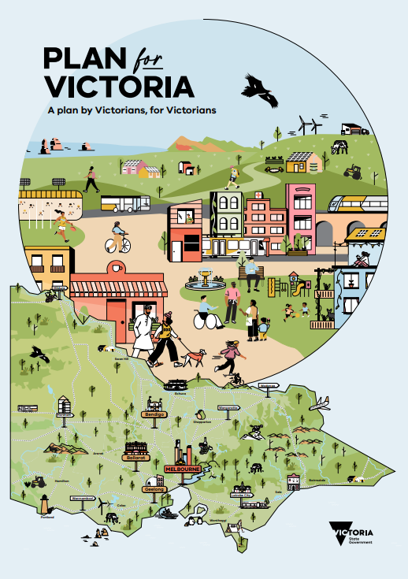
Department of Transport and Planning – Key drivers
10
Notes:
Colleen
Our planning work in the DTP is being shaped by two key drivers:
Victoria’s Housing Statement
The three 'pillars' of: 'Good decisions made faster', 'Cheaper housing close to where you live' and 'A-long term housing plan' will all work together to support industry to deliver Victoria’s housing needs.
Plan for Victoria was released on 28 Feb 2025.
replaces Plan Melbourne 2017-2050 and statewide regional growth plans.
The people's panel vision for Victoria by 2050
"By 2050, Victoria will be a vibrant, accessible and connected community, valued for its diverse cultures, sustainable environmental practices and respect for the First Peoples of Victoria.
Building a state that provides choices and opportunities for current and future generations of Victorians in quality housing, transport, employment, environment and connectivity will require input from the community, government, local businesses and industry alike.
We will create a society that caters to the unique needs of all Victorians, nurturing individual health through physical and cultural recreation."
There was extensive community engagement:
Community engagement reached more than 110,000 people across Victoria.
Over 15,000 pieces of feedback have been collected, including over 600 submissions from community, local councils and industry stakeholders
Shape Victoria People’s Panel - 49 Victorians randomly selected to review all the feedback heard from the community and tasked to develop an overarching vision for Victoria.
Dedicated Traditional Owner engagement.
Plan for Victoria is an action plan, setting out key actions to achieve the plan’s vision for Victoria.
sets housing targets for each Victorian municipality, identifying how many and where homes should be built.
provides guidance to deliver more homes near transport, jobs, and essential services in vibrant, liveable, and sustainable communities over the next 30 years.

Slide 11
Key DTP policies and programs to support regional housing supply
Victoria’s Housing Statement
Plan for Victoria
DTP programs
Build a modern, fit-for purpose planning system
Housing targets for every local government area
Development Facilitation Program
Reduce permits and streamlined requirements
Manage the outward sprawl of regional cities and towns
Minister for Planning as RA for Central Geelong and Alpine resorts
Surplus government land
Increase the number of social and affordable homes
Infrastructure Assessment to support new communities
Townhouse and Low-rise Code
Regional Growth Plans*
Deemed to comply residential standards
Small second homes
Regional Planning Hub
Future Homes
Supporting delivery of the Big Housing Build
*To be updated in VPP following Plan for Victoria release
11
Notes:
Colleen
Victoria's Housing Statement actions cover the entire state but some specific activities that apply to regional Victoria include:
Streamlining the planning process for medium to high density developments worth at least $15 million in regional Victoria
Unlock and rezone surplus government land to deliver around 9,000 homes across 45 sites in both metropolitan Melbourne and regional Victoria. A target of at least 10 per cent of affordable homes to be built across these sites.
The VPA is delivering 7 PSPs across regional Victoria – Wonthaggi, Ballarat, Ballarat North, Shepparton South East, Corio Norlane, Bannockburn South East, East of Aberline.
Supporting the Big Housing Build, which is investing $1.25 billion in regional housing.
Expanding the Development Facilitation Program to boost housing supply in regional Victoria
Of course Plan for Victoria also has a state-wide application but specific elements that apply to the regions include:
Flags that more homes will be built in regional Victoria in well connected, well serviced locations. The 3 major cities of Ballarat, Bendigo and Geelong will accommodate the most homes.
Sets housing targets for all local government areas to channel growth away from Melbourne and provide the benefits of growth to regional cities and towns.
DTP has a suite of programs and initiatives that are supporting regional housing supply.
These programs support delivery of homes by providing:
Accelerated assessment pathways such as through the Development Facilitation Program.
Facilitating planning and approval processes for state infrastructure projects through Infrastructure Assessment.
Putting in place streamlined processes for social and affordable housing under the Big Housing Build.
The townhouse and low rise code will support faster decisions. This new code introduces a deemed to comply assessment pathway for townhouse and apartment buildings up to three (3) storeys.
In 2023 changes were made to make it easier to build a small second home.
DTP through the Regional Planning Hub provides direct assistance to rural and regional councils by:
Assisting them with their workloads.
Boosting capacity and capability within councils
Helping with significant regional planning projects.
Improving planning schemes to simplify processes and approvals.
Additionally The Economic Growth Statement released in December 2024 also provides for regional development.
One of the four key actions is 'Reach every Community: A strong Victoria underpinned by a strong regional Victoria.
Initiatives with a regional focus include:
Delivering a 10 year plan to unlock industrial land, examples are unlocking land for jobs at regional greenfield location such as Avalon, Bendigo and Parwan.
Enable faster planning approvals for projects in Victoria's renewable energy zones by incorporating them in the State Planning Framework

Slide 12
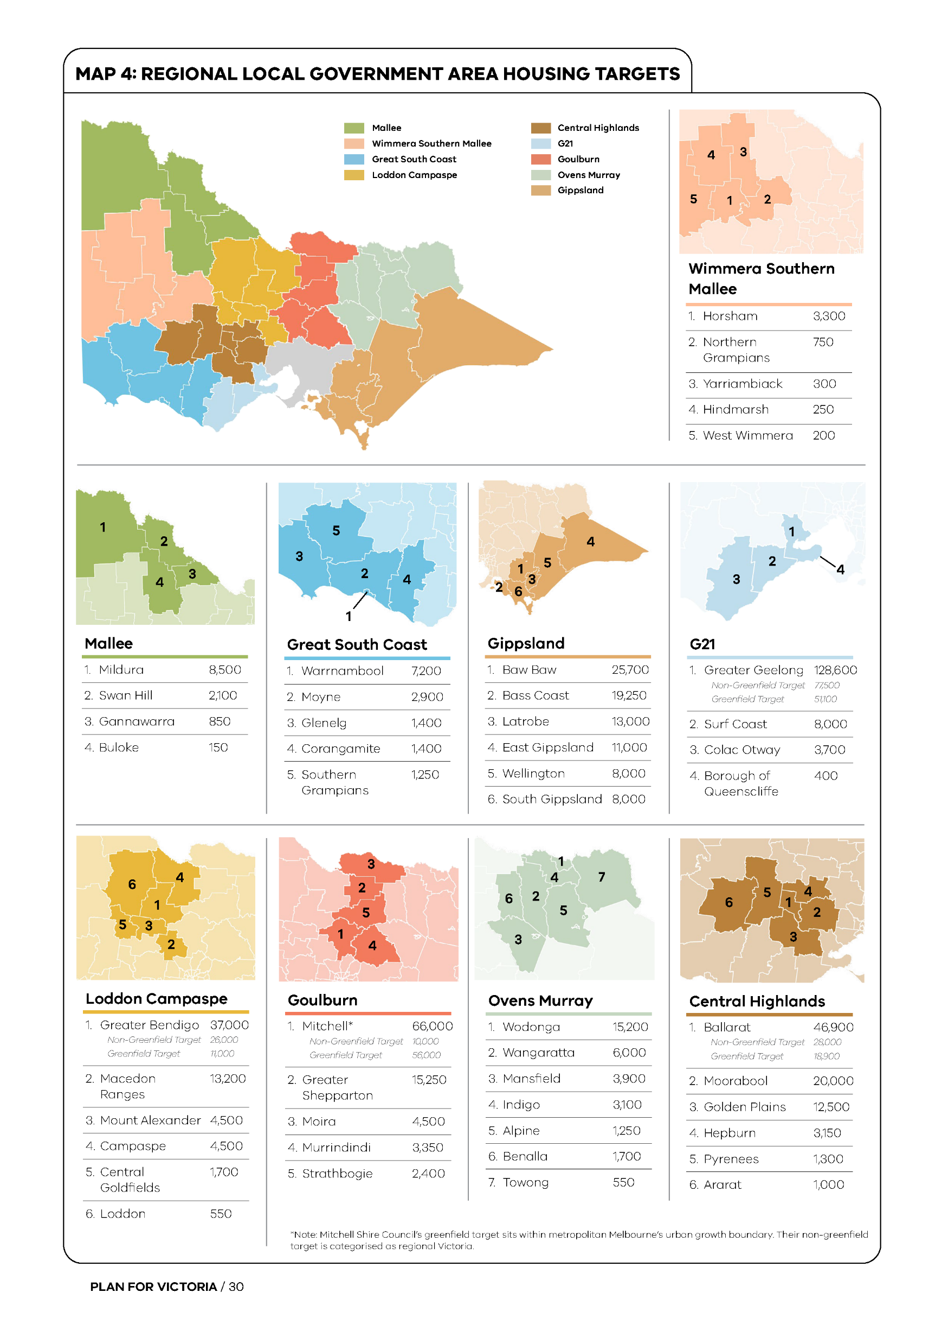
Policy context: Plan for Victoria housing targets
Regional targets:
*Mitchell Shire excludes greenfield target of 56,000 where LGA crosses into Melbourne Metropolitan region
Wimmera Southern Mallee | 4,800
Mallee | 11,600
Great South Coast | 14,150
Gippsland | 84,950
Barwon | 140,700
Loddon Campaspe | 61,450
Goulburn* | 35,500
Ovens Murray | 31,700
Central Highlands | 84,850
Total | 469,700
12
Notes:
Colleen
A Plan for Victoria has set housing targets for regional Victoria.
Housing targets:
play a crucial role in housing choice and affordability
aim to ensure every planning scheme identifies enough realistic opportunities for new development to deliver the targeted number of homes
Across the 9 regions, a total of 469,700 homes are targeted to be delivered by 2051. Please note this excludes the greenfield target of 56,000 for Mitchell Shire.

Slide 13
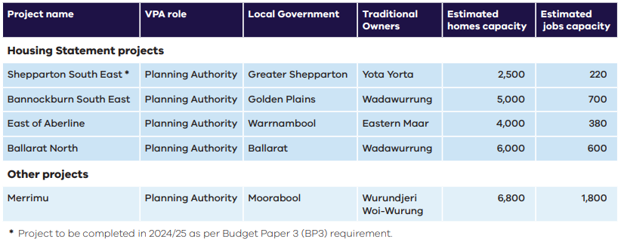
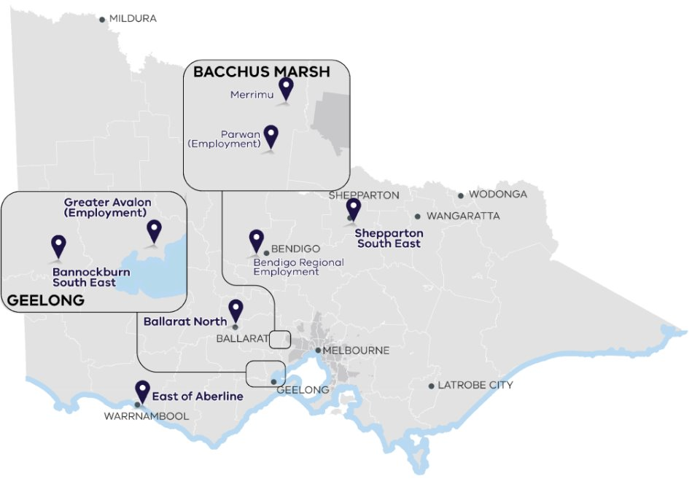
Housing supply from regional PSPs
      The VPA works to unlock more capacity for new homes and jobs in regional greenfield sites.
Notes:
Dean
As stated previously, the VPA has a key role in planning for future homes and jobs in the regional through their regional PSP program.
In Victoria’s regions, four Housing Statement projects will have potential, when fully developed, to accommodate an estimated 17,500 future homes and 1,900 jobs.
One other project, Merrimu, will also deliver land for future homes and jobs to alleviate housing supply shortages.
These 5 regional PSP are commitments within the VPA Annual Business Plan for 2025-2026.
The VPA also runs programs to support regional councils, such as the Regional Development Contributions Plans (DCP) Toolkit project.

Slide 14




Building reform – unlocking innovative construction to ease supply
Funding to deliver building regulatory reform for Modern Methods of Construction (MCC) in 2024/25 State Budget.
DTP is undertaking work to ensure the building regulatory framework does not present a barrier to implementation of MMC while maintaining adequate consumer protection.
Ongoing collaboration with key government and industry stakeholders, and researchers, particularly Building 4.0 CRC, an industry-led research initiative co-funded by the Australian Government.
Working closely with the Australian Building Codes Board (ABCB) on changes to the National Construction Code, to deliver integrated regulatory pathways.
Notes:
Dean
The Victorian State Budget 2024-2025 provided funding under the Building Reform Program to promote more modern methods of construction (MMC).
MMC, including prefabricated, off-site and modular construction differs from traditional forms of ‘onsite construction’.
Increased availability of MMC may deliver a range of benefits including,
rapid deployment of new homes
greater quality control through factory-controlled settings enhanced design flexibility, and
a reduction in emissions during the construction process.
DTP has commenced work on scoping reforms to promote enhanced access to MMC in Victoria.
These reforms will ensure that Victoria’s building regulatory framework does not present a barrier to the use of MMC, and that consumers are appropriately protected.
These are emerging construction techniques that will require collaboration between the Commonwealth, jurisdictions, industry and research organisations to deliver effective regulation.
Victoria is working closely with the Australian Building Codes Board, the Commonwealth and other jurisdictions to ensure that:
national building and plumbing standards do not present a barrier to the uptake of MMC
we deliver integrated regulatory pathways, and
on the design of a new voluntary certification scheme.

Slide 15
Questions
Notes:
Key points from presentation
Regional Victoria is growing and has the land supply to provide future homes for Victorians.
The key policy documents that are enabling the supply of homes in regional Victoria are the Housing Statement released in 2023 and the 'hot off the press' Plan for Victoria.
Both of these are enabling regional development and streamlining the planning processes to get homes built sooner.
DTP has a diverse suite of programs that are supporting development in regional Victoria.

Slide 16
Additional information

Slide 17
Key legislation
Planning processes have touchpoints with a range of other legislation - depending on nature of proposed development
Planning and Environment Act 1987
Provides head of power for planning schemes and administers the planning process (see next slide). Sets out objectives for planning in Victoria.
Subdivision Act 1988
Sets out the procedure for the subdivision and consolidation of land, including buildings.
Aboriginal Heritage Act 2006
Provides for the protection of Aboriginal cultural heritage and Aboriginal intangible heritage in Victoria.
Heritage Act 2017
Provides for the protection and conservation of the cultural heritage of Victoria.
Environment Effects Act 1978
Sets out the process for works which may require an Environment Effects Statement (EES).
Environment Protection and Biodiversity Conservation Act 1999 (EPBC)
Commonwealth legislation that defines protected biodiversity and assessment process.
Building Act 1993
Sets out the framework for regulation of building construction, building standards, and maintenance of specific building safety features. Provides for building permits.
Notes:
Colleen
A suite of legislation applies across the State to the planning for and delivery of homes.
The leading Act is the Planning and Environment Act. This governs the planning process in Victoria.
The Subdivision Act and the Building Act come into play when the land is subdivided for development and housing.
Depending on the values present on the land, other Acts such as the Aboriginal Heritage Act and the Commonwealth's Environment Protection and Biodiversity Conservation Act will have a bearing on how the land can be developed.

Slide 18
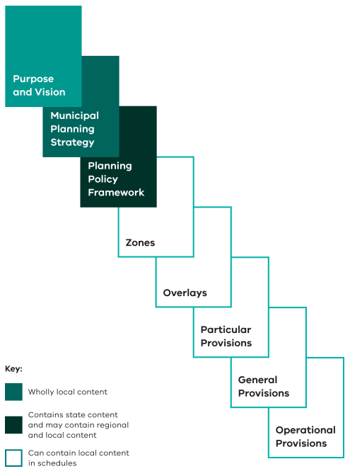
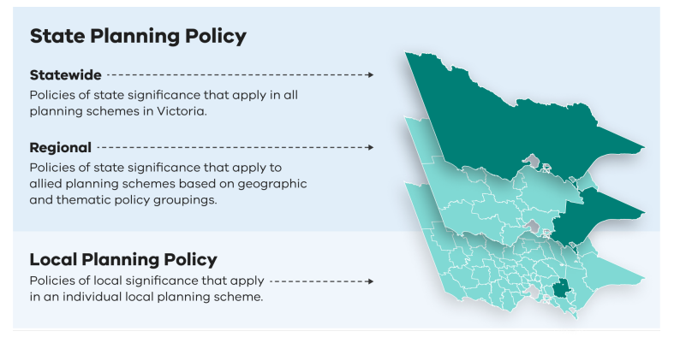
Overview of the planning framework
What is a planning scheme?
A statutory document that sets out objectives, policies and provisions relating to the use, development, protection and conservation of land.
Each municipal council planning scheme is made up of the Municipal Planning Strategy (local) and the Planning Policy Framework (PPF) which includes state, regional and local policy.
Zones regulate the use of land and Overlays regulate the development of land.
18

Slide 19

Overview of the planning process from inception to on ground development
PROCESS
Legislative instruments
Policy & Legislation
Place- based Strategic Planning
Amendment & Assessment
Subdivision & planning permits
Build out
DTP
VPA led :
PSP Sequencing & PSP preparation process
Responsible Authority: Minister / Council
Developers
Council led – plan/strategy preparation, PSA preparation & assessment of permits
DTP ROLE
Land-use Planning & Transport Planning
(Strategic policy development, Planning/Head TfV advice, infrastructure network planning)
Infrastructure Delivery
Assessment of PSAs
Assessment of Permits if MfP is RA
Development Facilitation Program*
(amendment/permit/call ins)
Head TfV
(permit referrals)*
Data & Digital – Improved monitoring & reporting framework
(under development)
* eligible projects
19
Notes:
Colleen
This diagram provides a high-level overview of the two main ways residential development at scale occurs in the regional context.
It goes without saying there are smaller subdivisions and privately led proposals, however for the most part VPA or Council are leading preparatory process at place (place-based planning)
DTP is involved throughout from policy and strategy (through instruments like Plan for Victoria or infrastructure planning) through to assessment and issuing amendments/permits for development.

Slide 20
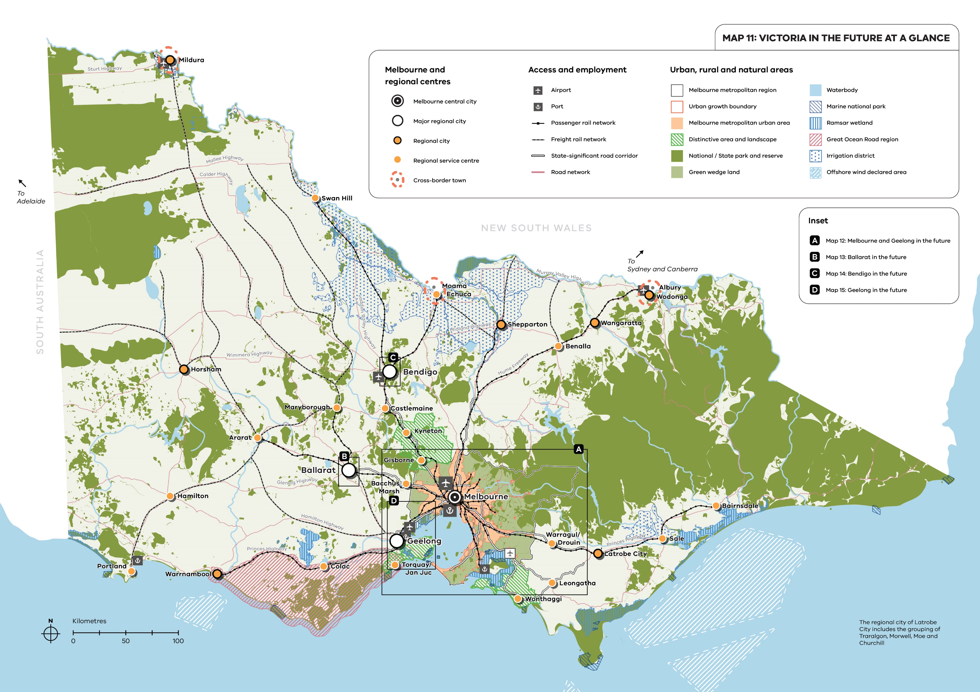
Policy context: Plan for Victoria maps
20
Notes:
Colleen
Plan for Victoria (released on 28 February 2025) is a new strategic plan for the whole state that sets a vision for how Victoria will grow over the next 30 years.
Plan for Victoria delivers on the commitments of the September 2023 Victoria’s Housing Statement to build 2.24 million homes across the state by 2051 by reforming the planning system.
In Plan for Victoria, there are 5 guiding pillars and 22 actions.
Pillar 1: Housing for all Victorians seeks to ensure housing is affordable, diverse and accessible across the state.
Pillar 1: Housing for all Victorians seeks to ensure housing is affordable, diverse and accessible across the state.
There are several actions in Plan for Victoria which support Pillar 1:
Housing for all Victorians including the delivery of housing targets for every local government (Action 1) to show where new homes will go.
Plan for Victoria commits to applying new guidelines for setting and amending regional city and town boundaries (Action 3) to promote growth and compact urban form without unwanted sprawl.

Slide 21
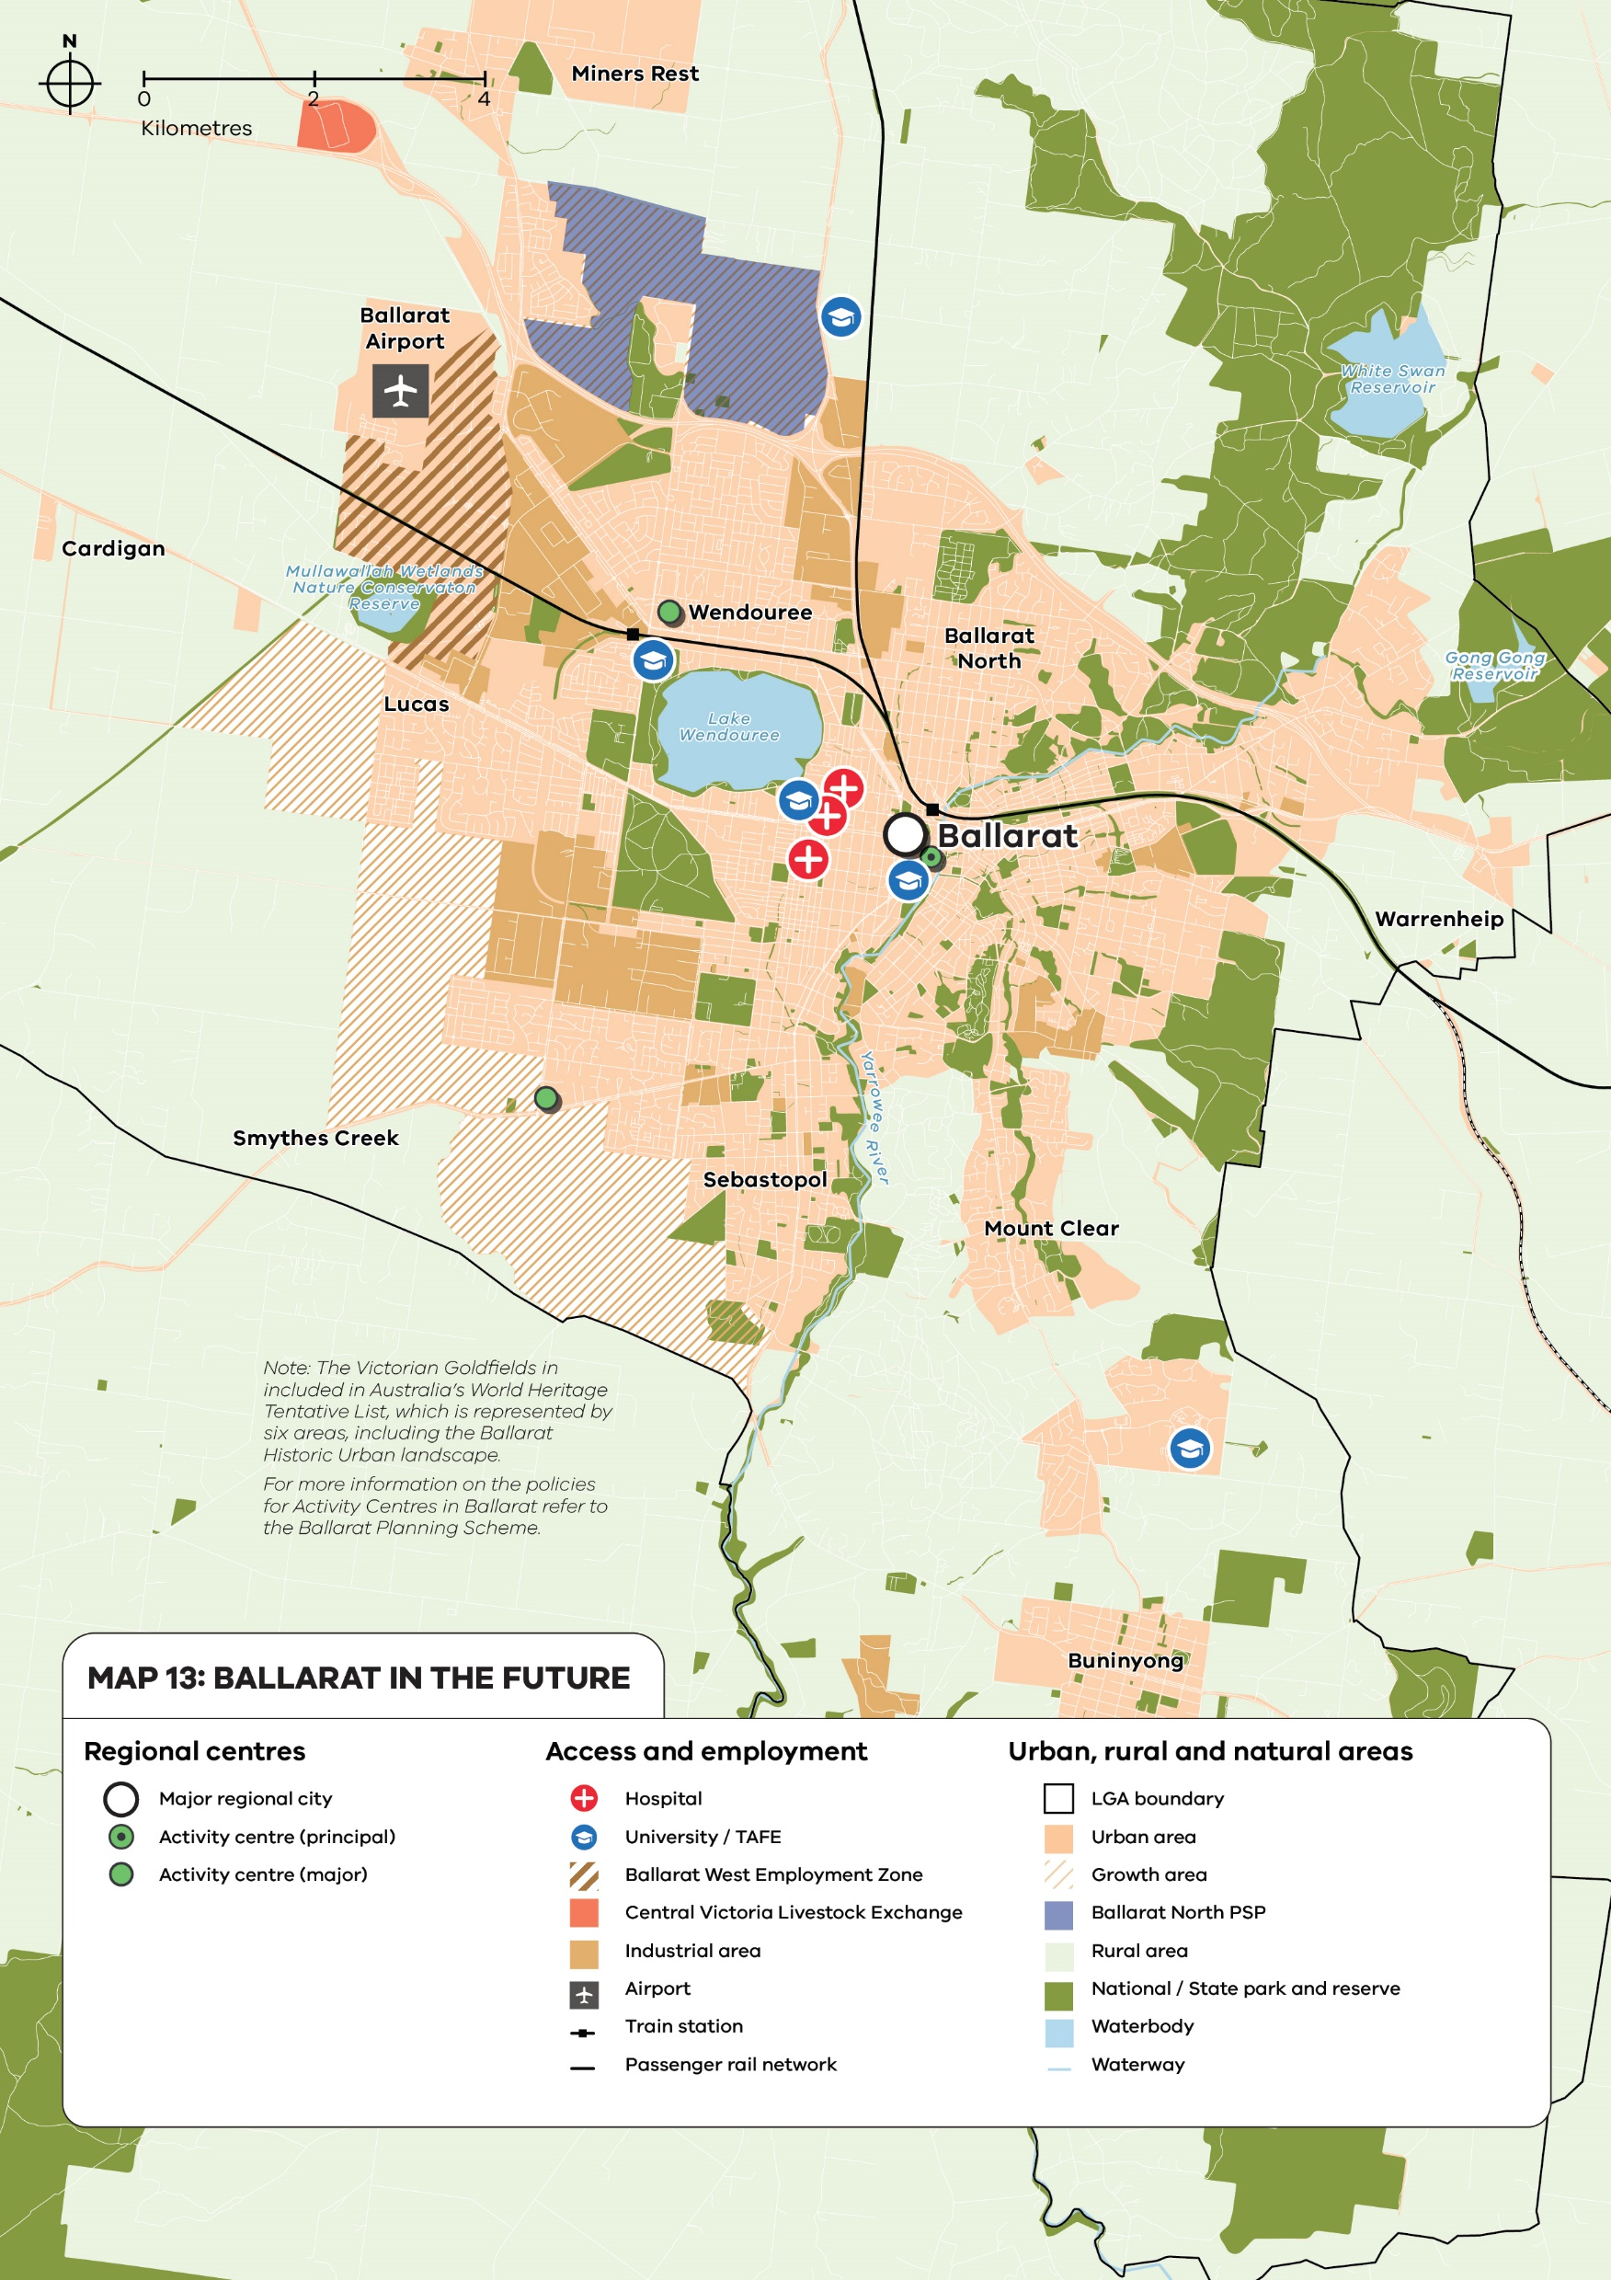
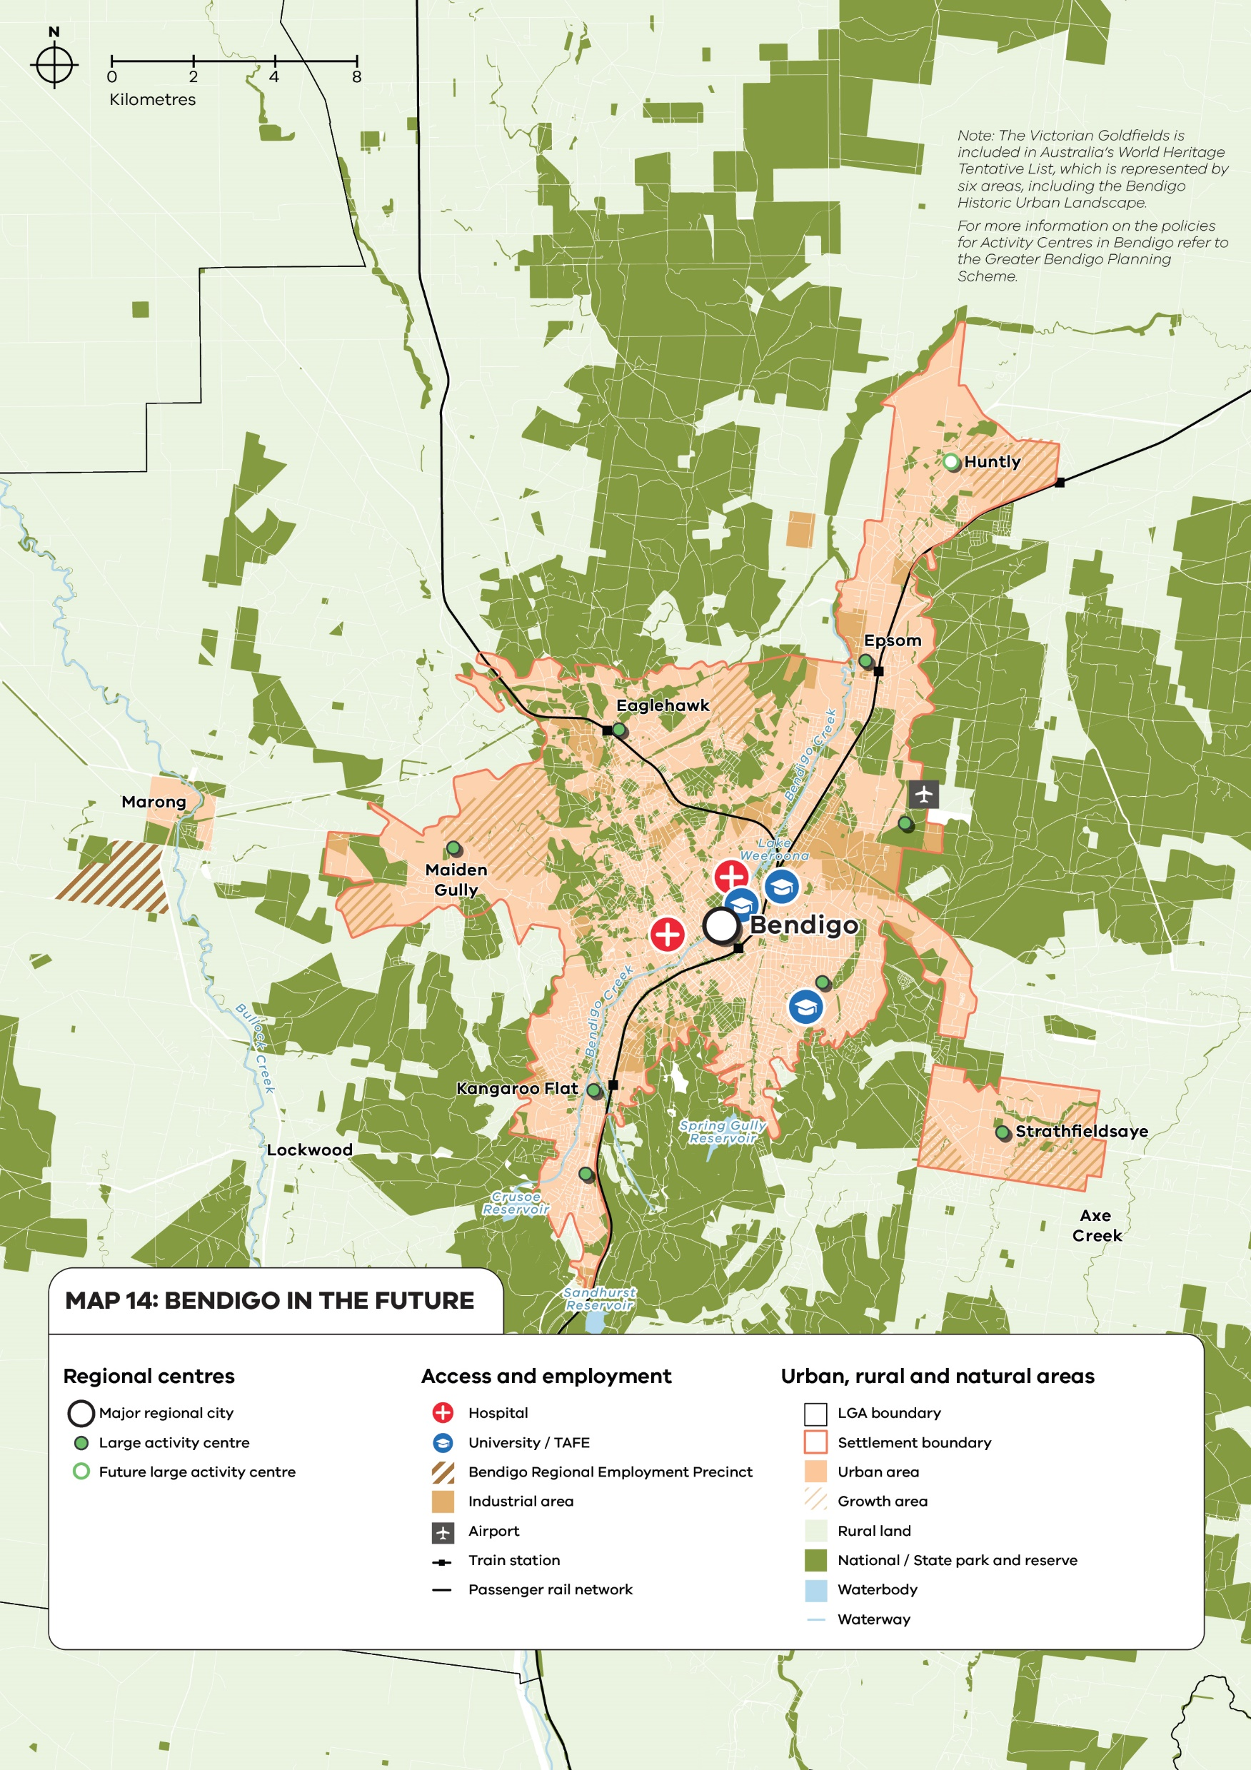
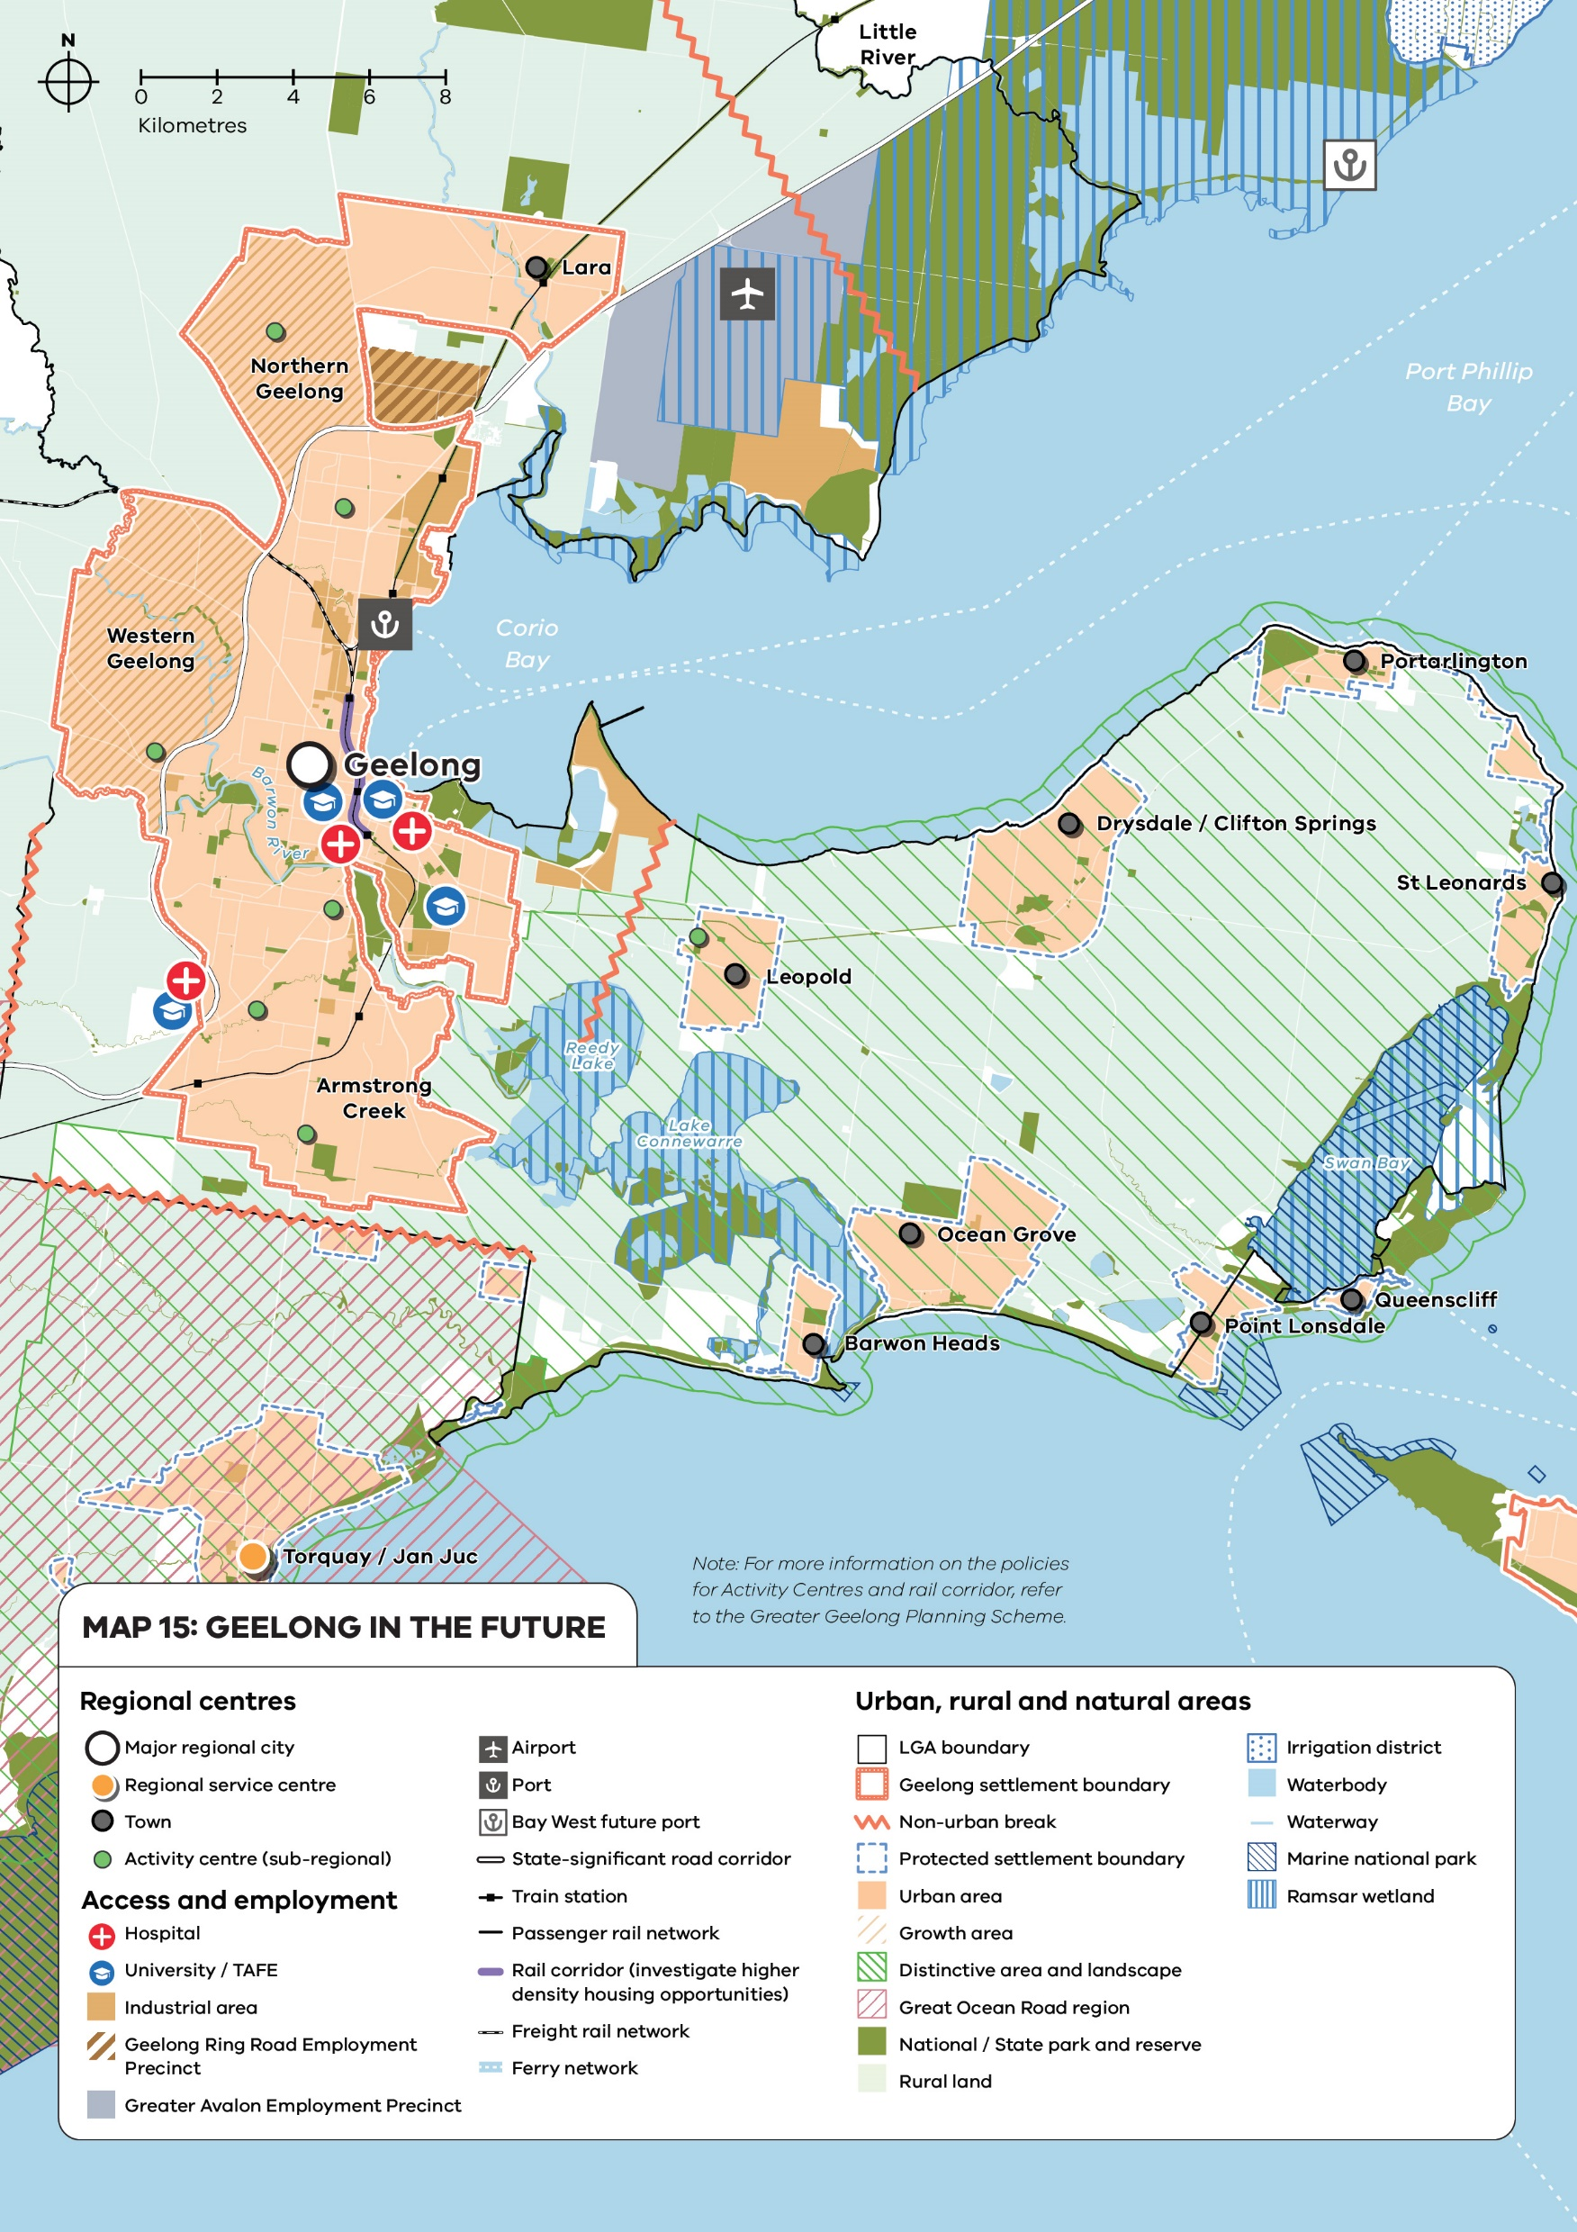
Policy context: Plan for Victoria maps
21
Notes:
Colleen
Plan for Victoria's Pillar 1 'Housing for All Victorians' aims to provide more housing and choice across regional Victoria.
Aim to build 2.24 million homes across Melbourne and our regional cities and towns over the next 30 years.
Local government housing targets will show us where these new homes will go.
More homes will be built in regional Victoria in well-connected, well serviced locations.
The three major regional cities of Ballarat, Bendigo and Geelong will accommodate the most homes.

