Slide 1
Regional Housing Supply
Simon Newport, CEO, Homes Victoria
4 April 2025

Slide 2
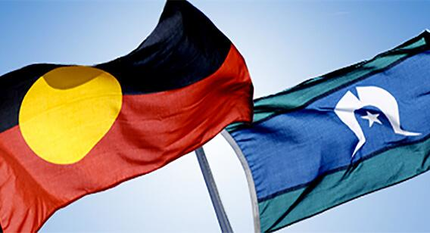
Acknowledgement
I acknowledge the Traditional Owners of the lands on which we meet and work, and pay my respects to Elders past and present.
CONFIDENTIAL​

Slide 3
Homes Victoria’s role
Homes Victoria’s key responsibilities are to:
support Victorians who are finding it difficult to secure stable housing within their means
manage and maintain the government’s social housing assets that are home to more than 116,000 Victorians.
renew and grow the portfolio by ensuring that the Victorian Government’s $6.3 billion investment in the Big Housing Build and Regional Housing Fund, combined with other large capital programs, are delivered on budget and on time.
play our part as stewards to transform Victoria’s housing and homelessness systems so that they are sustainable in the long-term and can deliver for generations to come.
deliver on our part of the Victorian Government’s Housing Statement by redeveloping and re-imagining the 44 older-style public housing towers across Melbourne.
.

Slide 4
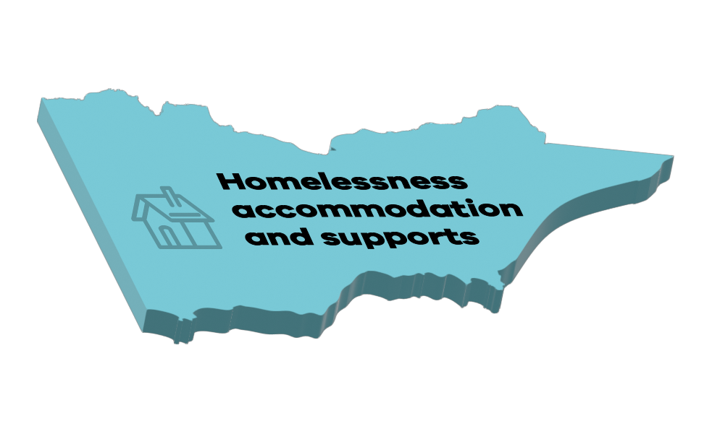
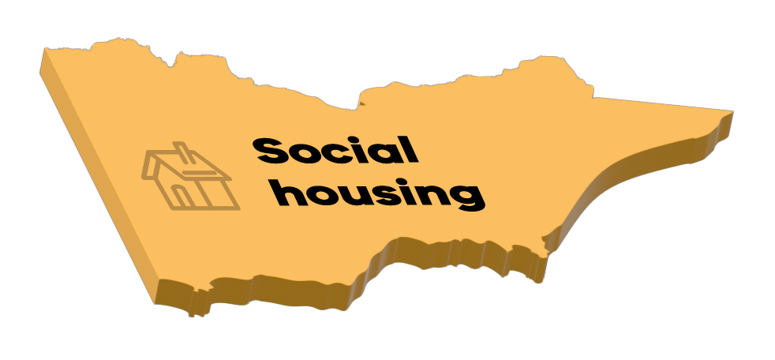
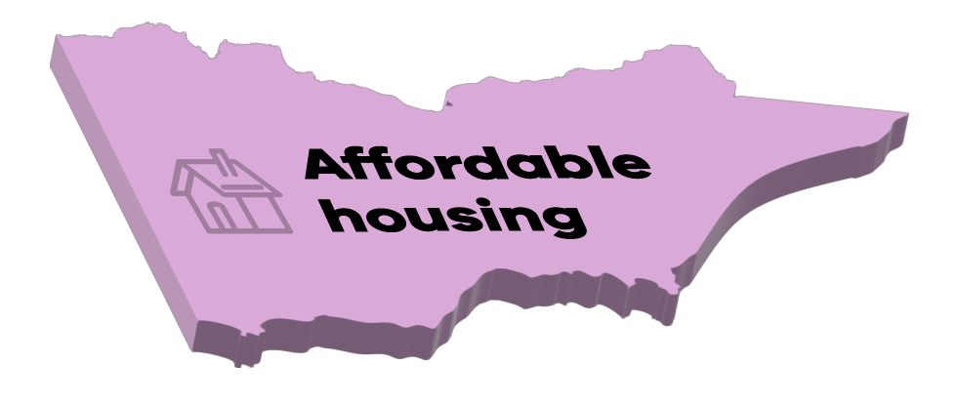
Addressing housing availability and support at multiple levels
Homelessness accommodation and supports
Homelessness services – provide a range of services, including cases management, crisis and transitional accommodation, early intervention (including private rental assistance)
Supportive housing – housing with on-site multidisciplinary supports for people who have experienced rough sleeping
Supportive housing for young people – dedicated to support young people with employment, education and life skills through housing such as youth foyers, education first foyers, and refuges
Social Housing
Can be run by Government (Public Housing) or by a not-for-profit Community Housing Organisation (Community Housing).
For people in need – both public and community housing are for people on the Victorian Housing Register
Very low rents – rents are based on a percentage of household income
Same protections for renters – renters in both have the same rights under the Residential Tenancies Act.
Secure, long-term housing – Both provide stable housing with long leases
Affordable housing
Lower rent – Rent is set at least 10% below the market rate for the area.
Supports people on low-to-moderate income earners – Affordable housing helps people who are struggling in the private rental market.

Slide 5
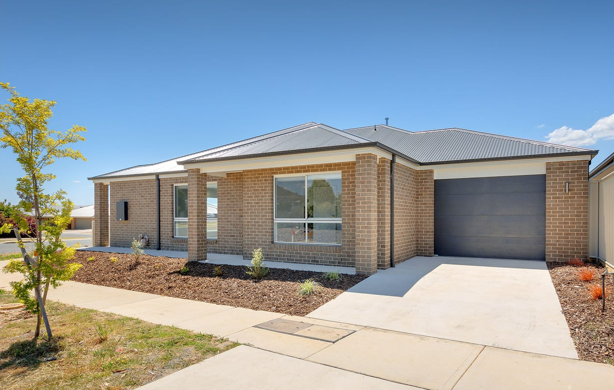
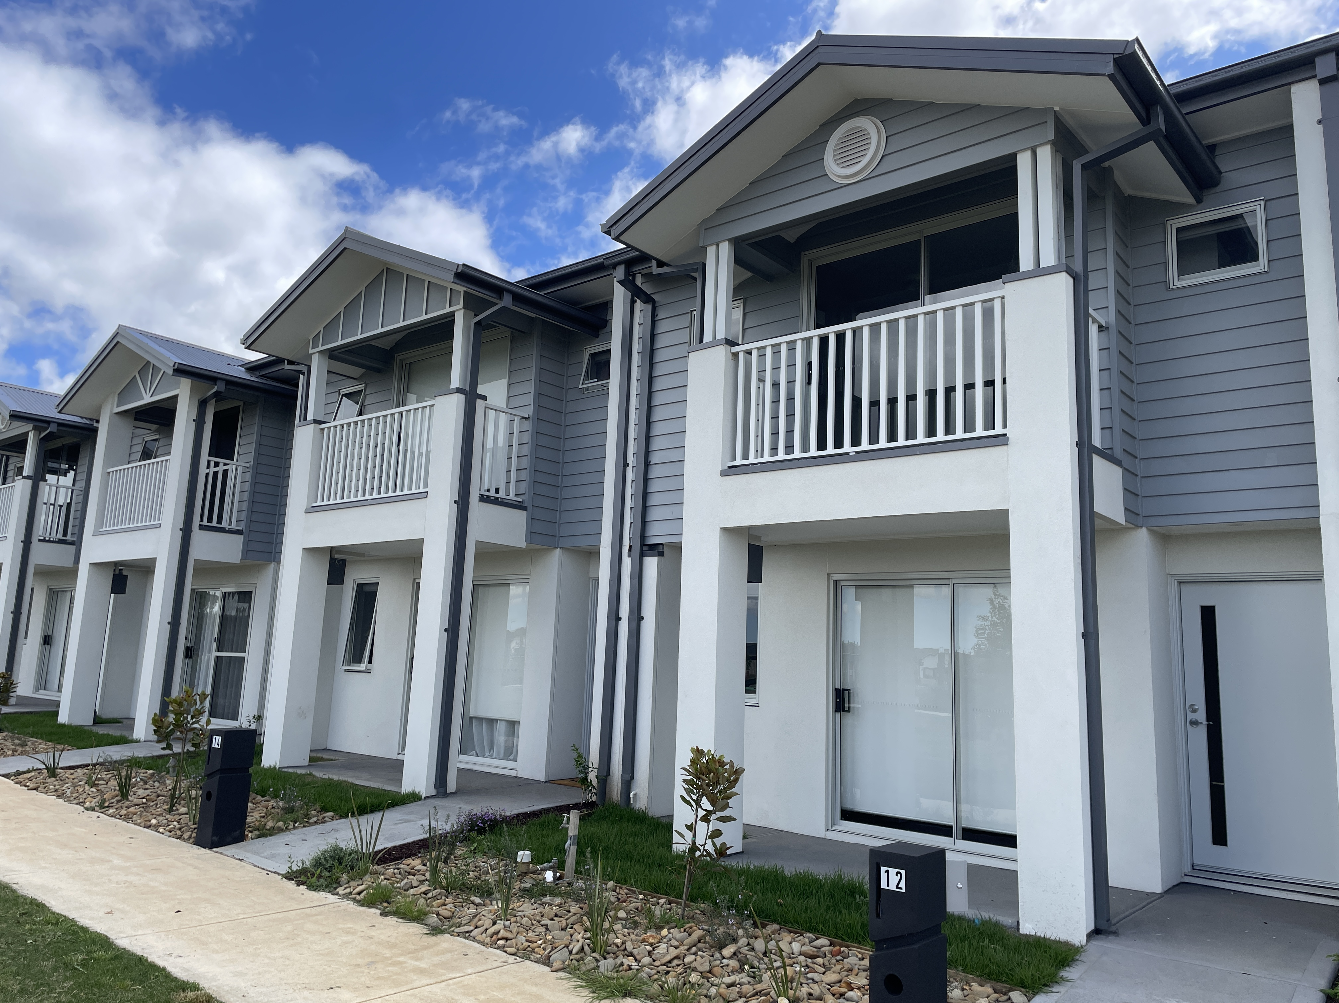
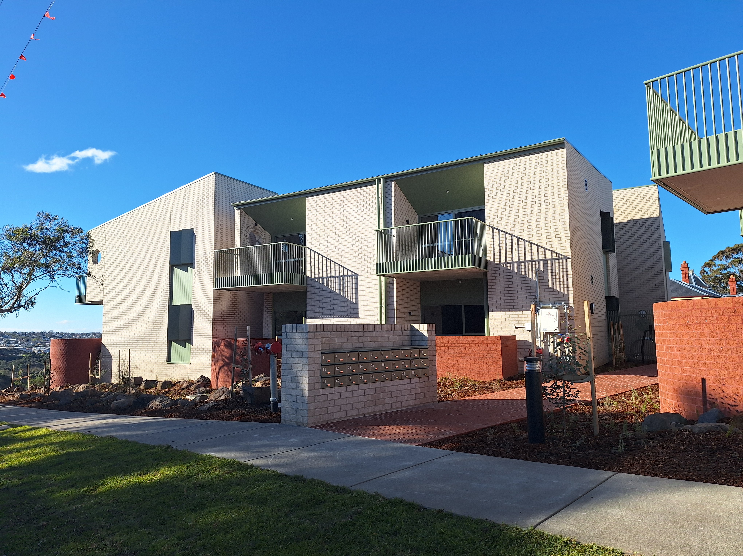
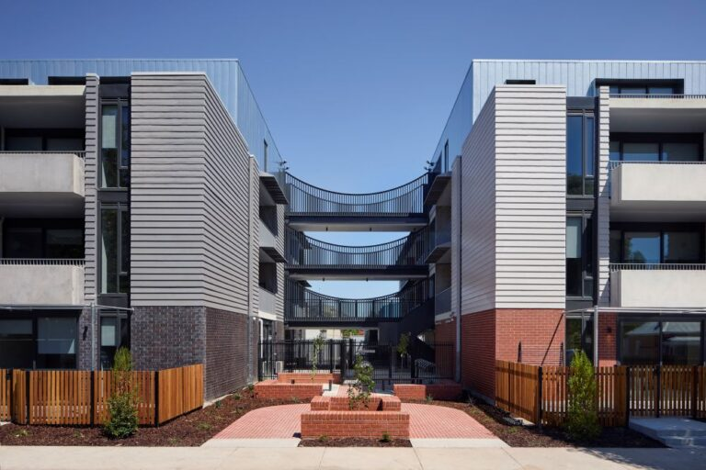
Getting on with the job – delivering more and better homes
2020
Early 2025
2,234 homes complete
1,846 homes underway
1,130 planning and due diligence
More than 4,000 homes completed or underway
Portfolio | Completed | Underway | Planning and due diligence
Big Housing Build | 1,707 | 1,584 | 476
Regional Housing Fund | 198 | 52 | 635
Other capital programs | 329 | 210 | 19
Total | 2,234 | 1,846 | 1,130
Recent completions
Wodonga –3-bedroom home, 2024
Macedon Ranges – 3 townhouse and 4 detached homes 2024
Geelong - 29 homes, completed 2024
Wangaratta - 44 homes, completed 2025

Slide 6
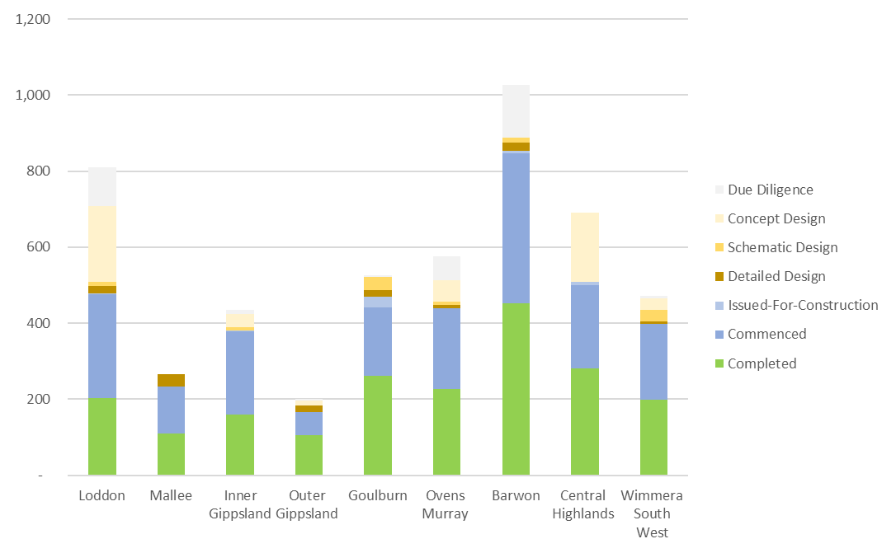



How delivery is tracking in each area
Big Housing Build (2020)
Regional Housing Fund (2023)
Other capital programs
Project preparation and planning stages can include site investigations, stakeholder engagement, tendering, design, and planning approvals
Procurement
Construction underway
Renters returning or new renters moving into brand new homes
North
South
East
West

Slide 7






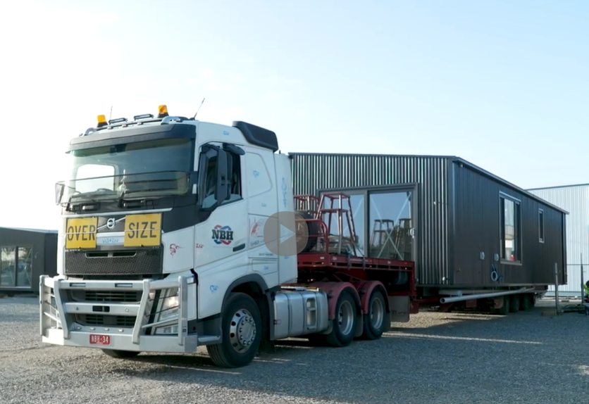
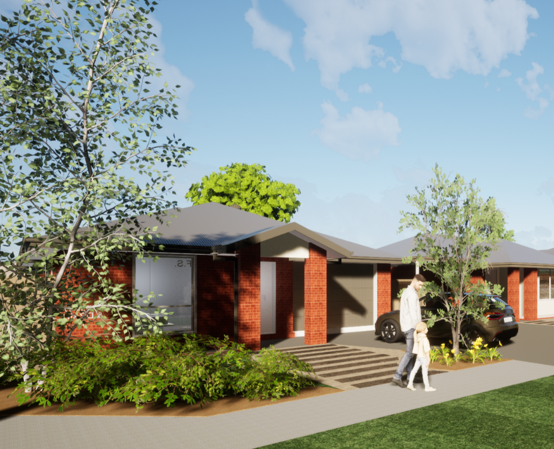
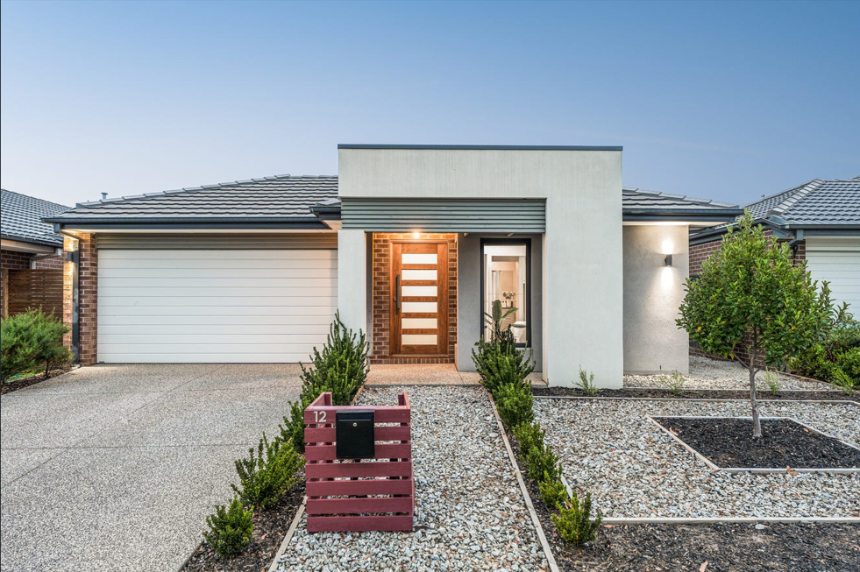
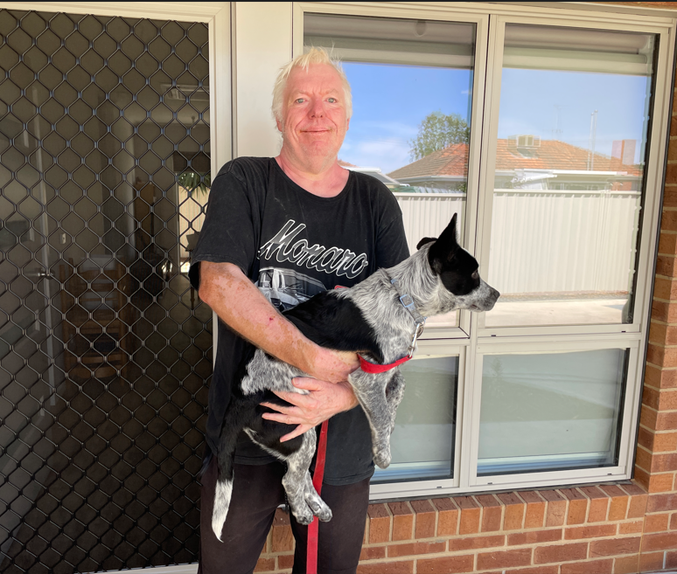
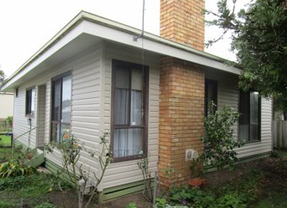
Using different methodologies
Using modern methods of construction
Redeveloping older social housing stock
Acquiring homes
Partnerships with the community housing sector
Immediate refurbishments to bring damaged stock back online
Modular homes enroute to
Nhill
New homes planned for Colac
Homes purchased in new development at Greater Geelong
Shepparton flood recovery homes by Beyond Housing
Homes brought back online in Warrnambool

Slide 8
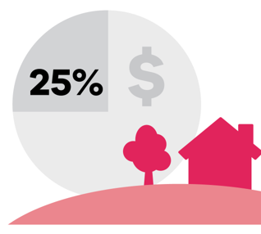
Commitments for regional and rural Victoria under the Big Housing Build
Minimum investment for regional Victoria
The Big Housing Build committed to invest 25% of the announced $5 billion program across regional Victoria. This will provide $1.25 billion across regional Victoria.
This is in line with Victoria’s population distribution. In 2023, 25% (1.7 million) of Victoria’s 6.8 million residents live in in regional Victoria.
Minimum Investment Guarantees for regional and rural LGAs
The Big Housing Build committed a Minimum Investment Guarantee to 18 regional LGAs, with $765 million committed across these LGAs.
The Minimum Investment Commitment ranges from $180 million (Greater Geelong) to $15 million (Horsham, Golden Plains and Swan Hill)

Slide 9
Minimum Investment Guarantee
LGA | BHB MIG ($m) | Status
Ballarat | 80 | Exceeded
Bass Coast | 25 | In Progress
Baw Baw | 35 | Exceeded
Golden Plains | 15 | In Progress
Greater Bendigo | 85 | Exceeded
Greater Geelong | 180 | Exceeded
Greater Shepparton | 45 | Exceeded
Horsham | 15 | Exceeded
Latrobe | 60 | Exceeded
Macedon Ranges | 30 | In Progress
Mildura | 40 | In Progress
Mitchell | 25 | Exceeded
Moorabool | 20 | Exceeded
Surf Coast | 20 | In Progress
Swan Hill | 15 | Exceeded
Wangaratta | 20 | Exceeded
Warrnambool | 25 | Exceeded
Wodonga | 30 | Exceeded
  The Big Housing Build’s Minimum Investment Guarantee has been met 13 out of the 18 local government areas with a total investment of over $1 billion across the 18 local government areas as at the end of December 2024.
  The MIG has been allocated to regional and rural Local Government Areas with a significant regional town or city or with projected high population growth.

Slide 10
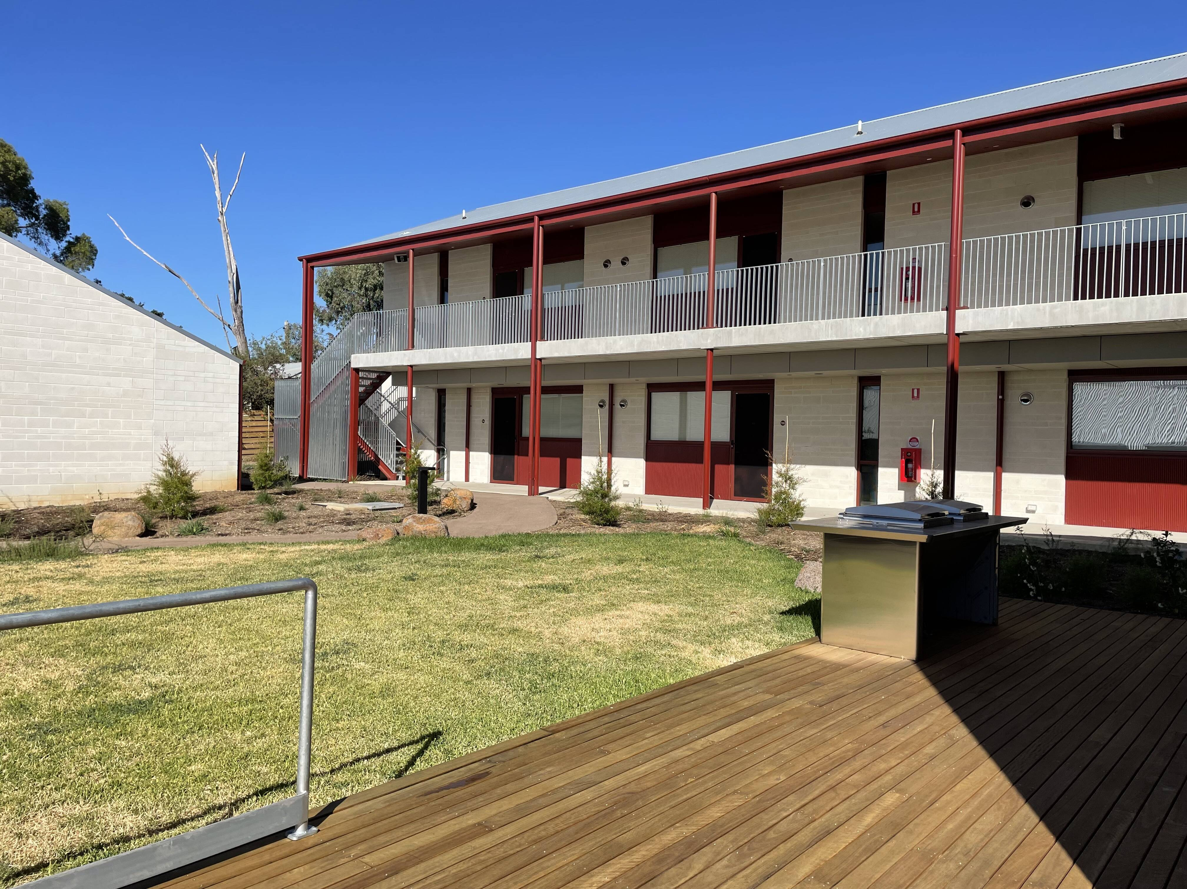
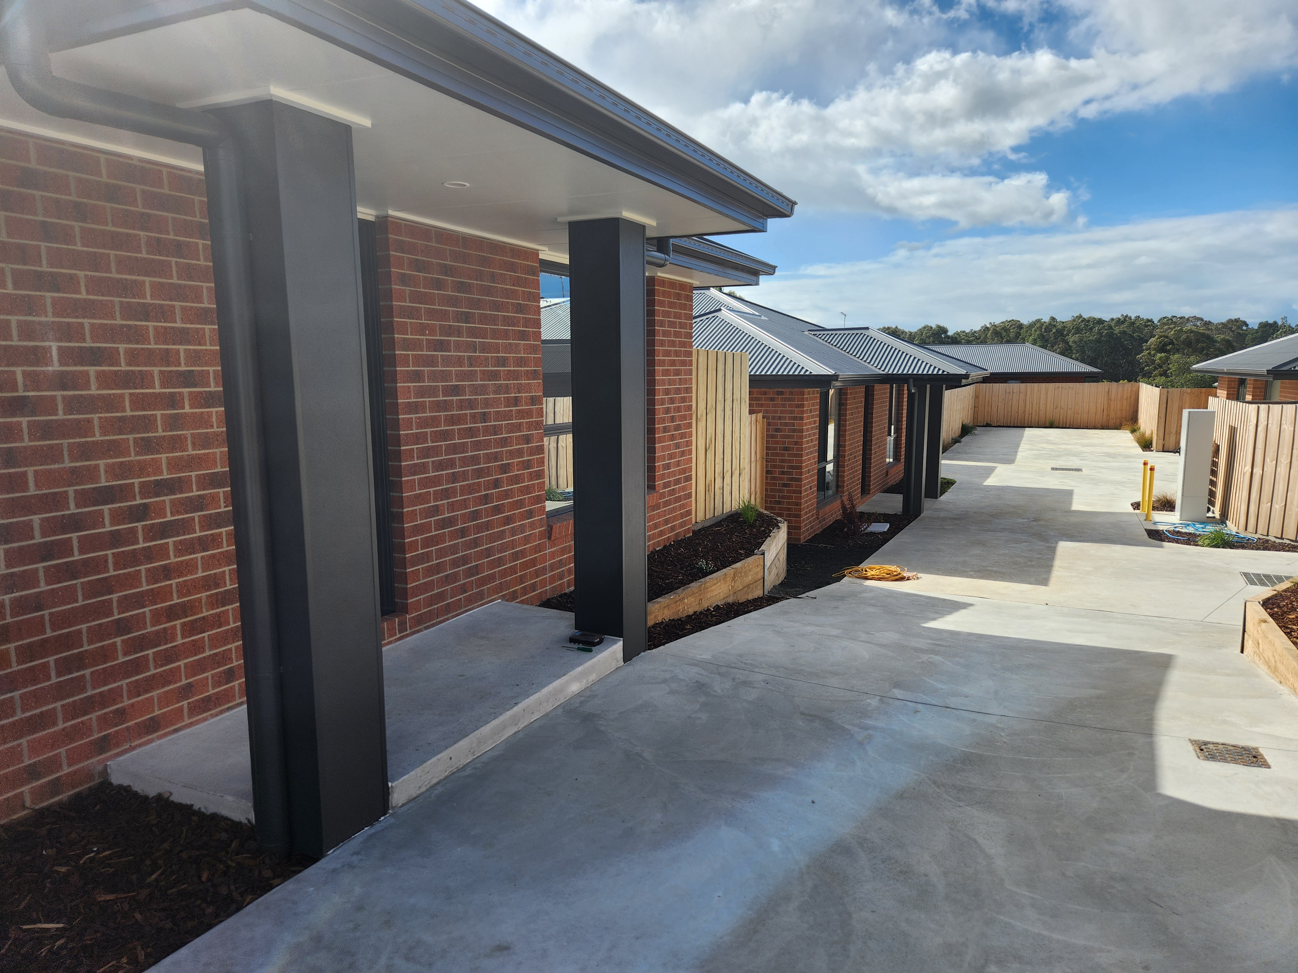
Regional Housing – key achievements in North and South
North | Big Housing Build & Regional Housing Fund 246 new homes have been completed and 400 new homes underway, a further 21 sites have been refurbished as part of bringing stock back online. Investment of $255 million. Other Capital Programs In addition to the above, a further 71 new homes have been completed as part of other capital programs. Investment of $28 million. Over 2,000 homes have had maintenance and/or upgrades undertaken across the LGAs in North Division with an investment of $28 million.
South | Big Housing Build & Regional Housing Fund 239 new homes have been completed and 265 new homes underway, a further 24 sites have been refurbished as part of bringing stock back online. Supported by investment of $205 million. Other Capital Programs In addition to the above, a further 32 new homes have been completed and 13 new homes underway as part of other capital programs. Investment of $29 million. 1,456 homes have had maintenance and/or upgrades undertaken across these LGAs with an investment of $19 million.
Golden Square, Bendigo
35 one-bedroom units completed in early 2025.
Delivered in partnership with Wintringham Housing, a not-for-profit focused on providing housing for people over 50 years of age
Funded through the Social Housing Growth Fund
Accessible homes with private outdoor spaces.
Wurruk, Gippsland
10 new homes completed in mid 2024.
3 two-bedroom, 5 three-bedroom and 2 four-bedroom homes
Delivered under the Big Housing Build, spot purchase program.

Slide 11
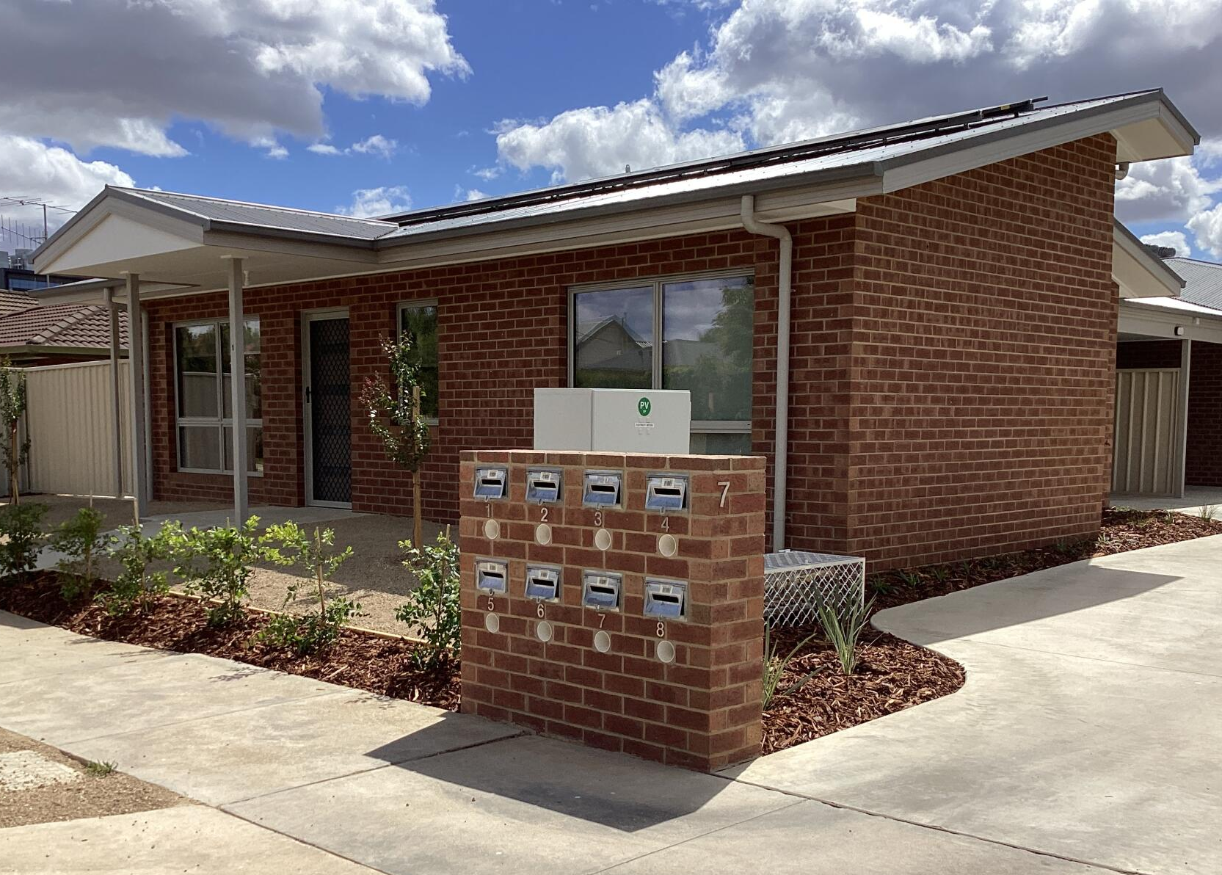
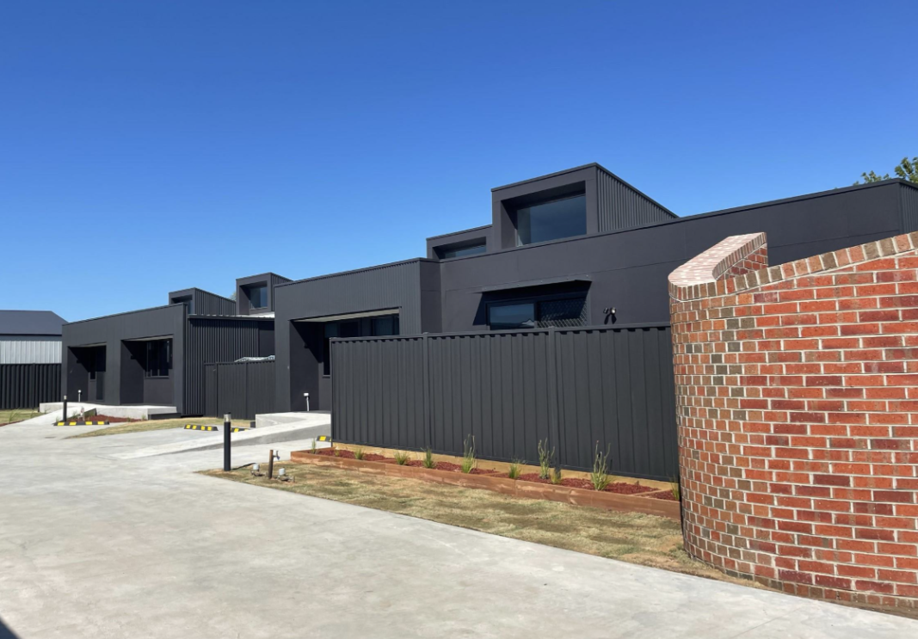
Regional Housing – key achievements in East and West
East | Big Housing Build & Regional Housing Fund 415 new homes have been completed and 325 new homes underway, a further 31 sites have been refurbished as part of bringing stock back online. Supported by an investment of $279.5 million. created. Other Capital Programs In addition to the above, a further 135 new homes have been completed and 8 new homes underway as part of other capital programs $58.5 million investment. Over 1,870 homes have had maintenance and/or upgrades undertaken across these LGAs with an investment of $25 million.
West | Big Housing Build & Regional Housing Fund 865 new homes have been completed and 620 new homes underway, a further 62 sites have been refurbished as part of bringing stock back online. Supported investment of $578.5. Other Capital Programs In addition to the above, a further 91 new homes have been completed and 189 new homes underway as part of other capital programs $305 million investment. Over 3,280 homes have had maintenance and/or upgrades undertaken across these LGAs with an investment of $42.5 million.
Flood Recovery homes, Shepparton
8 new homes – 5 one-bedroom units and 3 two-bedroom units completed in December 2024.
Funded through the Regional Housing Fund
Built by Community Housing provider Beyond Housing who will manage the homes and the renters
All-electric, featuring solar panels, rainwater tanks, built-in garages, and reverse cycle air-conditioning.
Modular homes, Horsham
25 new homes - 3 one-bedroom and 22 two-bedroom townhouses completed in 2024.
Funded through the Social Housing Growth Fund
Delivered in partnership with Community Housing provider Haven Home Safe
Built by Arkit
All electric with individual rainwater tanks.

