Slide 1
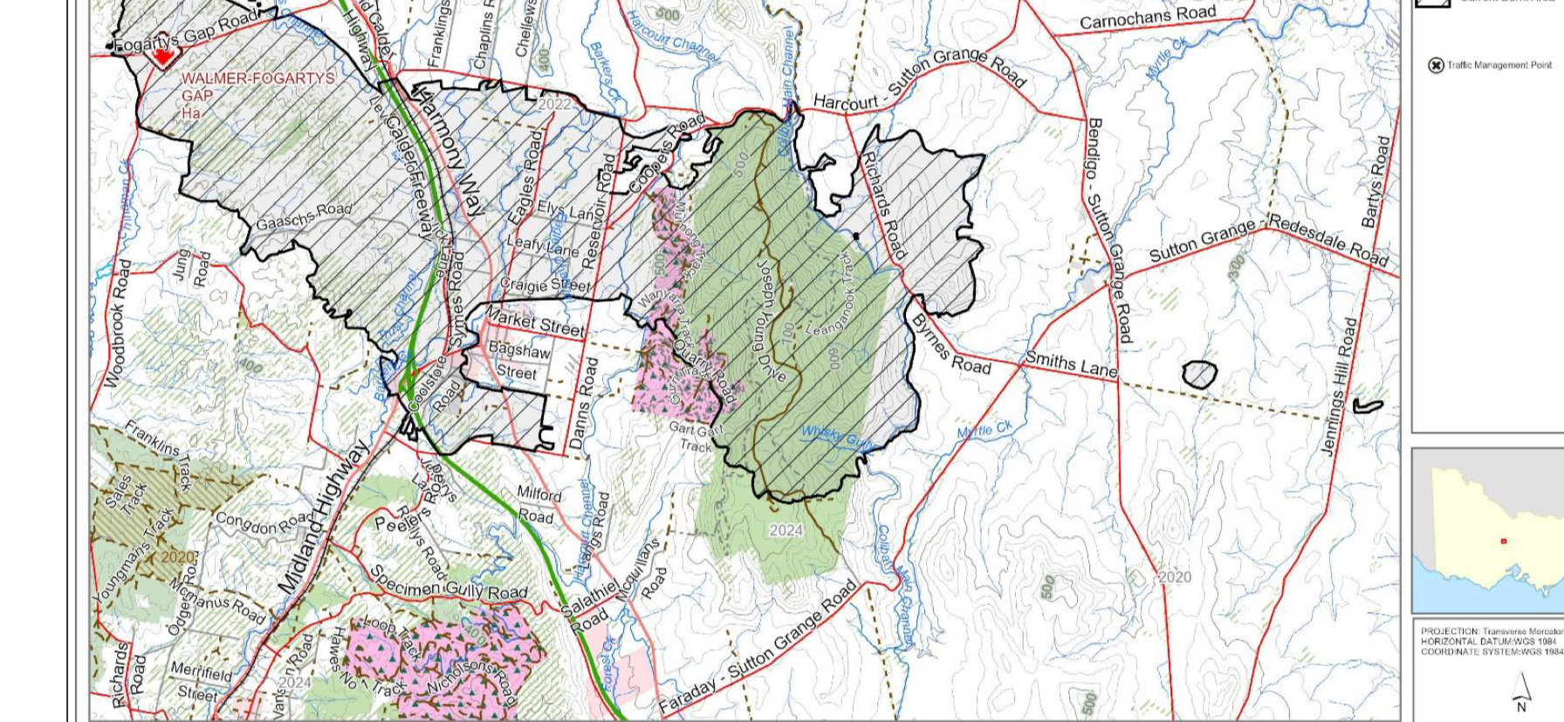
9 January 2026 Fire Event: Burn Scar
Rachel Vanstone 30/4/2026

Slide 2
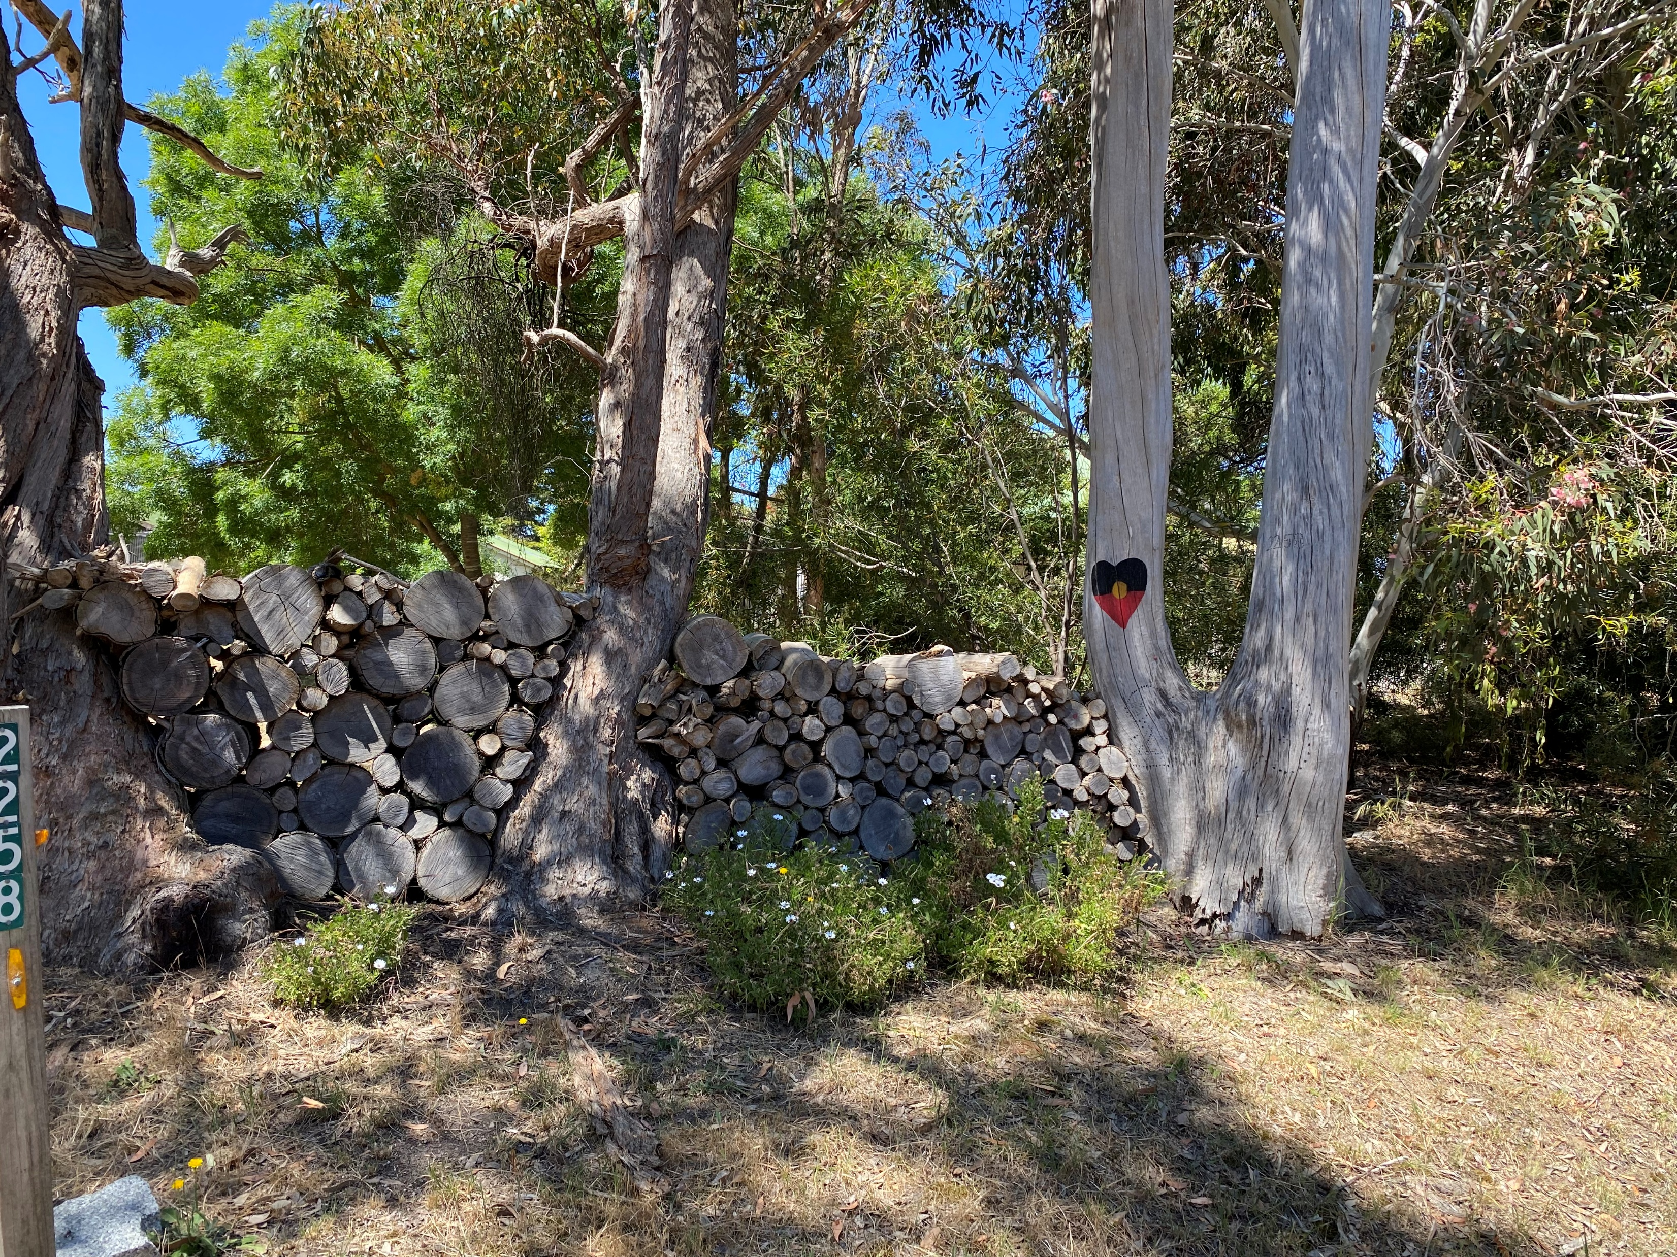

Slide 3
Impact 9 January fire event
288
16
Total number of properties burnt
Commercial industrial
or business impacted
74
908
Total number of houses lost
DFFH payments to impacted people in Harcourt, Harcourt North,
Sutton Grange, Walmer,
Ravenswood South, Barkers Creek
&Faraday
11
Total number houses unliveable but repairable
“Harcourt Valley has the smallest burn scar in Victoria, yet the fires impact has been profound”
Source: Estimates from Mount Alexander Shire 28/4/2026

Slide 4
Harcourt Progress Association
$91,135
2
Value gift cards distributed
Auspices:
Harcourt Bushfire Donation Centre
& Harcourt Relief Centre
35
Number of $2,000 payments to
Households who lost their
primary place of residence
50
Number of properties received
free fencing materials
“Harcourt Progress Association stepped up to provide essential relief and recovery services to the community”
Source: Harcourt Progress Association 28/4/2026 & Blaze Aid 26/4/2026

Slide 5
Harcourt Bushfire Donation Centre
1035
89,604
January –
Number of people provided access
Volunteer Hours
397
462
February –
Number of people provided access
Total number of volunteers
328
March –
Number of people provided access
“The Harcourt Bushfire Donation Centre has provided innumerable material aid and emotional support to bushfire survivors”
Source: Harcourt Progress Association 28/4/2026

Slide 6
Harcourt Relief Centre
“The Harcourt Relief Centre has provided meals, connection and a food pantry to bushfire survivors”
1953
328
Community lunches served
March – people accessed
1035
193
January – people accessed
April l – people accessed
397
64,081
Volunteer hours contributed
February – people accessed
Source: Harcourt Progress Association 28/4/2026

Slide 7
Harcourt Progress Association
Harcourt Bushfire Donation Centre
Harcourt Relief Centre
“Despite delivering these essential services, the Association has received no direct government funding.* Support has come from donations, philanthropy, local businesses, and community banks. Every service has been volunteer-led. Mount Alexander Shire Council’s recovery team is not expected on the ground until mid-May.
That means Harcourt Valley, supported by our friends in Castlemaine, has carried recovery ourselves — by the community, for the community. Government assistance for individuals is welcome, but there has been no investment in community-based recovery”.
*with the exception of funds made available by the Magistrates Court of Victoria to purchase fencing materials applied by Blaze Aid

Slide 8
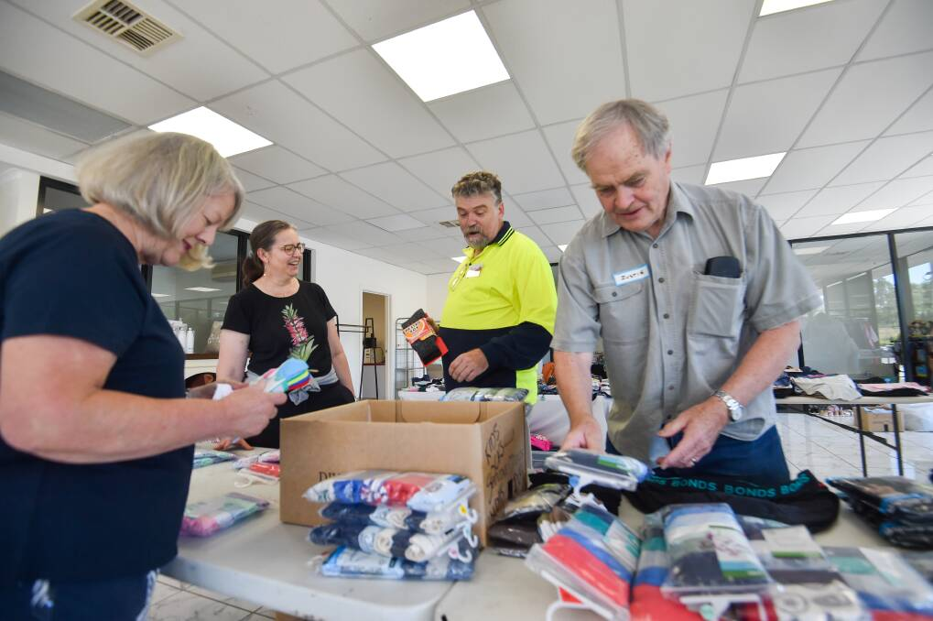
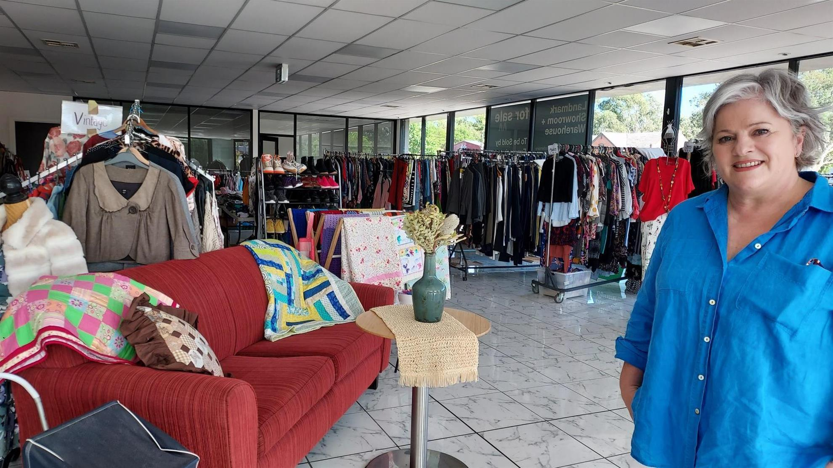
“This reveals a serious gap in disaster policy. Communities are expected to provide essential recovery services through unpaid labor, leading to burnout and inconsistent support. Often, the volunteers are survivors themselves. In the current environment, recovery depends on communities leading it—but we are doing so without sufficient support and resources. This must be addressed. At local and state levels, systems and funding must better support community-led recovery.”
Rachel, Micheal, Faye and Justin
Just 5 of the 462 volunteers in total at the Harcourt Bushfire Donation Centre
Tania Butterworth – Manager Harcourt Bushfire Donation Centre

Slide 9
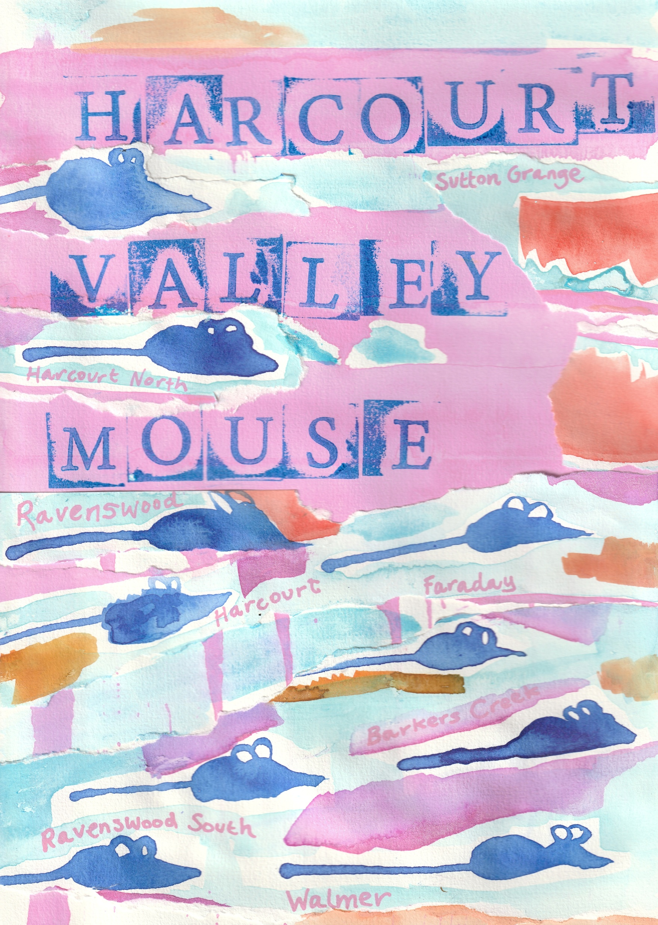
“We also need better state preparedness: a recovery playbook for communities, resources for children, volunteer support frameworks, and regional disaster plans that can activate quickly.
As always, Harcourt Valley has responded with action - a picture book for our children: Harcourt Valley Mouse”.

Slide 10
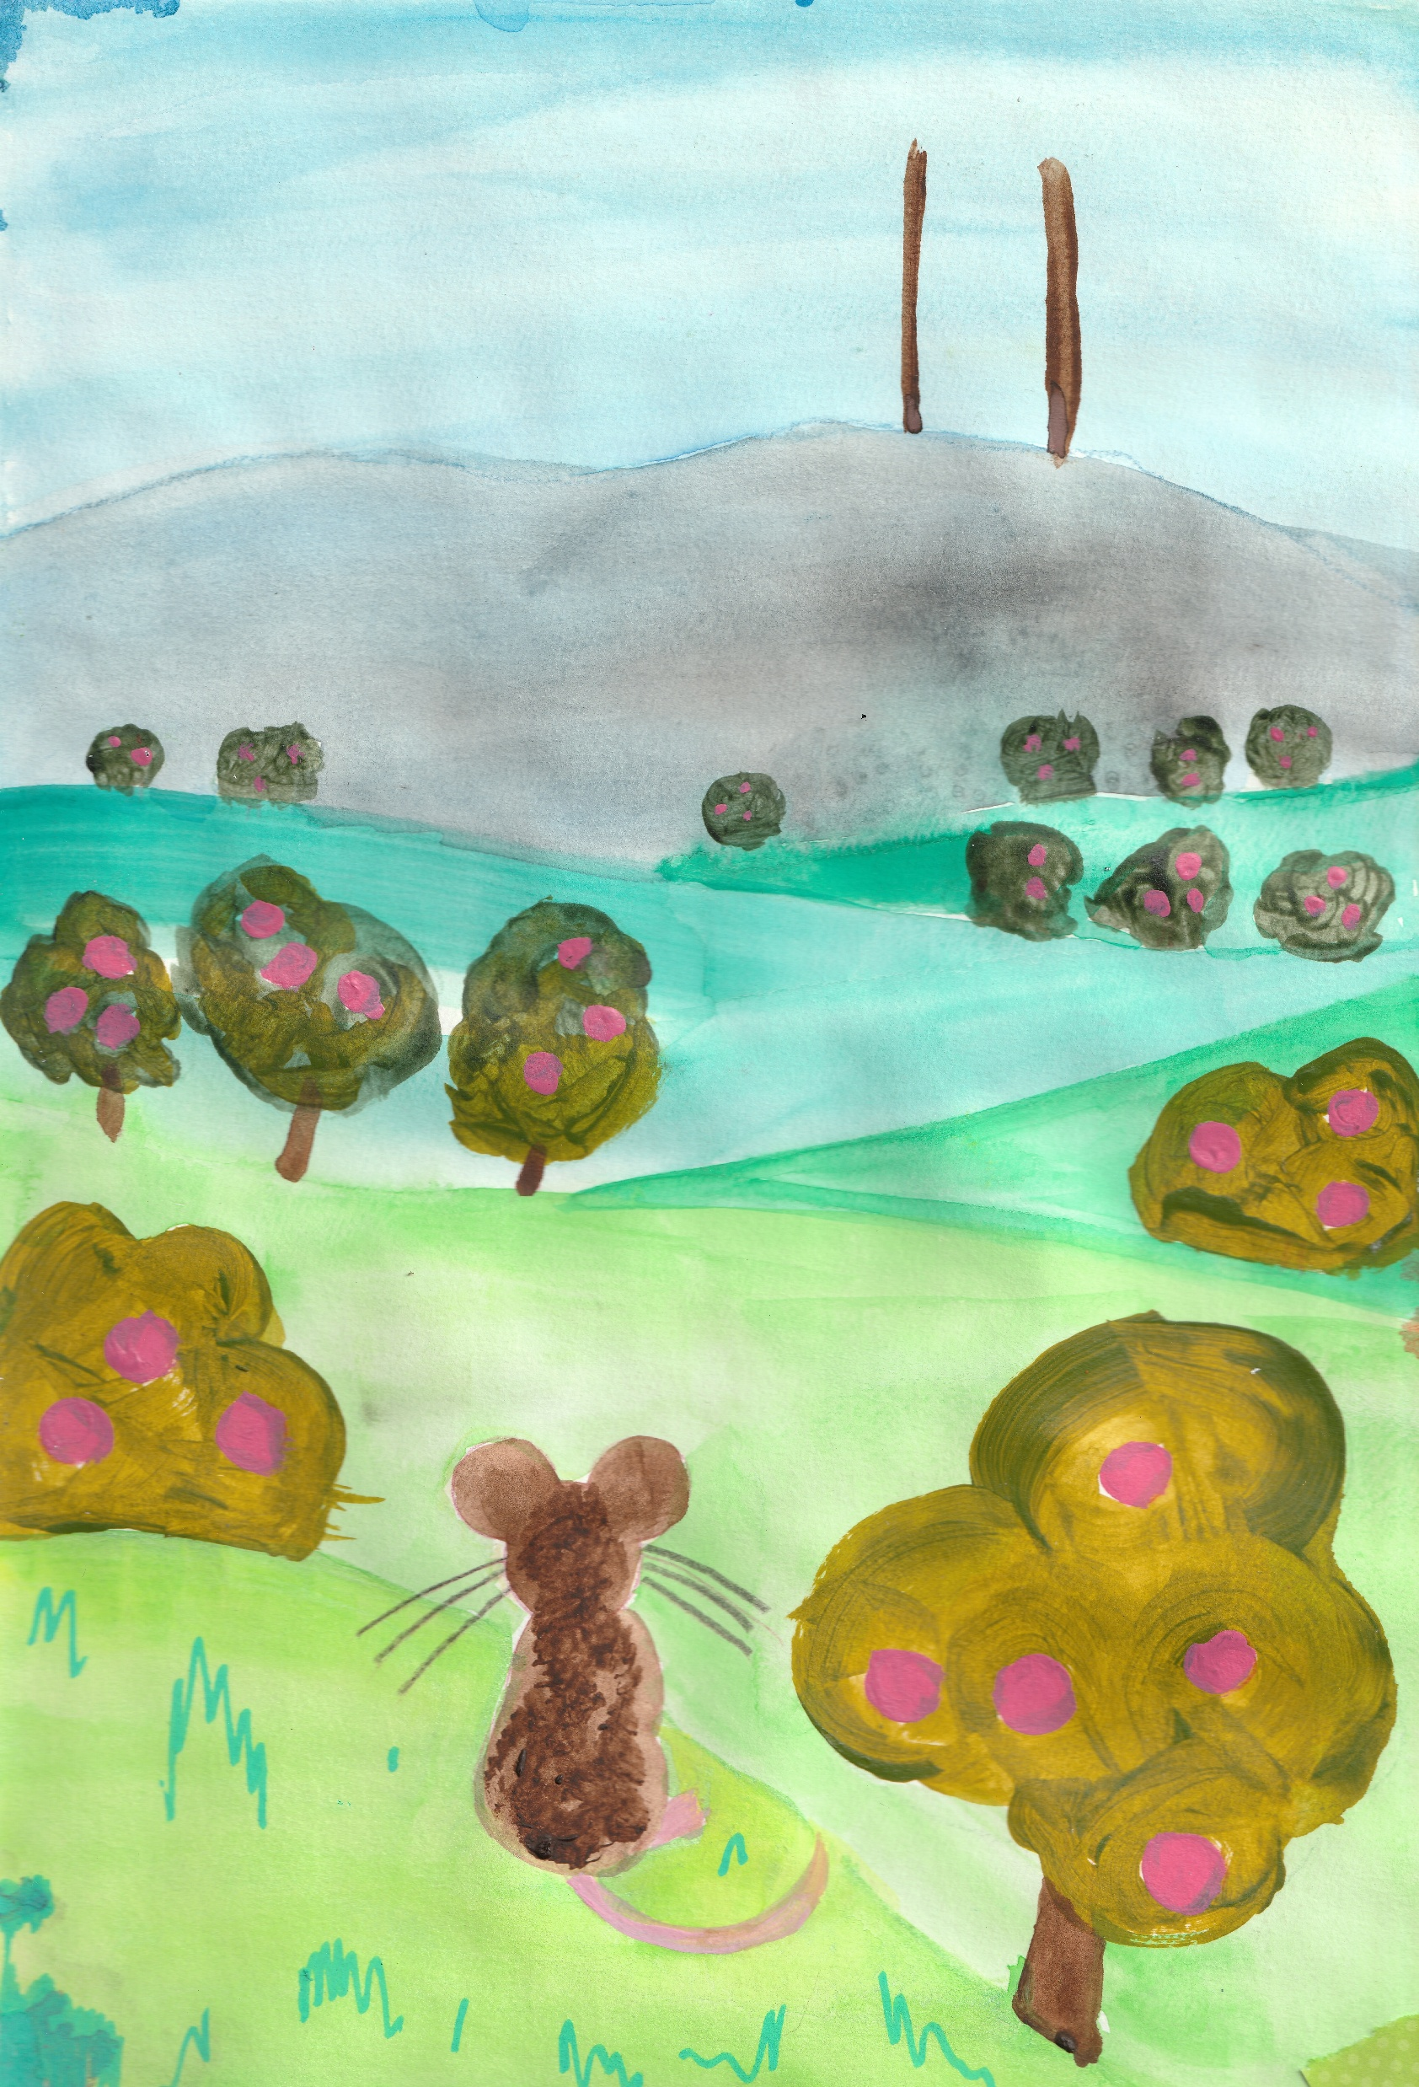
HARCOURT VALLEY MOUSE
A PICTURE BOOK DEDICATED TO THE CHILDREN OF HARCOURT VALLEY

Slide 11
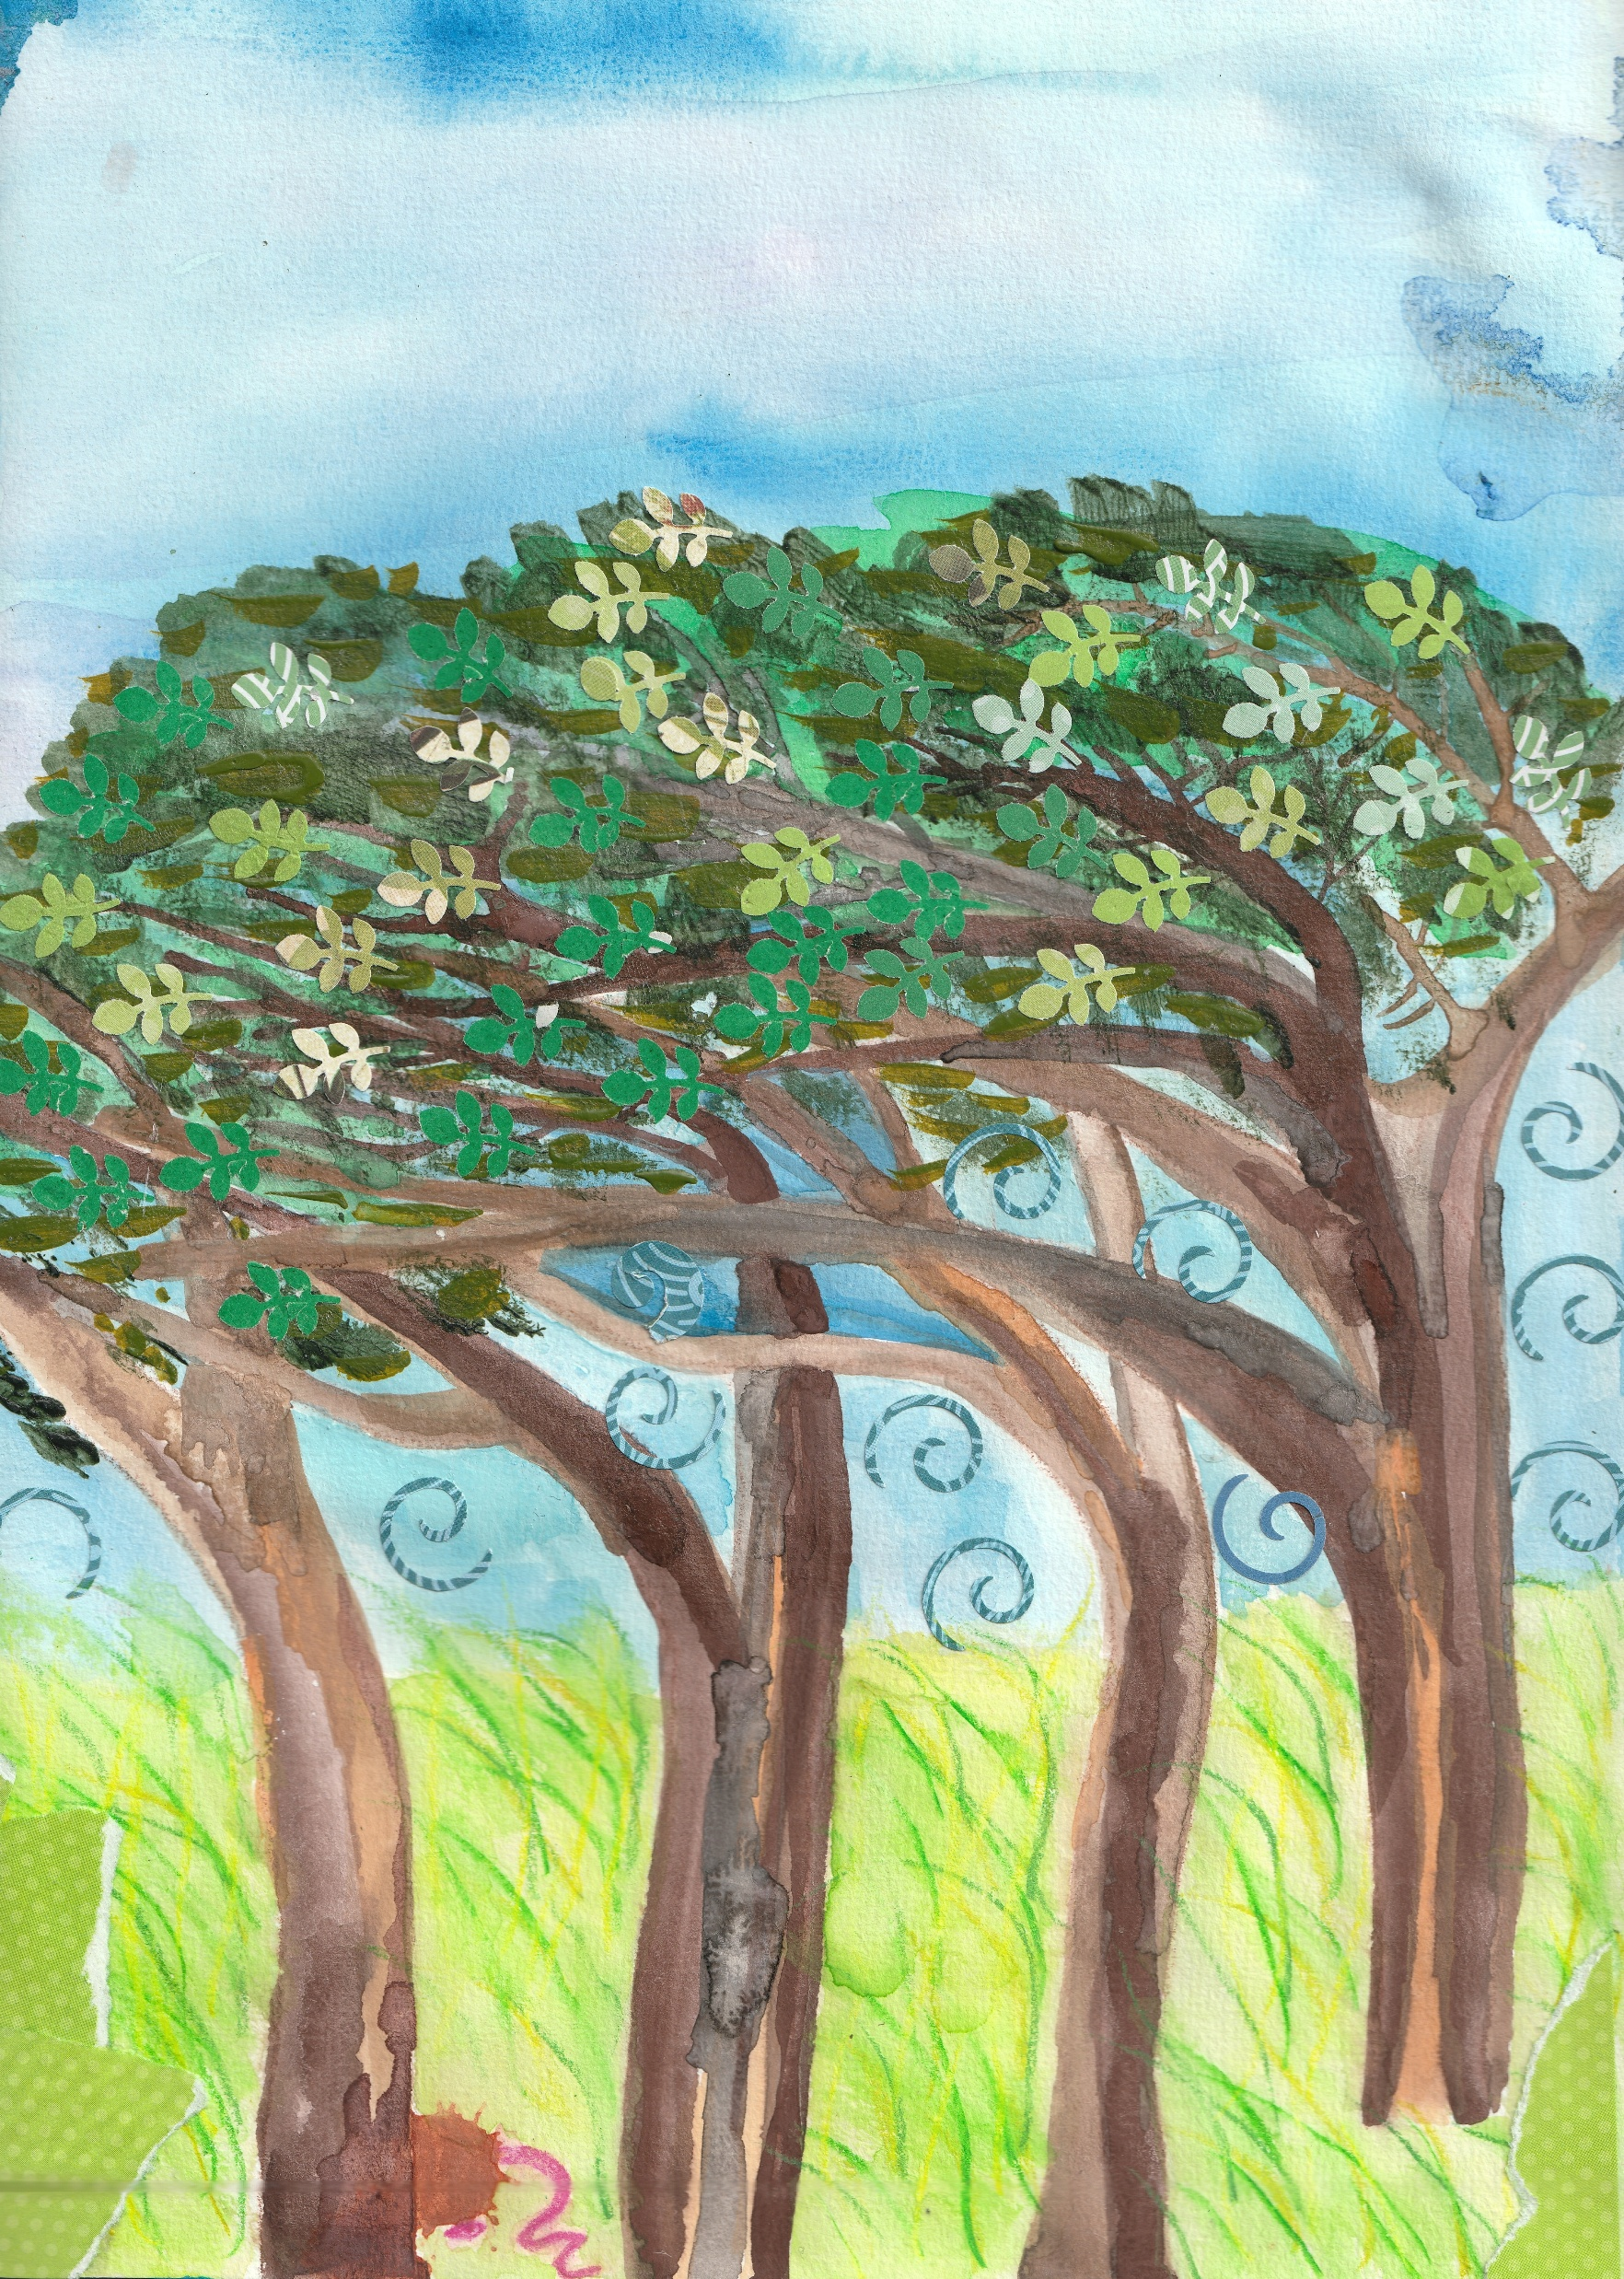

Slide 12
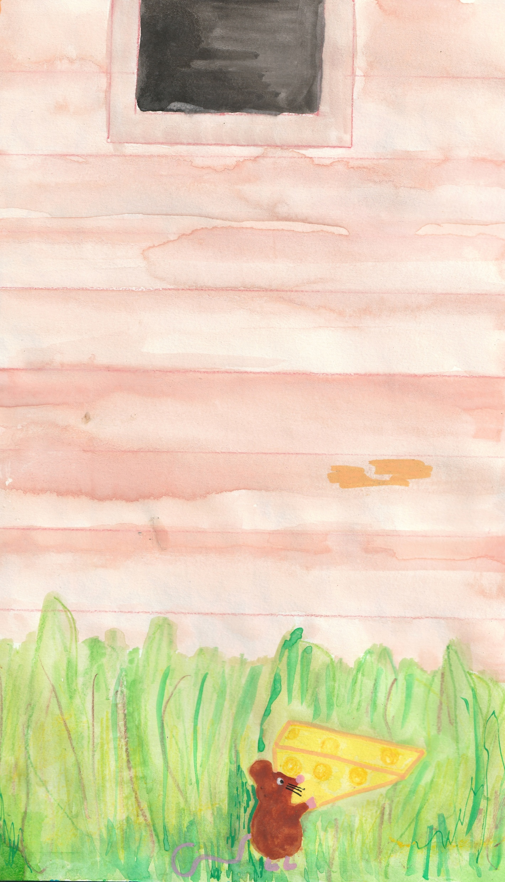

Slide 13
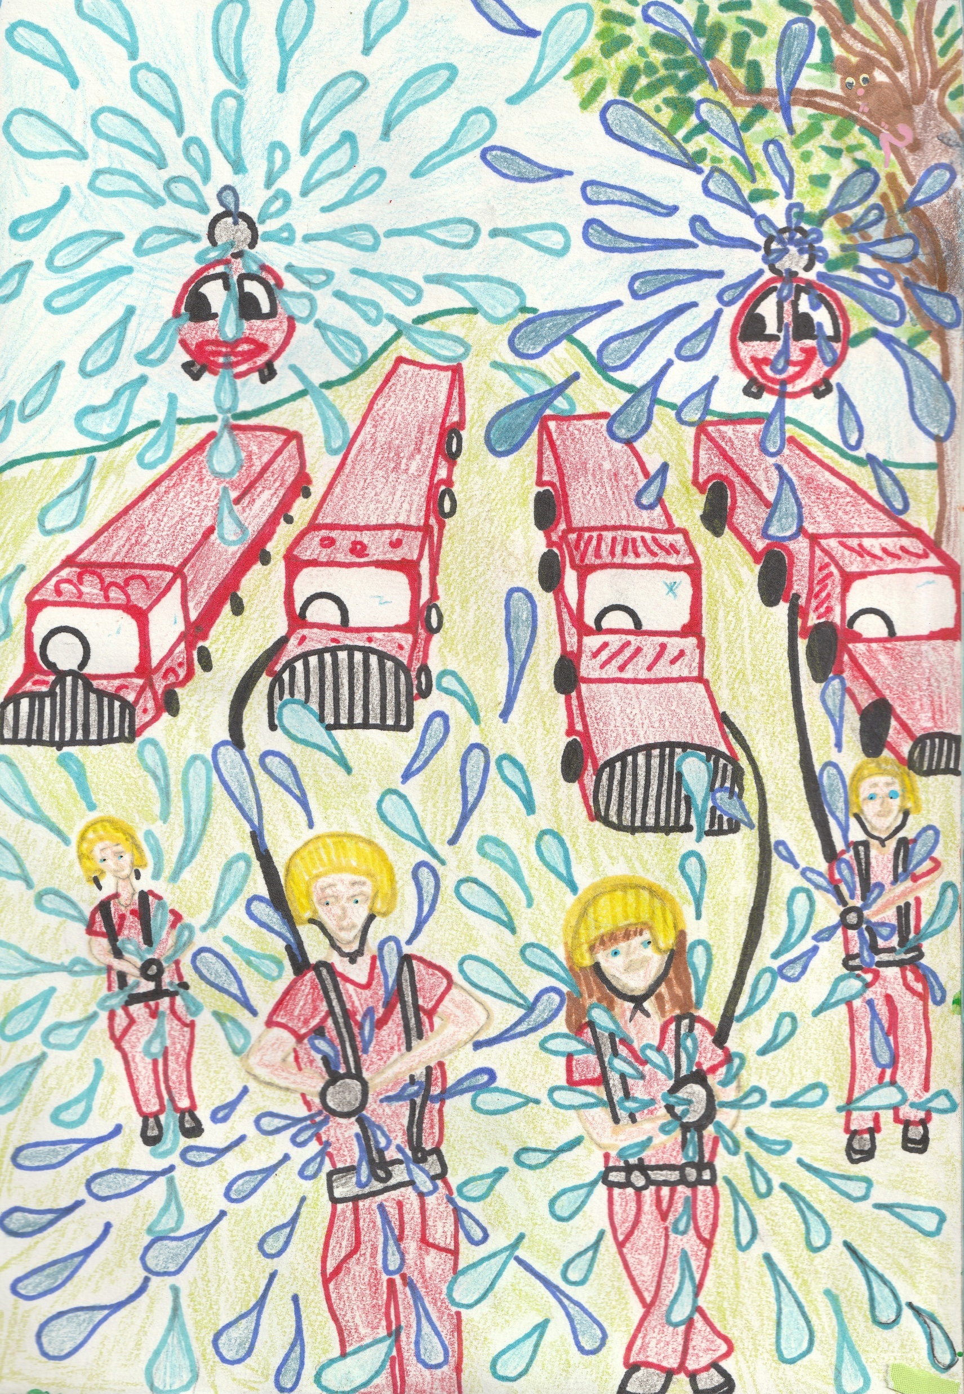

Slide 14
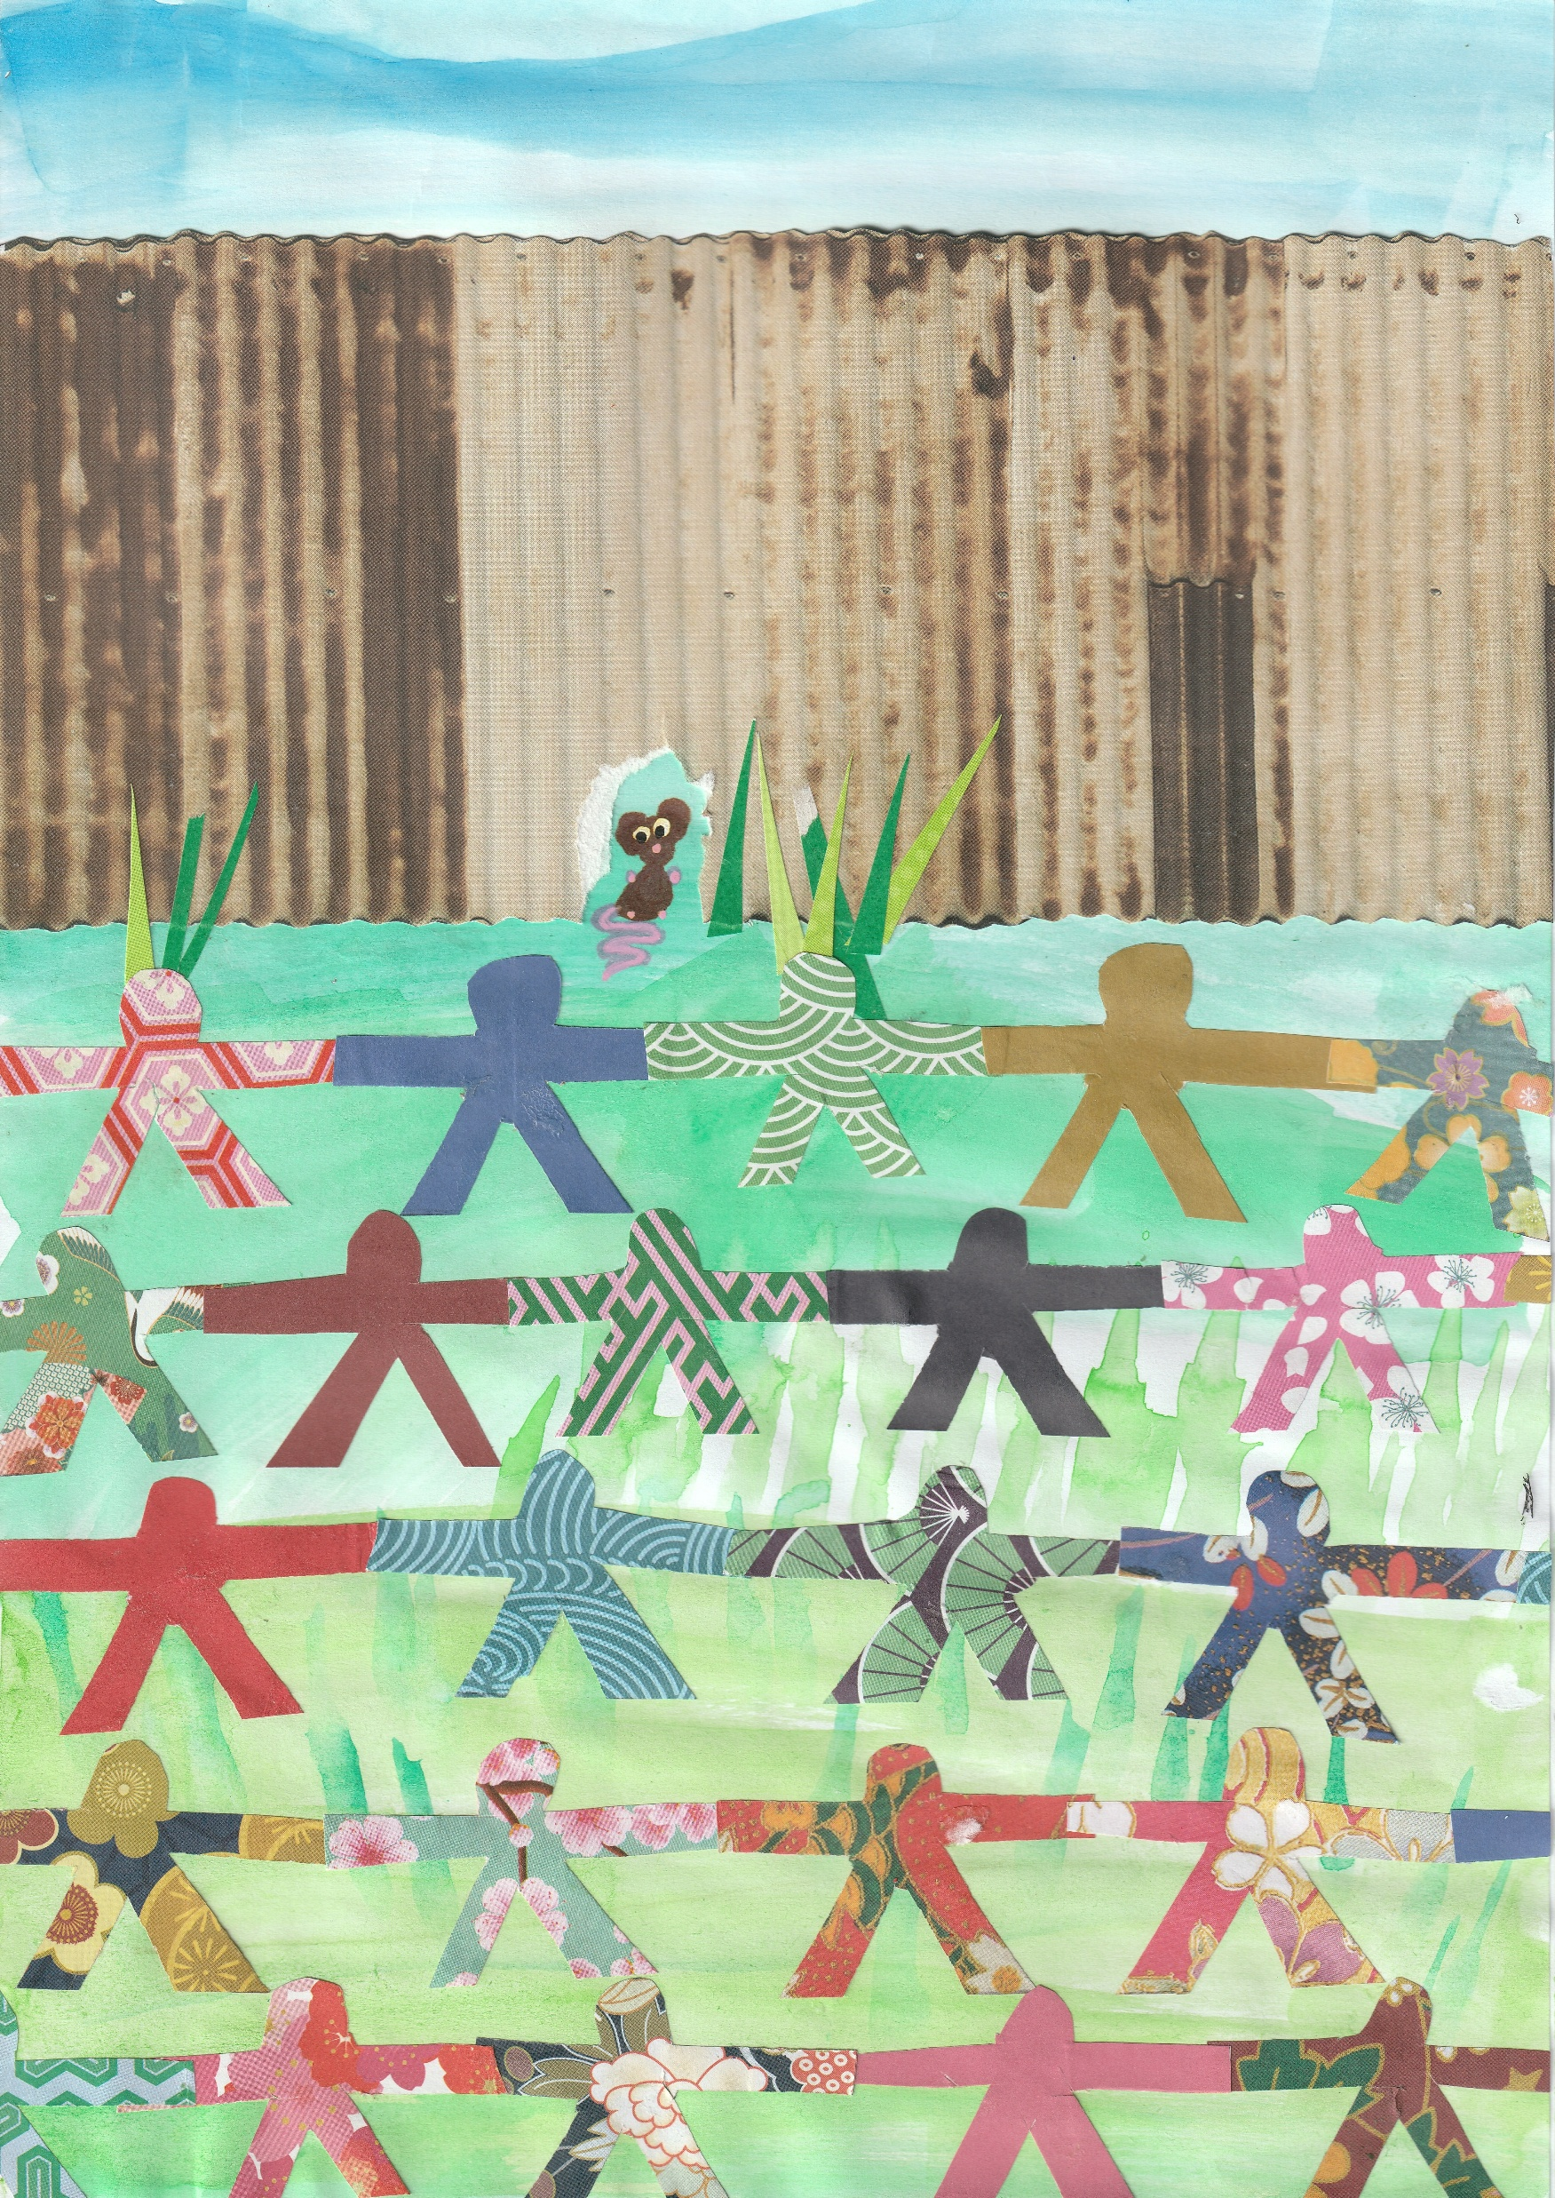

Slide 15
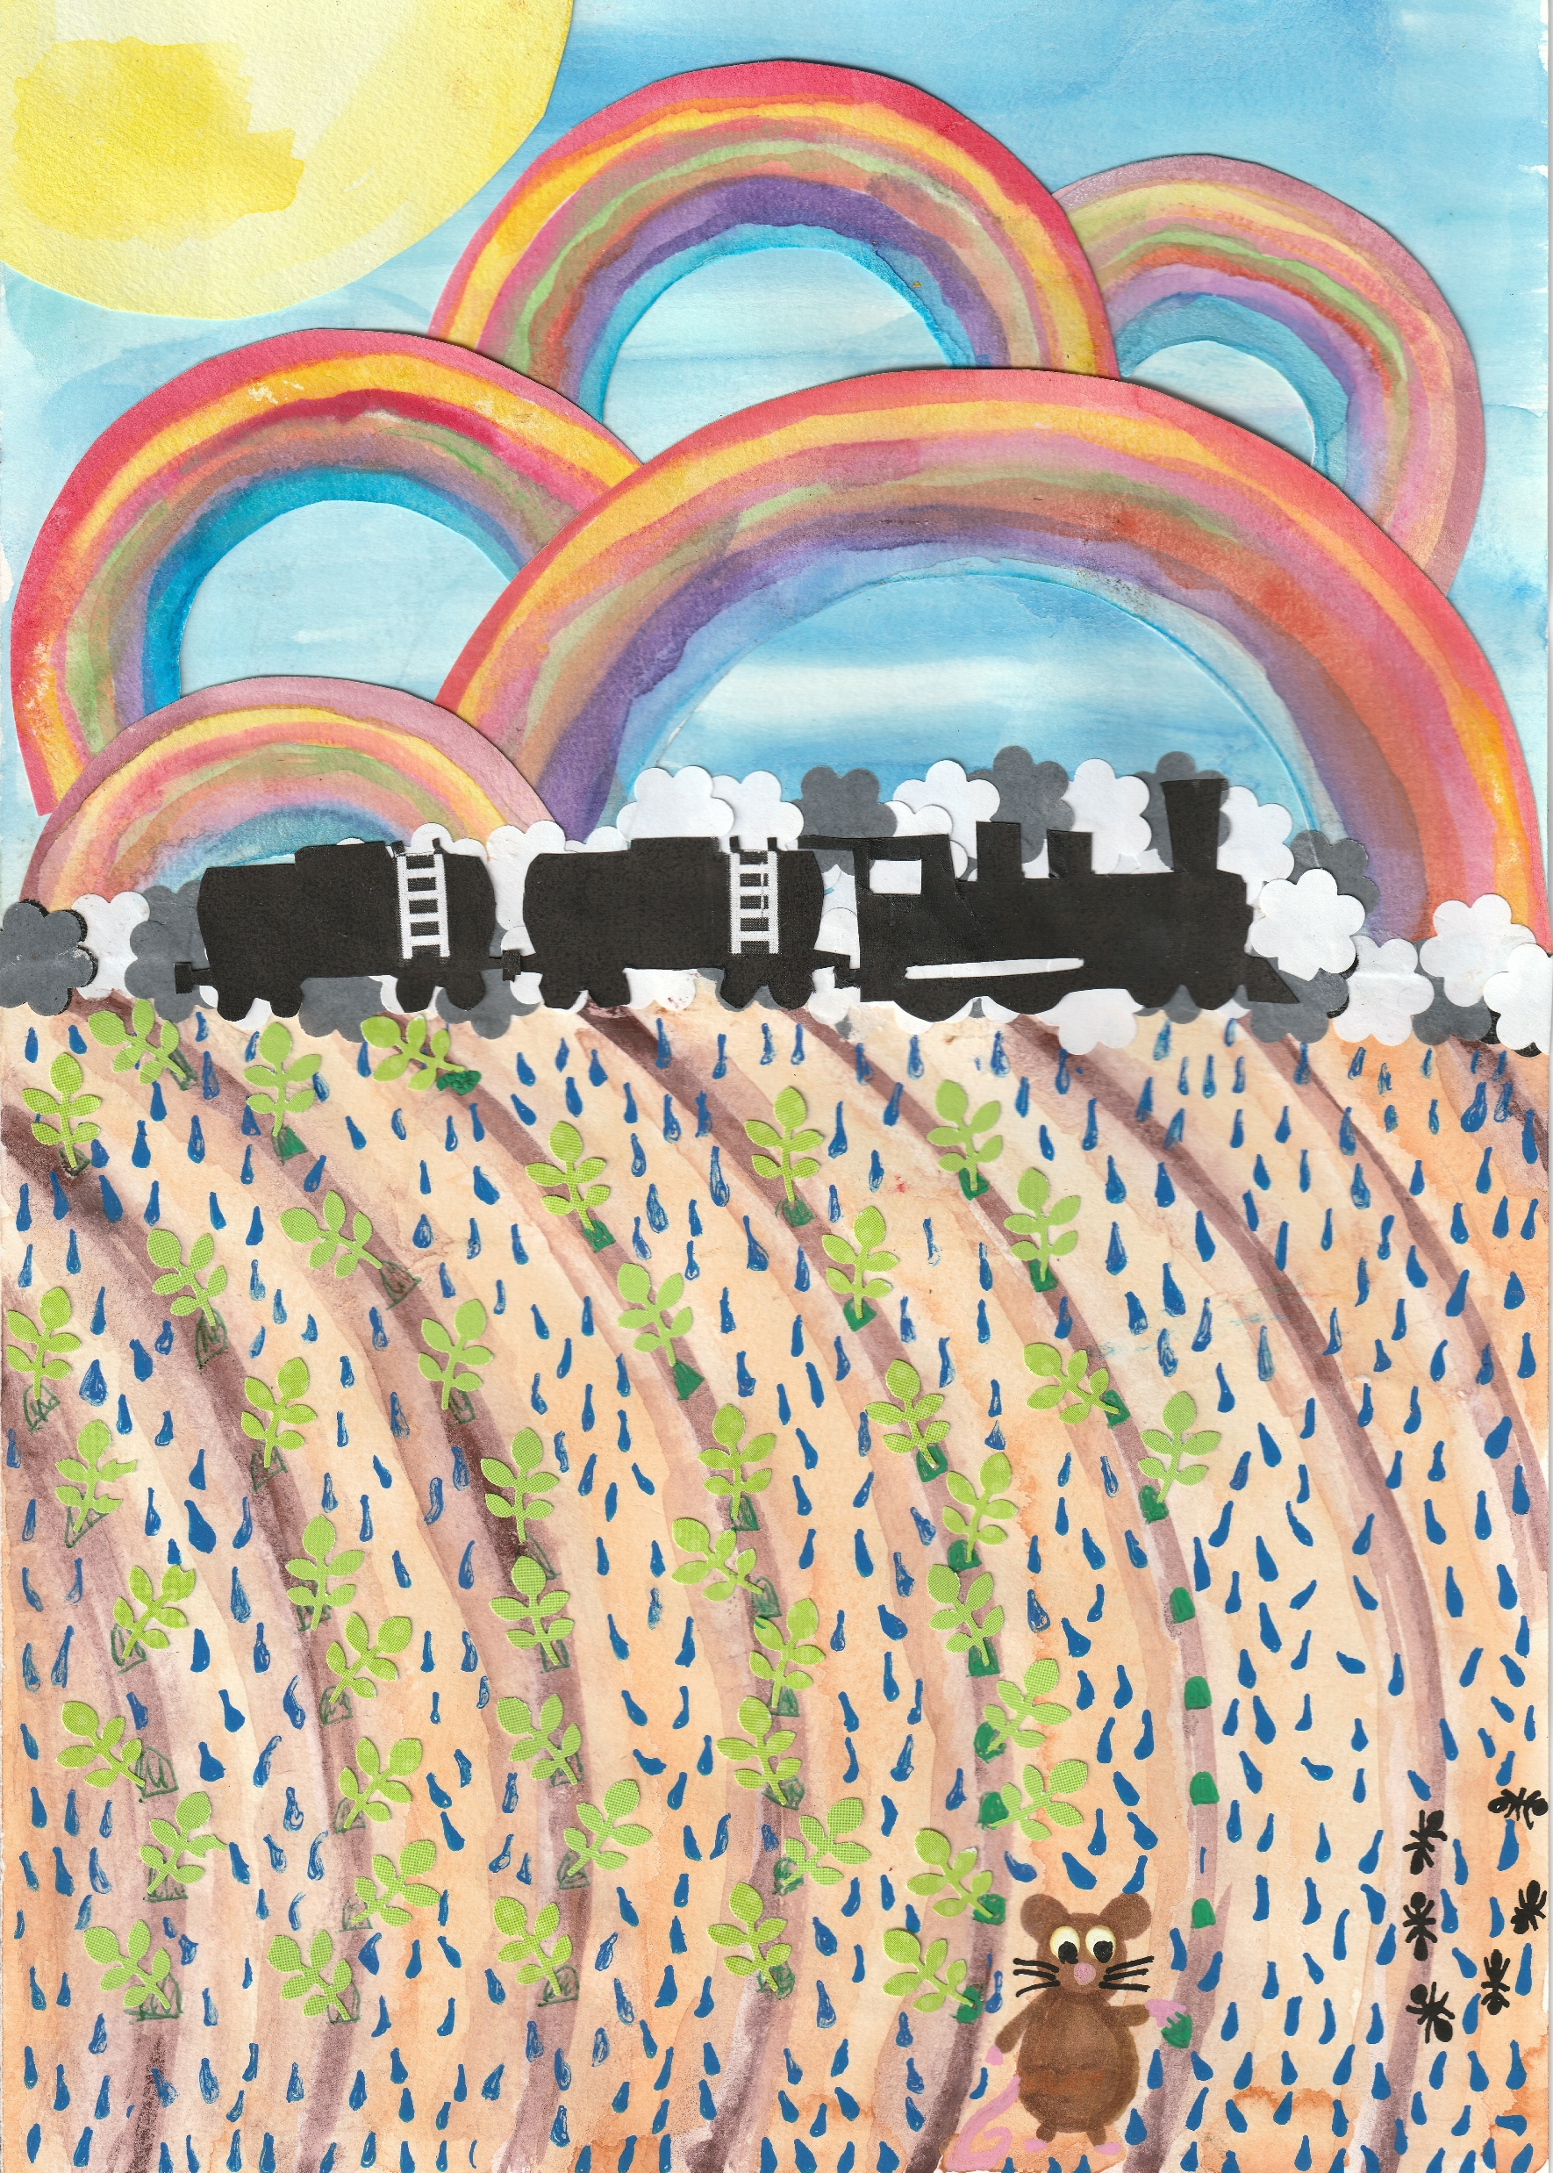

Slide 16
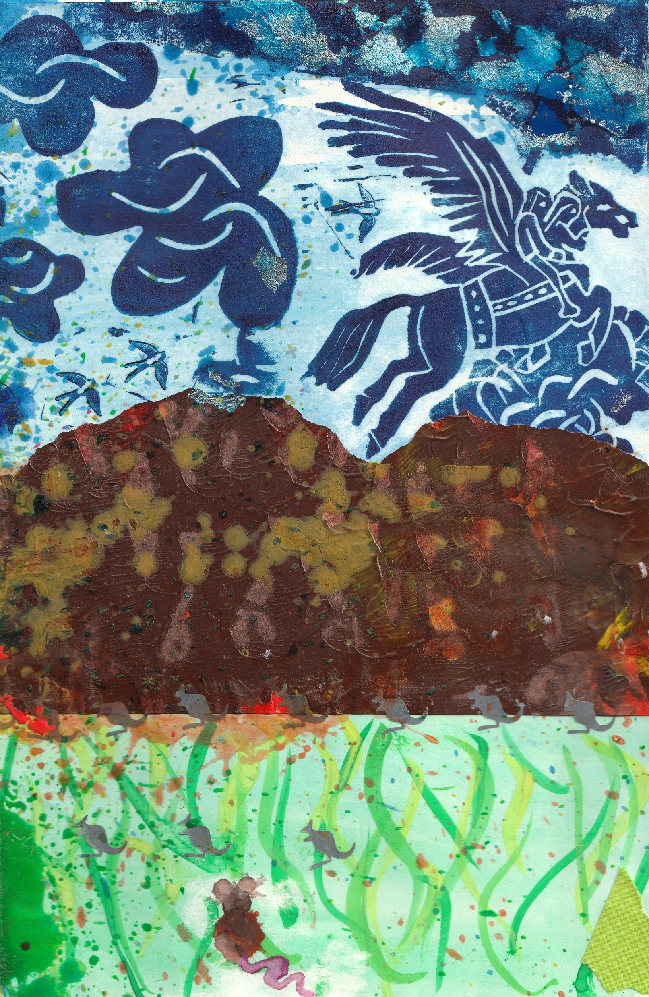

Slide 17


Slide 18


Slide 19
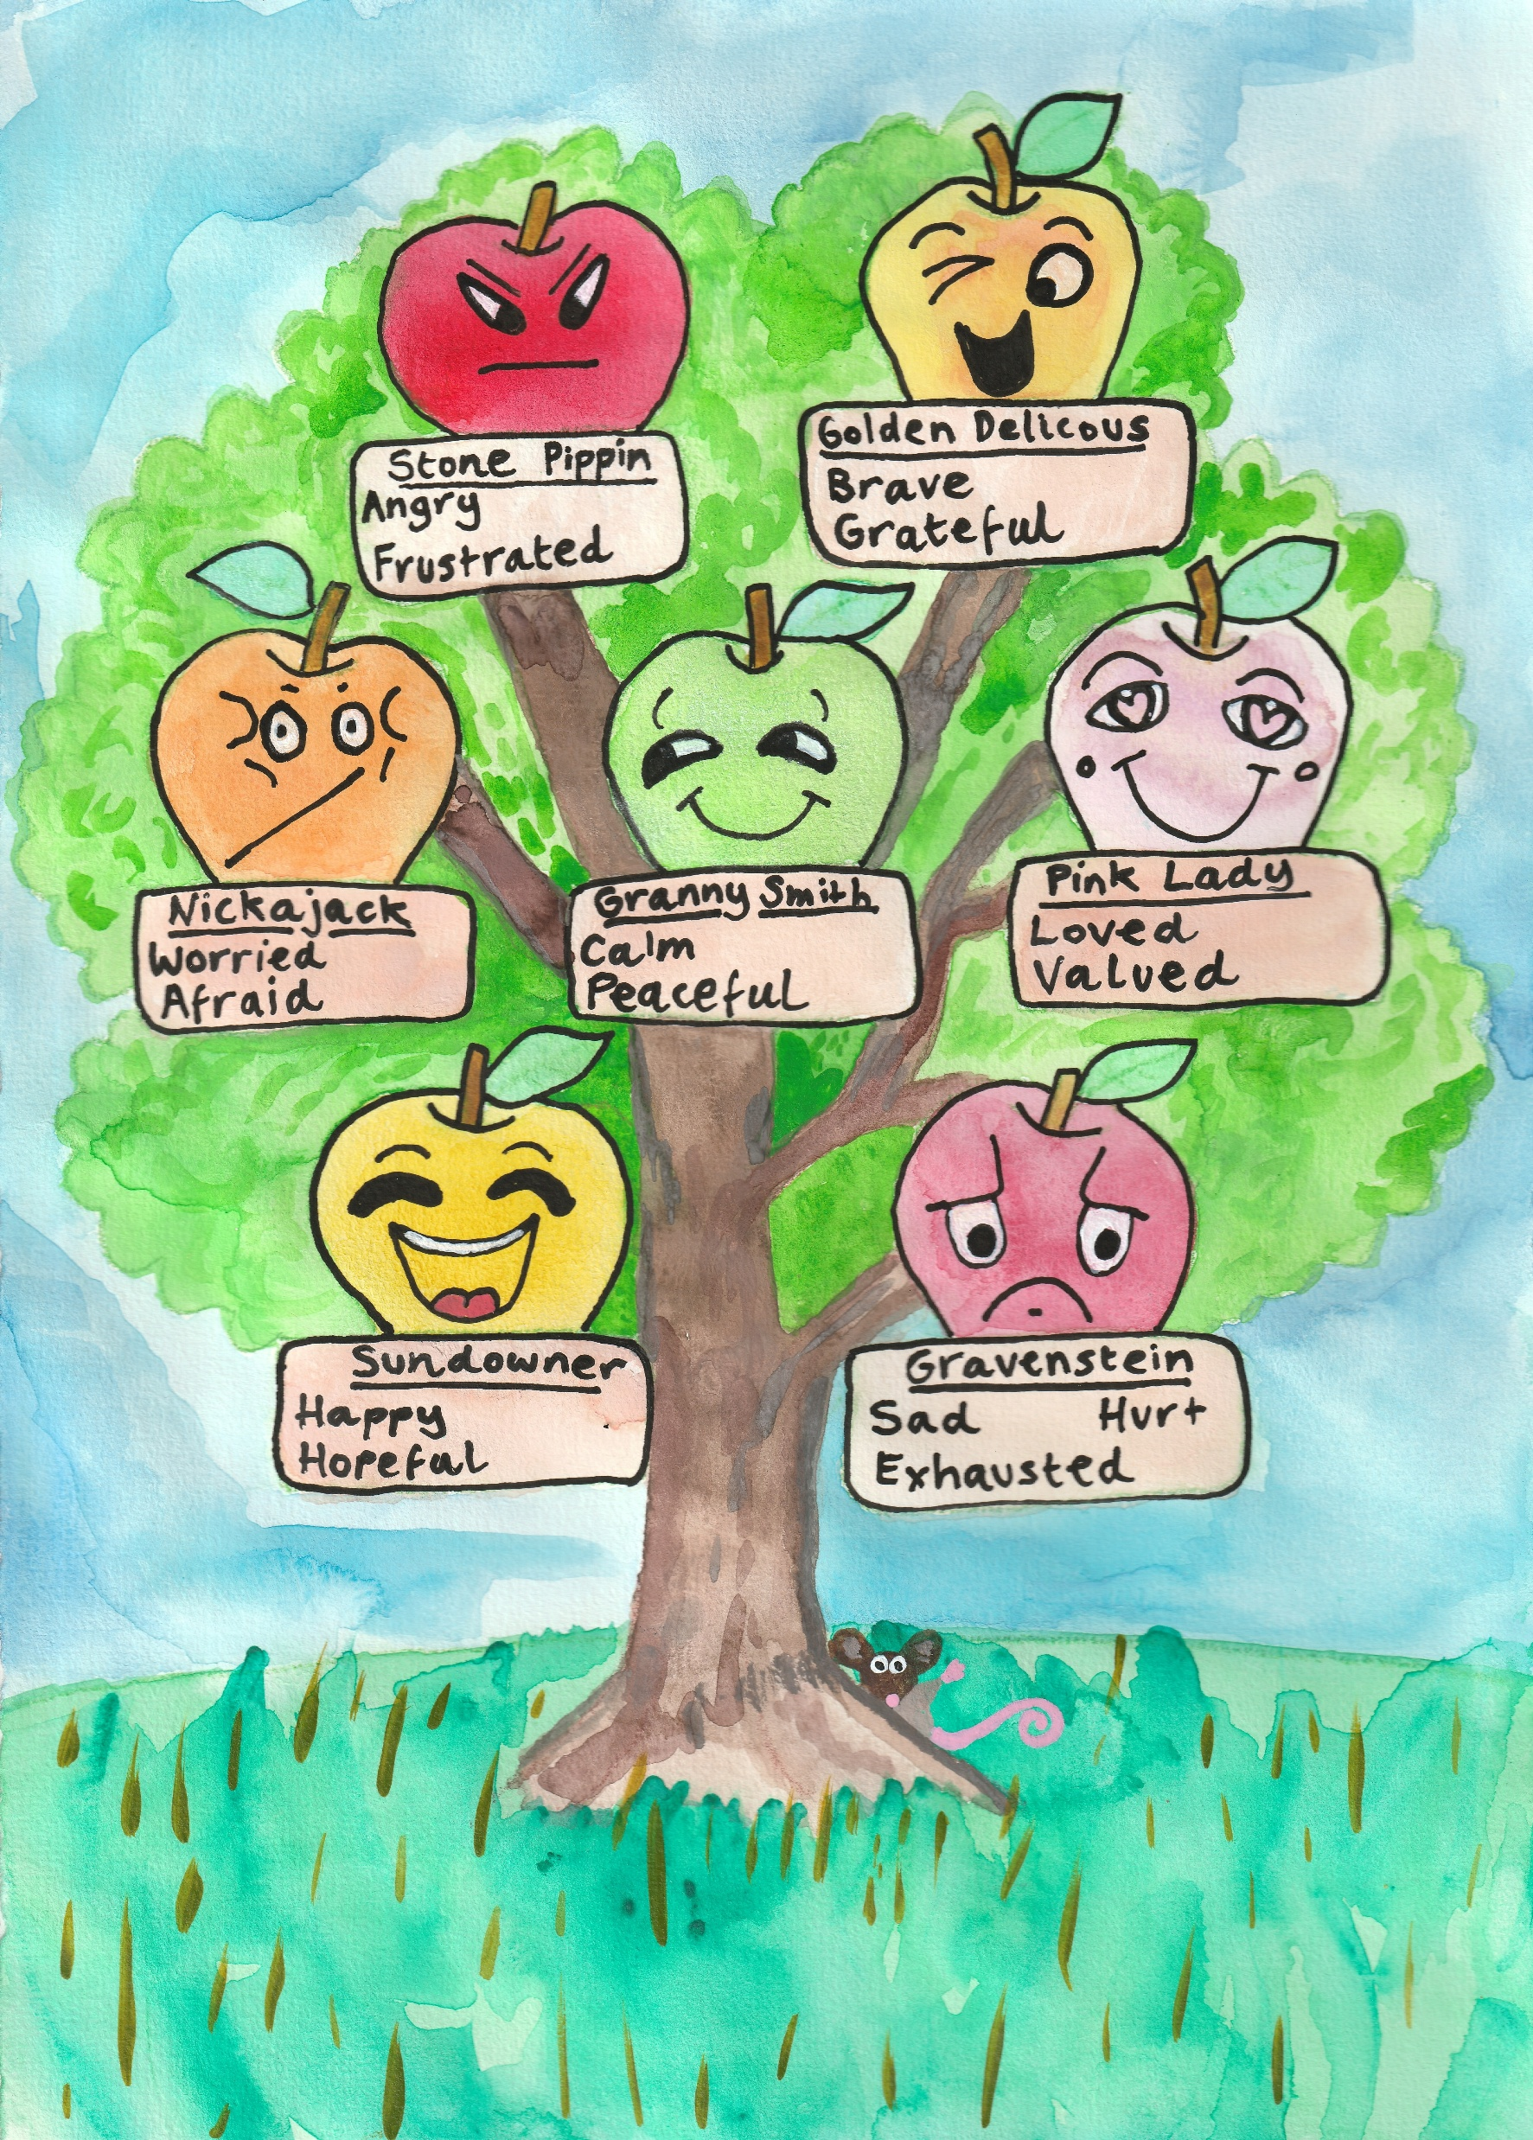

Slide 20
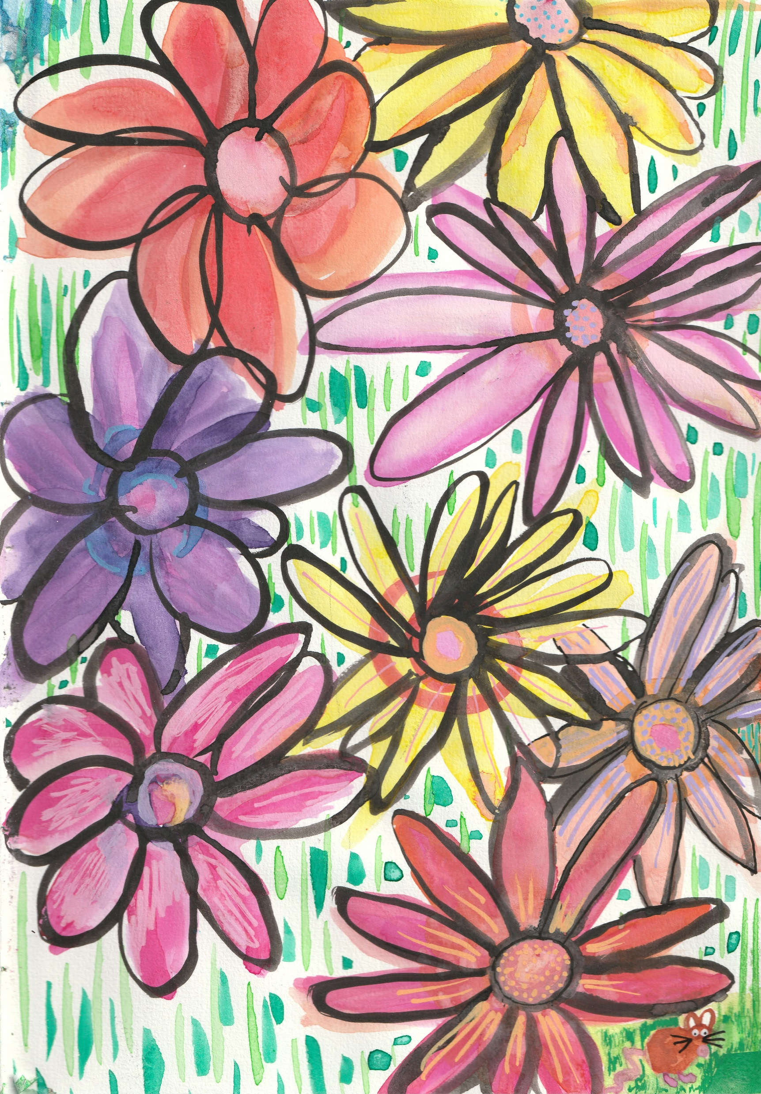

Slide 21
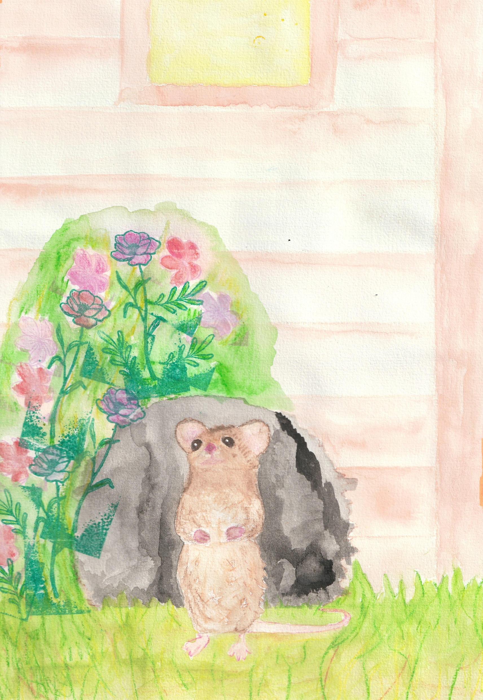

Slide 22
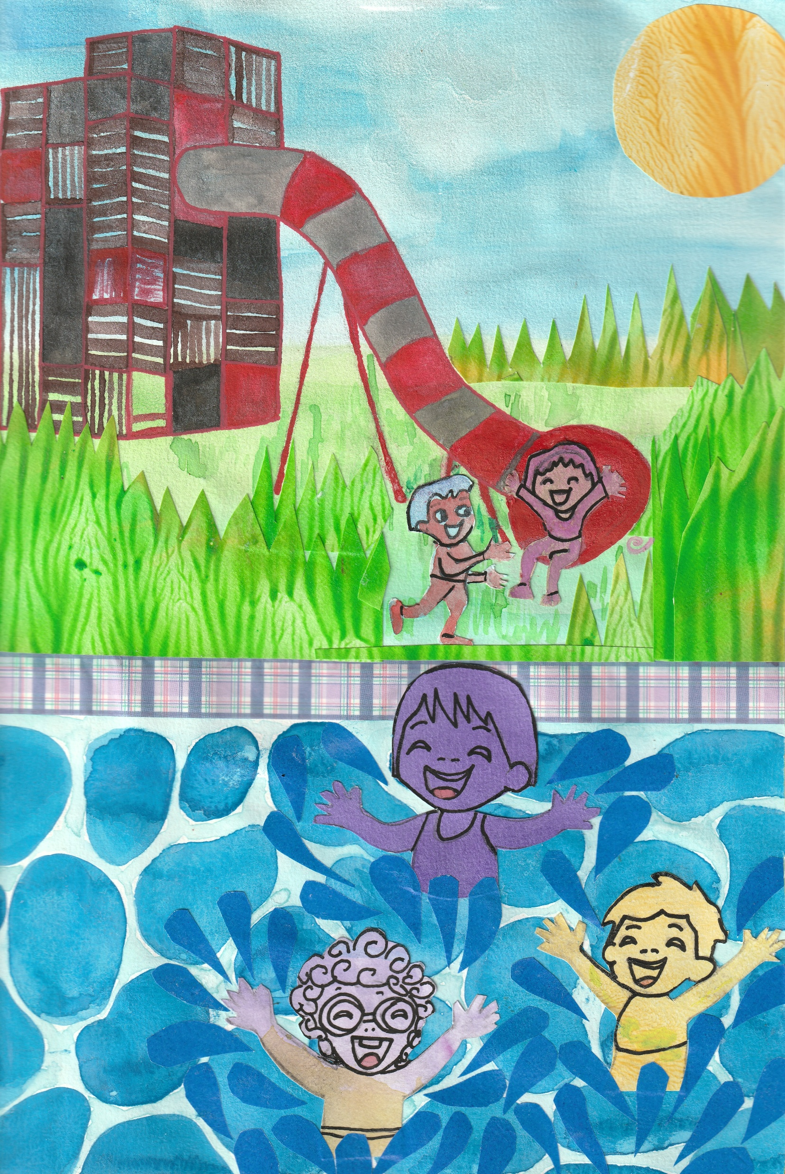

Slide 23
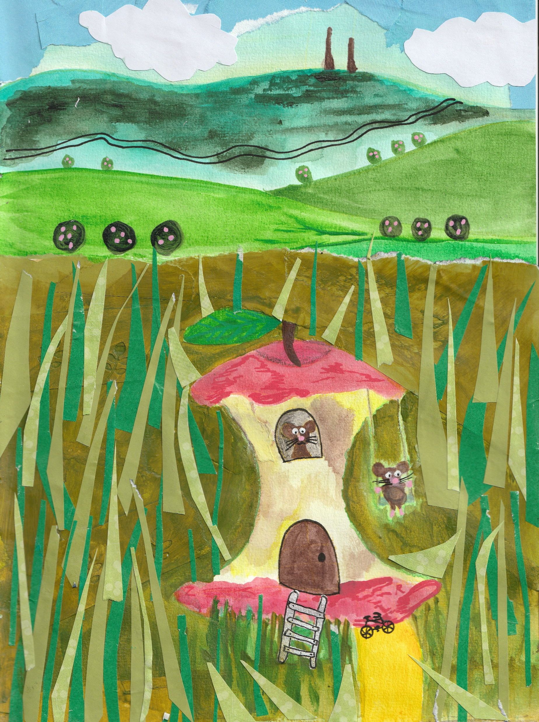

Slide 24
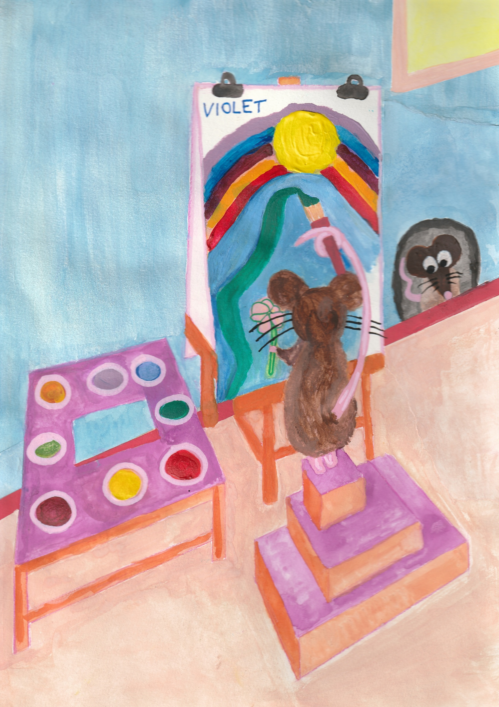

Slide 25

Catastrophic bushfires swept through the Harcourt Valley, Victoria in January 2026, seventy-four homes were destroyed. Inspired by the heroic response of the community, Rachel Vanstone has written a warm and charming tale of how a small brave mouse played its part. This story will appeal to young and old, encouraging all to persevere in hope, even in the face of great disaster. It sings with the beat of the human heart, and is a reminder of the strength of the human spirit.
Carmel Bird.

Slide 26
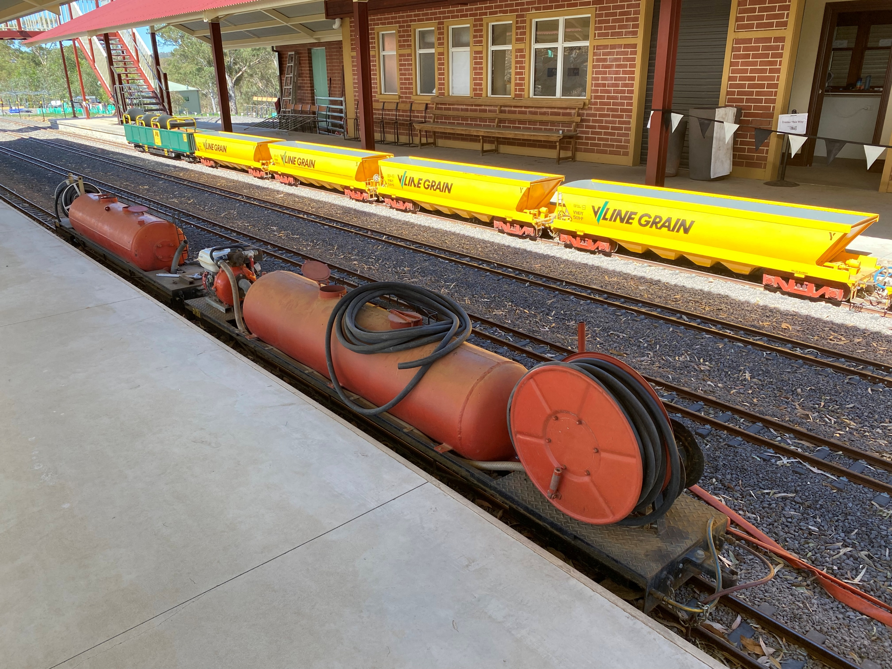
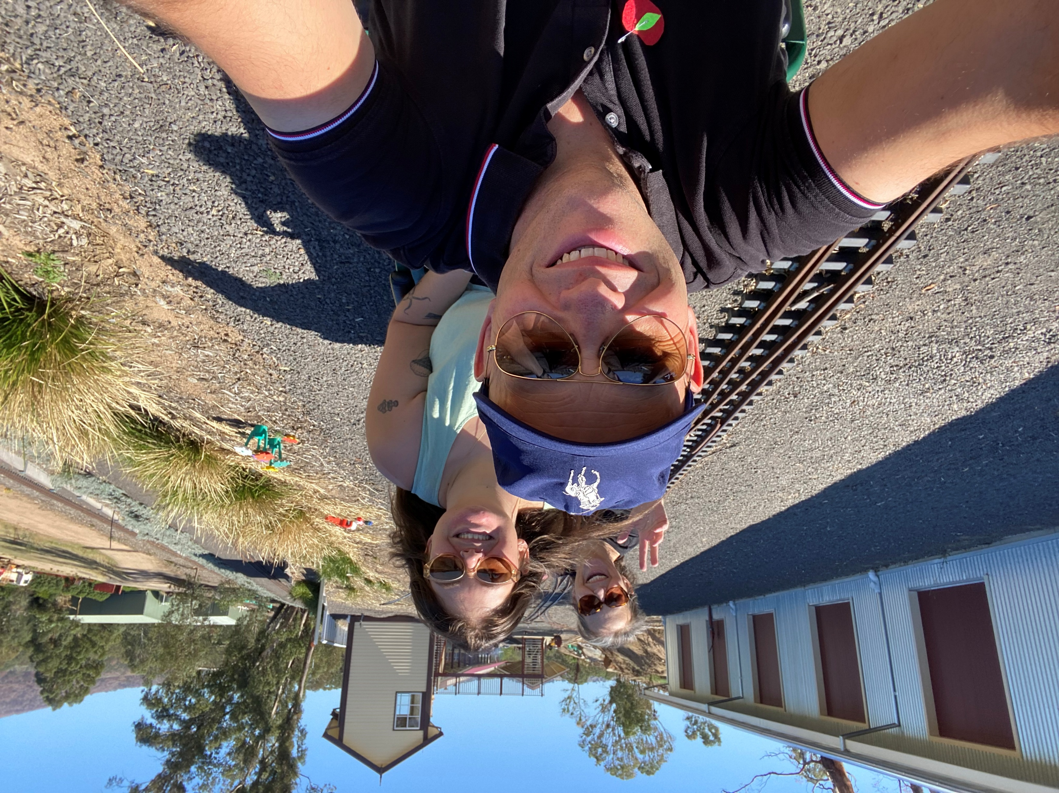
“You just heard the story for our children. Now it’s time for Parliament to get on board and keep our recovery on track. I am putting forward 20 practical recommendations to keep families housed, rebuild businesses, strengthen wellbeing, support volunteers and future proof Harcourt Valley. Now I ask Parliament to act”.
Top: The Victorian Miniature Railway tankers used during the firefight on 9 January 2026.
Left: Gavin, Ruby and Rachel Vanstone enjoying the Victorian Miniature Railway when Applefest returned in March 2026. A big thank you to all volunteers at the Victorian Minatare Railway for all they did during the firefight and relief effort.

Slide 27
20 Recommendations to Parliament
Housing & Displacement
Keep Harcourt Valley families in Harcourt Valley. Establish a discretionary emergency housing fund so no resident is permanently displaced because insurance, rentals, or social housing have failed.
Track displacement and bring people home. Implement regular public reporting on temporary relocations, housing need, and return-to-community outcomes.
Increase local housing access. Review whether existing Victorian Housing Registrar stock and allocations can meet Harcourt Valley needs, and fill any shortfalls urgently.
Insurance & Cost of Living
4. Fix rural insurance failures. Review high premiums, underinsurance, claim delays, inconsistent policies, and whether current insurance models are failing rural Victoria.
5. Address recovery cost pressures. Recognise rising living costs as a barrier to recovery and provide targeted relief where needed.
Volunteers & Community Capacity
6. Support volunteers properly. Develop volunteer recruitment, retention, recognition, training, and reimbursement frameworks. Volunteers cannot be the unpaid backbone forever.

Slide 28
Community Recovery & Governance
Fund community recovery, not just individuals. Create a place-based recovery fund communities can access quickly for local priorities, services, and urgent gaps.
Invest in local recovery leadership. Fund a full-time community based recovery coordinator/social worker for two years to deliver a community-led recovery plan.
Create a rapid response gap fund. Establish a flexible local fund to solve urgent service, infrastructure, or preparedness issues as they arise.
Strengthen local governance. Provide governance, financial management, and leadership training for community organisations leading recovery.
Economic Recovery
10. Boost economic recovery. Fund tourism and marketing campaigns for Harcourt businesses, cideries, wineries, and the Victorian Miniature Railway.
11. Rebuild faster. Fund project management support and permit liaison officers to accelerate business, coolstore, and commercial rebuilds.

Slide 29
Mental Health & Social Wellbeing
11. Strengthen mental health recovery. Monitor access and waitlists to free and subsidised counselling and fund healing programs, including art, gardening, cooking, music, and connection activities.
12. Support vulnerable groups. Fund programs designed locally for older women, retired men, families, children, and those at risk of isolation or violence.
13. Support children’s recovery. Provide discretionary recovery grants to Harcourt Valley Primary School and Harcourt Kindergarten for camps, excursions, uniforms, supplies, and therapeutic supports.
14. Recognise loss. Support a community memorial chosen and designed by the community.
Infrastructure & Preparedness
Future-proof critical infrastructure. Deliver backup power, communications redundancy, and emergency resilience upgrades for Harcourt and district.
Upgrade community facilities. Invest in the Harcourt Leisure Centre as a fit-for-purpose emergency and community hub.
Build digital resilience. Fund a trusted Harcourt community website for emergency information, volunteering, donations, services, and preparedness.
Environment & Wildlife. Improve land and wildlife recovery. Review future fuel-load management on Mount Alexander and formalise wildlife rescue access and coordination during emergencies.

