Slide 1
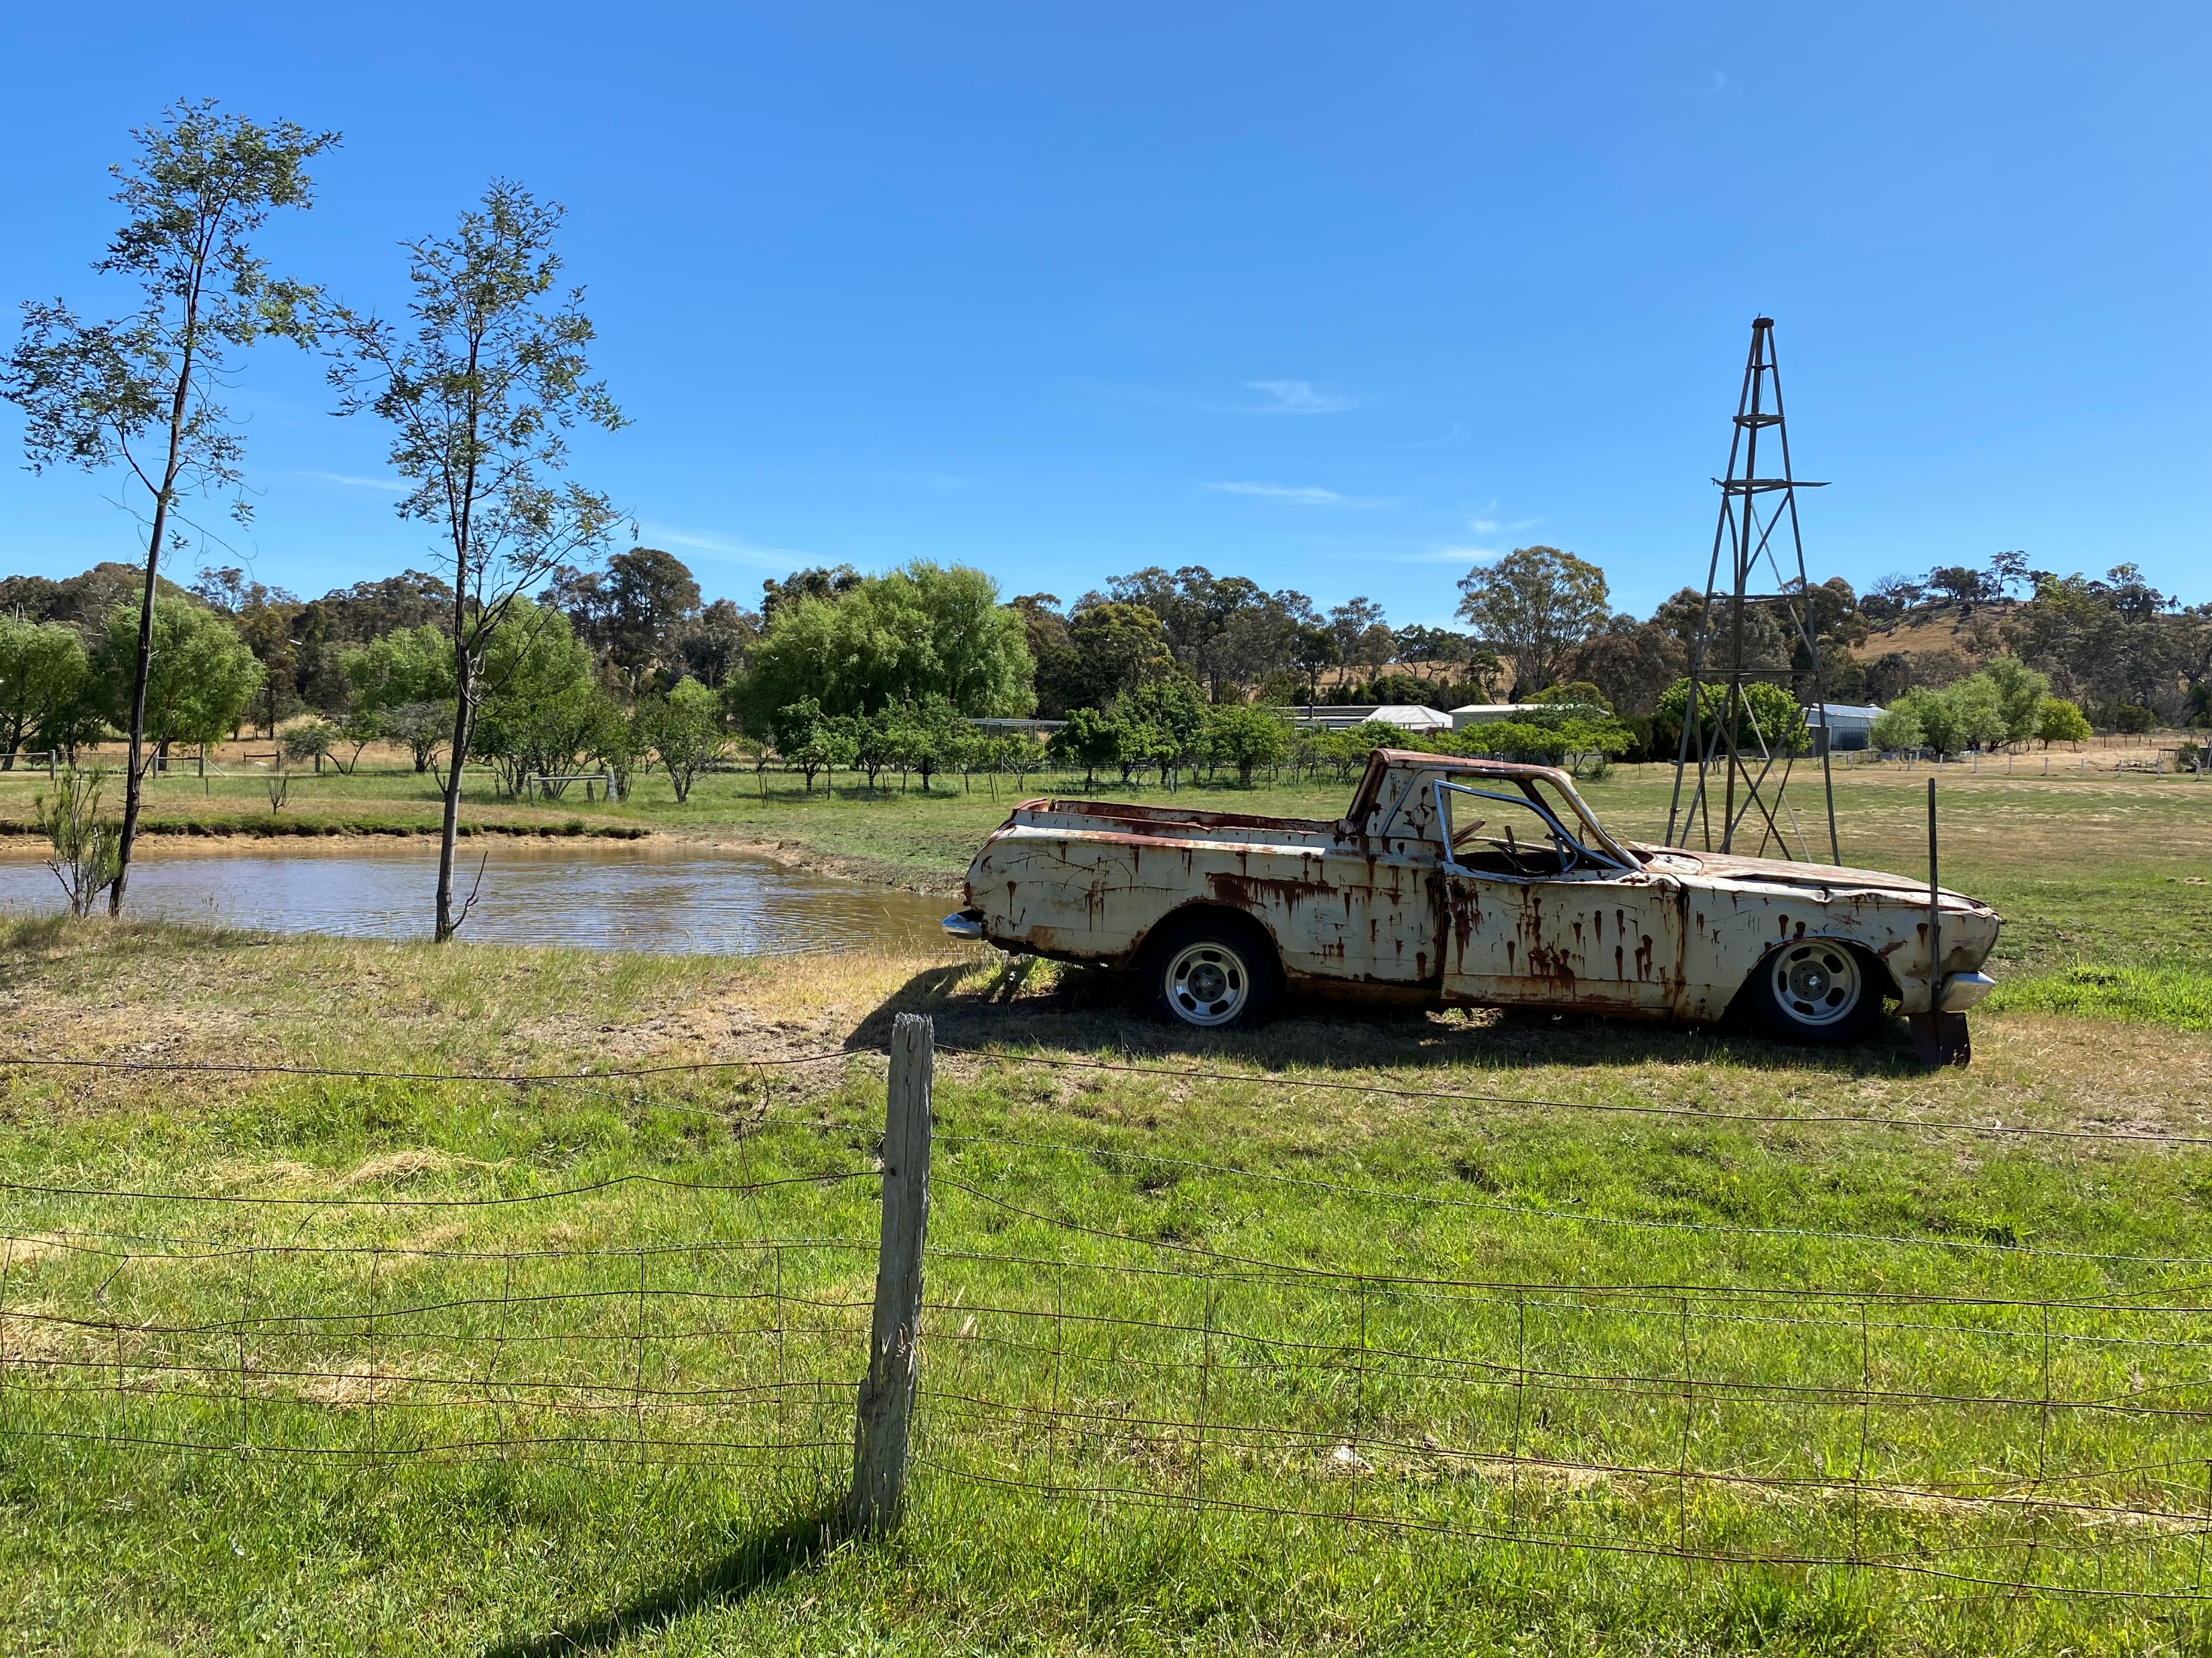
Presentation to Parliamentary 2026 Bushfire Inquiry 30 April 2006 in Harcourt
Ivan Gilbert,
Chairperson, Harcourt Progress Association

Slide 2
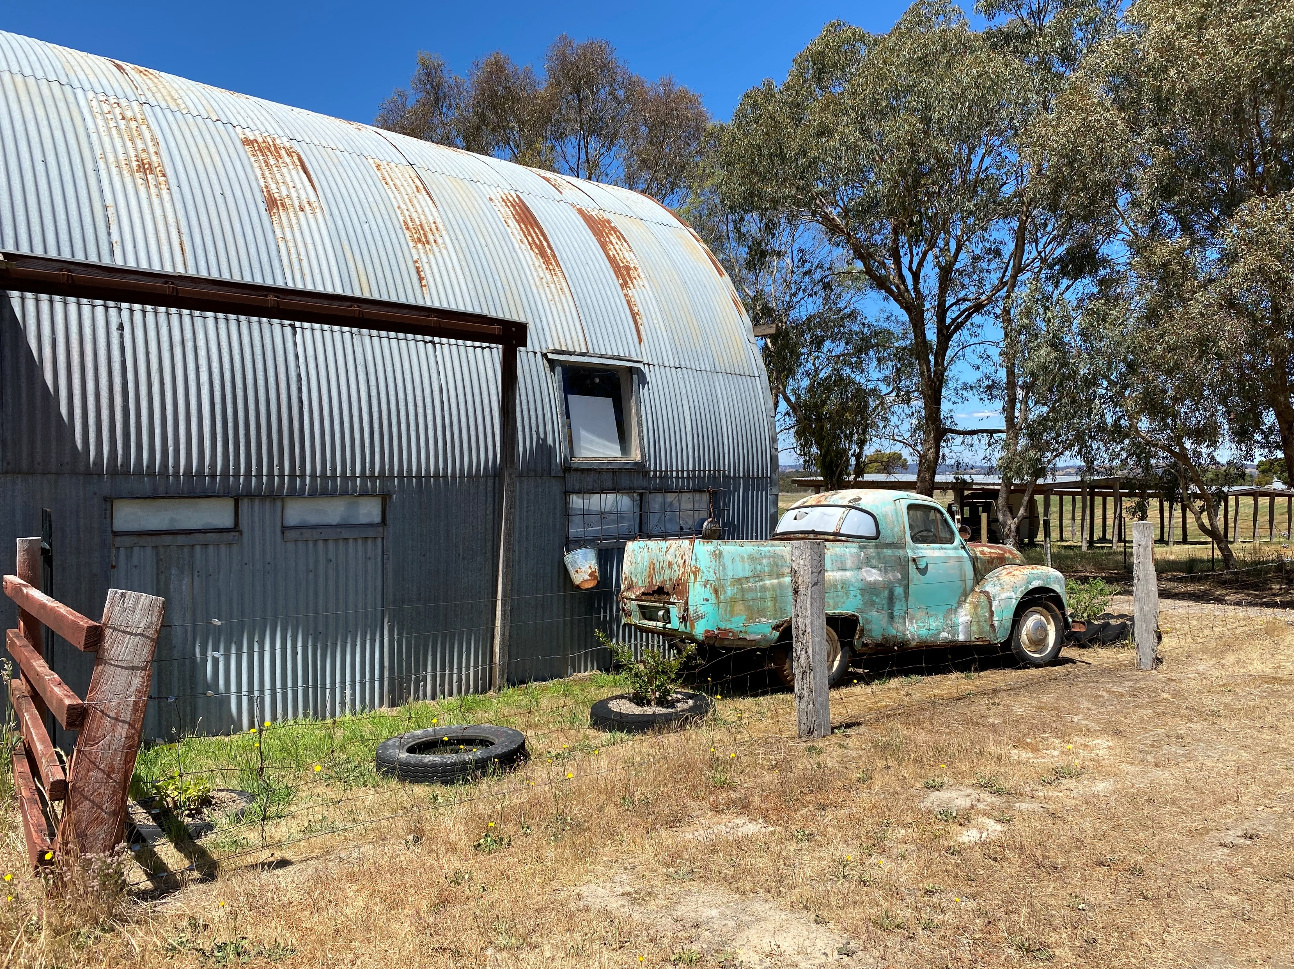
Thank you for the opportunity to present from the Harcourt Progress Association and on behalf of the resident of the greater Harcourt area – Barkers Creek, Harcourt, Harcourt North, Ravenswood South, Sedgewick, Sutton Grange, Walmer and eastern Mount Alexander Regional Park.
I particularly wish to draw your attention to the following critical issues which we believe are requiring urgent Government attention:
As referenced in our HPA submission (page 5).
Property insurance issues:
Our submission outlines a range of issues impacting property owner’s capacity to adequately insure their properties at an affordable cost.

Slide 3
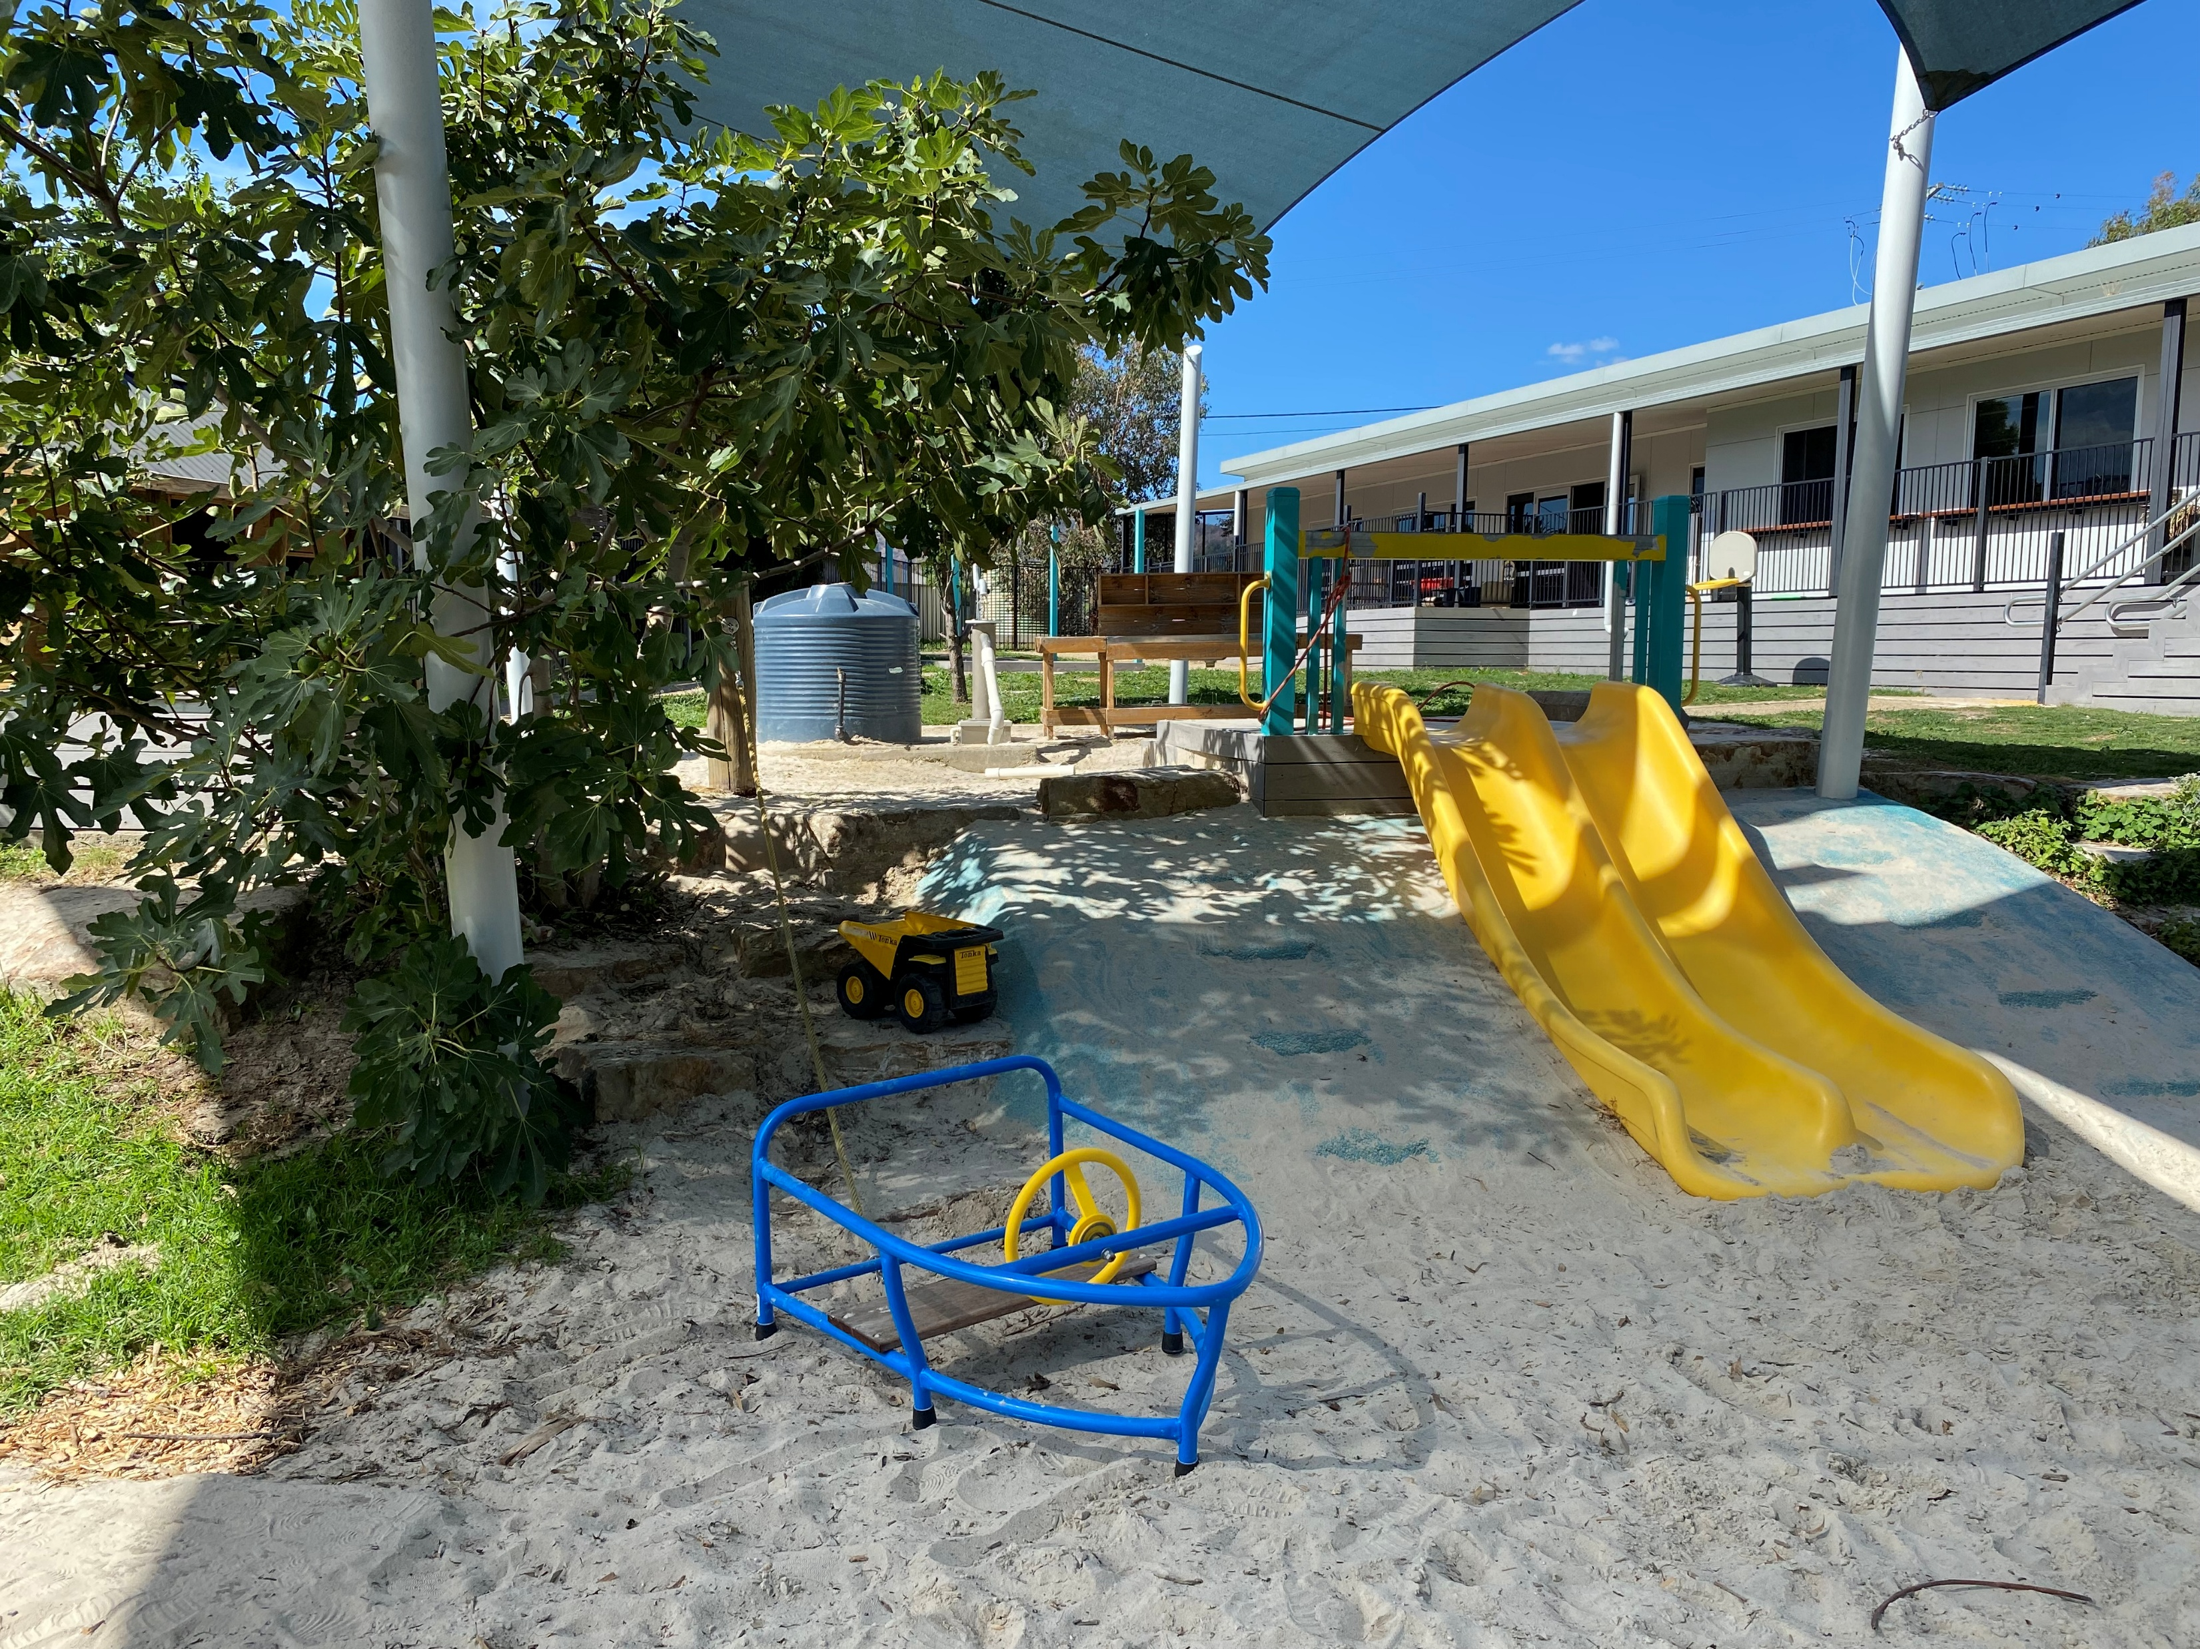
People in our community who have either had no insurance or inadequate insurance (this was drawn to attention when residents came to apply for HPA funding assistance) have raised the issue insurance policy coverages for household and businesses and the successive increase in premiums etc in so called “bushfire zones” and the critical impact upon their capacity to afford insurance. It is most regretful the Rural Victorians broadly face persistent structural barries to gaining adequate insurance for fire and flood, many of which issues have been repeatedly identified in major inquiries: People have asked us….what actions were taken or outcomes achieved from the referenced Royal Commission. We would respectfully request that this Inquiry into the 2026 bushfires not only give listening attention to the Insurance Issue but more critically, pursue some positive actions including taking the matter up with the Federal Government to positively address this issue as so-called climate change will likely exacerbate the matter.

Slide 4
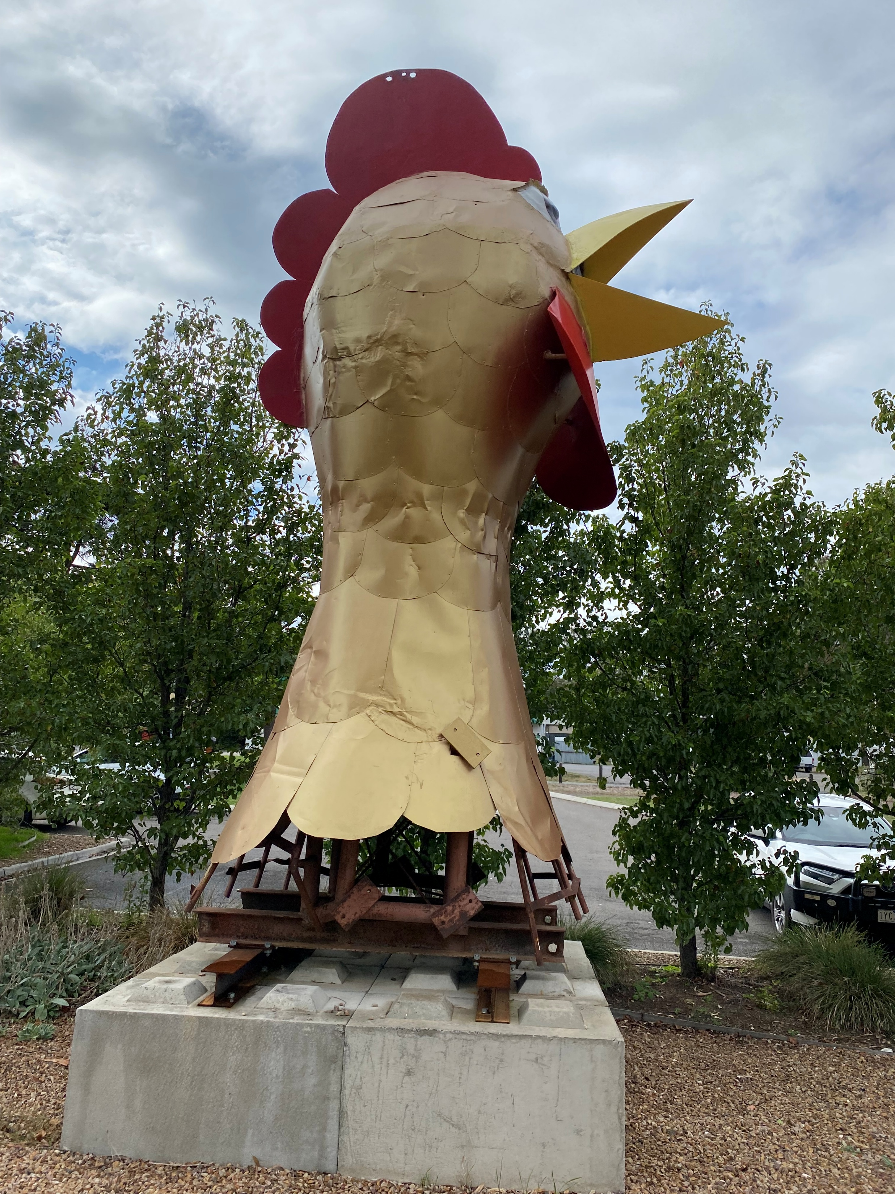
Impact on Wildlife and Essential Services Infrastructure:
Our submission has referenced the severity of the 9 January bushfire. Notable elements of destruction include that it:
- virtually wiped out any wild-life and delicate plant-life, particularly in the environs of Mount Alexander;
- severely impacted critical infrastructure located on Mount Alexander leading to lengthy service interruptions and delays and of course, very expensive repair works.
Huge damages as noted in our Submission pages 6-9. Also as noted in our submission… Page 8
The inconvenience to each of Government, business and our wider regional community as a result of, the referenced losses was a major disaster and we consider could have been significantly reduced and possibly avoided--- ---- if Government authorities had taken notice of and acted upon many of the recommendations of previous Inquiries and Royal Commissions.
The exorbitant reparation costs now to be met by Government, business and community alike could potentially have been significantly reduced – possibly avoided.

Slide 5
OF MOST SIGNIFICANT CONCERN ARE THE REFERENCES ADDRESSED IN OUR SUBMISSION REGARDING CONTROLLED…Pages 7 - 8 .
Our Committee has also given very particular attention to the the 2009 Victorian Bushfire Royal Commission finding that “bushfires obtain their energy from fuel and their speed and direction from the weather, topography and the fire itself. These factors affect fire behavior, including the rate of spread, flame height and angle, persistence in the area, and the way firebrands travel”.
Of absolute significance in this regard is…. the conditions on 9 January 2026 were catastrophic, heat was in excess of 45 degrees and winds were in excess of 100k/ph – firefighting in these types of conditions is ‘unimaginable’.
Critically, the 2009 Commission went on to say “the only element that can be controlled by humans is the management of fuel. Prescribed burning— ‘the controlled application of fire under specified environmental conditions to a predetermined area and at the time, intensity and rate of spread required to attain planned resource management objectives’—is the most effective mechanism for managing fuel.” (p 280)
Also of significant note is that… Dja Dja Wurrung advocate for cool, wet, low‑intensity cultural burns that work with moisture and seasonality, to protect ecosystems, and maintain cultural responsibilities to Country. They distinguish these clearly from Western controlled burns, which are hotter, riskier, and focused on fuel reduction rather than ecological health.

Slide 6
A most notable number of residents have also, strongly criticized Governments as effectively completely disregarding: the previous Royal Commission, the experienced advice which both long-term residents, and the long-time traditions and actions of our First-Nations people, who each strongly advocate for a vastly improved fuel management regime on the Mount in particular.
Our Harcourt Progress Association Committee would strongly recommend that the manner in which future dry- fuel loads on Mount Alexander are managed and how qualified wildlife rescuers are able to enter fire grounds be not just reviewed but indeed, actioned by the Parliament in a manner to specifically enable and in fact require, more practical fuel reduction management practices.

Slide 7
The above referenced issues are also of critical concern with vast areas of noxious weeds and inflammable material (thick forest including dead timber) located adjacent to or in very close proximity to critical services and residential developments around the Harcourt, Barkers Creek areas and interestingly, closely abutting residential and commercial areas in Castlemaine and nearby “suburbs”.
Management of weed infestation should become a requirement of the appropriate Government Agency. Lack of attention and enforcement of this issue by private property owners is contributing notably to fire risk issues.

Slide 8
Critical Economic Services
Coolstore challenges insure and govt grant bureaucracy issues
We are aware that Government has offered the Coolstore some financial assistance. I am also led to understand that the so referenced “bureaucracy” attached to that offer is causing considerable concern to the Coolstore management.

Slide 9
General Statistics:
Total number of properties burnt 228 – some very minor damage to fencing or trees but captured as a fire impacted case
Total number of houses totally lost 74
Number of houses affected by fire, to the point of being unliveable, but are repairable 11
Number of houses affected by fire, but are liveable 27
Number of commercial properties burnt –16 cases for commercial industrial or business impacted
Number of commercial farms (vs hobby farms) burnt – awaiting final clarity -but 6 cases for commercial industrial or businesses that are FARMS
Orchards burnt – awaiting final clarity - but 3 cases for orchards
Locations of people displaced or severely impacted - Sutton Grange, Walmer, Harcourt, Harcourt North, Ravenswood South, Barkers Creek, Faraday.

Slide 10
Attendees at our Harcourt Progress Association Relief Centres:
Harcourt Progress Association Inc (HPA), is a community organisation. I specifically emphasise that HPA Board Members are all volunteers. The HPA Board came forward immediately following the Fires and set up the Relief Centre at the Harcourt Leisure Centre AND also provided the “legal backup support” for the Castlemaine Distribution Centre. Both Centres provided immediate essential support services to community members who had been impacted by the fires – lost their homes, unable to live in damaged homes, etc
Services included:
Community lunches being served at the Harcourt Leisure Centre
Items provided for impacted residents included:
Food products;
Clothing;
Bedding materials;
Toiletries and personal items;
Other essential products to enable people to live in temporary accommodation;
Food and essential items for pets;

Slide 11
Support services from Agencies including Anglicare, Redcross, various Government Agencies which provided specific support services to impacted residents – private, business, agricultural, etc.
Our HPA Board Members have critically provided a range of other immediate supports to our residents whom had suffered impacts from the fire. These tasks included:
Manning the HPA Desk at the Relief Centre at Harcourt,
Managing funding assistance procedures to impacted residents,
Issuing a range of Gift Cards / Vouchers to enable residents to purchase essential items,
Arranging financial contributions to those persons whom had completely lost their permanent place of residence,
Referring residents to particular services including Anglicare, Government Agencies for particular assistance / guidance.
Managing a major Fund raising Program
Meetings with Council, Government authorities. Welfare Agencies, Service Clubs (Rotary, Lions, etc), Bendigo Bank, Parliamentary Members, representatives of statutory agencies, etc.
Attendance at community functions,
Attendance at internal meetings,
Contributing between 50 – 500 hours by each Board Member.

Slide 12
Attendees: visiting the Centres on “open days”.
January - mostly 50-100 people per day, biggest day 21/1/26 = 300. Total of 1035
February - mostly 50-65 per day, total of 397
March - mostly 30-50 per day, total of 328
These community support services were enabled and operated by an amazing number of community volunteers who generously offered their services from the January.
Volunteers:
January - up to 38 volunteers on site, contributing between 3 to 8 hour shifts
February - up to 19 volunteers on site, contributing between 3 to 8 hour shifts
March – up to 18 volunteers on site, contributing between 3 to 8 hour shifts.
Total of 462 Volunteers presented in shifts, (over the 27 days of opening):
over 193.95 hours of volunteer shifts;
resulting in a huge number volunteer hours of service.
I must emphasise absolute praise and support for:
our many dedicated and community supporting CFA Volunteers;
the members of the VMR Harcourt for their fire management/fighting works and also for their amazing contribution in offering support to victims of the fires;
The many other community volunteers who came out to support their fellow community.
Thank you for the opportunity to present on behalf of our HPA Board and indeed many in the wider community. I will be pleased to respond to any questions or points of clarification.

