Slide 1
Cannabis: health and policy considerations
Chris Wilkins c.wilkins@massey.ac.nz
Marta Rychert m.rychert@massey.ac.nz
Shore & Whāriki Research Centre
College of Health, Massey University

Slide 2
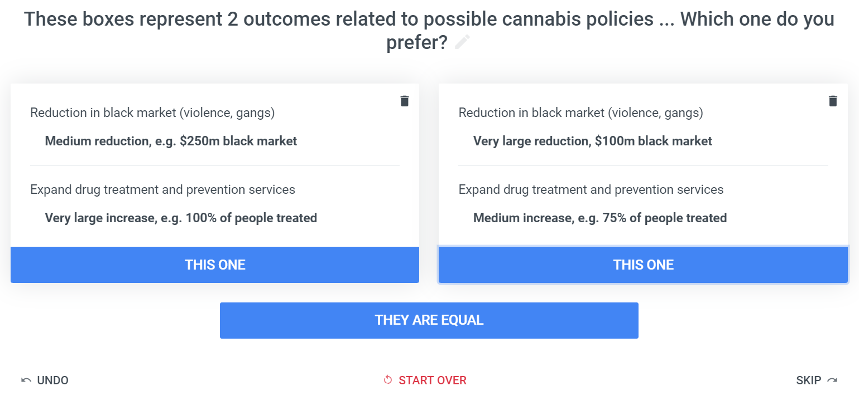
Decision making criteria and trade-offs

Slide 3
What outcomes are most valued in cannabis policy
Policy Criteria | Relative value
Health and social harm | 46%
Reduction in arrests | 31%
Reduction in black market | 13%
Expand treatment & prevention | 8%
Tax and employment | 2%

Slide 4
Four alternative cannabis policy pathways
Prohibition
No tax revenue ($0M)
Health harm ($1.3B)
Black market ($500M)
Arrests (10,500)
Treatment (50% demand)
Government monopoly
Tax revenue ($350M)
Health harm ($1.2B)
Black market ($300M)
Arrests (5,000)
Treatment (80% demand)
Strict regulation (like tobacco)
Tax revenue ($250M)
Health harm ($1.4B)
Black market ($250M)
Same arrests (5,000)
Treatment (70% demand)
Light regulation (like alcohol)
Tax revenue ($150M)
Health harm ($1.6B)
Black market ($150M)
Less arrests (2,000)
Treatment (60% demand)

