Slide 6
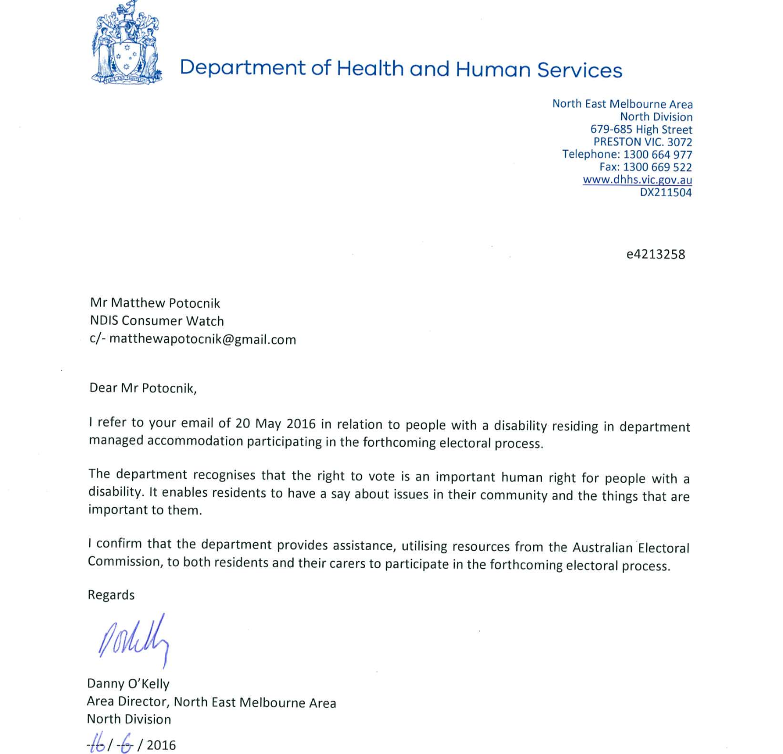

Slide 7
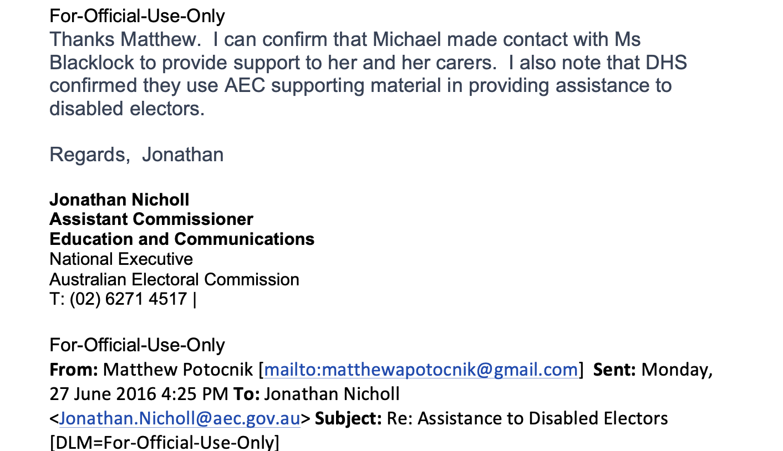

Slide 8
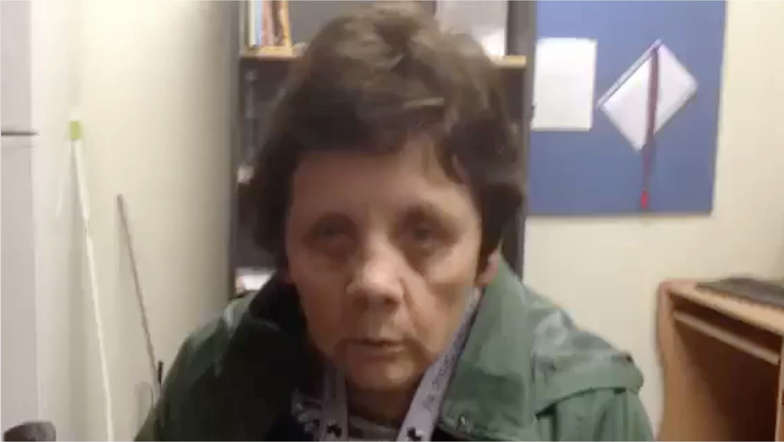
Despite Heather having engagement from the “DHHS Director of Disability Accommodation Services” and the “Assistance Electoral Commissioner” – Heather was not included in the Victorian State Election of 2014 or the subsequent 2016 Federal Election.
I do not know if Heather has been included since.
There is simply no ACCOUNTABILITY for these citizens despite the law
Link to Heather Blacklock video interview: https://youtu.be/M0Zp0baflV8

Slide 9
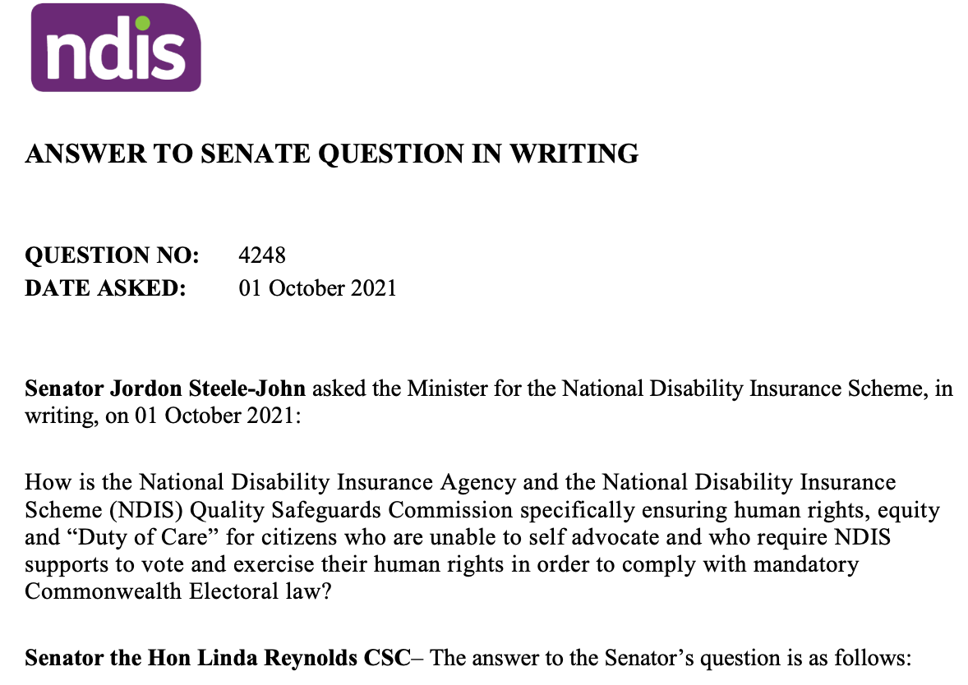

Slide 10
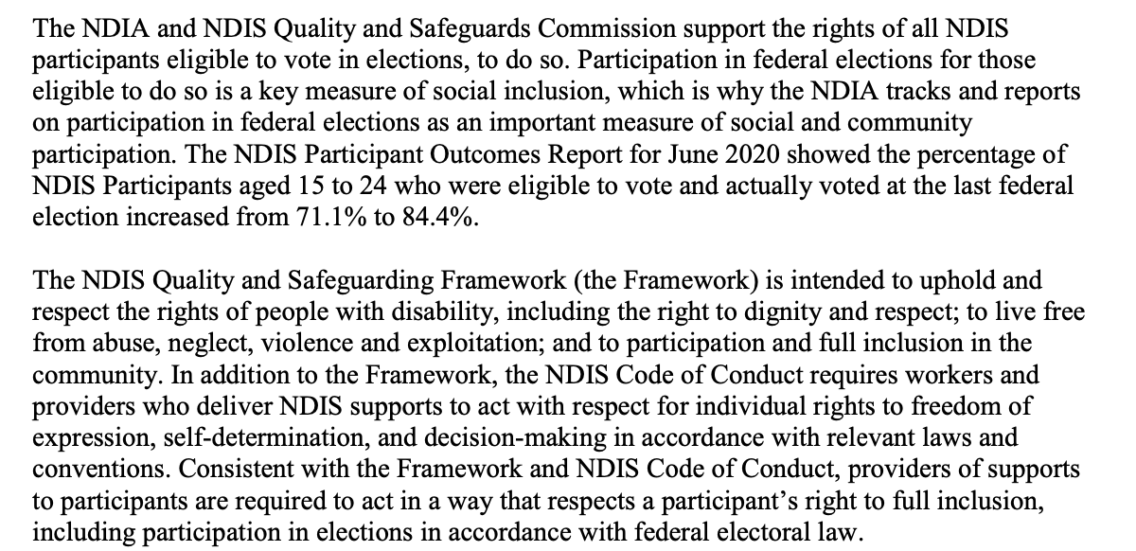

Slide 11
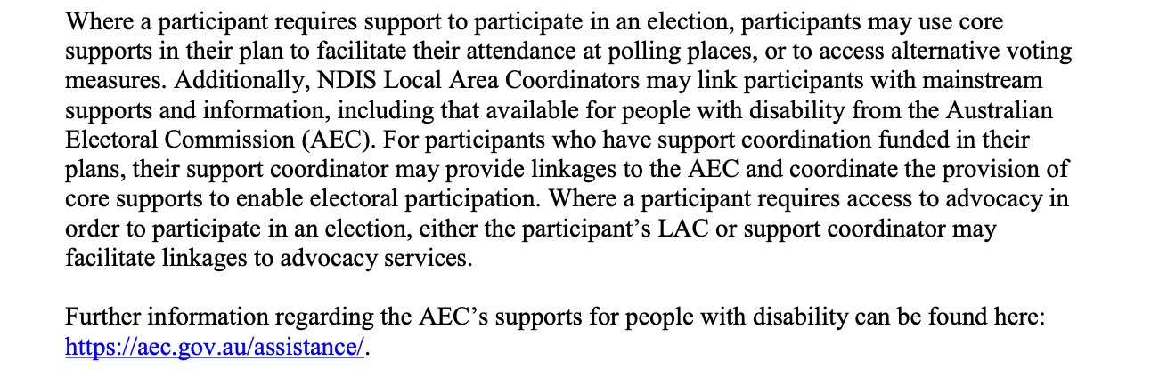

Slide 12
