Slide 1
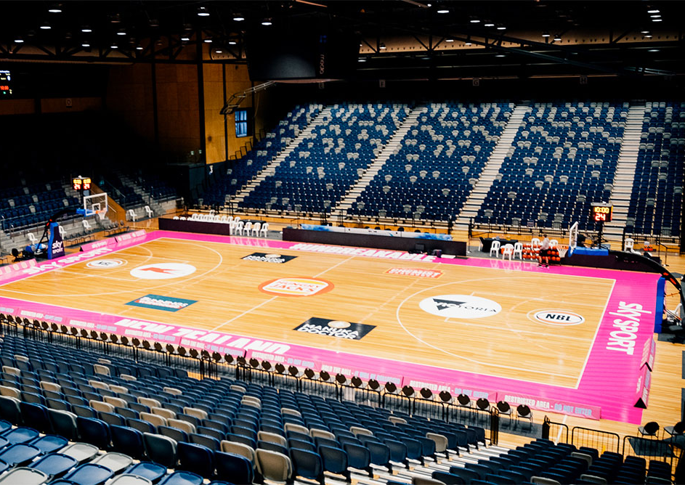

Bendigo Stadium Ltd
  Sports and Entertainment business.
  Operates Bendigo Stadium, The Borough Club and St Arnaud Sporting Club.
  Currently employ more than 170 people.

Slide 2
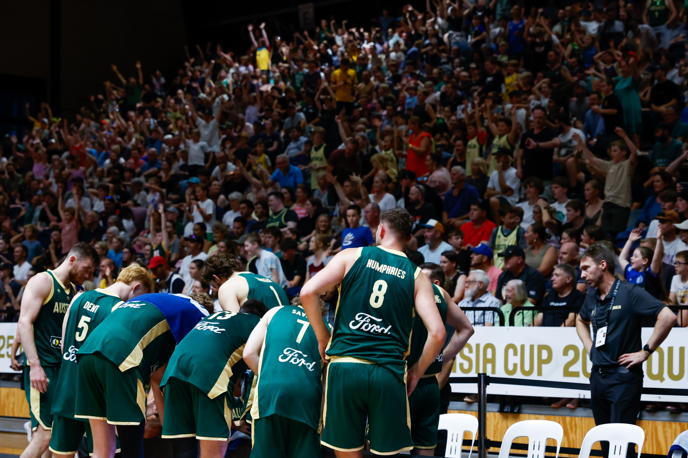
Bendigo Stadium
  City of Greater Bendigo community asset
  4,000-seat show court arena, 10 indoor multi-purpose courts, and 12 outdoor netball courts.
  15,000 patrons each week through sporting competitions and programs, and hospitality.
  Home to the WNBL Bendigo Spirit and NBL1 Bendigo Braves basketball teams.

