Slide 1
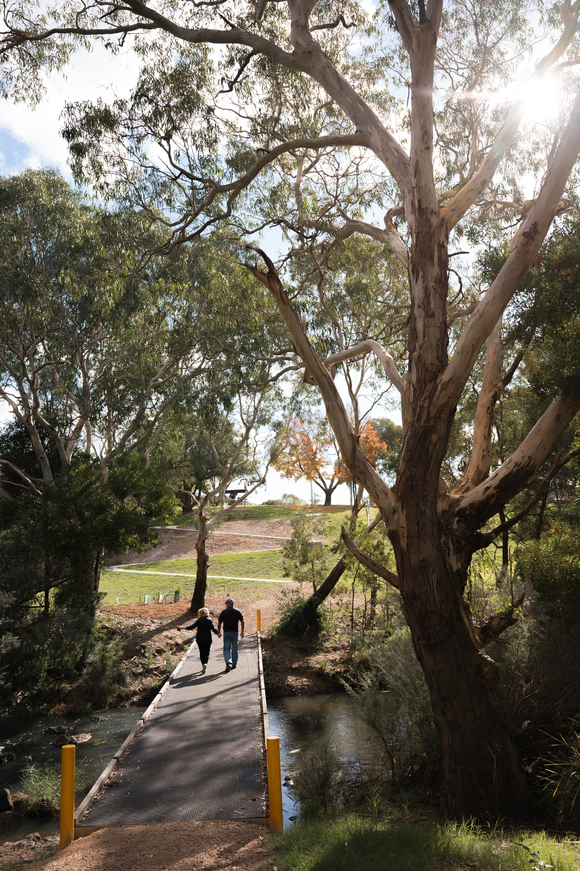

Surf Coast Shire Council
Presentation to Parliamentary Inquiry on cancellation of 2026 Commonwealth Games
13 February 2024
Wadawurrung Country

Slide 2
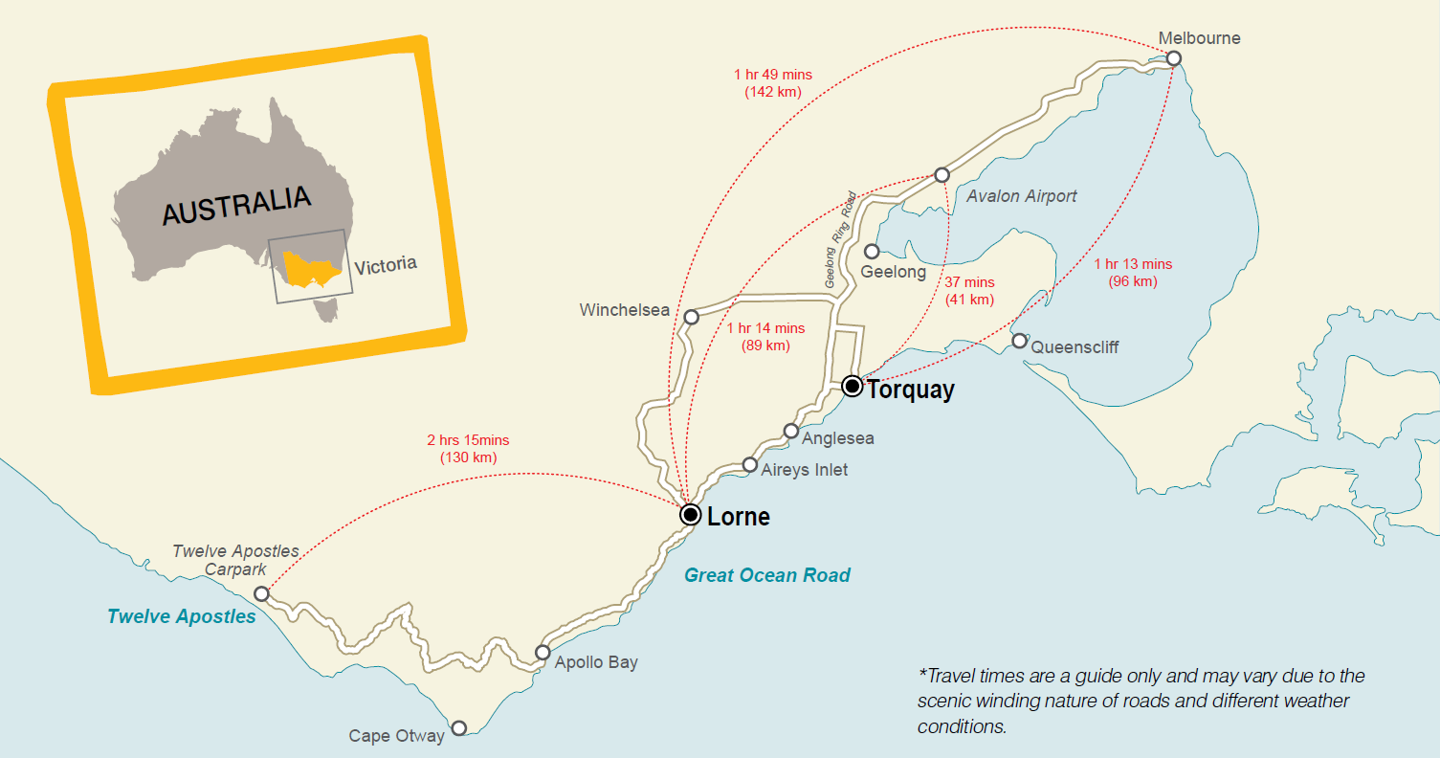
Our place in the world:
We sit between Victoria’s two largest cities and a major tourist destination – 12 Apostles
In 2030 years 1.5 million people will live within 1 hour of Surf Coast.
West Melbourne Corridor
1.1million residents
Greater Melbourne
Est 6.8 million residents
Geelong
327,000 residents
Surf Coast
47,000 residents
Great Ocean Road Visitors
8.6million + visitors

Slide 3
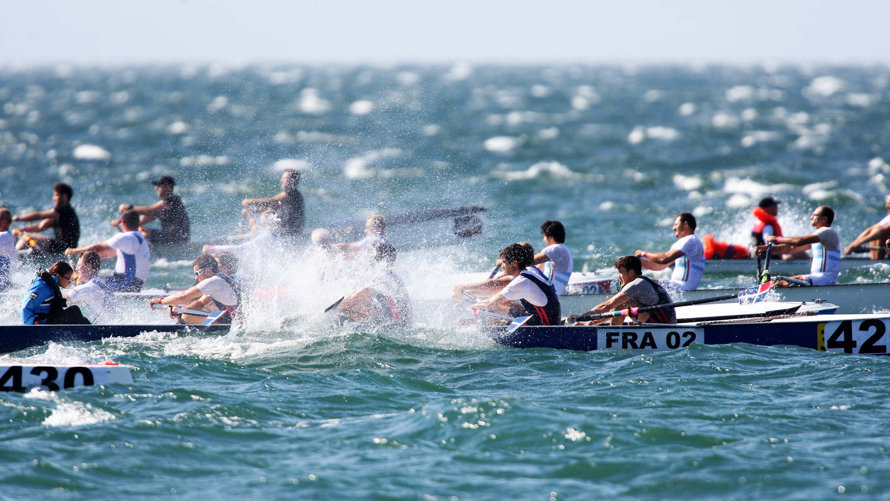
Commonwealth Games & The Surf Coast
Torquay was to host the Coastal Rowing events.

Slide 4
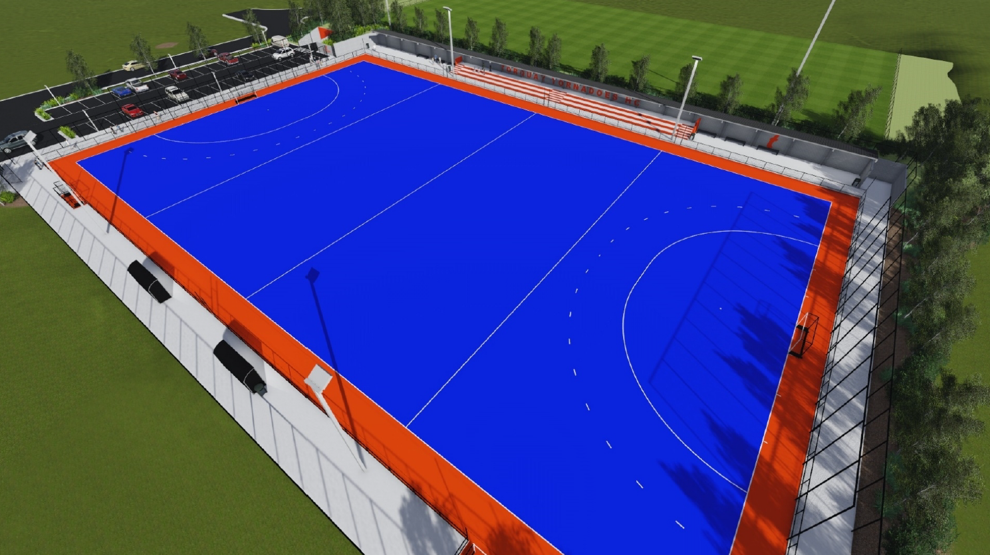
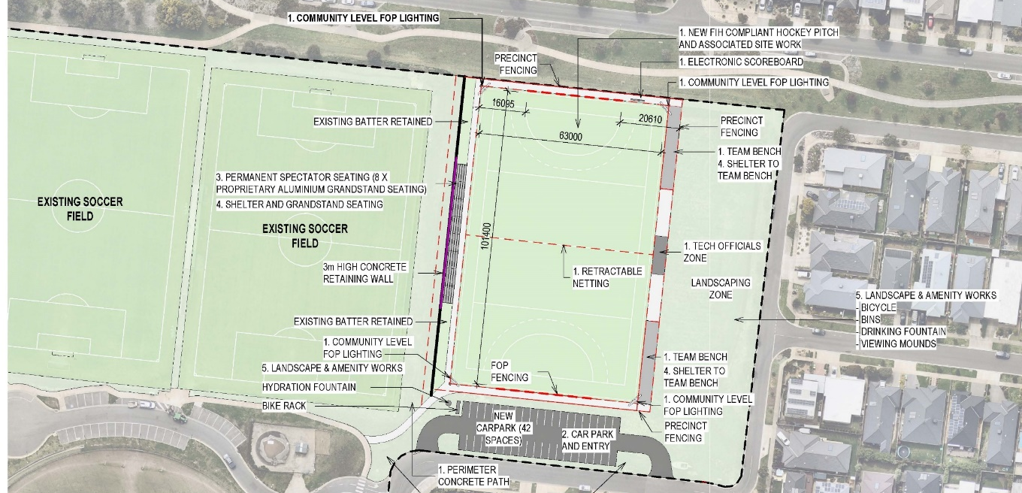
Commonwealth Games & The Surf Coast
A hockey training venue is still proceeding

Slide 5
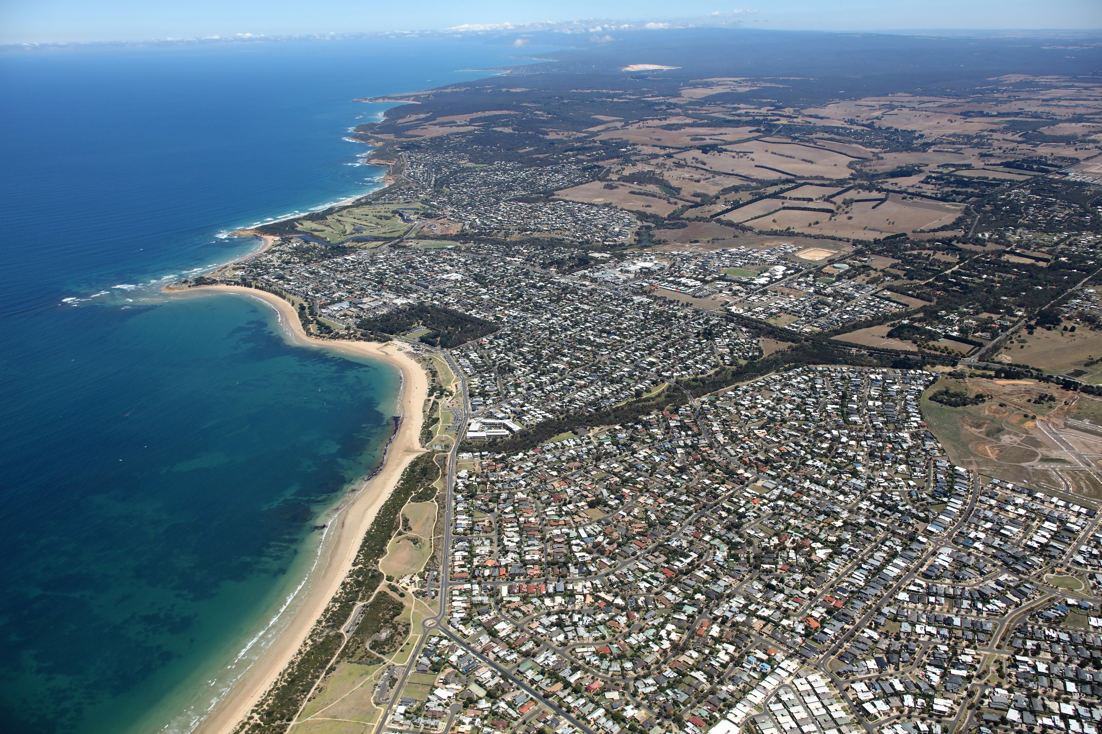
Looking forward
Funding Events & Marketing opportunities in Surf Coast Shire

Slide 6
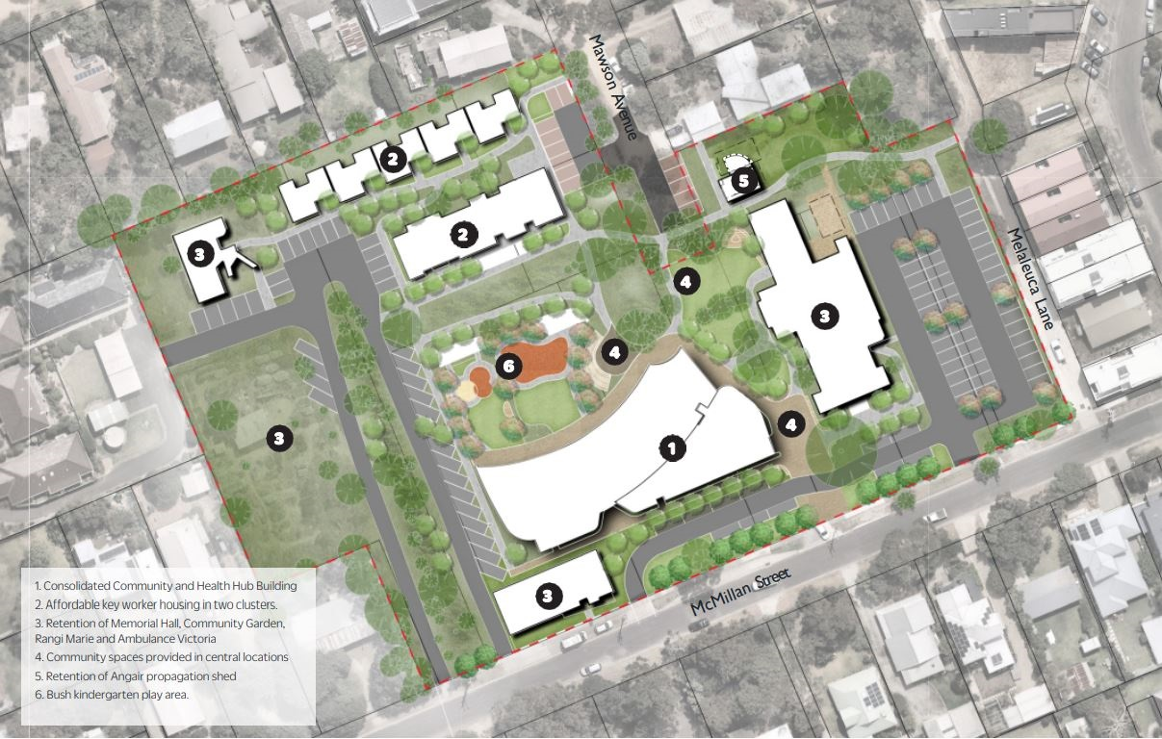
Funding opportunity – Housing Projects
Anglesea Community and Health Hub
Fraser Drive, Aireys Inlet - Social and Affordable housing.

Slide 7
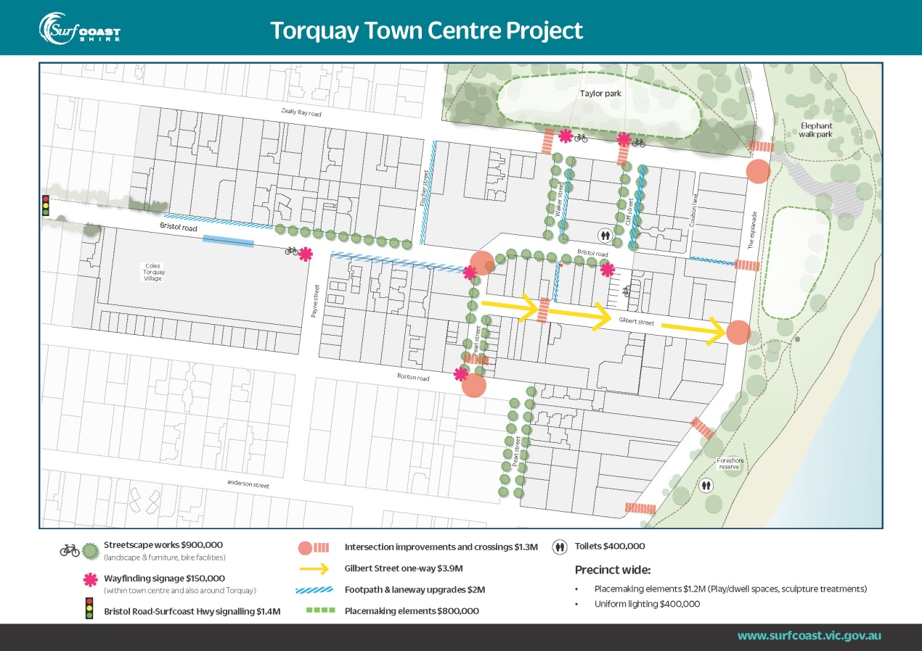
Funding Opportunity – Legacy Projects
Torquay Town Centre Placemaking.

Slide 8
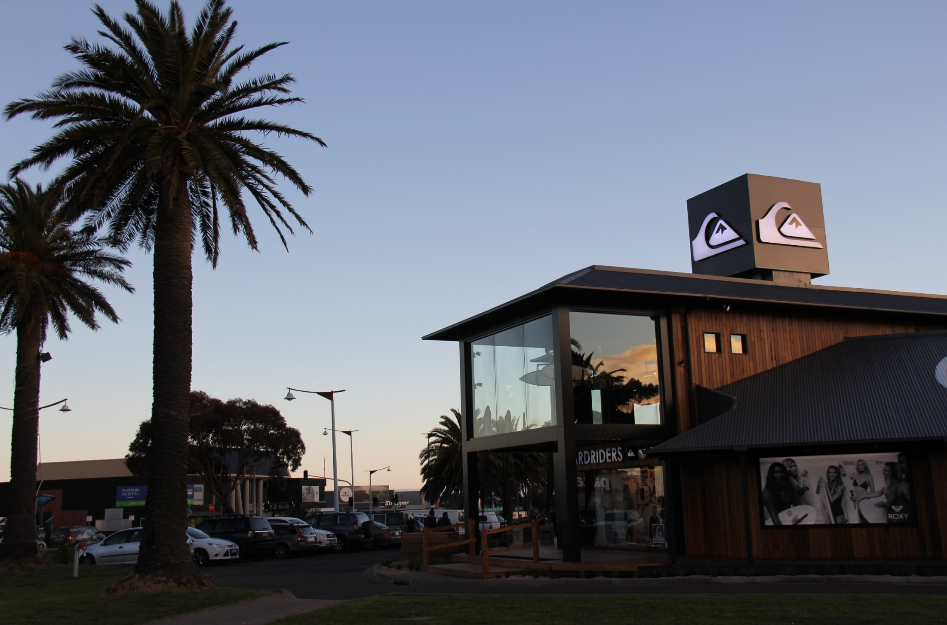
Funding Opportunity – Legacy Projects
Surf Coast Cultural Centre – Enhancing a cultural destination at the start of the Great Ocean Road.

Slide 9
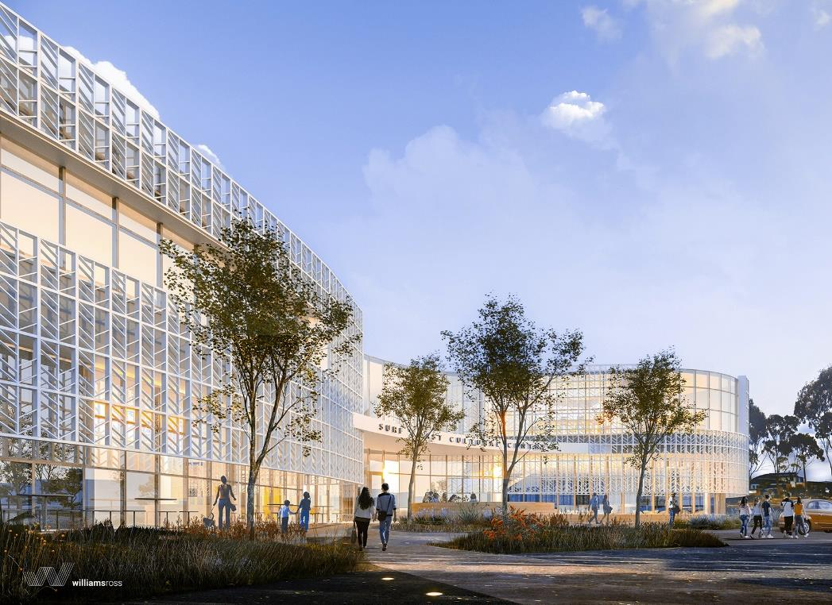
Funding Opportunity – Legacy Projects
Surf Coast Cultural Centre – Enhancing a cultural destination at the start of the Great Ocean Road.

Slide 10
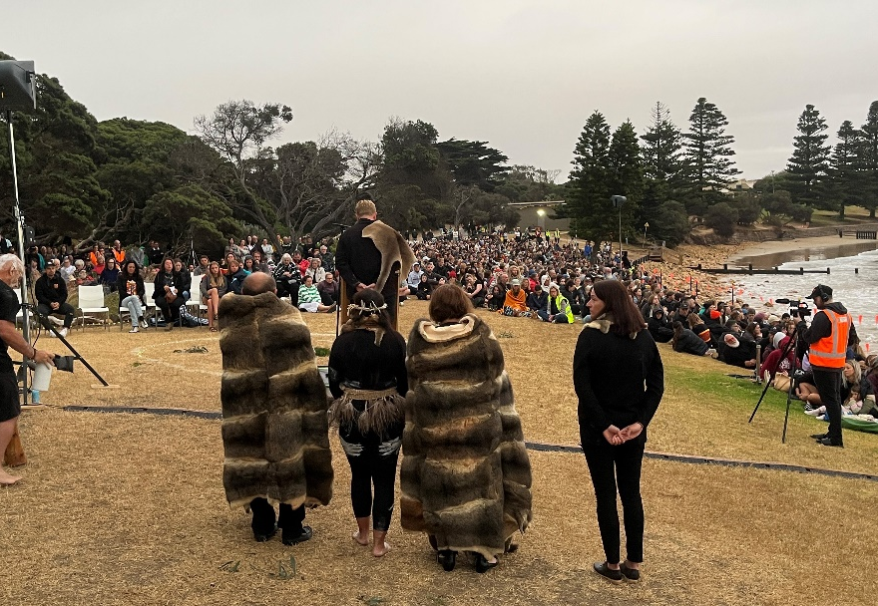
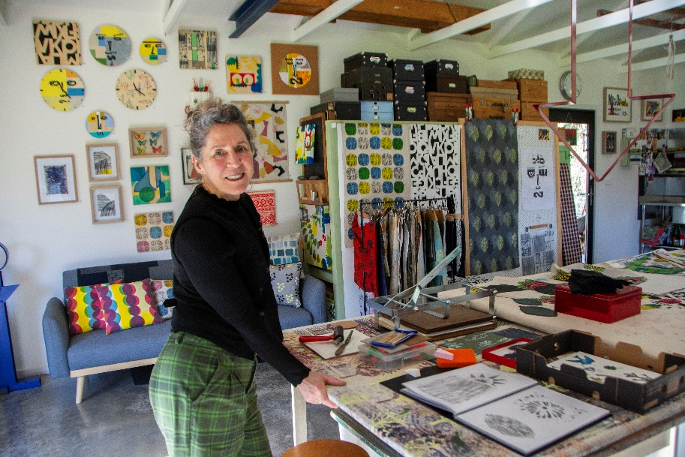
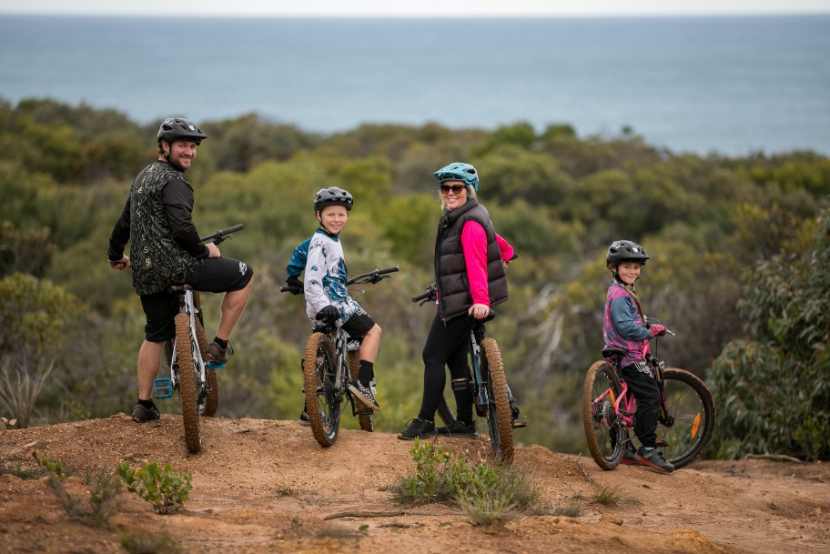
Our Values: Nature, Wellness, First Nations
From the hinterland to the coast, from the first peoples to the children of the future, we are an active, diverse community that lives creatively to value, protect and enhance the natural environment and our unique neighborhood.
We will leave the Surf Coast better than we found it.

Slide 11

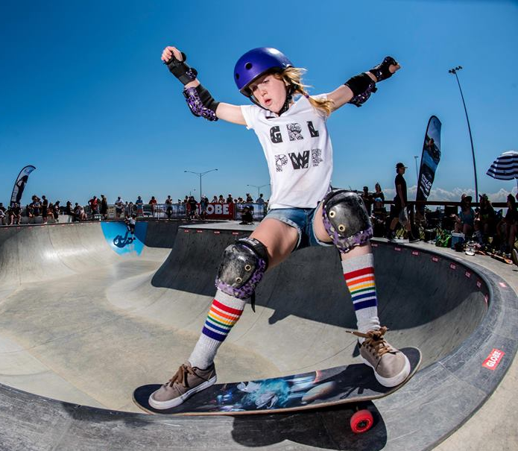
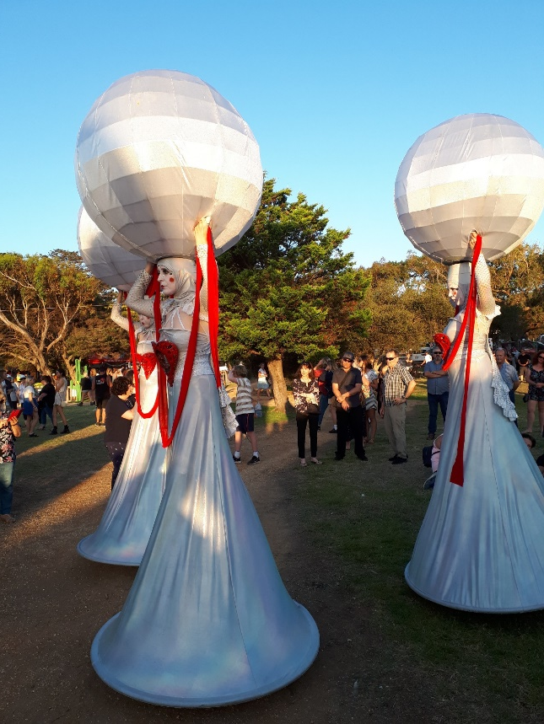


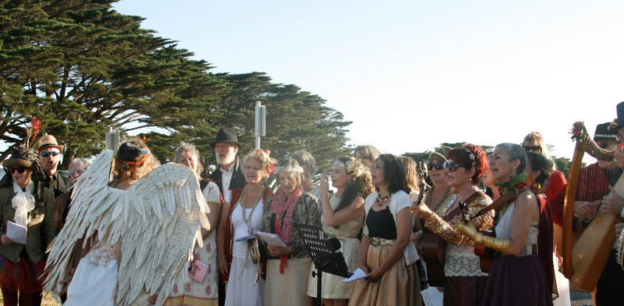
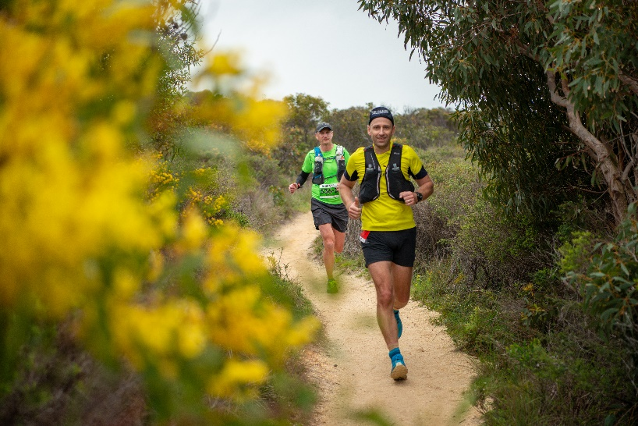

Significant Event Destination
Events create sense of place, connect communities & help businesses thrive
250 + community & major events
Viewed globally by 100M+ people
Welcomes 240,000 participants & spectators
Generate over $100M expenditure

Slide 12

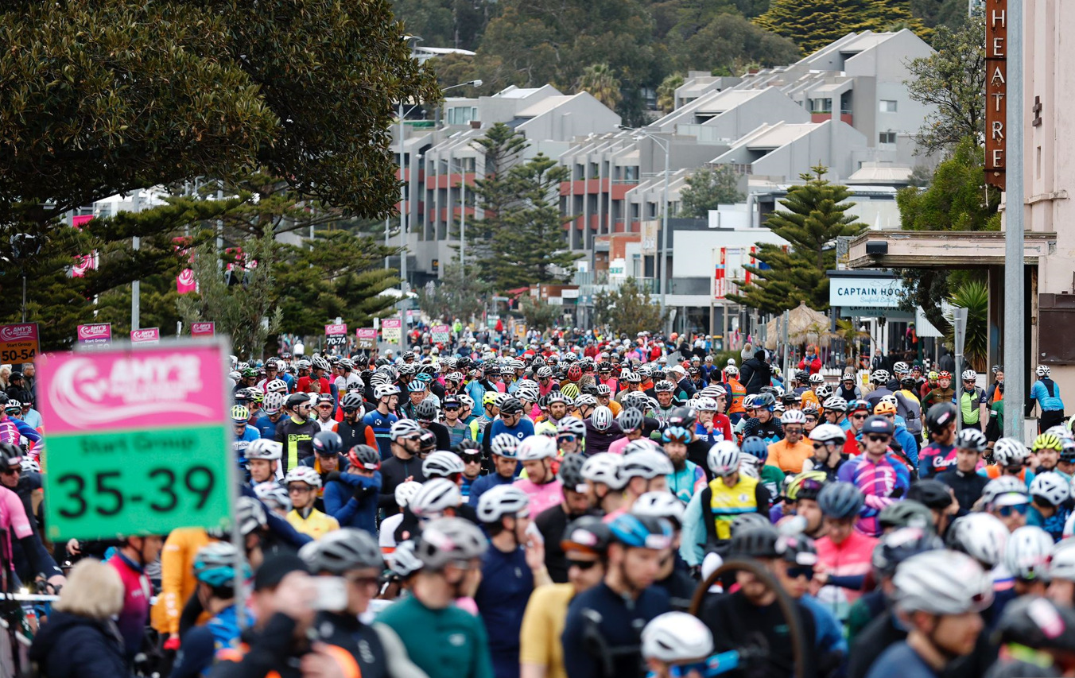
Event Case Studies
Rip Curl Pro & 2025 UCI Gran Fondo World Championships .
Rip Curl Pro Bells Beach - Easter
2025 UCI Gran Fondo World Champs
Event length: 10-day window.
Spectator attendance: 35,000+
Economic benefit $8million+
3.95million video views.
2.73million hours watched.
7.4million international audience.
GOR & Bellarine regional dispersal
Event length: 4 days.
Est 7,000 riders & 20,000 spectators.
3,500+ international riders.
Est economic benefit $10million+.
Very high level of extended stay outcomes (2 – 4 weeks).
GOR & Bellarine regional dispersal
Global audience
Off-peak visitation

Slide 13
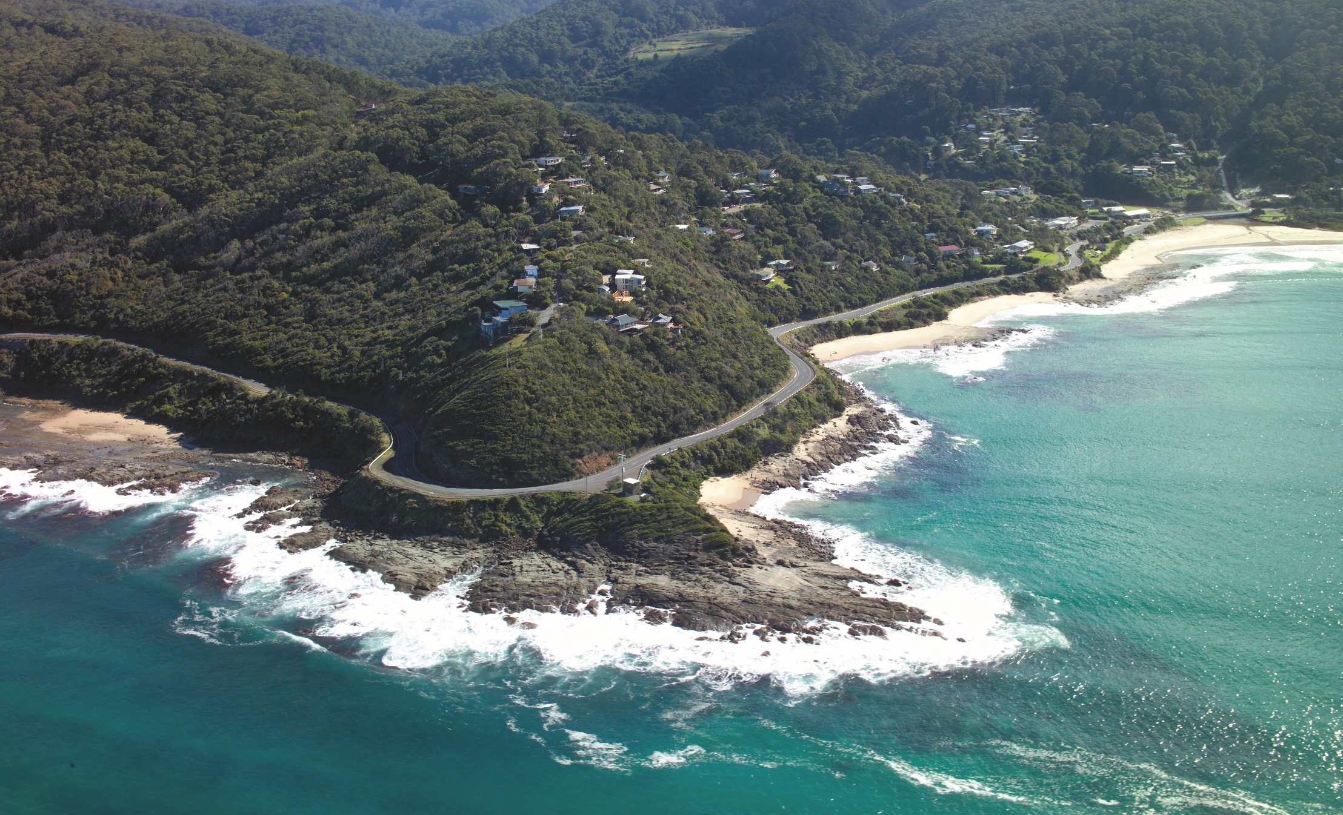

Conclusion and questions
surfcoast.vic.gov.au

