Slide 1
Regional Housing Fund Delivery
Simon Newport, CEO, Homes Victoria
7 February 2025

Slide 2

Acknowledgement
I acknowledge the Traditional Owners of the lands on which we meet and work, and pay my respects to Elders past and present.
CONFIDENTIAL​

Slide 3
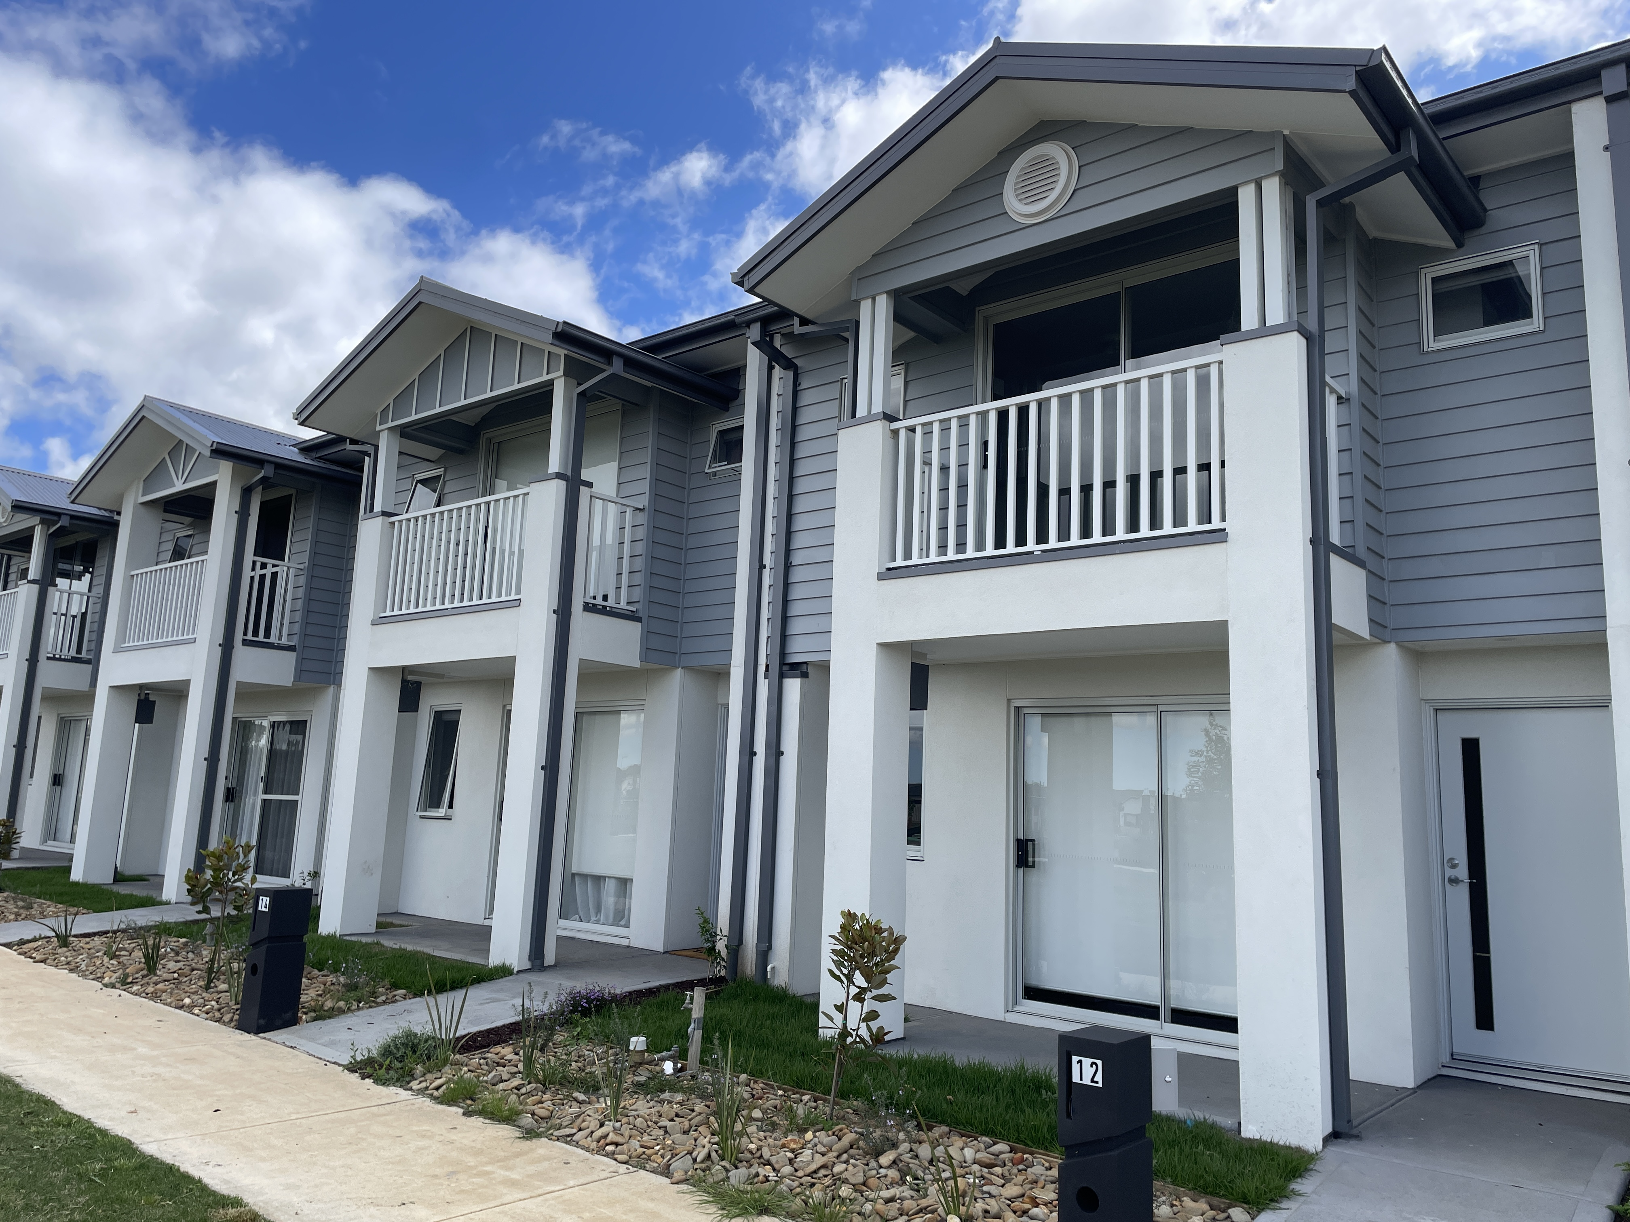
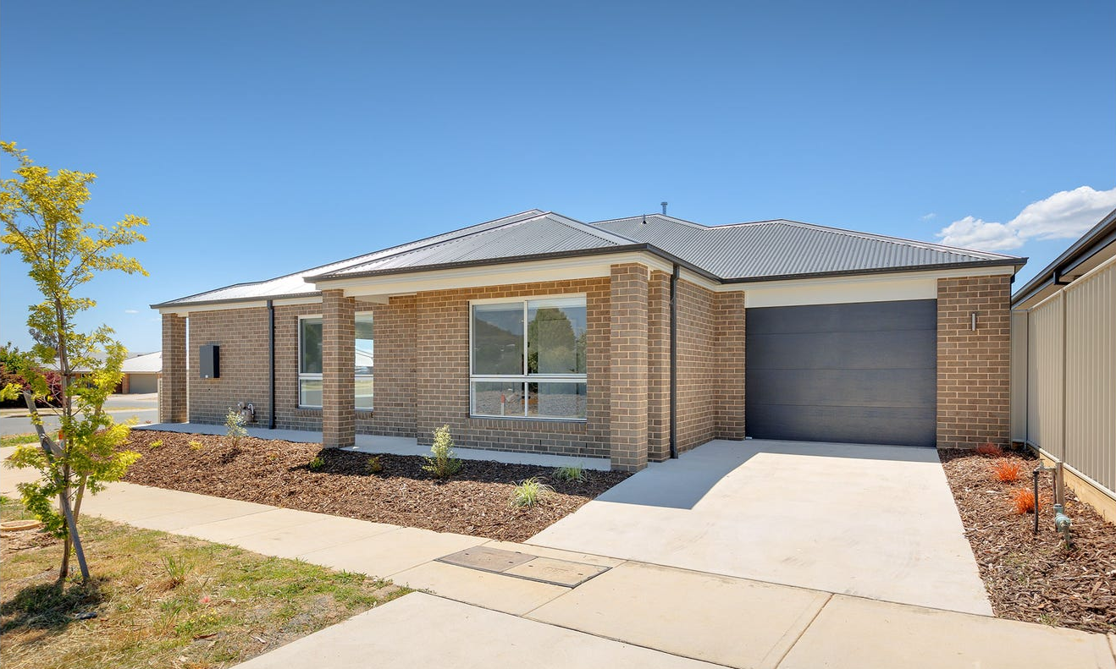
Delivering the Regional Housing Fund
We will deliver more than 1,300 new and upgraded social and affordable homes for people most in need across regional and rural Victoria.
The RHF delivery program was finalised in October 2024 and is forecast for completion by 30 June 2028.
A range of proven delivery methods are being used to deliver the homes as quickly and efficiently as possible in areas of greatest demand.
These include:
      acquiring homes in new developments
      using modern methods of construction
      redeveloping existing social housing stock
      partnerships with the community housing sector
      immediate refurbishment of old stock to bring it back online for new renters.
The Social Housing Growth Fund Affordable Housing Partnership Program will deliver up to 270 affordable housing dwellings towards the Regional Housing Fund delivery program.
In addition, a $25 million Rapid Housing Procurement program will secure homes for people experiencing homelessness or at risk of homelessness.
We are partnering with Development Victoria to deliver new social and affordable homes in Geelong and Bendigo at former Commonwealth Game Athletes’ Village sites.
New social housing in Macedon Ranges (top) and Greater Geelong.

Slide 4
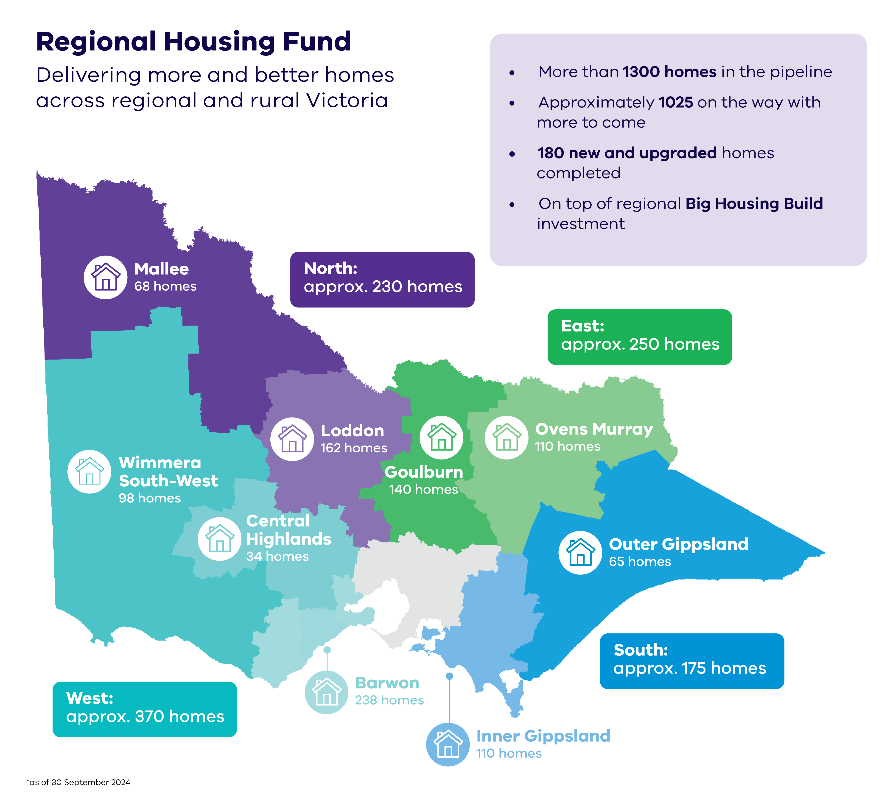
State-wide snapshot
Indicative regional distribution:
So far, the government has announced more than 1,000 new homes based on demand, local engagement and availability of sites including developments at Colac and Wodonga; flood recovery homes in Shepparton, Seymour, and Rochester; as well as the former Commonwealth Games athlete's villages at Bendigo and Greater Geelong.
More projects will be confirmed as future programs are finalised, such as the Rapid Homelessness Grant and Social Housing Growth Fund projects.

Slide 5
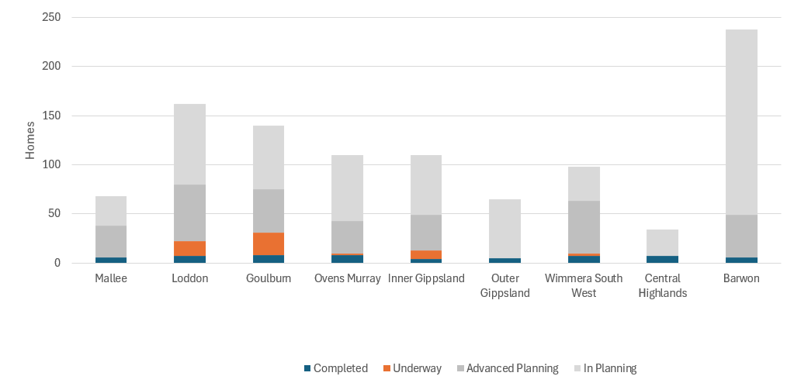
Progress on Regional Housing Fund delivery
North
East
South
West

