Slide 1

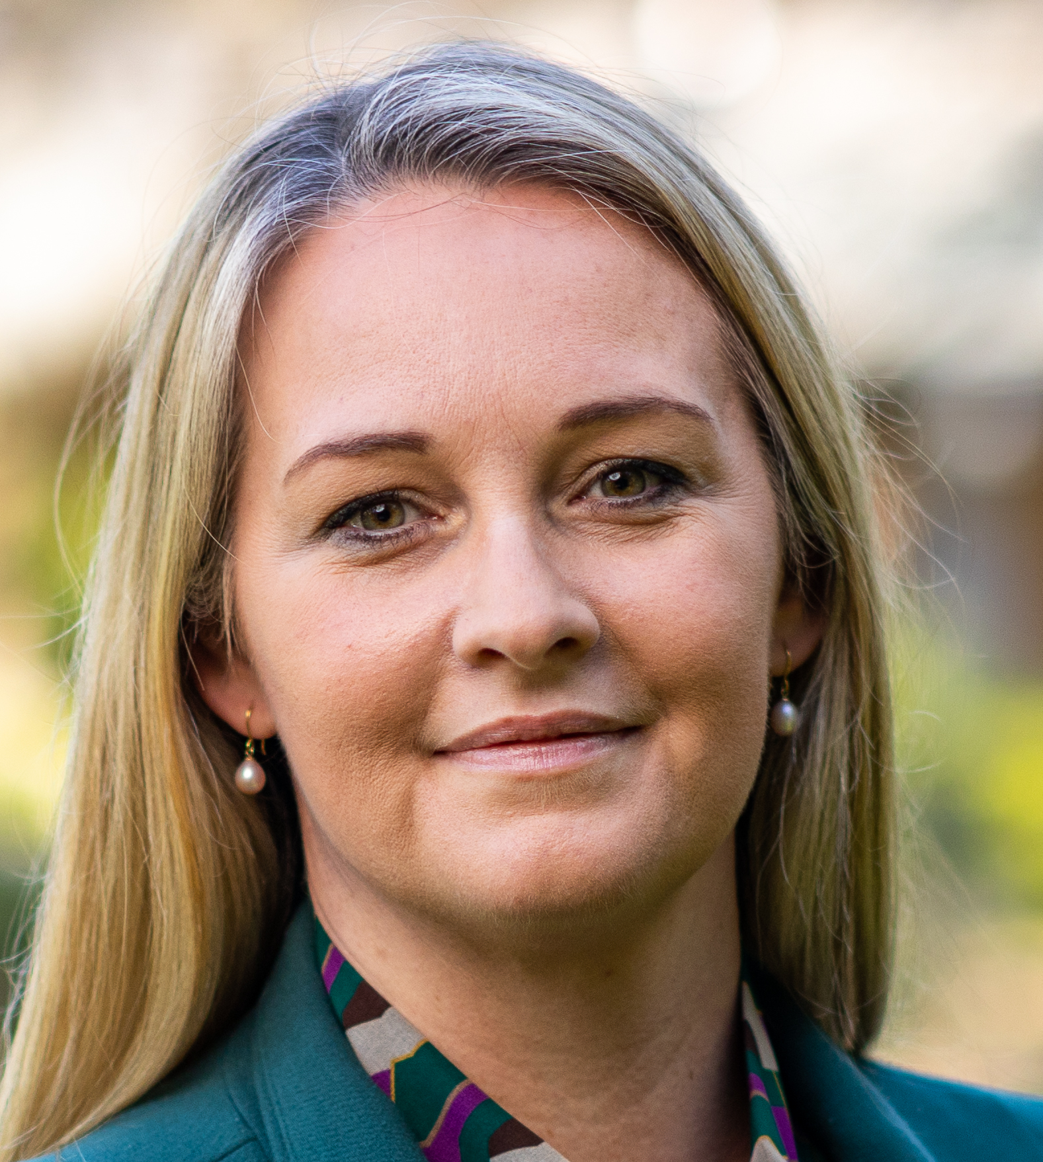
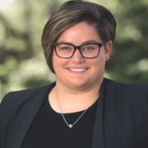
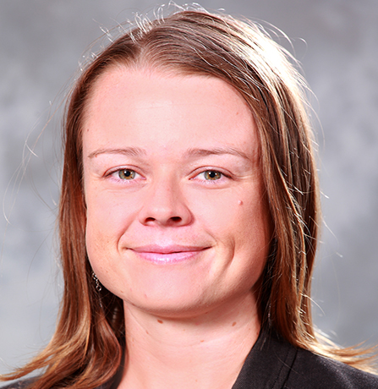
Commonwealth Games Inquiry:
Overview of Bendigo and
Central Victoria
Community Survey
Dr Alana Thomson, La Trobe University
Dr Ashleigh-Jane Thompson, La Trobe University
Dr Millicent Kennelly, Griffith University

Slide 2
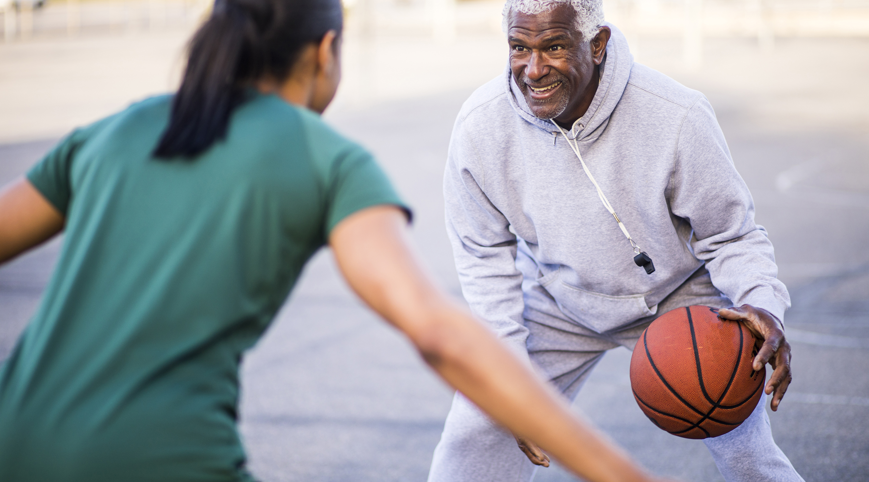
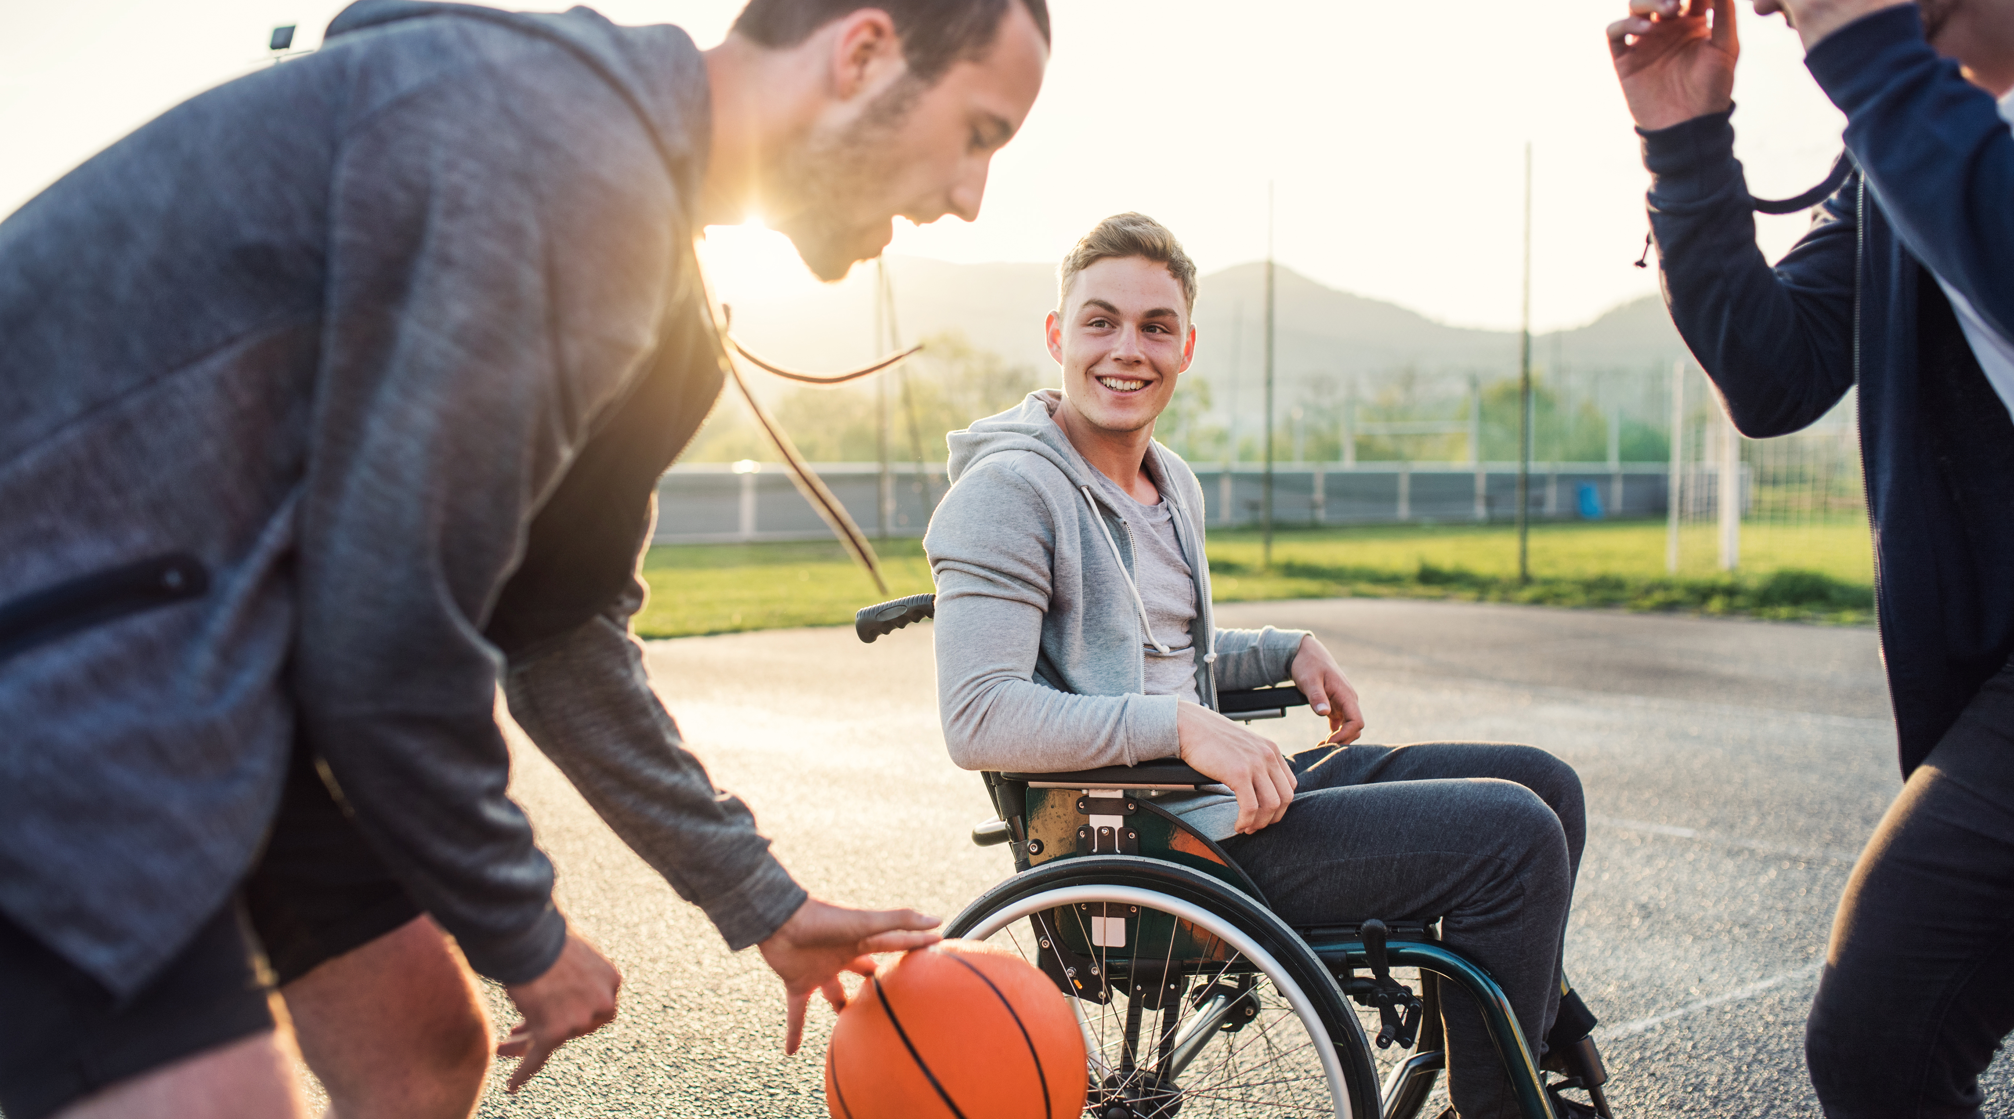

overview
Academic team – brief introduction – our background in sport event legacy
Background and research aim of Community Survey
Community Survey findings
A cancelled event – and closing the loop

Slide 3
Publications & funded work - Sport event legacy
Publications
Bakhsh, J., Johnston, M., Rowe, K., Ferkins, L., & Thompson, A. (2023, December). Co-hosting, let’s talk about it: Investigating the relationship between Australia and New Zealand to co-host the 2023 FIFA Women’s World Cup. Sport Management Association of Australia and New Zealand annual conference.
Carlini, J., O'Neil, A., Thomson, A. & Green, A. (2022). Understanding the interplay between event communications and local business decision-making using signalling theory: The case of the 2018 Commonwealth Games, European Sport Management Quarterly, DOI: 10.1080/16184742.2022.2125996
Carlini, J., Coghlan, A., Thomson, A., & O’Neill, A. (2020) From legacy rhetoric to business benefits: A case study the Gold Coast 2018 Commonwealth Games, Event Management, 24(1), pp.75-96
Doyle, J., Filo, K., Thomson, A., & Kunkel, T., (2021). Large-scale sport events and resident well-being: Examining PERMA and the Gold Coast 2018 Commonwealth Games, Journal of Sport Management, 35(6), pp.537-550.
Grainger, A., Beissel, A., Thompson, A., Brice, J., Postlethwaite, V. (2023, August). The 2023 football Women’s World Cup and Australia’s sport ambitions: Mobilising gender equality in the “Decade of Green and Gold”. International Women in Sport Symposium.
Grainger, A., Beissel, A., Thompson, A., Brice, J.E. (2023). The 2023 Football Women’s World Cup and Australia’s sporting ambitions: A decade of green and gold. In A. Beissel, V. Postlethwaite, A. Grainger, & J.E. Brice (Eds.), The 2023 FIFA Women’s World Cup: Politics, Representation, and Management (pp. 189-205). Routledge.
Grainger, A., & Thompson, A. (2022, December). Bidding ‘As One’, developing apart: Comparing legacy aspirations for the 2023 FIFA Women’s Football World Cup. Sport Management Association of Australia and New Zealand annual conference.
Reis, A., Frawley, S., Hodgetts, D., Thomson, A., & Hughes, K., (2017) Sport Participation Legacy and the Olympic Games: The Case of Sydney 2000, London 2012, and Rio 2016, Event Management, 21(2), pp.139-158.
Thomson, A., Kennelly, M., & Toohey, K. (2020) A systematic review of empirical research on large-scale sport events’ social legacies, Leisure Studies, 39(6), pp.859-876.
Thomson, A., Toohey, K., & Darcy, S. (2021). The Political Economy of Mass Sport Participation Legacies From Large-Scale Sport Events: A Conceptual Paper. Journal of Sport Management, 35(4), 352-363. doi:10.1123/jsm.2019-0166
Thomson, A., Cuskelly, G., Toohey, K., Kennelly, M., Burton, P. & Fredline, L. (2019) Sport Event Legacy: A Systematic Quantitative Literature Review of Literature, Sport Management Review, 22(3), pp.295-321.
Thomson, A., Schlenker, K., Schulenkorf, N. and Brooking, E., (2017) The social and environmental consequences of hosting sport mega-events, Managing Sport Mega-Events, Routledge, New York, pp.150-164.
Thomson, A., Schlenker, K. & Schulenkorf, N. (2013), Conceptualising Sport Event Legacy, Event Management, 17 (2) pp.111-122.
Zardini, C., Kennelly, M., Fullagar, S. & Cuskelly, G. (2023). Exploring administrative legacies from the Rio 2016 Paralympic Games: impacts on processes and professionalisation of parasport NGBs in Brazil, International Journal of Sport Policy and Politics, 15(2) https://doi.org/10.1080/19406940.2023.2206410
Notes:
Our research has been published in top international sport management journals

Slide 4
Publications & funded work - Sport event legacy
Funded Work
DOYLE, J., Filo,. K. Thomson, A., Kunkel, T. (2018). More than just a Game? The Impact of GC2018 on the Social-Psychological Well-Being of Community Members, Department Tourism, Sport and Hotel Management Commonwealth Games Research Grant Scheme
Kennelly, M., Thomson, A., Toohey, K. (2019). Developing an inventory to improve evidenced-based planning and monitoring of intangible legacies, International Olympic Committee’s Advanced Olympic Research Grant Programme
Pavlidis, A., Fullagar, S. Kennelly, M. Darcy, S., Forsdike, K., Thorpe, H., McGillivray, D. (2023-2026) Engaging Outsiders in Sport: Transforming Sport Event Legacy Planning, ARC Discovery Project, DP230101022
Riot, C., Pavlidis, A., Kennelly, M., Toohey, K., Filo, K., Thomson, A., Hill, B. Lloyd, K. (2017). Securing a Sport Participation Legacy for Women and Girls, Department Tourism, Sport and Hotel Management Commonwealth Games Research Grant Scheme
Thomson, A., and colleagues (2021) Federation University Road Nationals Championships (Road Nats) 2021 - Local business impacts and event leverage strategies, Ballarat City Council
Thomson, A. and colleagues (2021) Business and community benefits of cycling events: Systematic review of leverage strategies and outcomes, Ballarat City Council
Thomson, A. Kennelly, M. Toohey, K. (2019) Commonwealth Games Social Legacies: Planning, Monitoring and Evaluating, Commonwealth Sports University Network Research Grant Scheme
Thomson, A. (2018) Planning and policy for achieving social legacies from large-scale sport events: A case study of the Gold Coast 2018 Commonwealth Games (GC2018), Griffith Business School New Researcher Grant Scheme
THOMSON, A., DOYLE, J., Cuskelly, G., Burton, P., Toohey, K., Fredline, L., Kennelly, M. (2018) Sport Event Venue Legacies: Planning, Engagement and Perceptions of the Gold Coast Commonwealth Games (GC2018) Venues Program, Department Tourism, Sport and Hotel Management Commonwealth Games Research Grant Scheme
Thomson, A. Toohey, K. Kennelly, M. (2017). Measuring the social legacy of the Gold Coast 2018 Commonwealth Games: Innovating research into social legacies, Department Tourism, Sport and Hotel Management Commonwealth Games Research Grant Scheme
Notes:
Combined, we have delivered a couple of hundred thousand dollars worth of competitive grants and consulting projects focused on legacy, including an IOC-funded project and several projects related to the Gold Coast 2018 Comm Games

Slide 5
Background and research aims
Co-design with Sports Focus and inform their strategy to leverage V2026 for local sporting legacies
Community insights to inform gaps and identify possibilities to secure short and long-term benefits for sport
Unfunded research project - ideas of the civic university and social impact
Inform practice AND contribute to the body of knowledge – sport event and legacy management
Mid-Late 2022
Start 2023
Mid 2023 [planned but disbanded]
120 responses
Researchers connect with Sports Focus (SF) – what does V2026 mean for sport in Bendigo and Central Victoria?
Ran survey - co-designed with SF
9 themes in responses
Questions focus on community ideas of anticipated benefits, expected impacts, barriers and challenges to legacy, opportunities and strengths for legacies
Let’s work together to build evidence base, inform policy, shape strategy
Focus groups with communities under-represented in survey
4 main categories
e.g. Karen community (non-Commonwealth country), First Nations community, young people
Themes: 1) Facilities; 2) Local sport club development; 3) Local sport club financial supports; 4) Local sport club human resources (inc. officials and volunteers); 5) Sport offerings and promotion; 6) Sport participation; 7) Performance and competition; 8) Inspiration and community passion for sport; 9) Capacity for event hosting (inc. Pre-event training).
Across Bendigo and Central Victoria
Respondents highly engaged in sport
Strengths
Challenges
Potential negative impacts/legacies
Potential positive impacts/legacies
Notes:
This work dates back to 2022 – the Exec officer from Sports Focus – the regional sports assembly – got in contact with me after reading media which covered my research and advice around securing legacy in the regions.
We got talking – Sports Focus were very well informed already – asking for previous work that could help them best prepare.
Cognisant that there are few case studies of the event running in a regional co-host model, we suggested implementing a survey to garner community insights and help direct Sports Focus planning in the period up to the Games, and post.
So we designed and ran the survey – I’ll talk about the specific findings in the next slide – what I want to flag here is this work was looking at the community level to identify opportunities and gaps to securing legacy – maximising the value of V2026.
The work was unfunded – the research team used our discretionary time, and Sports Focus also redeployed existing resources to support the design and rollout of the survey.
But we were doing this to build the evidence base to inform practice, and from our perspective, use this case study to contribute to the body of knowledge on planned events.

Slide 6
Community Survey findings
120 responses
Respondents very engaged in sports, middle age to older demographic with the biggest response groups being 40-44 and 50-54 years
Gender and disability reflective of population profile, lower representation of Aboriginal and Torres Strait Islander peoples and those speaking language other than English at home
Strengths
Some good facilities, or others easy to upgrade
A local passion for sport
A track record in hosting sport events
Challenges
1. Access to adequate facilities (event time and legacy)
2. A range of factors affecting the current operational capacities of sport clubs (e.g., dealing with challenges in the current sporting landscape, access to volunteers, participation numbers and access to elite opportunities in the regions)
Notes:
Strengths – a really solid foundation in terms of available spaces, passion and experience of hosting events
Challenges – nothing surprising here – but typical community sport challenges exacerbated by hosting an international standard event

Slide 7
Community Survey findings
Potential negative impacts to sport in Bendigo and Central Victoria
Disruption to local sport around Games-time
Investment focused on event delivery rather than shared across regional sport
Volunteers time-switching or burning out due to Games commitments
Potential for less people participating post-event due to cost-of-living pressures
Notes:
Again – nothing really surprising – these are typical of events – but interesting how the local community was quite aware/informed of what could occur

Slide 8
Community Survey findings
Potential positive impacts to sport in Bendigo and Central Victoria
The benefits of new and upgraded facilities
Opportunities to re-energise the sport sector (inc. support, partnerships and collaboration)
Opportunities to generate revenue for sports
Opportunities to upskill and broaden experiences of volunteers (and recruit more volunteers)
5. Opportunities to promote inclusion and diversity
6. Opportunities to use the excitement of event hosting to encourage greater sport participation
7. Opportunities to attract elite performers into the regions
8. Opportunities to experience a sense of inspiration and community passion for sport
9. Potential for Bendigo to host other events into the future
Notes:
A wide range of potential positives – the event as a catalyst to realise outcome for community sport that have not received attention in other ways

Slide 9
A cancelled event
What does that mean for this body of work now?
Closing the loop - a need to feedback to the community, thank people for participating in the survey
Academic perspective – some extrapolation to make sense of findings
Local strengths remain and present a solid base for regional sport development
An opportunity to address ‘challenges’ in a way that is driven by, and responsive to, the community – rather than event-led development
Negative impacts brought about by event unlikely to occur, but some issues raised need to be considered in future planning (e.g. cost of sport participation)
Notes:
As we were due to release our report, the event was cancelled.
But we had collected this data – people in the community had taken the time to complete the survey – so we were committed to work with Sports Focus to ensure the community respondents we had heard what they said.
As part of that, acknowledging that with or without the event, many of their concerns for sport development in the regions remain highly relevant into the future.

Slide 10
A cancelled event
What does that mean for this body of work now?
Closing the loop - a need to feedback to the community, thank people for participating in the survey
Academic perspective – some extrapolation to make sense of findings
$2bn investment package (e.g. venue and facility upgrades) sees some of the positive impacts realised, but many ideas highlighted by the community are not addressed in the funding package and may indicate missed opportunities
There is an opportunity to identify events with a better strategic fit
Smaller scale events may better deliver on some of those sport capacity and legacy aspects
The inspiration piece, the volunteer opportunities and recruitment, and local sport participation – as well as contribute to tourism outcomes
E.g. university games, masters games
Notes:
also, there might be other opportunities in the future that could better realise the sport development outcomes desired by the community

Slide 11
Thank you
latrobe.edu.au

Slide 12
survey design
Open 8 February 2023 through to 21 March 2023
A set of standard demographic questions were included.
The research team and sports focus staff implemented a locally focused PR campaign to encourage engagement with the survey, in addition to sports focus’s mailing list and social media advertising.
Key Questions:
  Q1. What benefits would you like to see for community sport in Bendigo and Central Victoria as a result of co-hosting the Victoria 2026 (V2026) Commonwealth Games?
  Q2. How do you think community sport in Bendigo and Central Victoria will be impacted (positively or negatively) by co-hosting V2026?
  Q3. What are the barriers/challenges that Bendigo and Central Victoria will have to overcome to realise sporting legacies from co-hosting the 2026 Commonwealth Games?
  Q4. What local opportunities or strengths will help ensure Bendigo and Central Victoria secures long-term legacies to community sport from co-hosting the 2026 Commonwealth Games?

Slide 13
Bendigo and past events
Bendigo previously held:
A regional University Games in 2010, attracting 1000 students from 14 Australian universities
An Oceania Masters Athletics Championships in 2014, attracting 400 athletes from across Australia, New Zealand and the Pacific Island nations

