Slide 1

Parliament of Victoria
Inquiry into Managing School Infrastructure
Presentation by .id
10 March 2020

Slide 2
Topics
About .id
How we undertake forecasts
How we help education providers
Challenges of forecasting

Slide 3
About .id
Started 1997
Provide demographic information products and knowledge to 320 Councils across Australia and New Zealand as well as a wide range of public and private sector clients. We help them answer questions around where they need to be and when.
Private sector clients include retailers, banks, developers, sporting organisations.
Have deep knowledge of Australian cities, towns and suburbs; their role and function, historical development and likely future.
Have the largest team of population forecasters in Australia.

Slide 4




















How we undertake forecasts
migration by age

Slide 5












migration by age
dwellings
Urban Development Layer
household formation
Small areas
Council input
Building approvals
Aerial photography
Property Database
Land use changes
Notes:
This incorporates significant research to understand the community and migration patterns. The benefit of SAFi is highlighted in future growth corridors where SA2’s may be large due to the current lack of residential development. To understand the change, the SAFi areas provide local insight as to how the urban fridge changes over time.

Slide 6
SAFi (Small Area Forecast Information)
Granular (SA1 derived geography) enabling customised catchments to be built
Single year of age
Combines both tops-down and bottoms-up modelling techniques
Uses Council intelligence to inform development assumptions as well as aerial photography and third party sources of development information
Priorities determined by a monitoring lead approach

Slide 7
Outputs
Micro-geography – over 7,000 SA1-derived areas for VIC
Single year forecasts – 2016 to 2041
Population by single year of age (0-85+ year olds)
Dwellings
Household types (couples with kids, lone persons etc.)

Slide 8
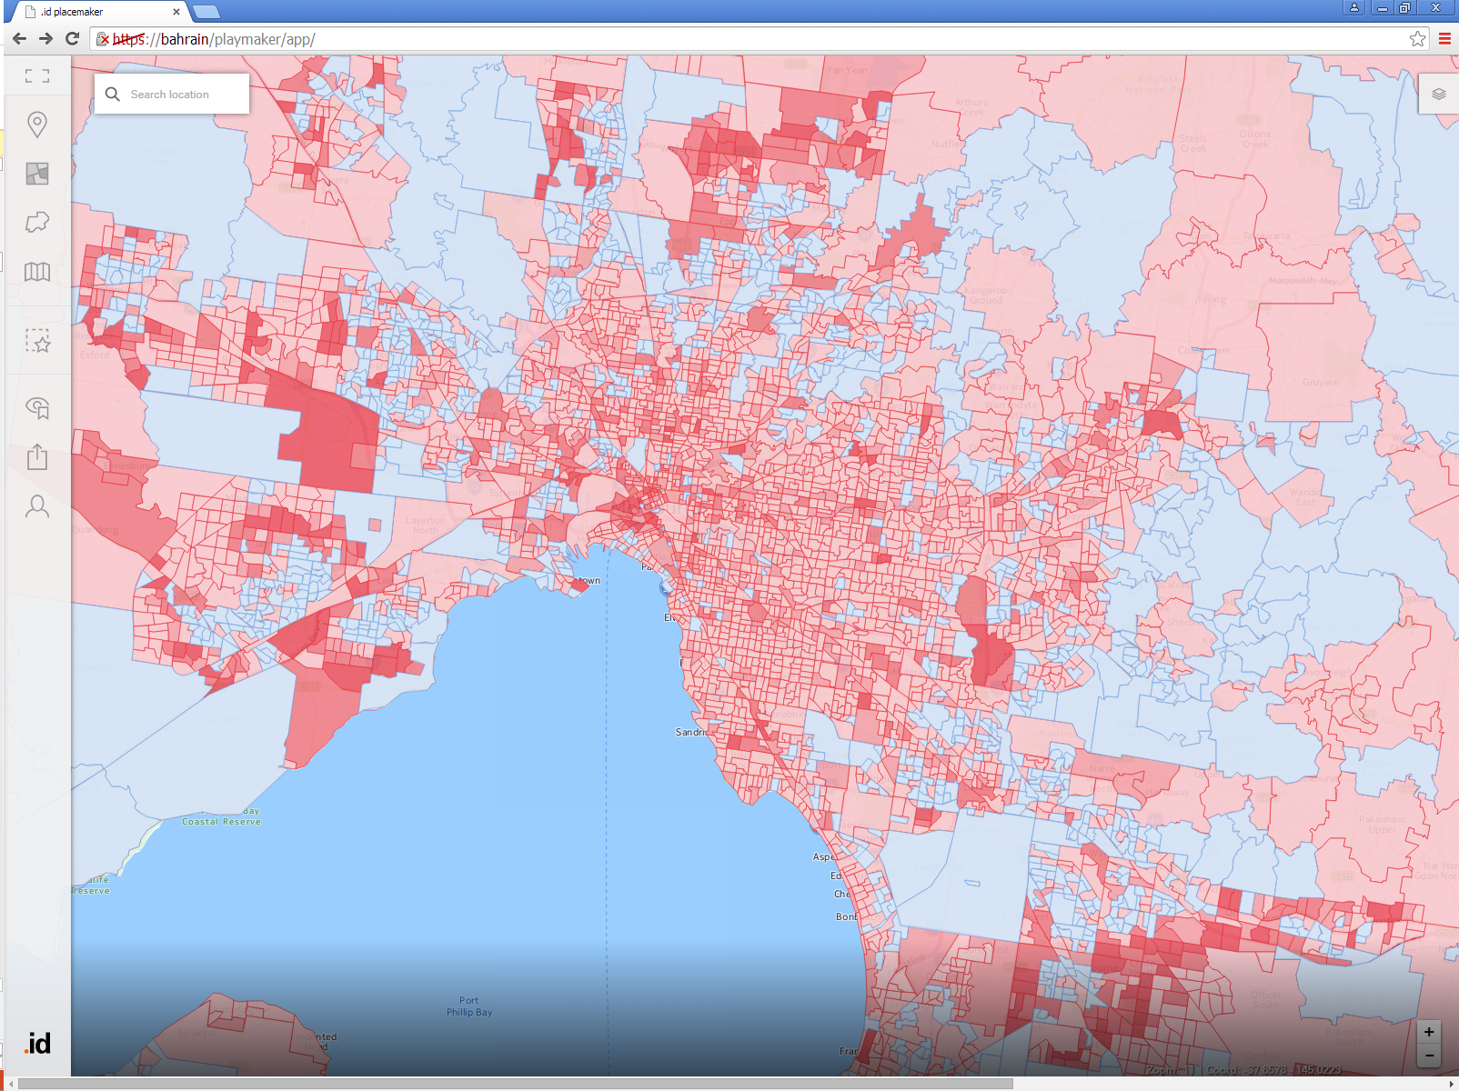
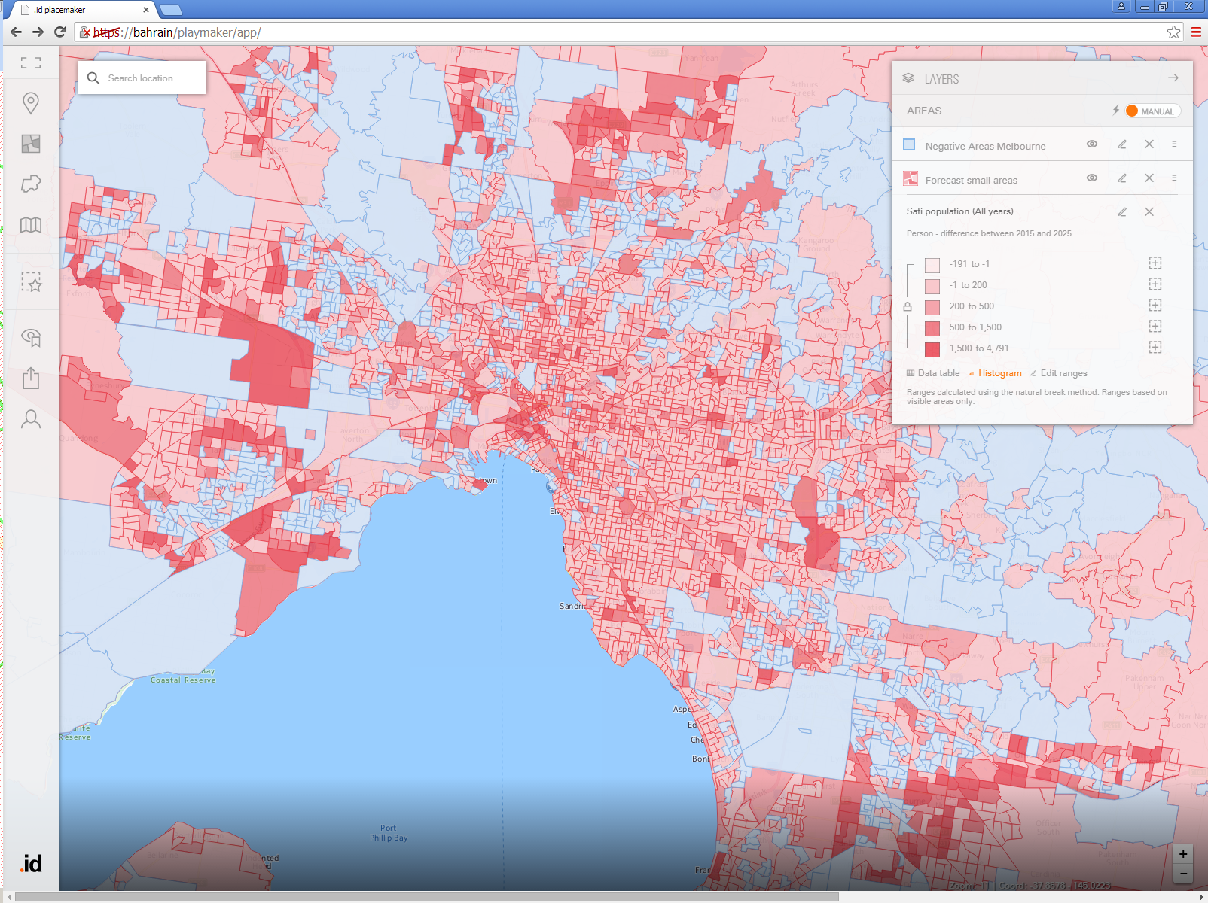
SAFi is granular….Over 7,000 small areas in Victoria

Slide 9
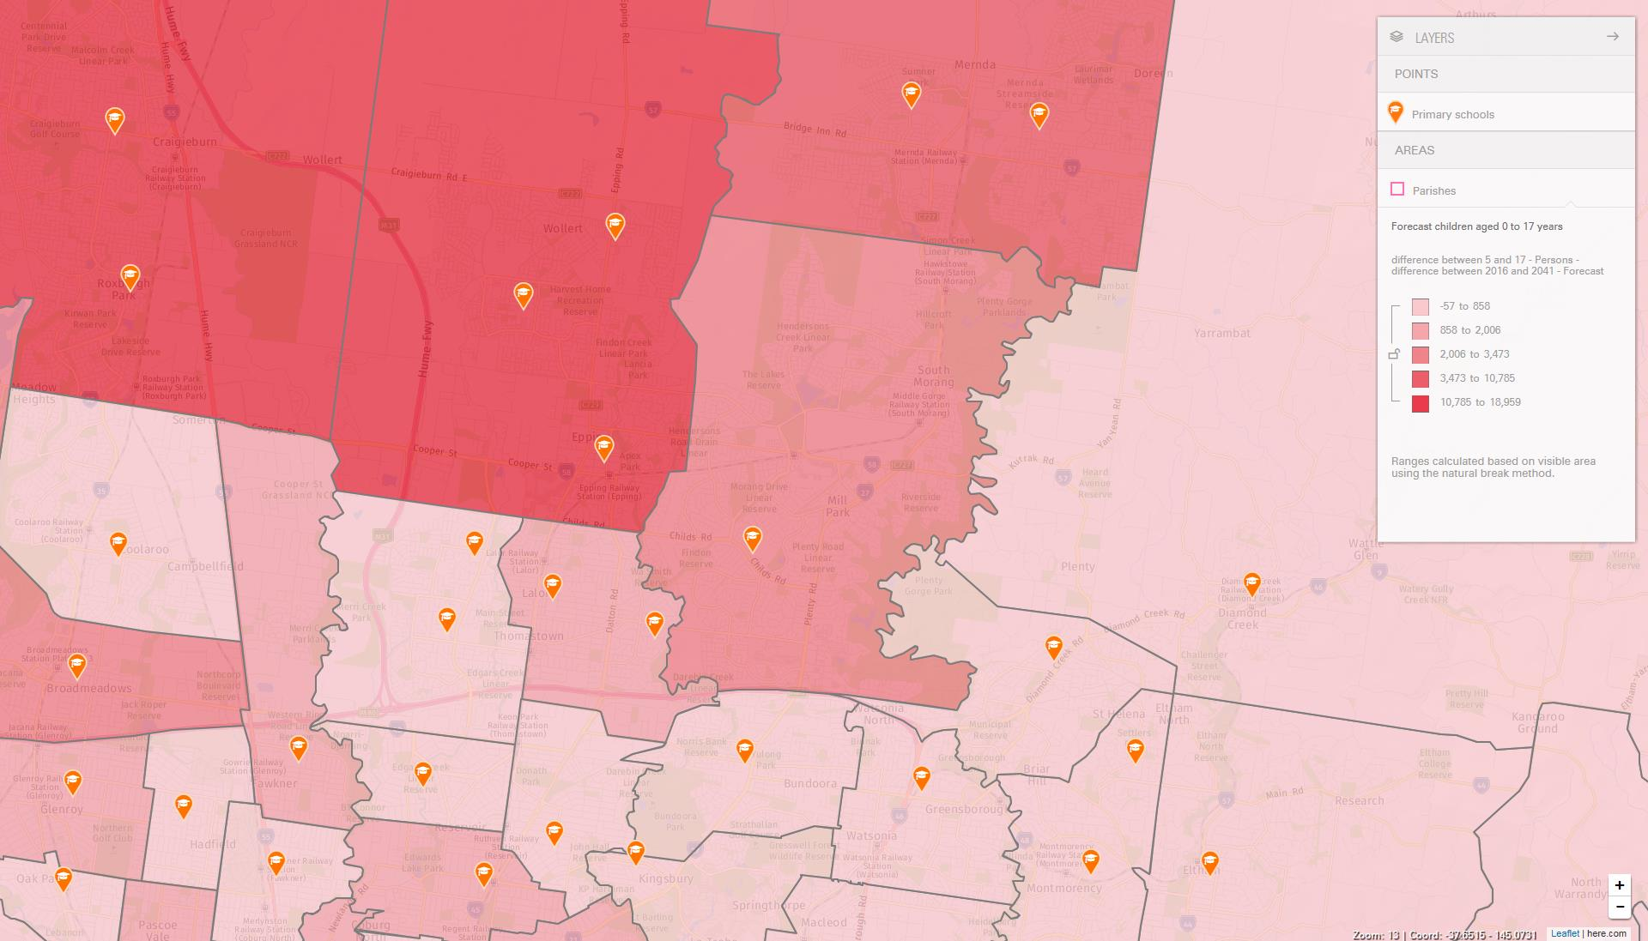
SAFi forecasts can be aggregated to school catchment geographies

Slide 10
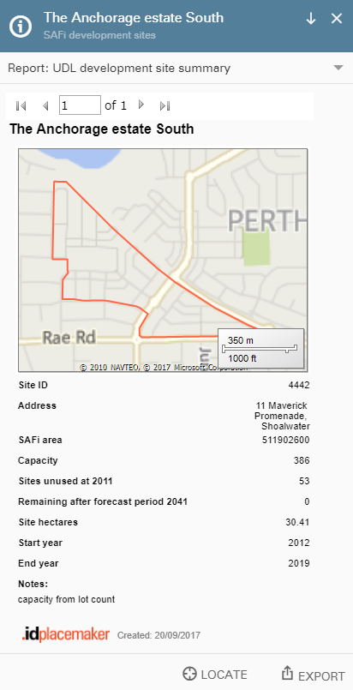
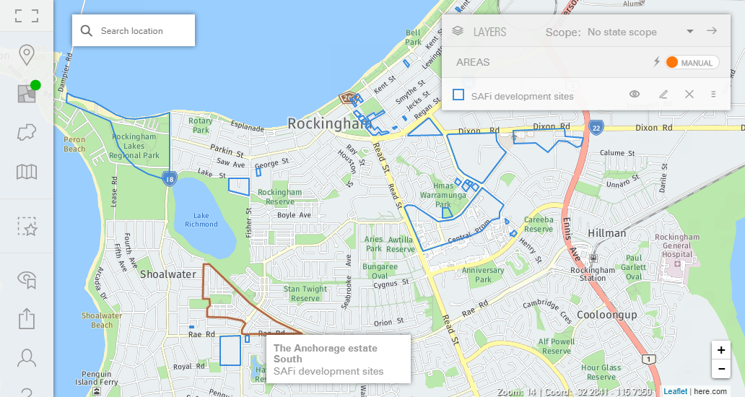
Detailed development assumptions
Urban Development layer identifies dwellings and timings
assumed in forecasts

Slide 11
Education sector clients
A range of non-Government education providers
Provide and maintain population and student aged forecasts for 8 Catholic Dioceses across Australia
We have worked with 11 independent schools across Australia assisting with likely future enrolment growth and potential growth areas
Flexibility of geography enabling scenario testing for proposed school catchments

Slide 12
Challenges of forecasting
Long term ‘top down’ assumptions – overseas migration rates and share by state/territory
Development rates at the coalface, speed and density of greenfield estate development, density of apartment development
Monitoring new greenfield development fronts/plans
Changing household characteristics (eg increases in average household size, multiple family dwellings, families in apartments).
Changes in land supply (rezonings, upzonings) at local level (affecting local catchments)
Additional challenges converting age specific forecasts into local enrolment demand (eg market share forecasting, students not attending local school)

Slide 13
Knowledge rather than numbers as key..
Forecasts need to be seen as more just a set of numbers, locked into a view at a certain point in time with little understanding of the drivers and assumptions that underpin them
Forecasts are the result of assumptions made based on an understanding of role and function of place
Forecasts need to reviewed and updated where necessary to provide continual confidence in the understanding of how and why places change
Knowledge of places and what is driving change enables confidence in decisions

