Slide 1
Family Engagement and Parenting
Corrections Victoria
Larissa Strong, Commissioner Corrections Victoria
9 May 2022

Slide 2
A Safe and Humane Prison System
Enabling people in our care to maintain relationships with family and friends forms an integral part of a safe and humane prison system.
The Corrections Act 1986
Section 37 provides for visits by family and friends.
Section 38 provides for the development of contact and residential visits programs.
Section 31(1) states that a prisoner’s child may be permitted to live with the prisoner if the Secretary is satisfied that it is in the best interests of the child and will not compromise the safety and good order of the prison.
Commissioner’s Requirements and Deputy Commissioner’s Instructions define the
procedures under which visits take place and our family engagement and parenting
programs run.
Section 17 of the Charter of Human Rights and Responsibilities Act 2006 (the Charter) recognises families as a fundamental unit of society and establishes the right of families and children to be protected.

Slide 3
The Importance of Family
Corrections Victoria (CV) recognises the importance of family connections in promoting rehabilitation, reducing recidivism, and supporting the reintegration of individuals released from prison.
Strong family relationships have been shown to improve mental health, education and employment outcomes as well as reduce family violence.
People in prison with solid social connections, including connections with their children, are also more likely to engage in positive behaviours post their release.
In Victoria, with a significant and growing proportion of people in prison on remand or for short periods of time, maintaining, repairing and strengthening relationships with family is more important that ever before.

Slide 4
The Impact on Families
It is important to acknowledge the impact that a period of incarceration has on a prisoner’s family.
CV recognises the impact that parental incarceration can have on children and takes seriously our responsibility to support children and families maintain family connection.
Over recent years we have expanded parenting and family engagement initiatives to support safe and humane imprisonment; reduce the impact of the sentence on the family and to support rehabilitation and reintegration.
Developments in the women’s system over the last few years included the implementation of family engagement workers, as well as a family therapy service, partnering with the Bouverie Centre.
The recently released 2022-23 State Budget included funding of more than $3m over four years to roll out the family visits program into men’s prisons.

Slide 5
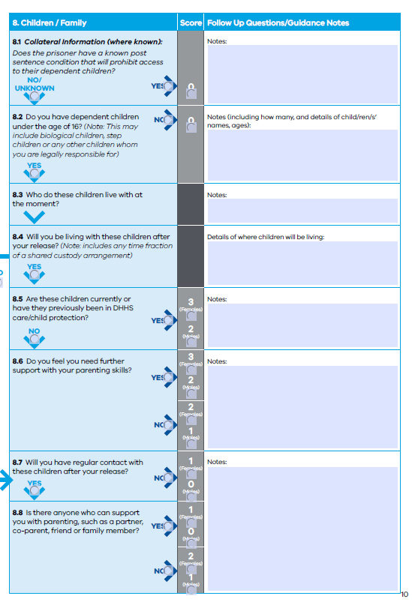
Parents in Custody
Reintegration Assessment
Reception Assessment
Victorian data demonstrates
In 2021, 53 percent of people entering prison custody (52 percent of men and 61 percent of women) reported that they had children.
Six percent of people entering custody in 2021 (10 percent of women) reported that they had legal custody of children.
A survey of women entering custody in 2021 found that 48 percent had at least one child under 18 years.

Slide 6
Continued Connections Through Visits
All prisons facilitate in person personal visits – each having varied times and days. In person visits are for up to two hours. Most metropolitan prisons facilitate visits each day.
Other visits, programs and permits: school holiday program (Tarrengower), primary caregiver permits, mother and child access programs.
The Family Ties (Primary Care Giver) Permit – allows a prisoner who has been the primary caregiver of a child or children or a sick or elderly relative prior to imprisonment, to maintain family ties.
The focus is the welfare of the child which is normally served by the maintenance of a close relationship with a parent and requires contact on a regular basis. The safety and welfare of the child is paramount.

Slide 7
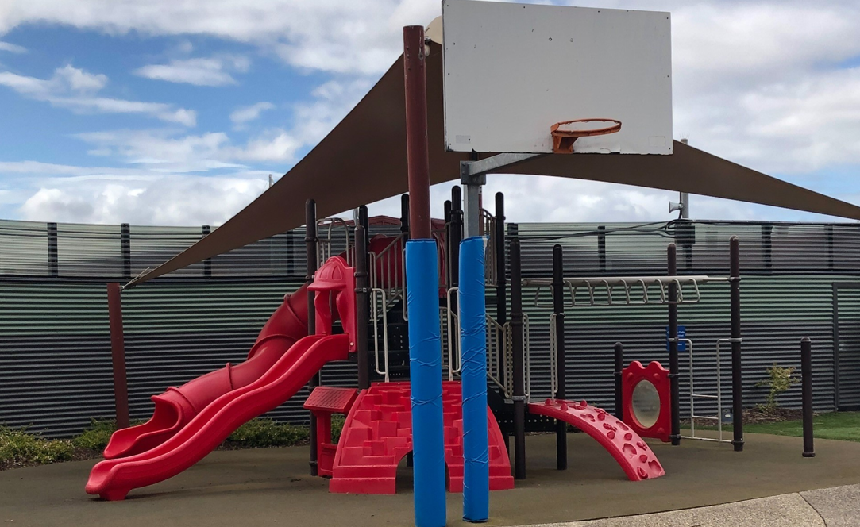
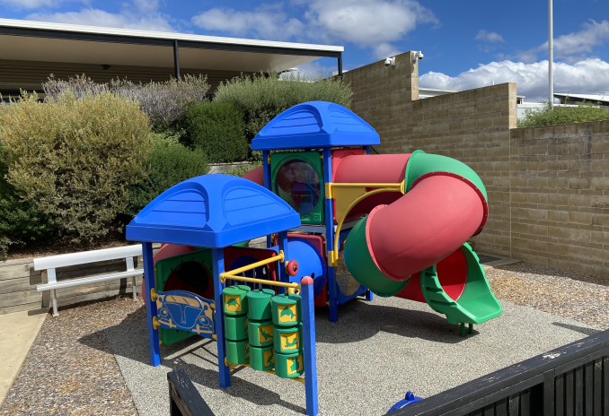
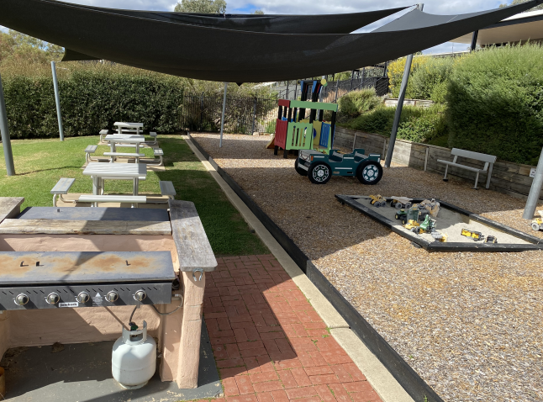
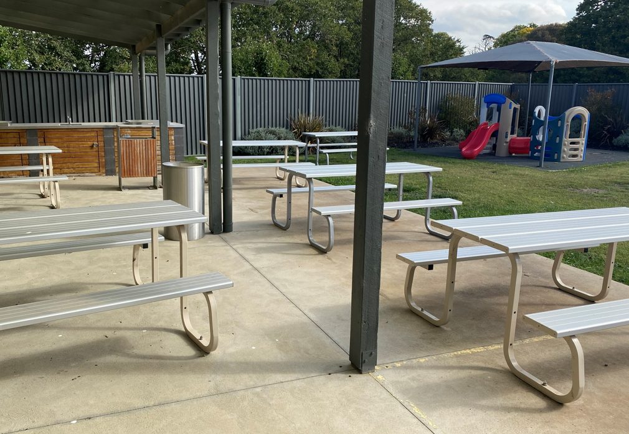
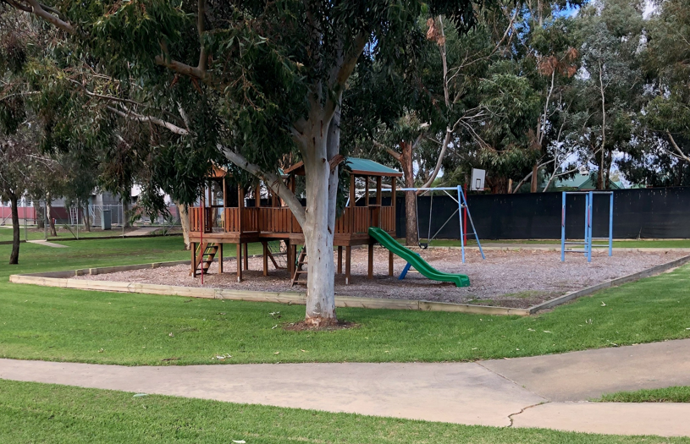
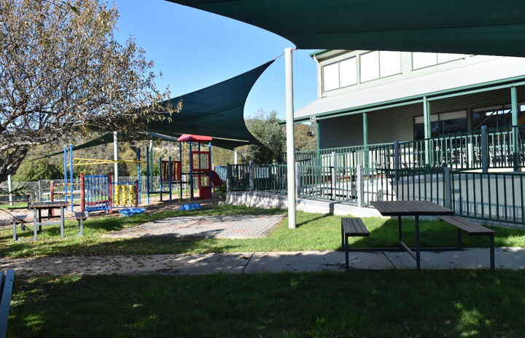
Our Visit Spaces
Dame Phyllis Frost Centre
Beechworth Correctional Centre
Langi Kal Kal Prison
Dhurringile Prison
Tarrengower Prison

Slide 8
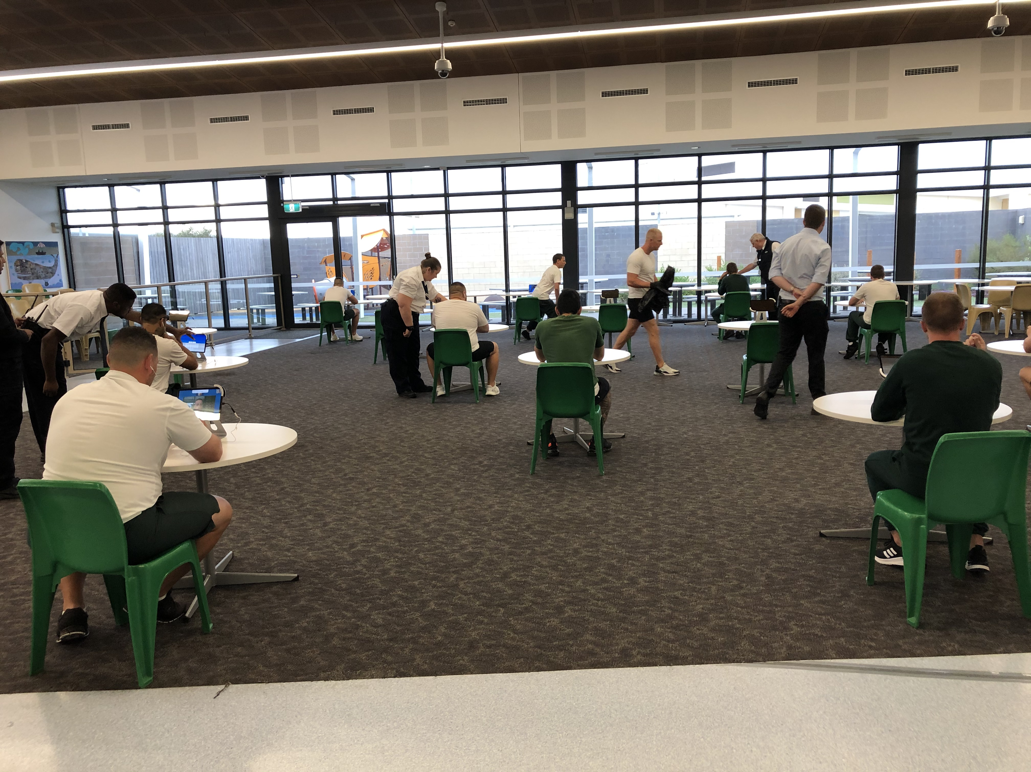
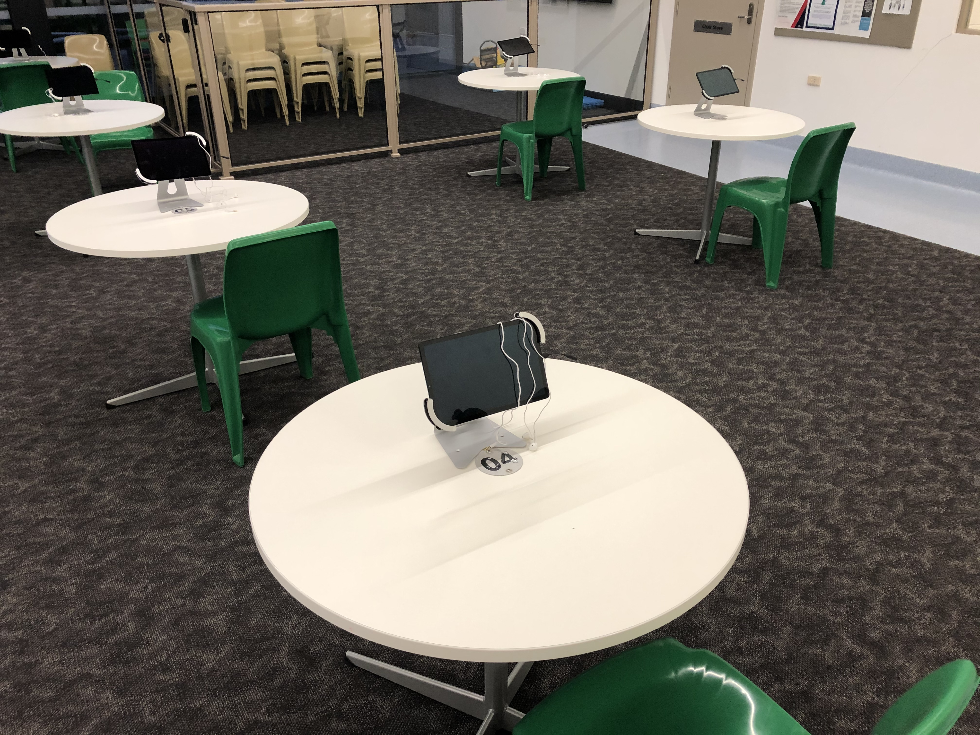
Use of technology to support family connection – complement face to face visits
Access to video visits has continued following the resumption of in person visits. Video visits complement face to face interactions.
A total of 139,542 personal video visits were conducted between 1 July 2021 and 31 March 2022 across public and private facilities. This is approximately 60,000 more than in person visits conducted over a comparable period.
Technology provides people with the ability to connect in a way that adds to rather than takes away from in-person visits.
It allows people to have a relationship outside the sterility of visits centres and to support and strengthen connections. This includes more regular contact with family members who may be interstate or overseas, but it also provides a different kind of interaction, seeing a person’s child within the family home, seeing the family dog, or helping their child with their homework.
Video visits at Ravenhall Correctional Centre

Slide 9
The Living With Mum Program
The living with Mum program in the women’s system aims to diminish the impact of a mother’s imprisonment on her dependent children and supports family ties.
Women in custody who are pregnant or who are the primary carers of young children may apply for the Living with Mum Program. The program is available for infants and children of a pre-school age.
Assessment, eligibility and the program is centred on what is in the best interests of the child.
There are currently three children in the program, located at Tarrengower Prison. Numbers are low due to the COVID-19 Pandemic.
Children and parents reside in dedicated units that meet community standards for the safe, and secure housing of children. These units are cottage style living with self-contained kitchens, living areas, bedrooms, and bathrooms.

Slide 10
A Programmatic Response
Over time, just how fundamental family connections are has become more widely understood.
This has led to innovation and a further development of CV’s suite of family engagement and parenting programs.
.
Principles
Outcomes
Understanding the importance of family relationships while a person is in custody
Understanding the importance of kinship and culture to Aboriginal people and their families
Recognising the impact and unique challenges faced by children when a parent or caregiver is sent to prison
Recognising families as an important source of support for people in prison
Promoting the value of family connections throughout a persons contact with the justice system
Understanding the importance of family relationships as a motivating force to desist from reoffending
Increase in parenting knowledge
Increase in quality of family relationships
Improved outcomes for children of incarcerated parents
Improved understanding of family engagement and supports

Slide 11
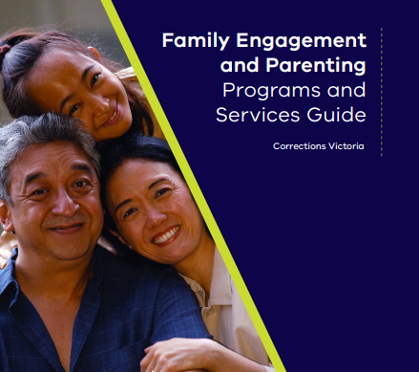
Family Engagement and Parenting Programs and Services Guide
Released in March 2022 this guide describes CV’s response to family engagement across the Victorian prison system and provides an in-depth description of the prison programs and initiatives aimed at increasing family engagement opportunities for people in prison.
Based on an evaluation of the Marngoneet Correctional Centre Inside Parenting Program.
Expanded Triple P into 11 sites in late 2019.
CV staff undergo four days training by Triple P to become accredited facilitators, they must maintain this accreditation and are professionally supervised by Triple P.

Slide 12
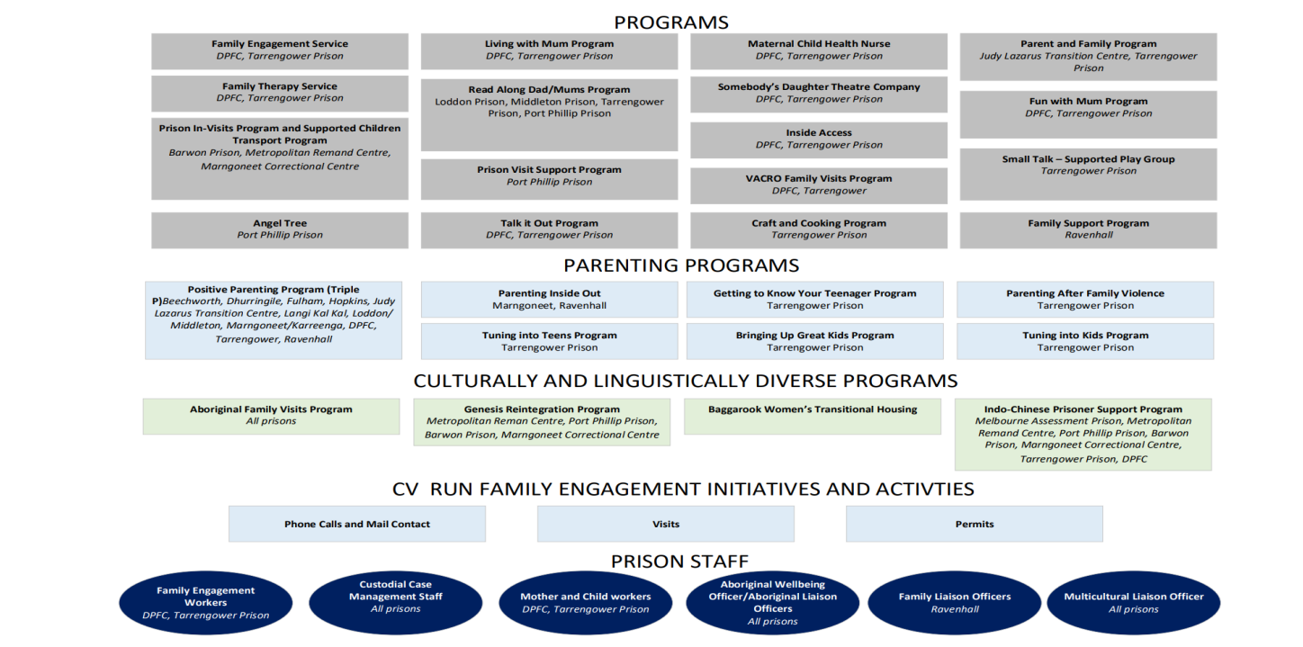
Our Programs and Services

Slide 13
Thank you

