Slide 1
La Trobe Autonobus Shuttle Trial
Professor Aniruddha (Ani) Desai
Director, Centre for Technology Infusion

Slide 2
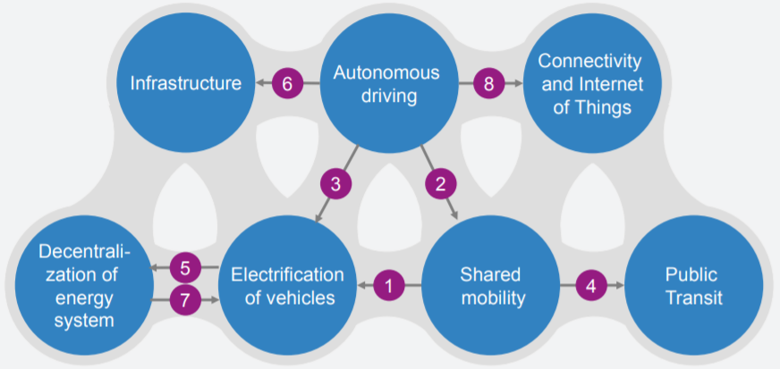
Pillars of Future Transport – Electric, Connected, Automated & Shared
Reinforcing effects accelerate individual mobility trends
Shared mobility to accelerate electrification
Self-driving could merge shared mobility business models making it more competitive
Self-driving likely to inc. consumption of mobility making electrification more viable
An uptake in shared mobility will affect public transit
Electric vehicle volume production to reduce battery cost
Self-driving EVs will have different usage and charging infra. needs
Increasing renewables will make EVs more attractive for a greener transport sector
Self-driving vehicles might accelerate the uptake of IoT applications
Source: Source: Bloomberg, McKenzie & Co.
Notes:
An uptake in shared mobility will accelerate electrification, as higher utilization favours the economics of electric vehicles
Self-driving could merge shared mobility business models into a single proposition competitive with private car ownership and public transport
Self-driving – private and shared – vehicles are likely to increase mobility consumption in which case electric vehicles offer lower total cost of ownership
An uptake in shared mobility will affect public transit
Electric vehicle production at scale would accelerate battery cost reductions, with multiple effects
Self-driving electric vehicles will have different usage and hence requiring different requirements for charging infrastructure
Increasing renewable power generation will make electric vehicles more attractive as a means to reduce the carbon intensity of the transport sector
Self-driving vehicles might accelerate the uptake of IoT applications
Source: Bloomberg, McKenzie & Co. AN INTEGRATED PERSPECTIVE ON THE FUTURE OF MOBILITY (Oct 2016)

Slide 3
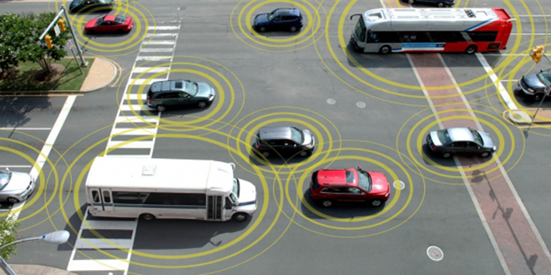
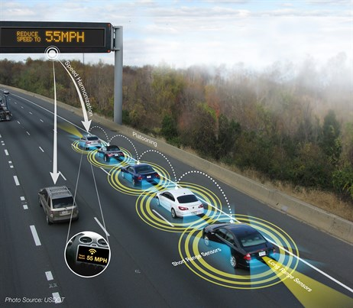
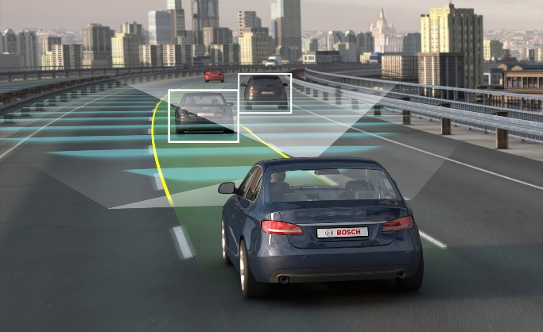
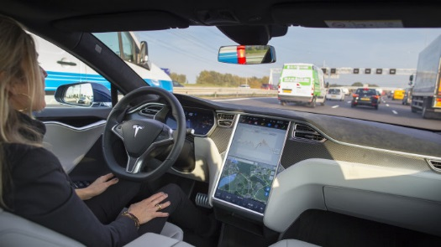
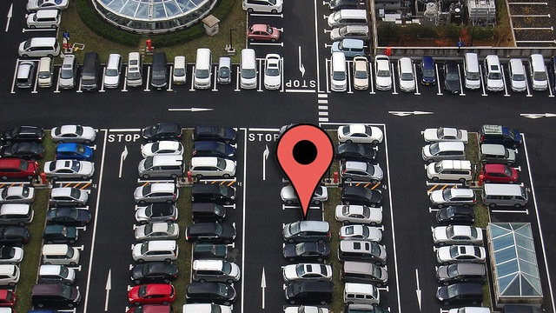
Connected Autonomous Vehicles (Some Potential Impacts)
Avoidable congestion:
$53.3 billion per annum by 2031 (IA)
Victoria modelling for 10 years to 2026:
~9% mode shift or
23-25% inc. capacity needed on 10% road links
Vehicle Cooperation
Central Management
Road accident cost:
$27 billion per annum
Over 187,000 road deaths since 1925
1600 deaths PA
Collision Avoidance
Pressureless Driving
Long term: Urban planning and private vehicles
Parking land is poor land utilisation
Private vehicle is a fast depreciating
& mostly idle asset
Notes:
Road accidents
The annual economic loss in Australia is an estimated $27 billion per annum (Department of Infrastructure and Regional Development)
Over 187,000 road deaths since 1925
1600 deaths PA
Driver error accounts for 75% of roadway crashes in Australia (Salmon et al. 2005)
Traffic congestion
The future avoidable social costs of traffic congestion in Australian cities has been estimated by Infrastructure Australia at up to $53.3 billion per annum by 2031 with total vehicle usage (in vehicle kilometres) increasing by 35%. (Infrastructure Australia Plan 2016)
Road crashes in AUS and NZ cost more than 2% GDP annually
The annual economic loss of road crashes in Australia is an estimated $27 billion per annum (Department of Infrastructure and Regional Development)
Since records have been kept in Australia (1925) over 187,000 road deaths have been recorded.
Driver error accounts for 75% of roadway crashes in Australia (Salmon et al. 2005)
http://advi.org.au/wp-content/uploads/2016/09/ADVI-Economic-Position-Paper-30-09-2016-3.pdf

Slide 4






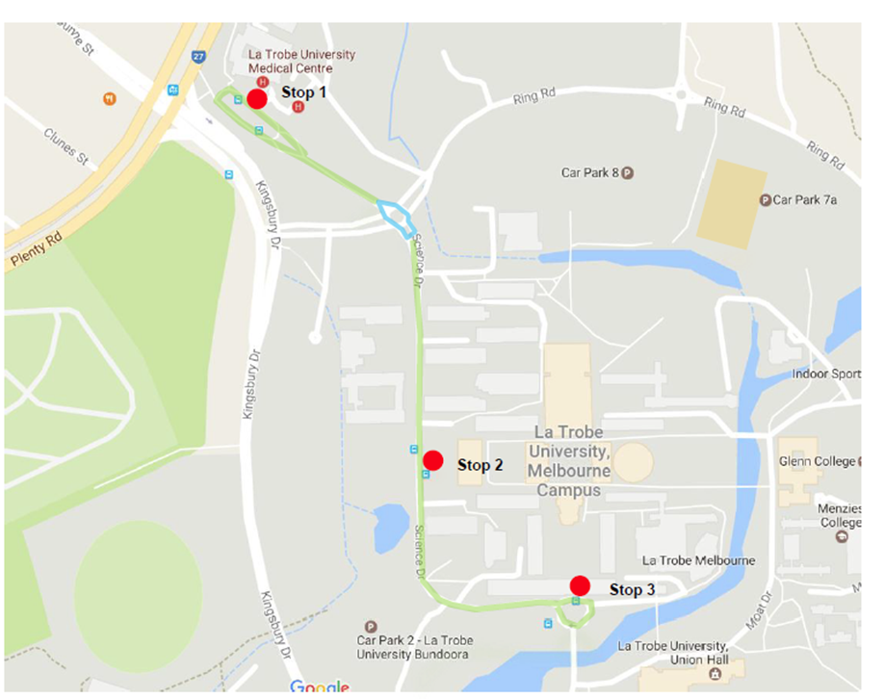
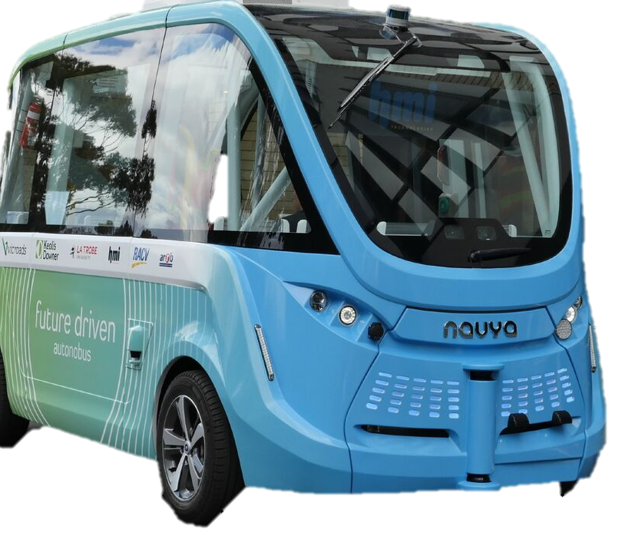
La Trobe Autonomous Vehicle Trial
In Partnership with the leading transport institutes, La Trobe University
will be the first Victorian ‘public’ road* trial of an Autonomous Vehicle
* The route though Science drive consists of a private road, but is close to public road as there are other road users
Notes:
First AV Shuttle trial in Victoria
First real-use case trial – LTU campus & first and last mile connectivity

Slide 5
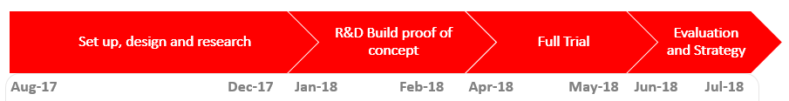
La Trobe AV Trial: Objectives
Explore use of AV Shuttles to address last mile access and integration with existing modes and promote potential for AV for new mobility solutions
Expected Outcomes
  Safety case: Develop a safety case for the operation of an AV shuttle
  Technical platform: Evaluate AV technical platform on a precinct, inc. public roads
  Operational framework: Develop a framework to operate AV shuttles and other types of AVs
  Customer Feedback: Obtain feedback from users of AV shuttle to help guide decision making on their long term use in "last mile" operations
  Commercial framework: Develop the commercial frameworks to operate AV shuttles, including risk allocation matrix between suppliers, operator, precinct/ road managers and third parties
  Regulatory: Help understand regulatory and legislative changes needed

Slide 6
Thank you
For information: please contact:
Professor Aniruddha (Ani) Desai
Director - Centre for Technology Infusion
La Trobe University Melbourne, Australia
M: 0425359041 E-Mail: a.desai@latrobe.edu.au

Slide 7
La Trobe AV Trial: Timing
First testing: Summer Holidays. Second Trial: April and May 2018
Set up, design and research
R&D Build proof of concept
Full Trial
Evaluation and Strategy
Aug-17 |  |  | Dec-17 | Jan-18 | Feb-18 | Apr-18 | May-18 | Jun-18 | Jul-18
Project commencement Confirmation of routes Use case development Safety case Research method Infrastructure works Stakeholder and communication plan Launch event |  |  |  | Site preparation and route mapping, Fully functioning proof of concept on trial route |  | Live operational trials in a real-use case context of last mile access at La Trobe |  | Review and report

