Slide 1

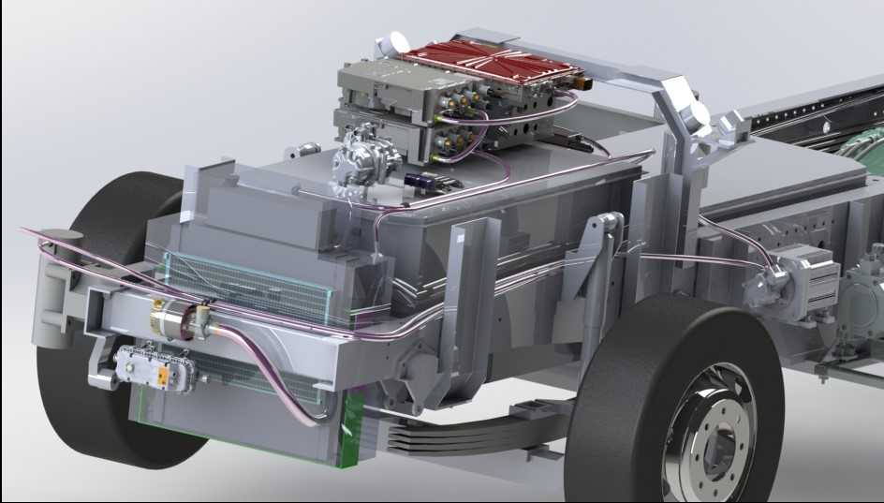
SEA Electric – Inquiry into EV’s
Tony Fairweather – Managing Director
12.30 Wed 8th Nov
1
1

Slide 2
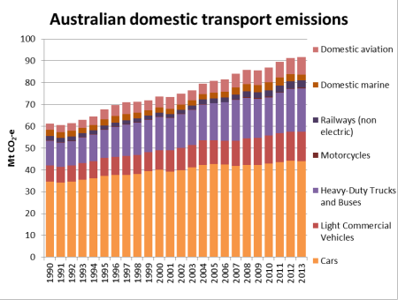
Why Electric Trucks?
Australian Statistics:
Transport = 16% of total emissions (85% of that from road transport)
600k trucks (30k new pa)
18m cars
(Vic approx. 30% of each)
30 times more cars than trucks
Applications more suited
Greater noise reduction benefit
Source: Truck Industry Council

Slide 3
SEA Electric
SEA is a Victorian automotive technology company which has developed 100% electric vehicle (EV) drivetrain (known as SEA-DriveTM), for adaptation to a vast range of commercial vehicle donor chassis’ – including SEA’s own exclusive vehicle range
With an engineering team lead by one of the world’s most successful and experienced electric commercial vehicle engineers, our SEA-DriveTM is the most effective and cost efficient electric drive system for commercial vehicles in the world.
With lithium ion batteries now below USD300kWh, the commercial vehicle market has no option but to transition to 100% EV
SEA’s adaptable and proven SEA-DriveTM technology enables OEM’s to execute an electrification program on any suitable-size platform, with low cost on very short lead times.

Slide 4
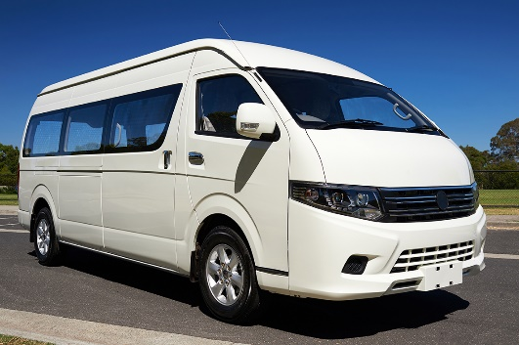
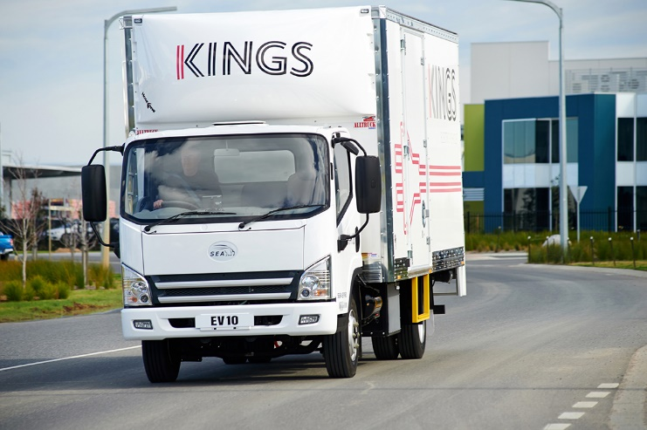
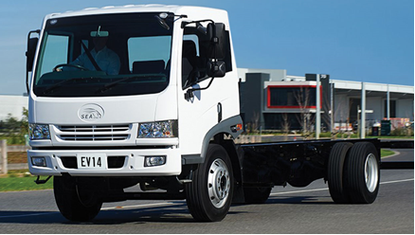
SEA Exclusive CBU Models
SEA EV10
SEA E4V
SEA EV14

Slide 5
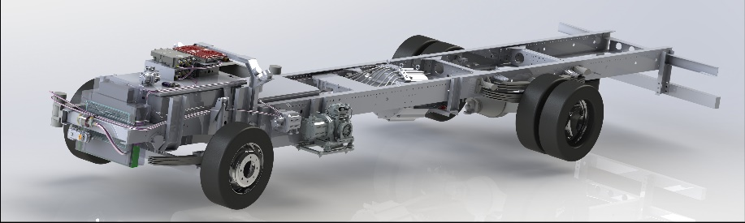
SEA-DriveTM Platforms
SEA-DriveTM 70:
  Created for 5m-7m delivery van (i.e. 6-10 cubic metre) or minibus vehicles
  70kWh battery pack with range up to 200km
SEA-DriveTM 120:
  Created for 9-12t truck cab chassis’
  120kWh* battery pack with range up to 180km
SEA-DriveTM 140:
  Created for 13t-25t truck cab chassis’
  140kWh* battery pack with range up to 180km
  * Both the SEA-Drive 120 and 140 have 40kWh battery module options that allow increased range or ancillary operations, like compactor bodies for waste collection

Slide 6
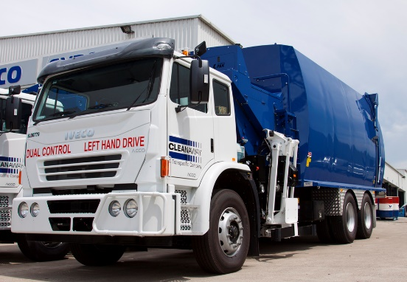
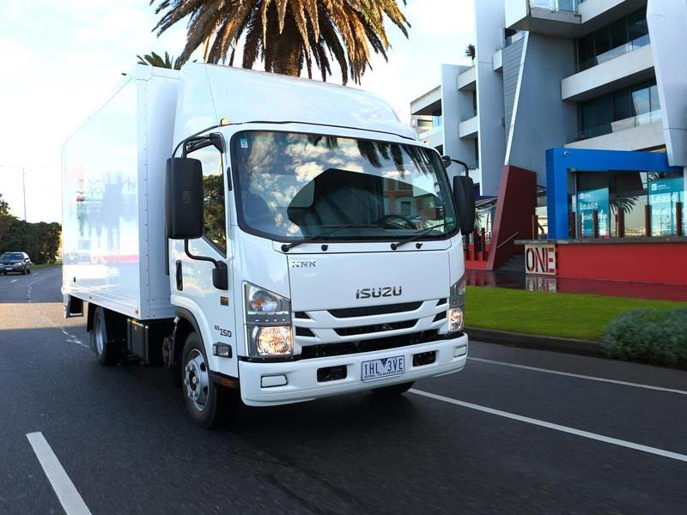
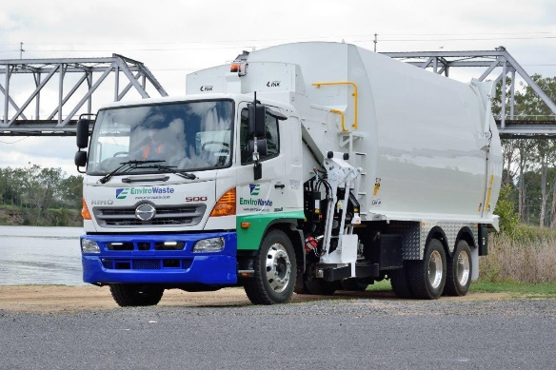
SEA Victorian Projects
SEA ACCO EV
SEA NEV
SEA GHEV

Slide 7
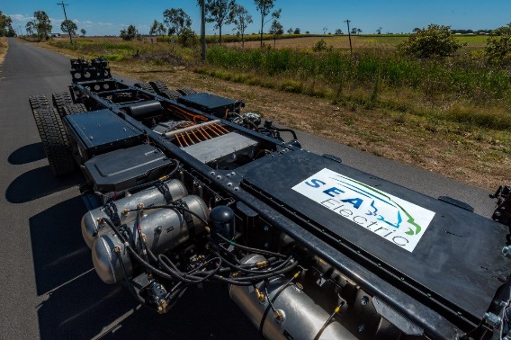
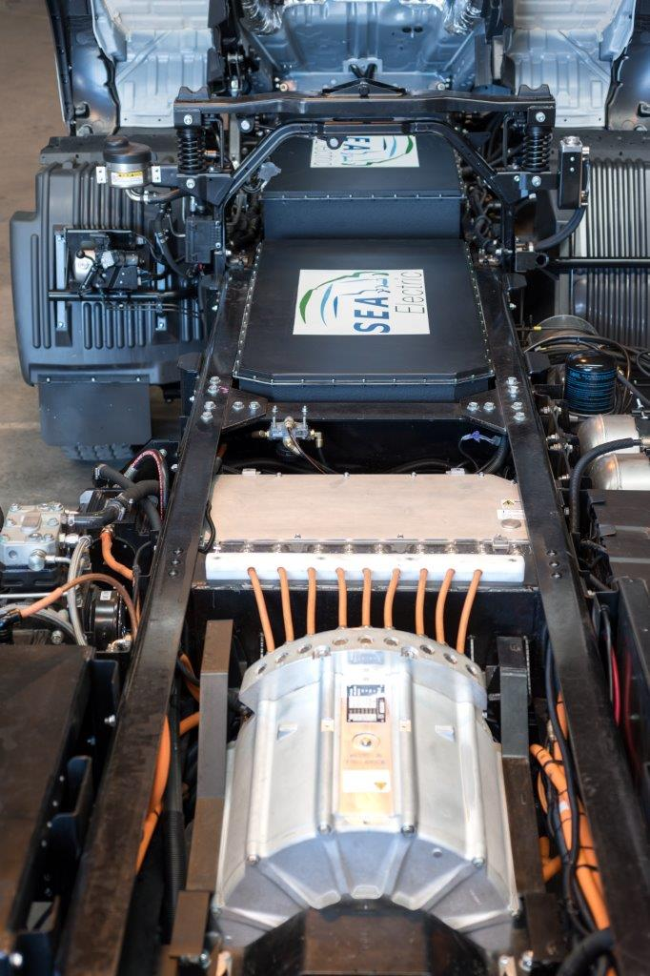
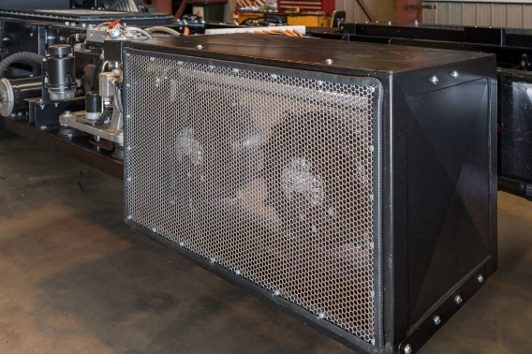
SEA-DriveTM 140 Installation

Slide 8
EV Incentives that Influence
Increased allowable GVM to manufacturers rating for EV’s
  E.g. Iveco ACCO built for 25t but restricted to 22.5t
Increase car licence range to 6t GVM for EV’s - as per New Zealand (from 4.5t GVM)
  This would drive substantial uptake with Woolworth’s/Cole’s home delivery vehicles and truck rental market – high volume segment
Relax noise restrictions on access for commercial EV’s
Toll reduction or elimination for EV’s
Access to Bus-Ways and other restricted roads
Preferential CBD parking allowances (including fine exemptions) for EV PUD vehicles

Slide 9
Other EV Incentives
The reduction or elimination of registration costs for EV’s
Coordination of preferential retail/commercial charging rates for EV users – like AGL has introduced
  Note the SEA-Drive has an on-board 22kW charger, so no additional charging infrastructure is required
Similarly, the coordination of preferential retail/commercial insurance options for commercial EV’s
The elimination of import duties for all components used in the supply of EV technology
Targeted rebates for first time buyers of commercial EV’s to facilitate the initial uptake

Slide 10


