Slide 1

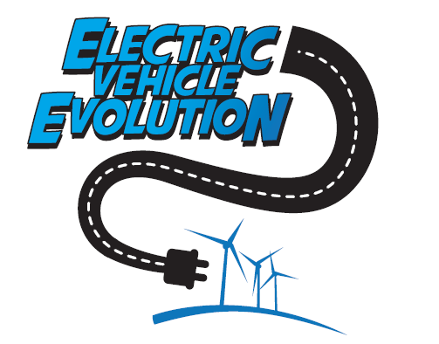

Transition to
Zero Emissions
Fleet
Notes:
Transition to zero emissions fleet.
Moreland has long been renowned for its strong stance on climate change and environmental sustainability initiatives
We’ve been working aggressively on carbon reduction projects since Council adopted a Carbon Management Strategy back in 2010
There are three main areas of focus in Councils operations those being buildings, public lighting and fleet and having achieved significant reductions in the buildings and public lighting areas our focus in this presentation is fleet operations

Slide 2
Purpose
  Understanding the urgent need to reduce emissions from fleet operations;
  Recognising the inefficiencies associated with continued use of internal combustion engines;
  Acknowledging the devastating environmental and social impact the combustion of fossil fuels is having on local community's and the natural world;
  Progressively moving renewable energy into the fleet fuel space
Notes:
As part of Councils sustainability journey we understood the need to reduce emissions from our fleet operations which represents around 20% of total emissions
We believe a key element on a path to zero emissions fleet is the adoption of alternatives to internal combustions engines and their gross inefficiencies.
This fact often gets lost in the debate over Biofuels where even if they can be sustainably sourced you are still effectively wasting up to 75% of the energy in the process of converting the fuel to motion
Whereas electric vehicles can operate anywhere up to 85% efficient.
And most importantly we recognized the urgent need to take action to address the devastating environmental and social impact the combustion of fossil fuels is having on local communities and the natural world and the science is telling us we need a transition now not in 10 or 20 years time
So with knowledge gained through various studies commissioned by Council and ongoing research by technical officers, we drew the conclusion that electric drivetrains powered by renewable energy sources are the key to a zero emissions fleet operation.
More specifically that renewable powered Battery Electric Vehicles will likely fill the majority of the personal transport space and Fuel Cell Electric Vehicles will likely fill the majority of the commercial transport space on a path to a zero emissions transport strategy.
And of course EV’s allow an easy transition to renewable energy to power our mobility and transportation methods.

Slide 3
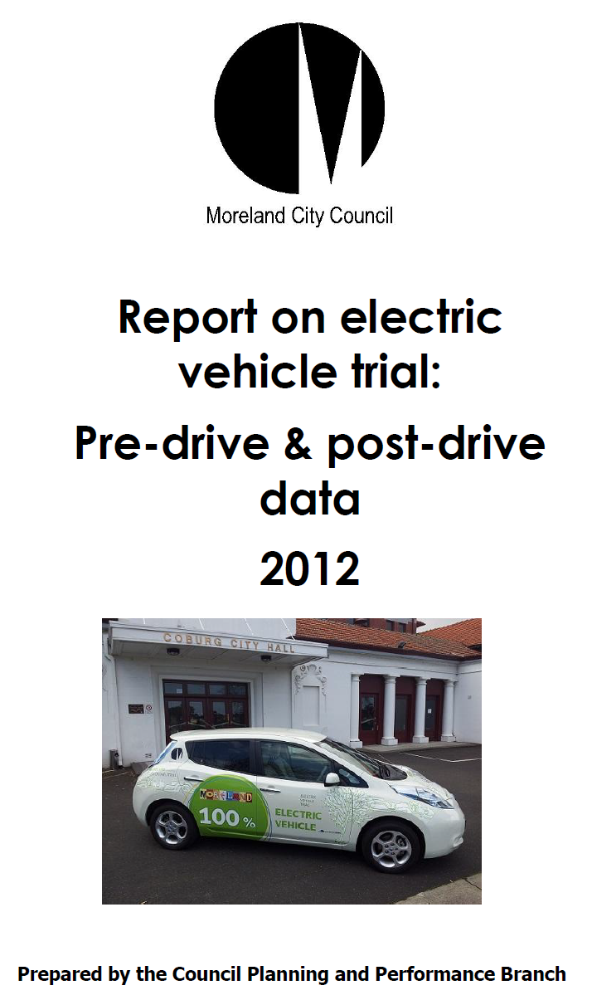

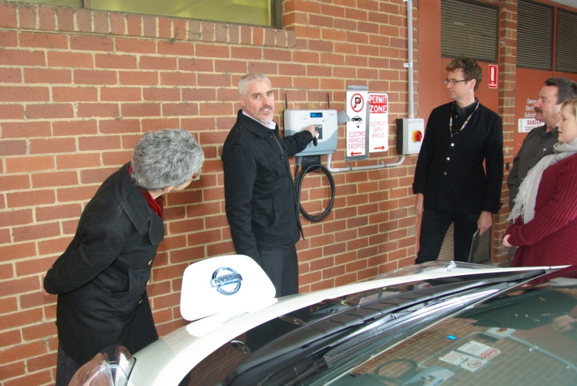
Electric Vehicle Trial
  Successful participation in the Vic EV trial
Notes:
The starting point of Moreland's transition to zero emissions fleet was to participate in Victorian Govts EV trial back in 2012 and get an understanding how EV’s might operate in our fleet
Morelands participation in the Vic govts EV trial (Round 2) was one of the more successful
The Nissan Leaf operated in Councils fleet pool for 6 months – staff training was introduced to encourage participation
The EV was the most popular pool vehicle by a margin of 2-1 and covered more than 15,000kms over the 6 months, one of the highest of any vehicle in the govt trial
To understand the impact of introducing EV’s to staff we conducted a pre/post drive survey to gauge reaction to the trial which received high praise from the Vic govt as a useful piece of research that may well be used in their final report

Slide 4
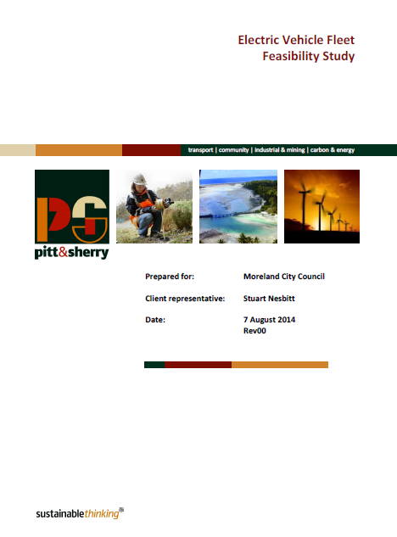
Electric Vehicle –
Fleet Feasibility
Study
Notes:
Following a successful participation in the Vic govt EV trial, Councils ESD unit submitted that EV’s would provide a positive environmental and cost benefits outcome if operated in Councils fleet
The Council executive called for more detailed analysis so Pitt & Sherry were commissioned to produce a comprehensive feasibility study in 2014
The study looked at a wide range of issues but key criteria was a direct lifecycle cost of ownership comparison between a Hybrid Camry, which at the time was considered a baseline vehicle in Councils fleet, and a Nissan Leaf EV

Slide 5
Purpose
  To understand the pros/cons of moving Council’s light fleet vehicles to EV;
  To promote the wider environmental & social benefits and operational savings opportunities to fleet operators and all tiers of government;
  To demonstrate leadership in sustainable transport transition
Notes:
Following Councils successful involvement in the Victorian Govts EV trial in 2012 we wanted to understand the pros and or cons of operating EV’s in a fleet operation and to receive some professional evaluation
Promote environmental benefits to community and business and to the local government sector – we believe it’s a corporate responsibility for all tiers of government to feed the used vehicle market with more fuel efficient and sustainable vehicles
Demonstrate leadership - Moreland already enjoys a reputation as a leader in the EV space with the first EV fast charger in Victoria (second in Australia) and hosts one of the largest number of public EV charging stations provided by any Council in Australia. We hope this leadership will have flow on effects to other sectors (community, government and business)

Slide 6
Feasibility Study - Key Focus Issues
  Carbon emissions;
  Peak oil/Fuel security;
  Local air quality;
  Alignment with renewables & NCOS;
  Lifecycle operational savings;
  Reputation/Leadership
Notes:
Carbon emissions – The report confirmed that offsetting the emissions of an EV over an ICE vehicle is more cost effective and less complicated because it can be achieved directly using renewable energy (Moreland is an NCOS carbon neutral organization)
Peak Oil – Need to reduce our dependence on predominantly imported fossil fuels for transportation to reduce the risk of supply chain issues effecting Councils ability to provide services to the community. And the price signals that Peak Oil influences will ultimately continue to increase the cost of fossil fuel
Local Air Quality – Identified as a significant benefit of large scale use of EV’s in high density urban areas – Important to align growth in EV’s with growth in renewable energy supplied grids to ensure carbon neutral operation and also so you're not shifting a problem elsewhere.
Food for thought - The Clean Air and Urban Landscapes Hub at Melbourne University published a report earlier this year. The report concluded that “Air pollution due to vehicle emissions is estimated to have caused 1715 deaths in Australia in 2015 - greater than the national road toll in that year”
Operational savings – Electricity costs can be controlled with onsite renewable energy production and bulk purchasing contracts. Fossil fuel prices cannot be controlled and will progressively rise as Peak Oil and global supply & demand factors weigh in
Reputation/Leadership – Council enjoys an enviable reputation in the EV space and is regularly referenced by govt and industry leaders as at the forefront of EV advocacy

Slide 7
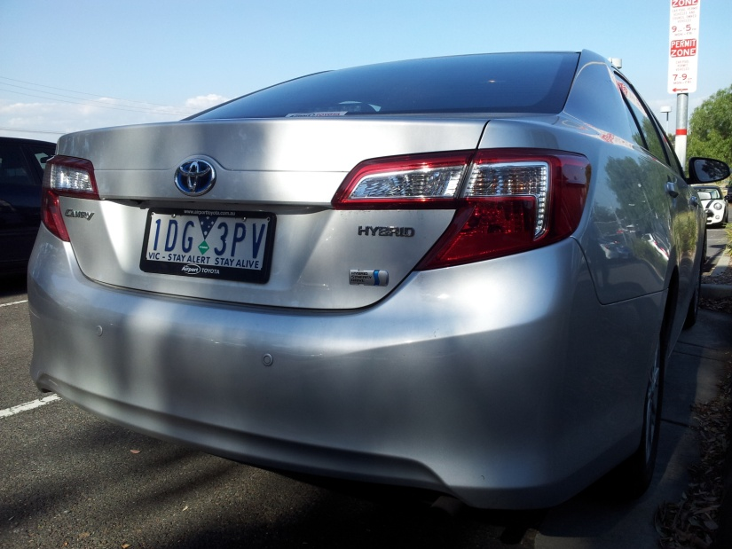
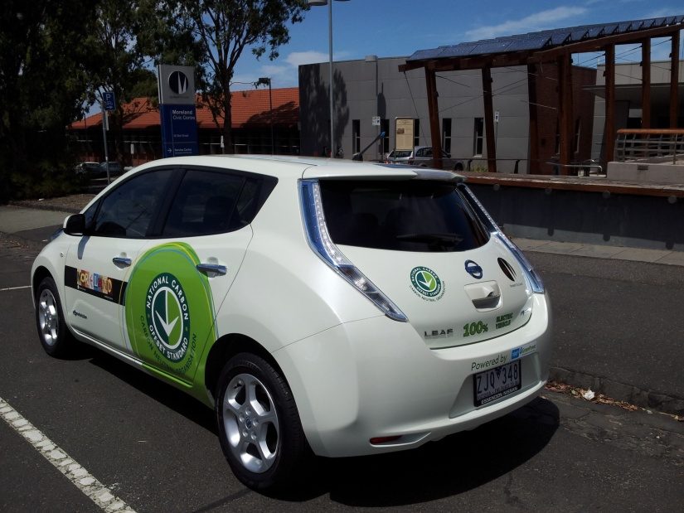
Feasibility Study – Base case comparison
  Whole of life cost of ownership analysis
VS
Results: “The benefit cost ratio for the adoption of Nissan LEAFs in the Moreland City Council fleet in place of Hybrid Camry’s at 7% discount rate was 1.48 indicating a sound investment” – Pitt & Sherry 2014
Notes:
Base case fleet comparison
As part of the feasibility study Pitt & Sherry were asked to conduct a comprehensive whole of life cost of ownership assessment between operating one of our base case fleet vehicles (Hybrid Camry) with the Nissan Leaf battery electric vehicle in Councils fleet operations
They were provided with all Councils actual fleet operational costs & parameters from existing vehicle variants, fuel/electricity costs, maintenance, insurance, financial and used industry standard return on investment methodologies for calculating depreciation and resale values
The results showed that even though the Nissan had a higher up front purchase price ($10K) - over three years and/or 60,000kms operating in Councils fleet the savings in fuel costs and maintenance would generate a saving of ($2.5K) to Council over and above the higher purchase price when compared with the Hybrid Camry
And of course the other benefits that come with operating EV’s (zero emissions using renewables, no fossil fuel dependency and local air quality improvements are all in addition to the operational cost savings with an EV)
Its important to remember that when this study was done the Councils purchase price differential between to the two vehicle variants was $10K but this gap is expected to narrow if momentum for EV adoption gathers pace

Slide 8
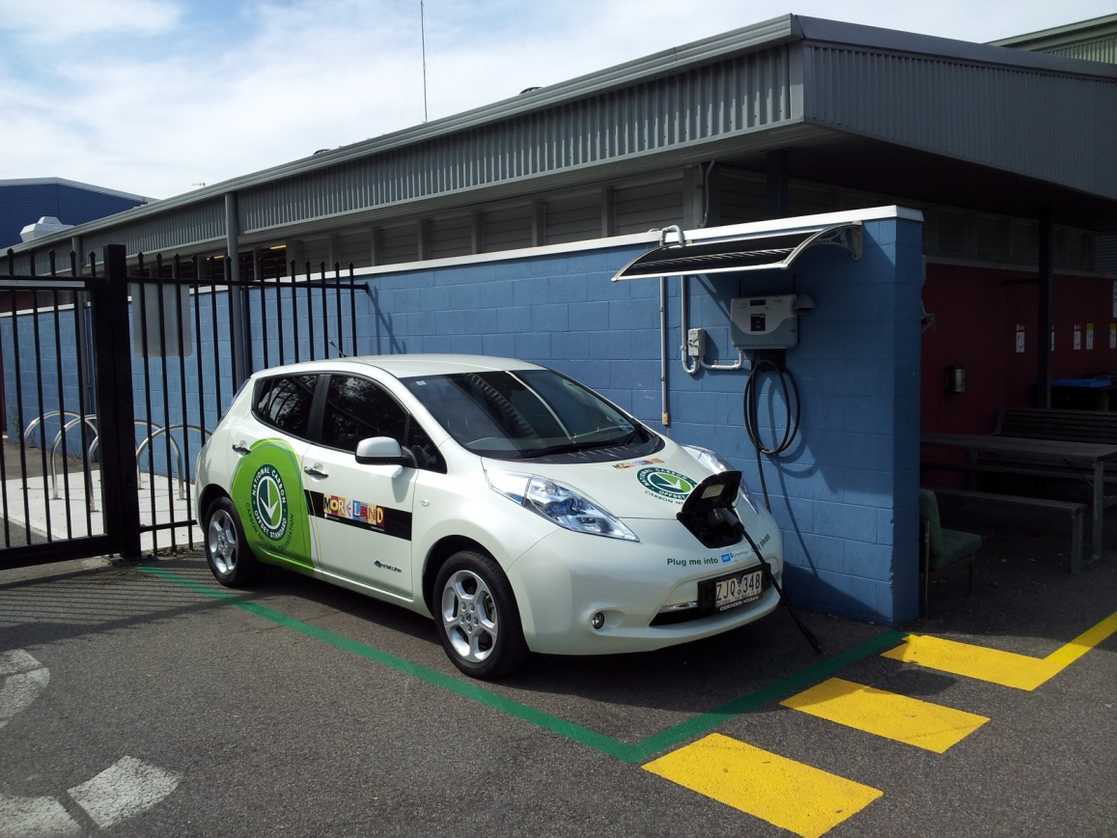
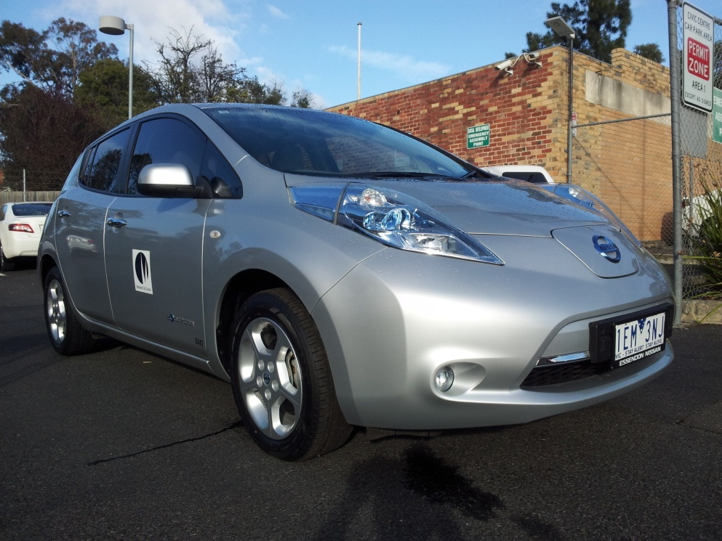
Fleet EV’s
  Successfully operating EV’s in Councils fleet
Notes:
Council introduced its first EV into fleet operations in early 2013 immediately following the EV trial
The vehicle sports special livery to promote EV’s and support Councils NCOS accreditation – if you like a mobile billboard for Councils environmental credentials
The car is still the most popular pool vehicle in Councils fleet. We find that staff actually prefer to use EV’s over other vehicles………. its quite amazing how staff have embraced EV culture
We currently operate four EV’s in the fleet with a commitment from Council to add two additionally EV’s annually as a gradual transition to a zero emissions fleet

Slide 9
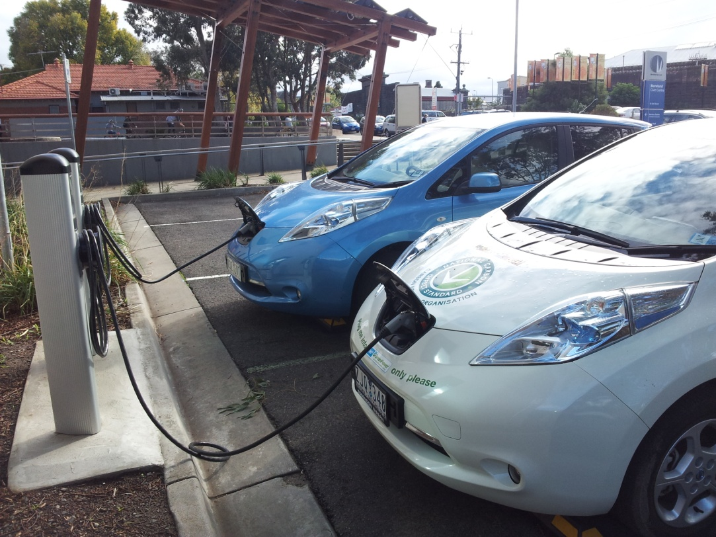
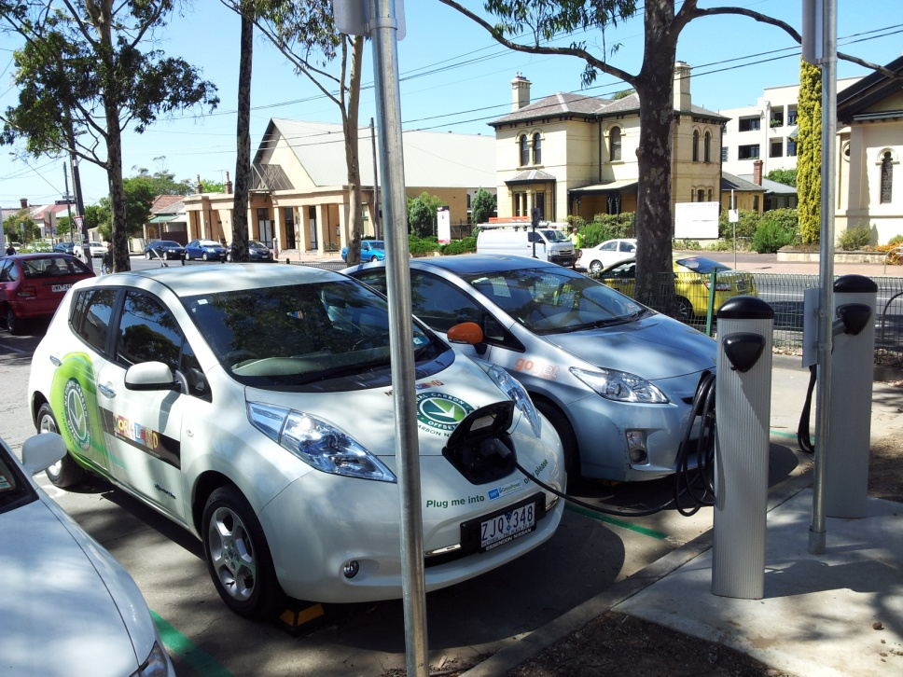
Charging network
  Developed a network of public EV charging stations owned/operated by Council
Notes:
With the support of the Vict Govts EV trial as the stimulus an EV charging network has been established around the municipality
Moreland enjoys a reputation as a leader in the EV space and hosts a network of one of the largest number of public EV charging stations owned & operated by a Council in Australia (6 public stations and 5 private).
It was important to Council that all Moreland's stations were available free to use with 24/7 access as part of our EV advocacy encouraging early adopters
A further 2 quick charge points are currently under construction as part of a community facility development in Pascoe Vale

Slide 10
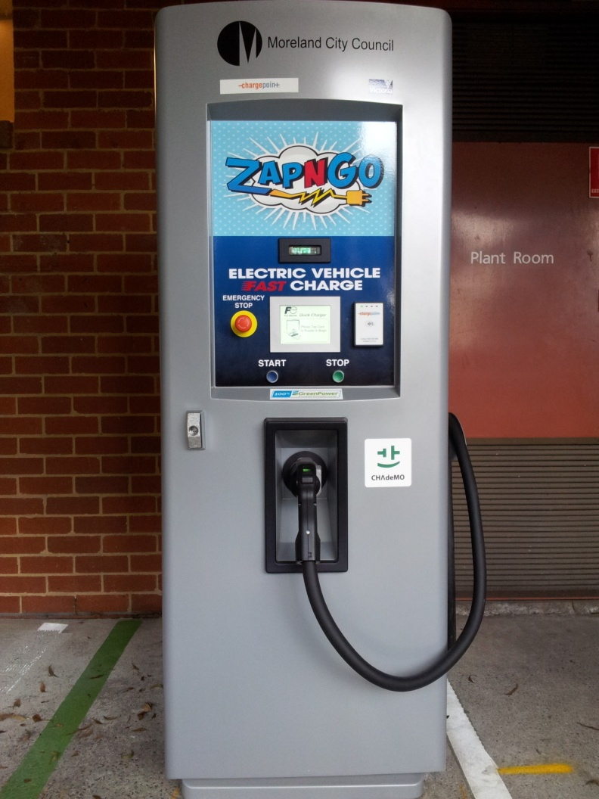
ZapnGo!
  ....including Victorias first EV FAST charge station!
Notes:
And the network includes the first EV fast charger installed in Victoria (second in Australia)
We dubbed the station ZapnGo!
EV owners have been known to travel across town to use this station. They find it convenient to quickly top up for their return journey
Trivia – The first person to officially use the first public EV fast charging station in Victoria was a Melbourne tram driver and early adopter of EV’s with a new Nissan Leaf who just happened to be in the area and checked has smart phone app to find the station had gone live 20 minutes earlier even though it hadn't been officially launched….

Slide 11
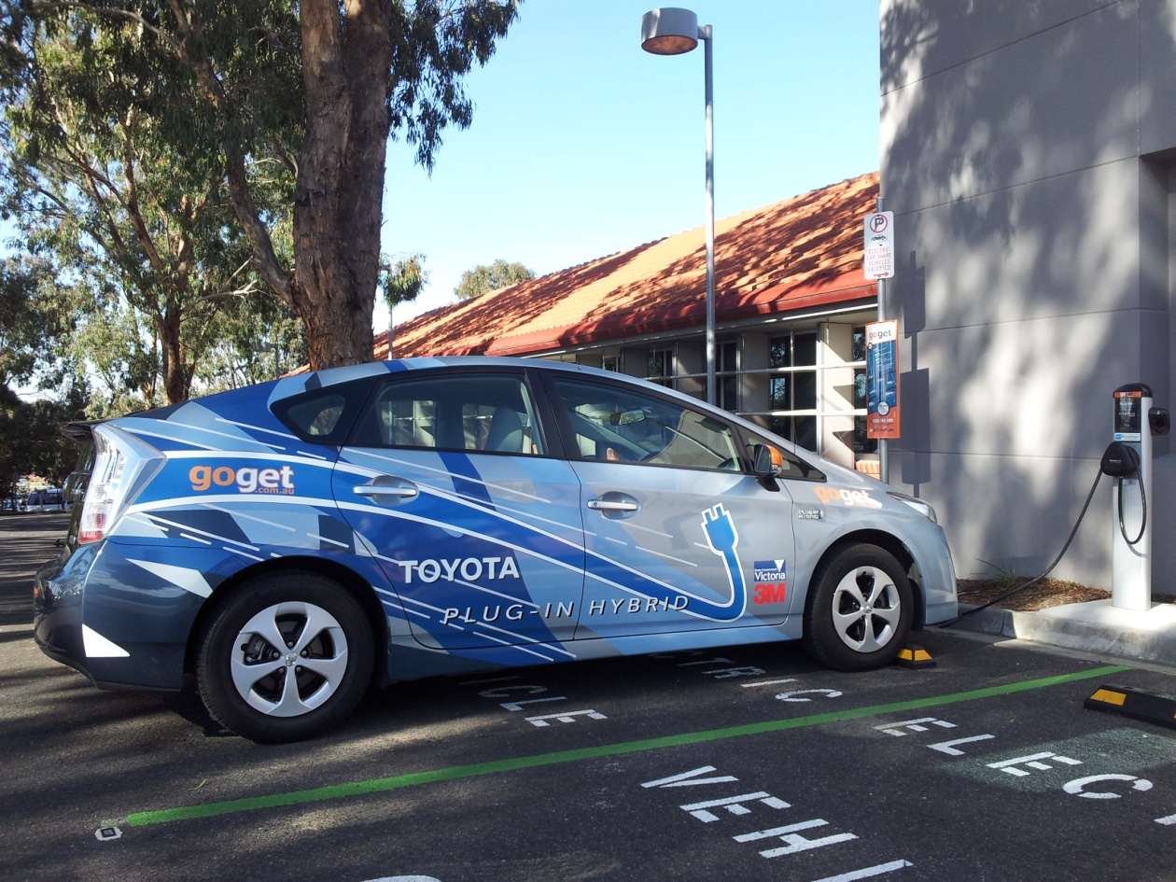
EV car share?
  ....and the first plug-in electric car share service!
Notes:
Partnering with the Vic Govt, Chargepoint, GoGet and Toyota - Council was asked to host two plug in electric hybrids to assess the feasibility of operating EV’s as a car share service
The trial was also seeking to assess the feasibility of a business (Council) sharing a vehicle with the general public to improve the viability of the service
The trial was so successful it continued beyond the official end date (July 2014) with Toyota providing the vehicles for an extended period in order to gather more data
The trial verified the likely benefits of low emissions car share opportunities

Slide 12
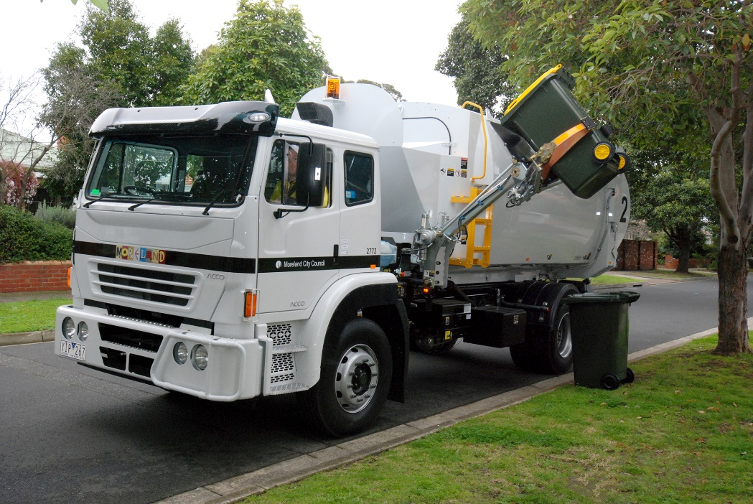

Heavy transport zero emissions
Hydrogen (100% renewable powered) fleet refuelling station planning & design underway
$1mil Vic Govt support through NEJF
Hydrogen fuel cell powered electric waste trucks
Transitioning away
from fossil diesel fuel
& internal combustion
engines
Notes:
Moreland are currently developing the first commercial scale 100% renewable hydrogen refuelling facility in Australia
The project has received $1mil funding support from the Vic Govt under the New Energy Jobs Fund
In a world first a Australian built Fuel Cell Waste truck called the ACCO ZE will be developed by CNH Industrial at their Dandenong assembly plant and pre production prototypes will be operated in Moreland's fleet prior to a production offering
The project signals the beginning of transitioning away from fossil diesel powered heavy vehicles and other Councils have signalled their intention to follow in Moreland's lead
Its important to note that fuel cell electric vehicles are also EV’s and Moreland's position is we need both battery electric and fuel cell electric vehicles to provide the diversity required to transition away from all forms of mobility currently utilising fossil fuel powered internal combustion engines

Slide 13
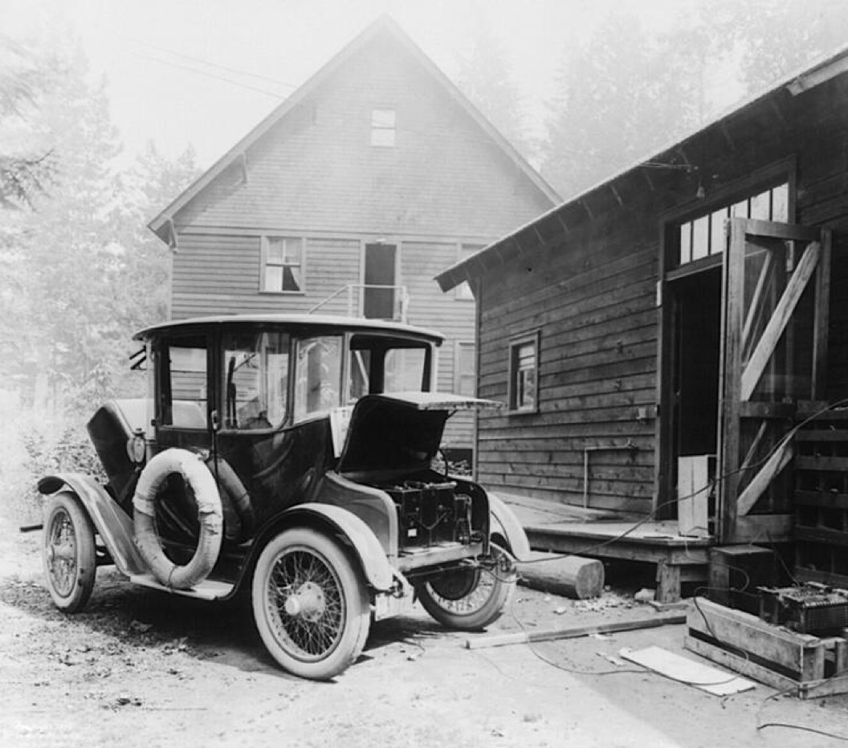
Electric Vehicles…
A new idea??
Maybe not.........
Notes:
Electric Vehicles.... A new idea right? Maybe not.....
For or a little bit of context I thought I’d throw in this photo
A lot of people will assume the electric car is a relatively new innovation but this photo shows a production version in 1914
Henry Fords collaboration with Thomas Edison produced the first production electric car
Theres a lot of conspiracy theory's going around as to why they didn't take off the way the ICE car did but the consensus is it had much to do with very powerful and influential people (lets call them the early oil cartels) discovering this black goop oozing out of the ground
And of course the main reason we’re revisiting the electric car now is because of the devastating effect all that goop has caused to the environment over the past 100 years
The Achilles heel of the early EV’s was energy density so improving mobile power storage technology was always going to be the key to their success.....

Slide 14
Failure to impose a cost on fossil fuels to reflect damages arising from their combustion effectively amounts to a subsidy and consequently an inefficient use of energy resources.
The “polluter pays principle” is
an irrefutable concept........
Notes:
And finally, here's a statement I extracted from a report written a few years ago by a consultant which exposes the barriers we traditionally experience in advocating a move to lower emissions in the transport sector. How often do you hear “it costs too much”
It points out that when comparing EV’s powered by renewables with fossil fuel powered ICE’s you need to compare apples with apples
In effect when making comparisons between the two modes you have to carry out the assessment using what they call “well to wheel” methodology and not purely operational economics. And when you do that you realise the fossil/ICE derivative inflicts significant environmental damage over its operational life compared to the renewable powered EV and that damage comes with downstream costs to the environment and human health. So it must be included in any business case…

Slide 15
How do we stimulate growth in zero emissions vehicles?
Recognise that market based mechanisms and policy levers such as incentives & rebates are needed to stimulate growth – operational economics alone is a flawed model
Introduce regulatory framework that rewards or penalises vehicles based on their ecological footprint – low emissions incentive
All tiers of government demonstrate leadership by operating the lowest emission vehicles in their fleets – hi volumes of low emissions vehicles entering the used vehicle market

Slide 16
Market based policy levers:
50% registration & stamp duty discounts for EV’s or designated low emissions vehicles for five years
Tax credits to offset the cost of installing charging infrastructure
Discounted or zero state sales tax on EV’s and charging equipment
Free to use charging stations at public facilities
Advocate the removal of Fringe Benefits Tax (FBT) applied to vehicles when EV’s are chosen for business use

Slide 17
Non market based policy levers:
Develop a state-wide EV target for Victoria
Develop collaborative zero emissions vehicle strategy with local government and other stakeholders
Mandate a fleet emissions policy of 100g CO2/km combined for government owned passenger vehicles
Phase out government fleet ICE purchases by 2025
Work with LGA’s to develop an EV bulk buy program to stimulate wider EV manufacturer imports
Initiate a state-wide study to identify strategic locations for destination charging with fast charge capabilities placing particular emphasis on regional centres and main transport corridors

