Slide 1
Victorian Parliamentary Inquiry into Electric Vehicles
‘Doing more with less’
Dr Elliot Fishman & Liam Davies
Institute for Sensible Transport
12th February 2018

Slide 2
Conclusions
What do you want Melbourne and Regional Centres to look like in 2060?
EVs are only as environmentally friendly as the electricity that powers them
EVs do not mitigate congestion, parking, safety or sedentary lifestyle disease impacts of regular cars
Incentives are required to boost uptake of EVs in conjunction with a wider package of mobility investment
Incentives targeted at the vehicles that drive the most

Slide 3
Melbourne: A growing city
7.7m people by 2051
7 million extra daily trips by 2040

Slide 5

Carrying Capacity, 3.5 Carriageway
Source: United Nations, 2013

Slide 7
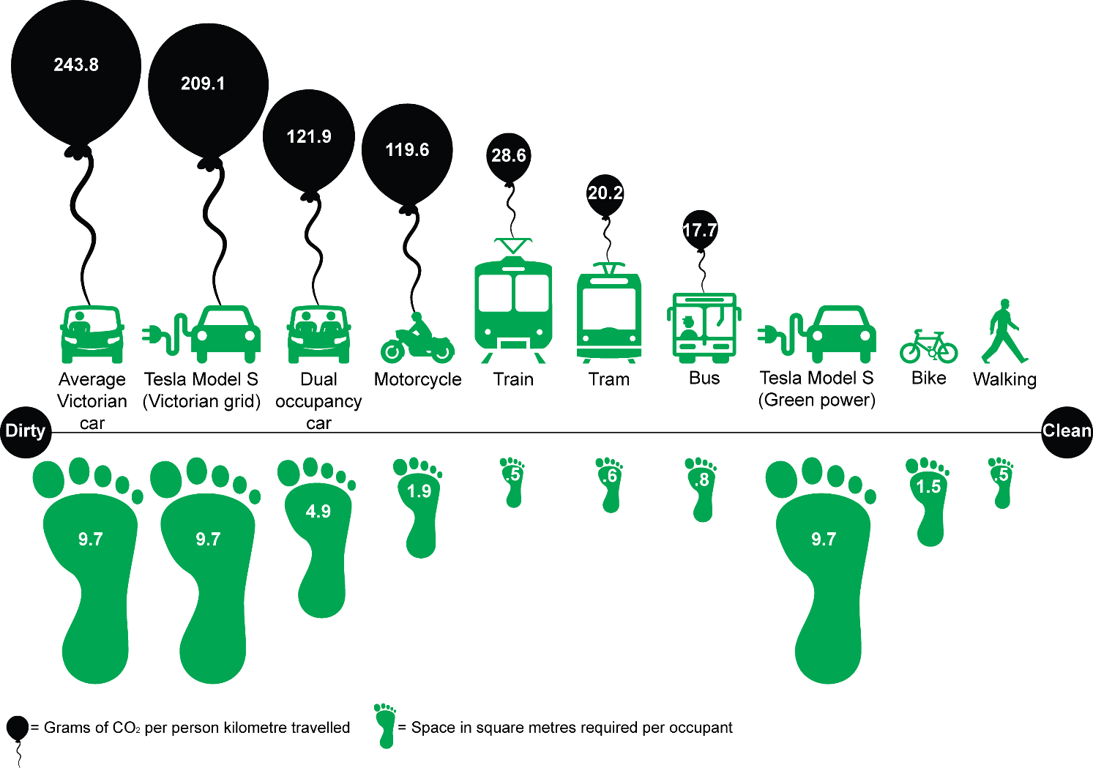

Slide 8
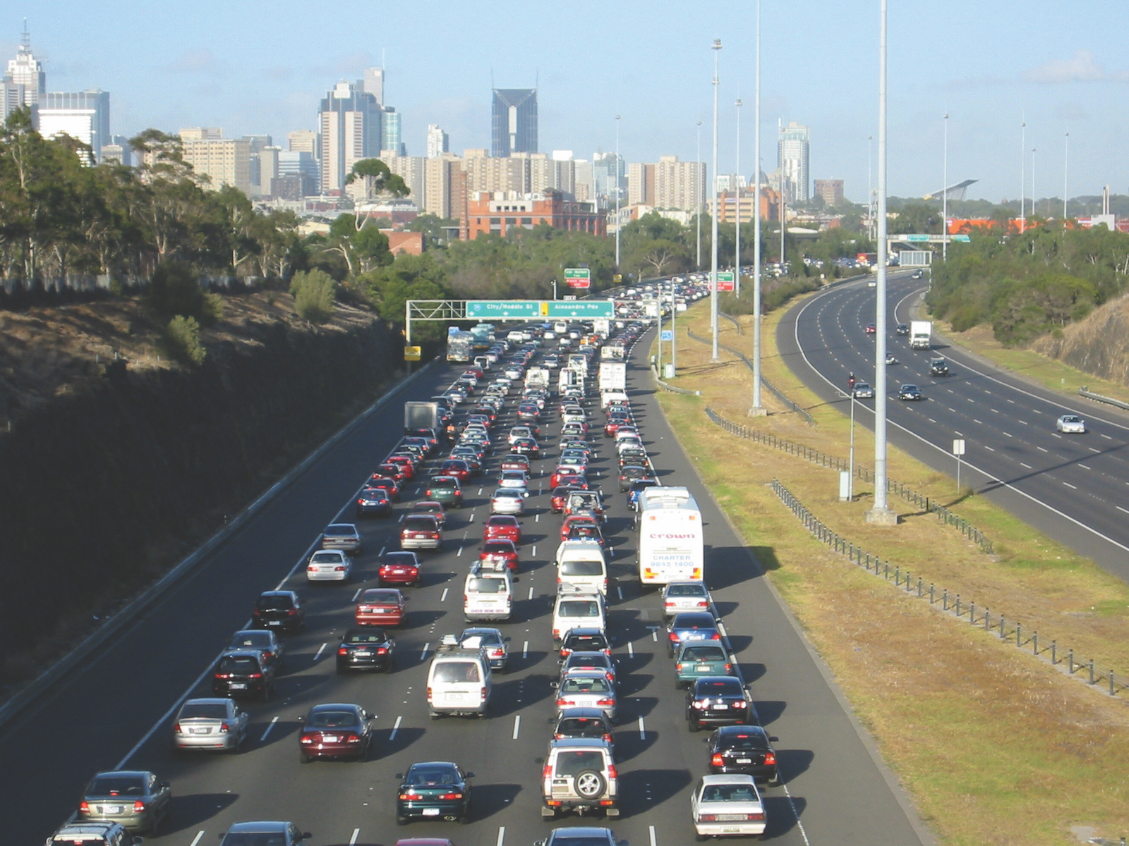

Slide 10
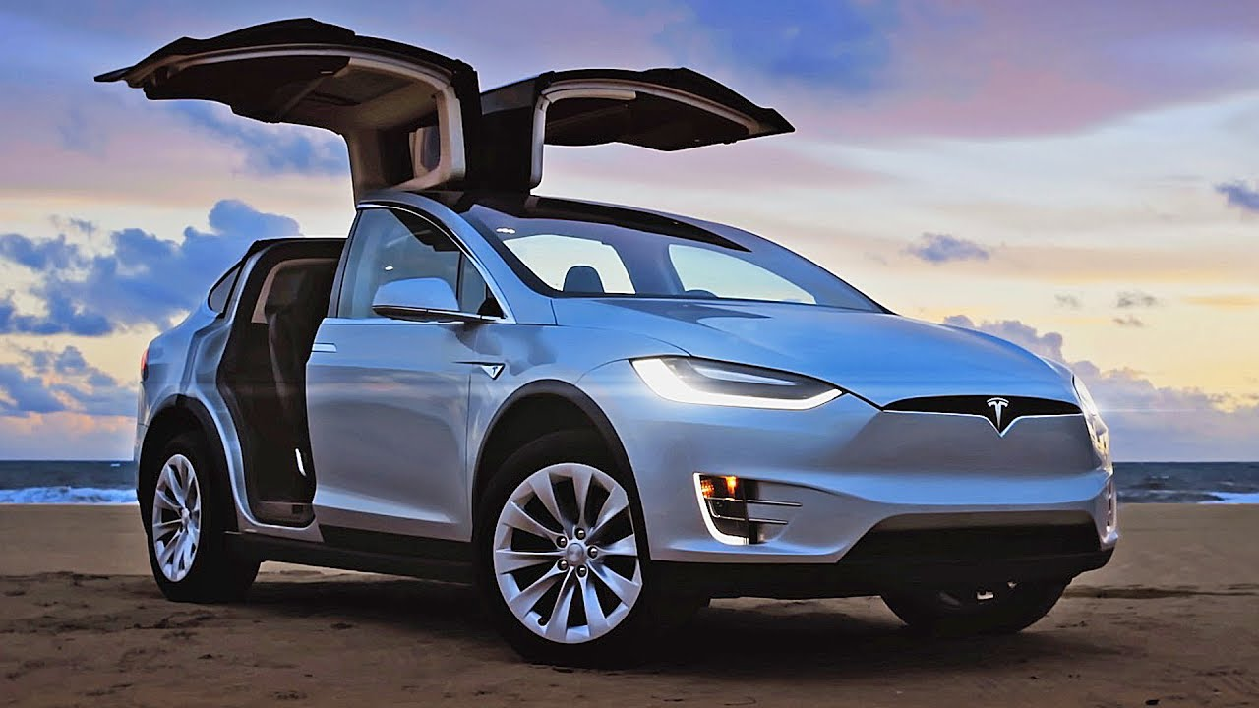

Slide 11
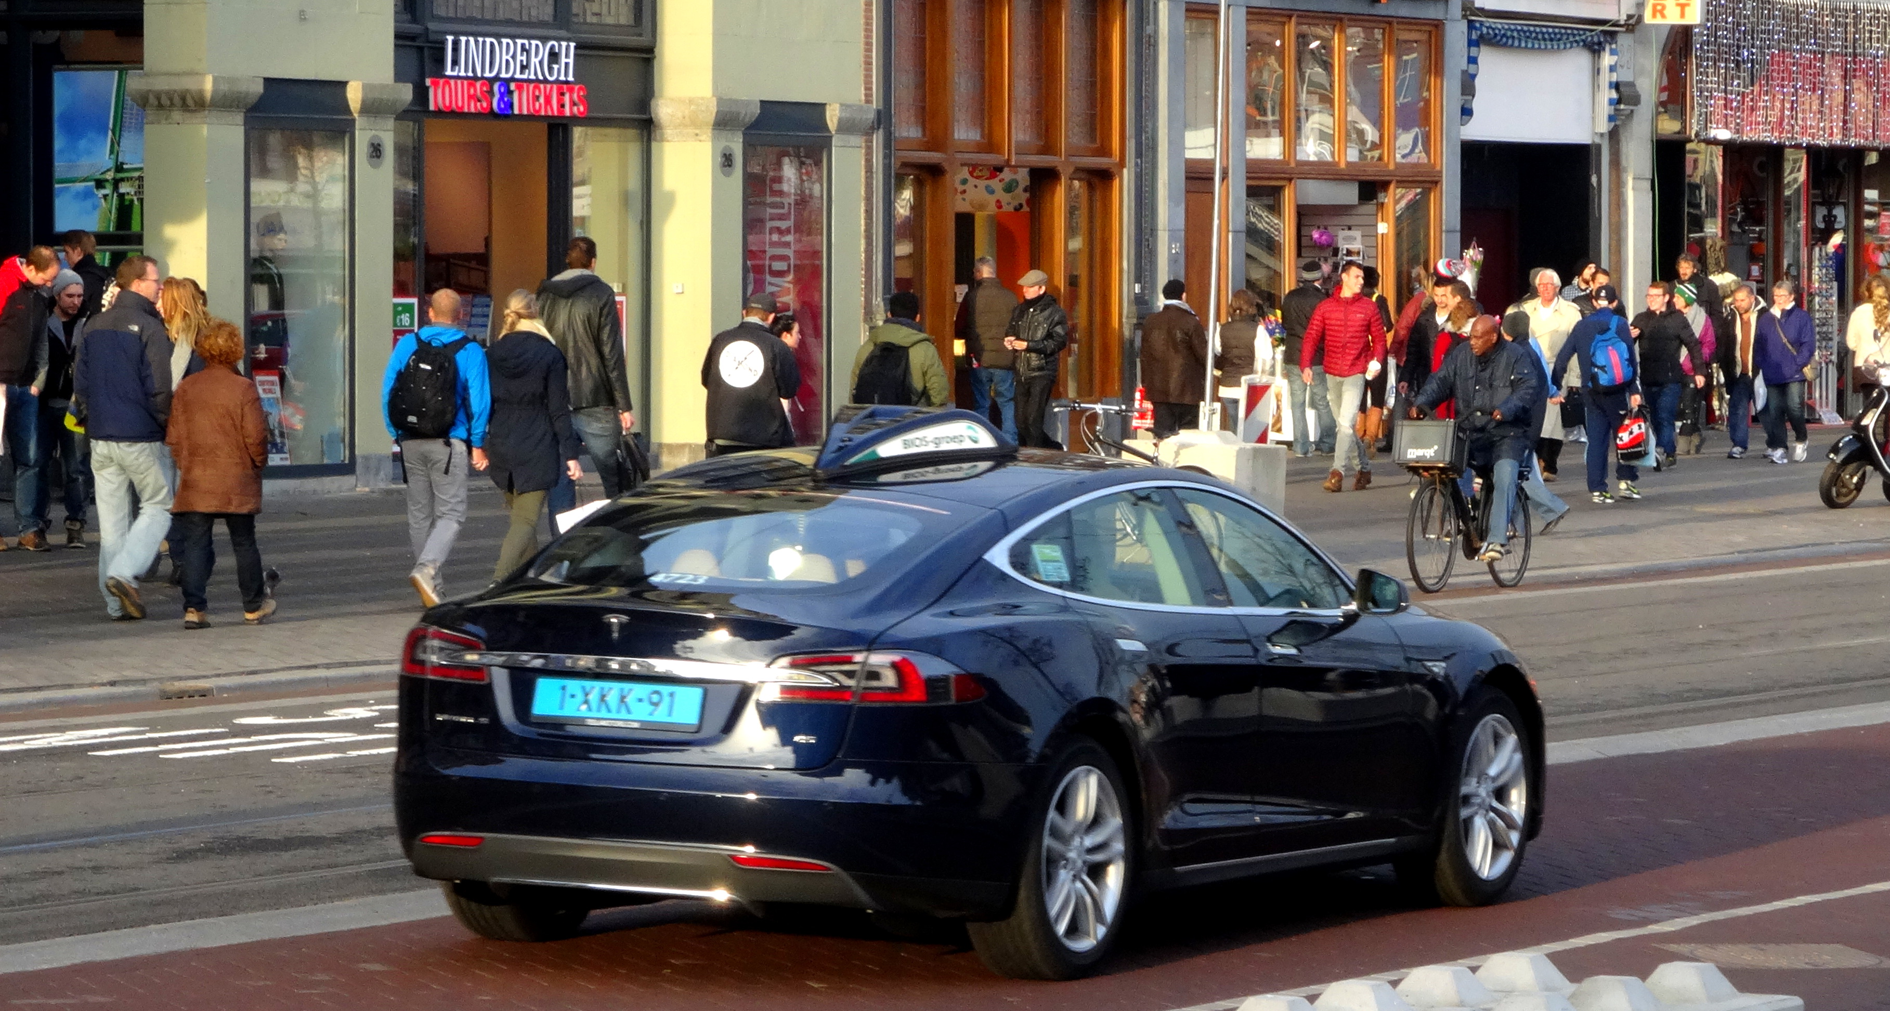

Slide 12
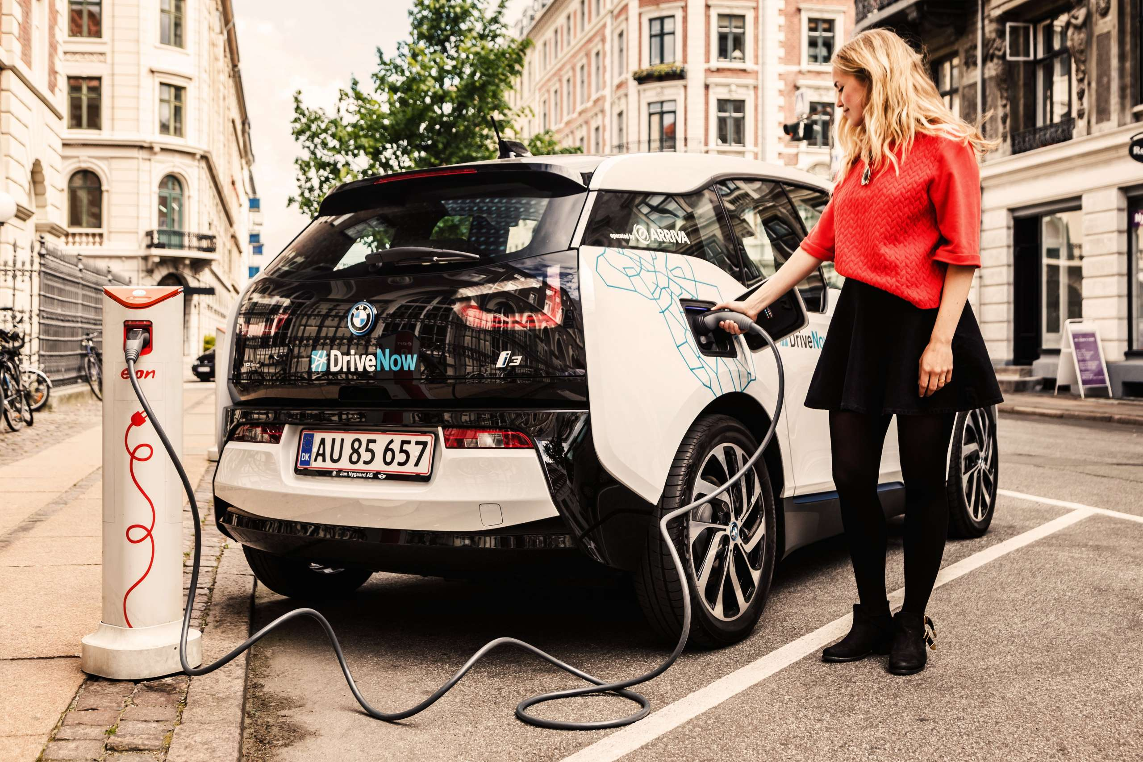

Slide 13
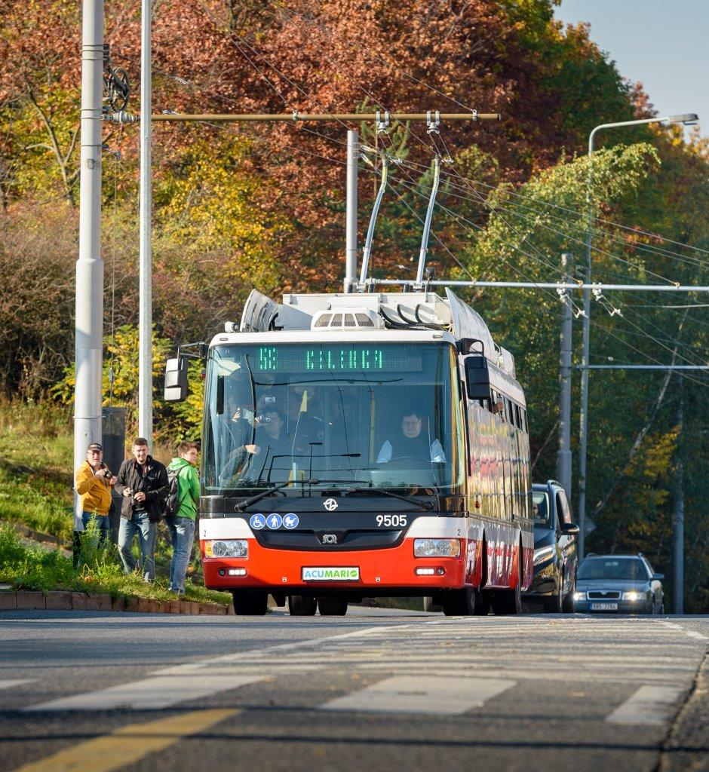

Slide 14
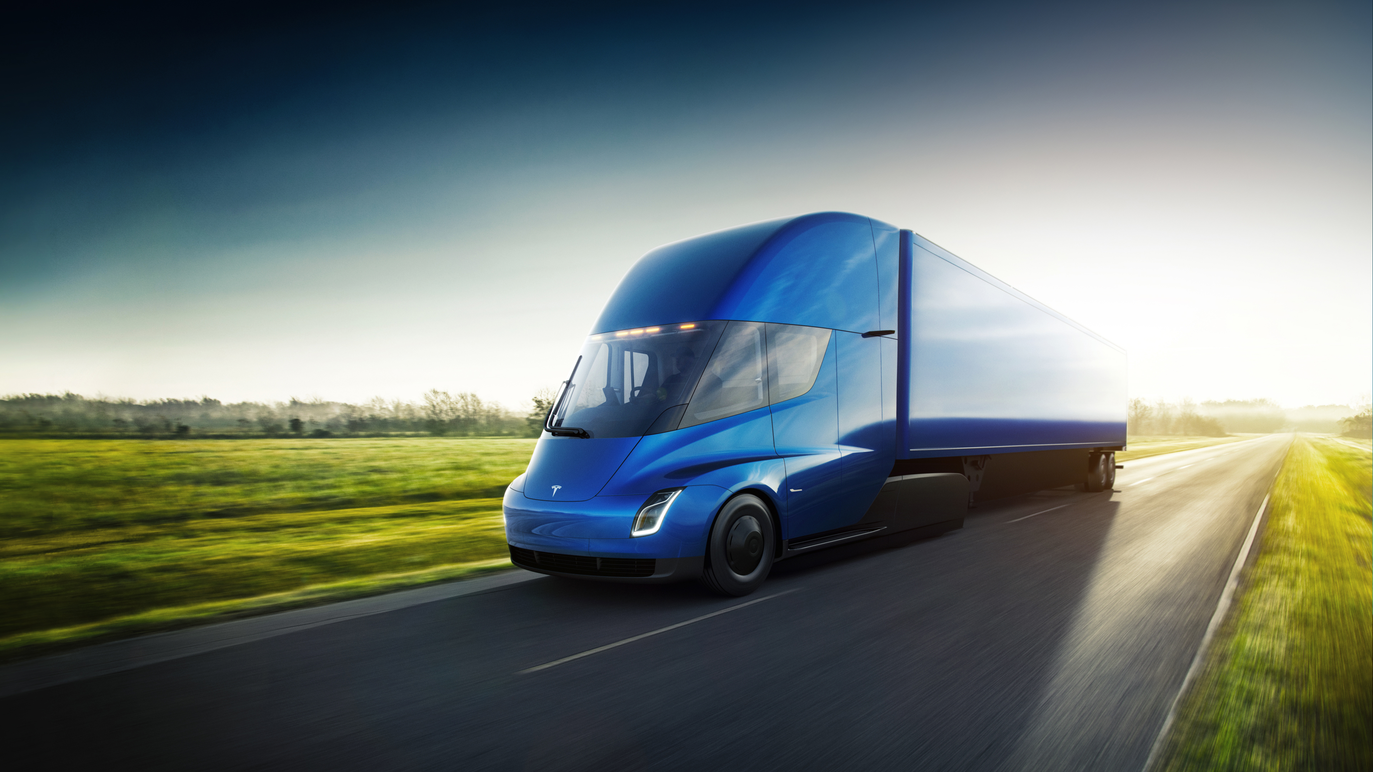
Freight

Slide 15
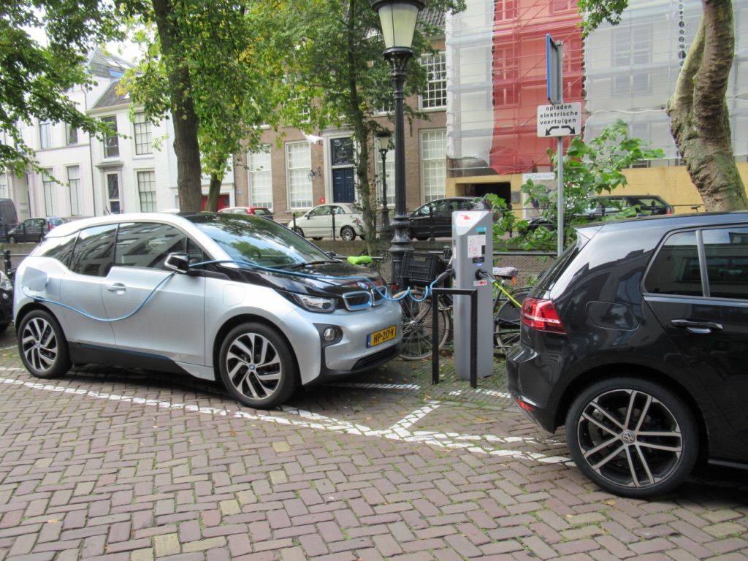

Slide 16
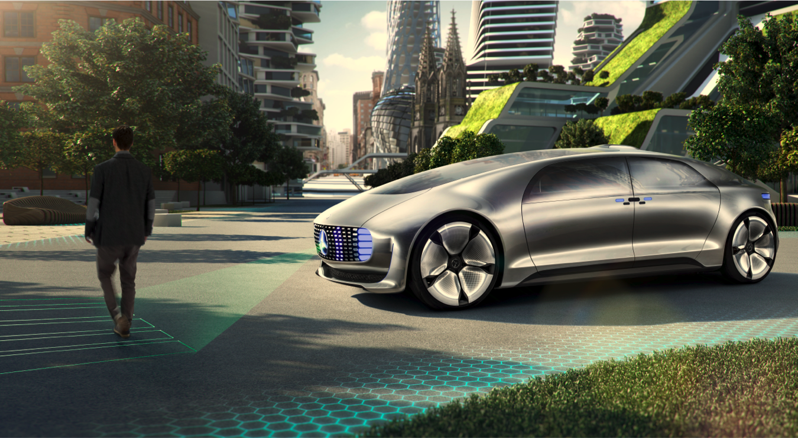

Slide 17
Thank you
Dr Elliot Fishman & Liam Davies
Institute for Sensible Transport
info@sensibletransport.org.au

