Slide 1

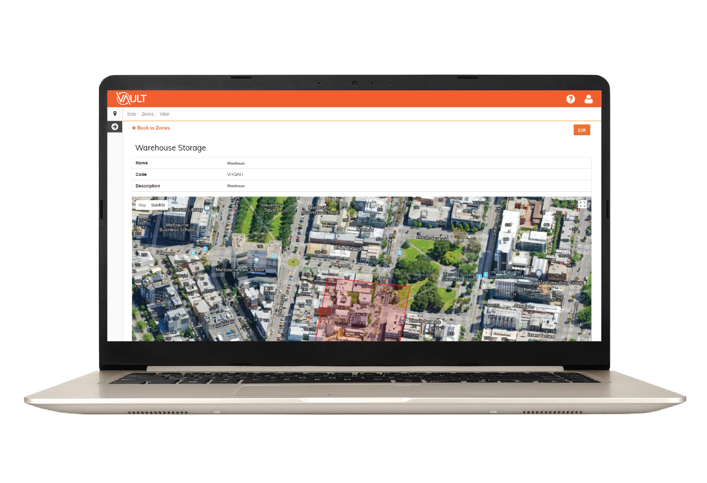
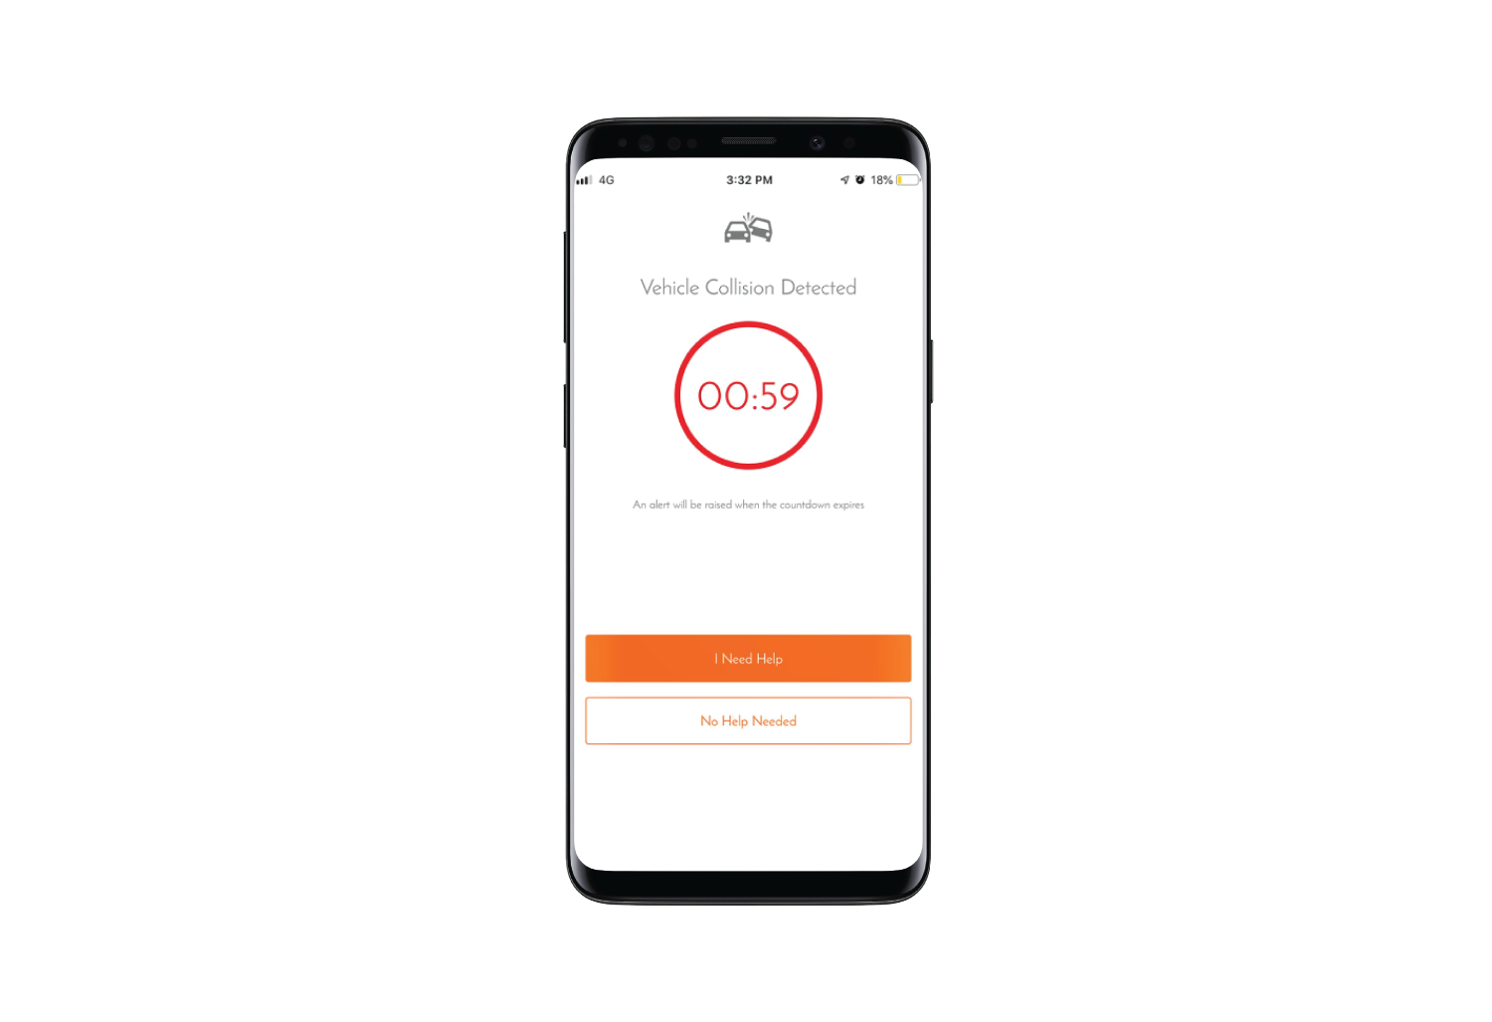

Victorian Government Road Toll Inquiry
Miguel Nasr & Shaun Gray
October 2019

Slide 2
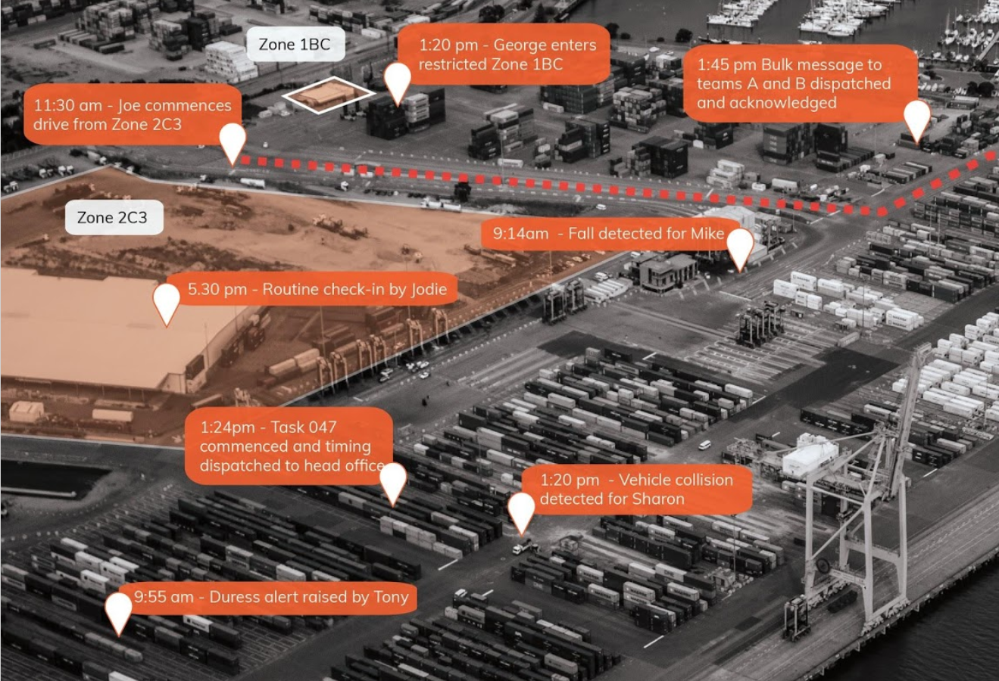
About Us
Vault Intelligence is a workforce performance and protection company.
Everyday Vault technology empowers businesses across industry to more effectively manage their risk, make better informed decisions and keep their workforces protected and performing.
Notes:
Thank you for your time today.
My name is Miguel Nasr and I’m the Chief Product Office at Vault Intelligence
Joining me today is Shaun Gray who is an Executive at Vault focused on Transport sector.
A little about our business - Vault is an ASX listed company whose sole focus is on keeping people safe with technology.

Slide 3

Why we support this Inquiry
Vehicle Accidents is one of the leading cause death from unintentional injuries.
“Human error was the sole cause in 57% of all accidents and was a contributing factor in over 90%”
VAULT SOLO P.3
Notes:
At Vault, we recognise that Distracted Driving is the leading cause of unintentional accidents worldwide.
We are very supportive of the measures being taken by the Victorian Government to improve road safety and reduce the road toll.
And we are committed to the development of accessible safety technology
Consistent with our submission, we want to highlight some of the challenges associated with existing solutions and programs and share what we’ve been doing and some successes we’ve observed in the hope that it creates an opportunity to work collaboratively with the government and industry to achieve material reduction in vehicle accidents and deaths on our roads.

Slide 4

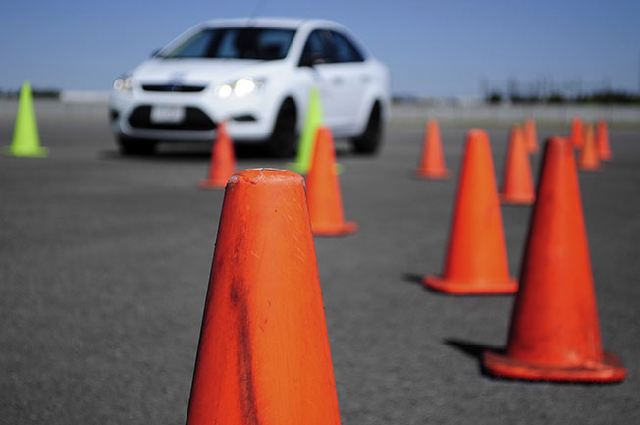
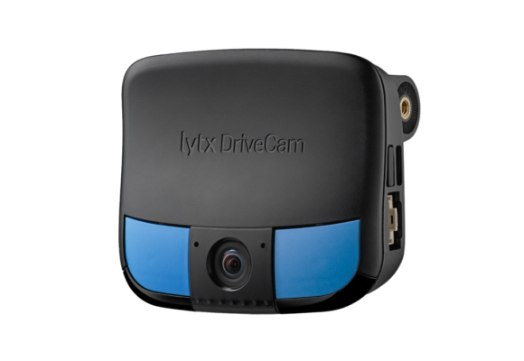
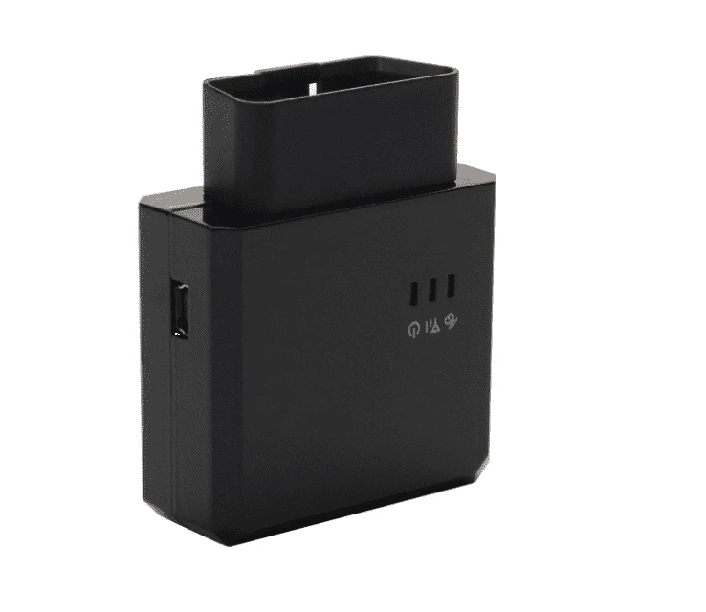

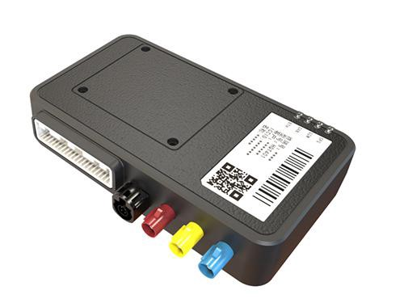

The issues we set out to address
Most Solutions to address Driver safety are either too expensive or not compatible or practical. None are very scalable
Buy a new car
$$$$$
Driver Training
$$$
Add Tech to vehicle
$$

Slide 5
The issues we set out to address
Accessibility
Our BHAG
Vehicle Technology
Driver Training
New Car
Affordability
VAULT SOLO P.3

Slide 6
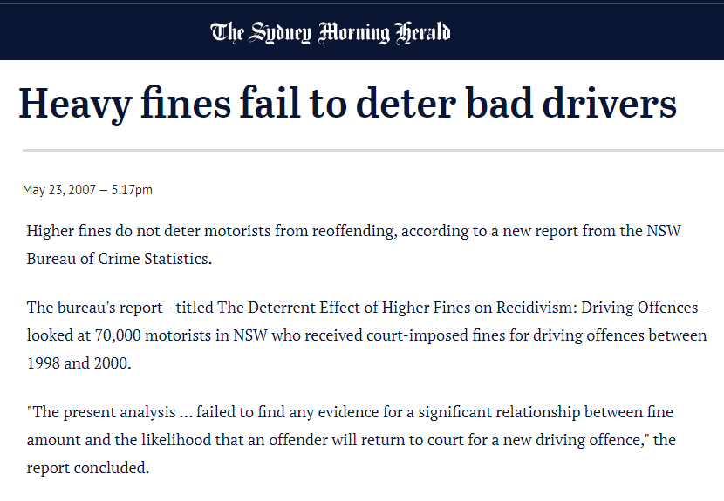
The issues we set out to address
The ‘Carrot’ and the ‘Stick’ Incentive strategies may be effective for some, but does not deliver long term sustainable outcomes for most
The ‘Stick’
(Fines or Disciplinary Actions)
Can be effective in the short term and may only work for a small proportion of the drivers.
The ‘Carrot’
(Rewards)
The ‘carrot’ approach can produces far better long term results… as long as the carrots keep on coming.
Its sustainability is dependent on the commercial model that underpins the rewards subsidy (e.g. Insurance).
Can lead to inappropriate behaviours, rule breaking, or under-reporting of incidents or crashes.
Notes:
When we look at the incentive strategies for Driver Safety, we categorise we come across the standard carrot-stick options
Fines
Rewards

Slide 7
The issues we set out to address
Rewards
Our BHAG
Sustainability
Fines
Cost

Slide 8
Why we built SoloDrive
“We’re on a mission to Democratise Driver Safety by making it accessible and affordable to as many people as possible.”
Our philosophy is to empower drivers with behavioural awareness and insights to help them improve their driving
“We believe that Education is more impactful than the ‘carrot’ or the ‘stick’ for sustainable behaviour change”
VAULT SOLO P.3

Slide 9
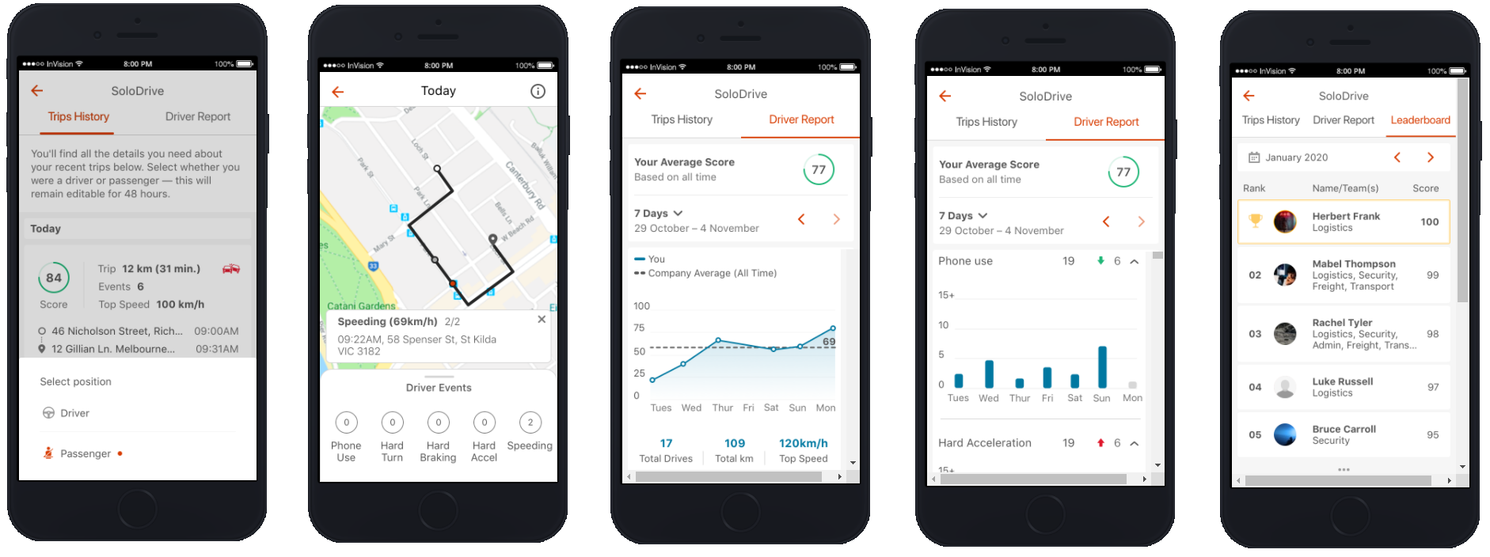
Introducing SoloDrive
A drive score after each trip
Trip details including all risky events
A Driver Report card showing your score trend
A Driver Report card shoring your risky activity trend
A Leaderboard for your close circle
VAULT SOLO P.3

Slide 10
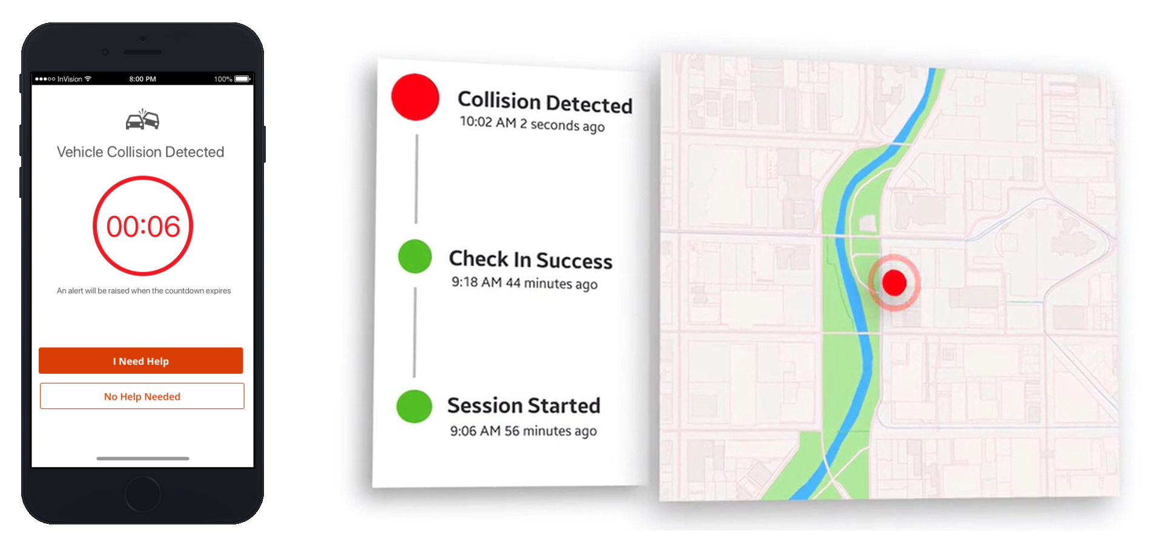
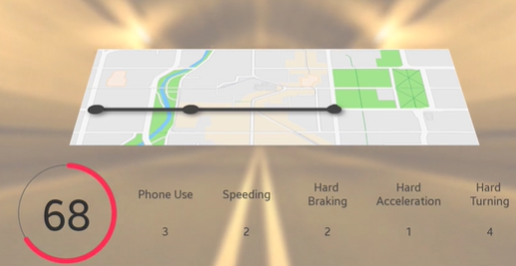
Introducing SoloDrive
Accessibility & Affordability:
SoloDrive can be instantly installed into 95% of Smartphones in the market. No need for new equipment to be installed in the vehicle.
Phone Use Whilst Driving
Speeding
Rapid Acceleration
Hard Braking
Hard Cornering
Vehicle Collisions
VAULT SOLO P.3

Slide 11
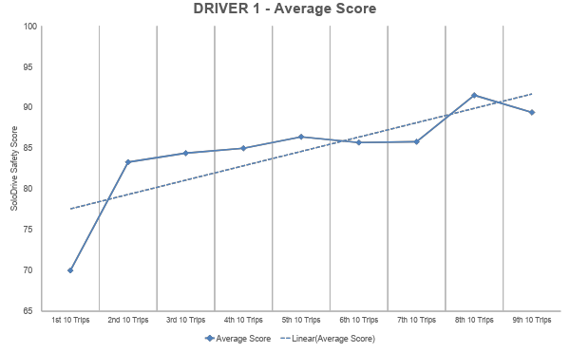
The power of Awareness
Sustainable improvements: SoloDrive provides drivers with unprecedented feedback on their driving behaviour and risky activities straight after each trip. The continuous reinforcement appears to have a sustainable impact.
Significant improvements are observed after approx. 20 trips

Slide 12
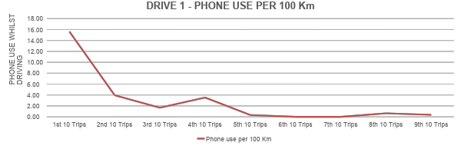
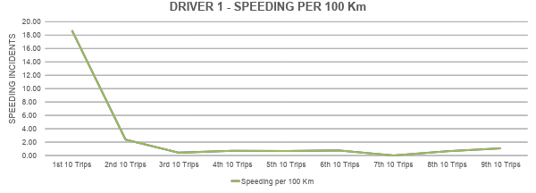
The power of Awareness
Sustainable improvements: SoloDrive provides drivers with unprecedented feedback on their driving behaviour and risky activities straight after each trip. The continuous reinforcement appears to have a sustainable impact.

Slide 13
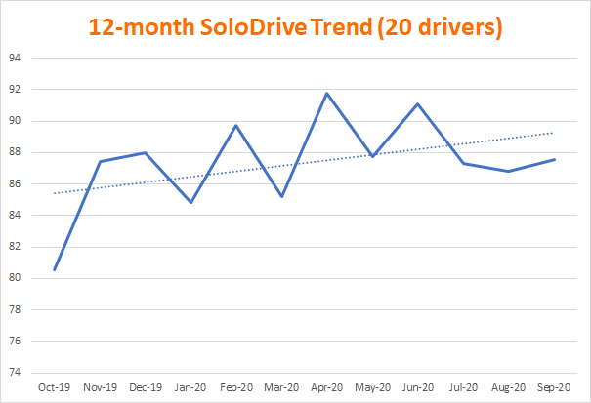
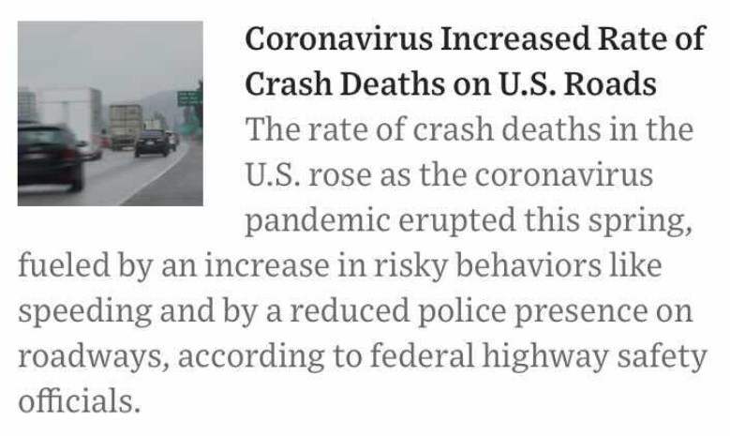
The power of Awareness
Sustainable improvements: SoloDrive provides drivers with unprecedented feedback on their driving behaviour and risky activities straight after each trip. The continuous reinforcement appears to have a sustainable impact.
COVID-19 period
VAULT SOLO P.3

Slide 14
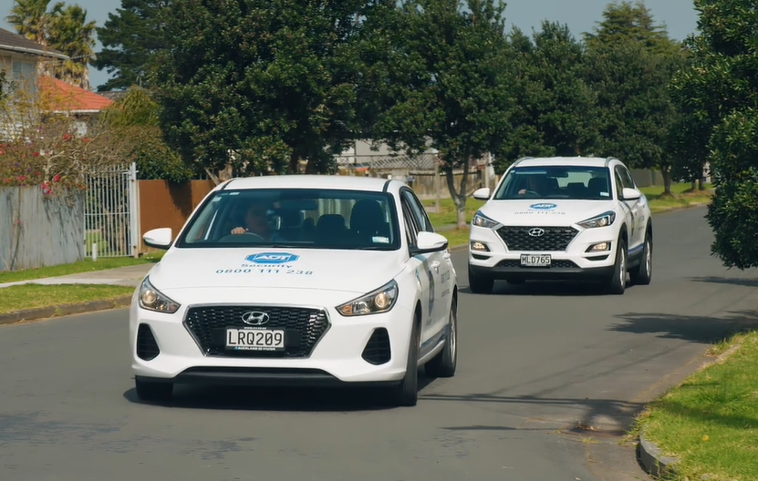
Case Study: ADT Security - ANZ
https://vimeo.com/461662304
VAULT SOLO P.12

Slide 15
www.vaultsolo.com
VAULT SOLO P.12

