Slide 1
Winchelsea Community Bank Village by
Winanglo Inc

Slide 2
agenda
Winanglo Inc. Committee Winchelsea Community Bank Village Vision & Objectives Development Principals Details Progress Financing Challenges Time Line Post Completion Future Projects

Slide 3


Winanglo Inc.
The board of Corangamite Financials Services Limited (CFS/Community Bank Surf Coast) set up an independent incorporated charity, Winanglo Inc, for the sole purpose of facilitating community projects in and around Winchelsea, Anglesea and Lorne
The Winanglo Inc. committee is made up of a combination of volunteers from the community and CFS.
CFS contributed an initial $500,000 towards to costs associated with the establishment, feasibility, engagement and costs of architect along with the cultural heritage plan.

Slide 4
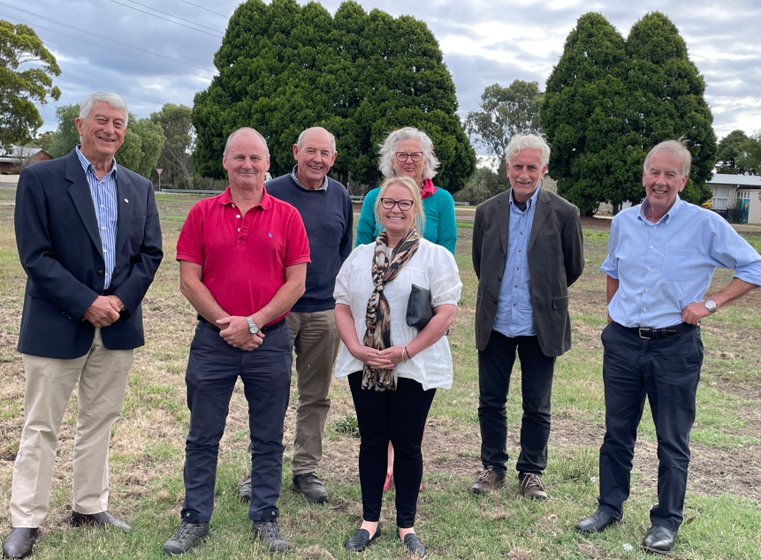
Meet Our Committee
Committee is made up of Corangamite Financial Services Directors (steering committee), Community Members and Representatives from local organisations that hold complimentary skillsets to effectively manage the project and organization and see it through to its completion.
Notes:
John Knuckey Corangamite Financial Services
Michelle Stocks Corangamite Financial Services / Administration / Retired Hesse Rural Health Board Member
Gerard Kelly Corangamite Financial Services / Accountant
Ken McDonald Corangamite Financial Services / Real Estate
David Kelly Hesse Rural Health / Community Member
John Hutton Winchelsea Lions Club / Community Member
Richard Butcher Community Member / Community Member
Naida Hutton Hesse Rural Health / Community Member

Slide 5

Vision & Objectives
  Develop suitable housing options for seniors in Winchelsea and surrounding communities.
  Address the lack of quality, affordable, low maintenance downsizing accommodation.
  Prevent residents from having to move away from their social connections.
  Retain a community with strong roots to its history and remain engaged with all ages.
  Create a community asset that serves as a central meeting point for local residents.
  Support the aging population in remaining in their homes while receiving the necessary care and assistance to maintain their independence.
  In line with the government initiatives promoting in home supported living as a preferred alternative to transitioning into aged care facilities.

Slide 6
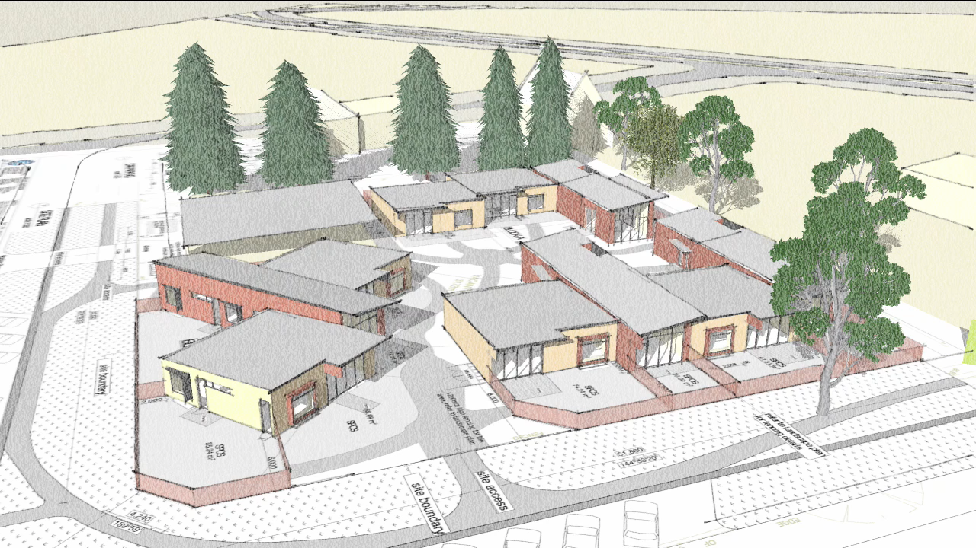
Development Principals
  Efficient use of existing infrastructure and services.
  Incorporate sustainable design practices; considerations to energy efficiency, water conservation and incorporate the use of eco-friendly materials.
  Adaptable housing to meet a variety of needs – long term housing solutions.
  Sympathetic build to compliment the surrounding community.
  Create a lasting community asset that will benefit generations to come.
  9 star energy rating to prioritise environmental sustainability while significantly lowering operational costs.

Slide 7
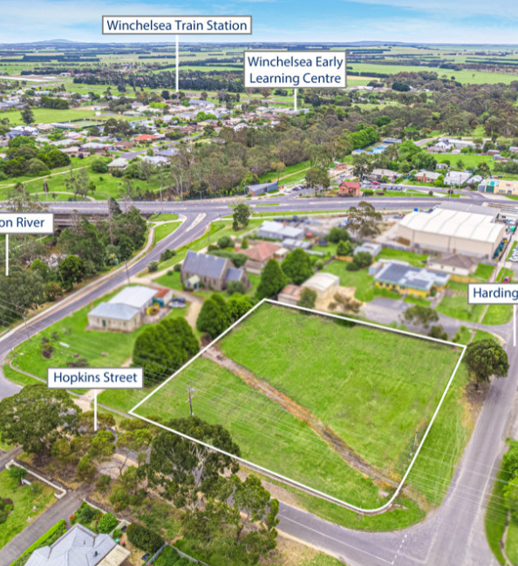
The Village
Location: Corner of Harding Street and Hopkins Street, next to the Senior Citizens Club and the Anglican Church.
10 small homes designed to high standards State-of-the-art design and beautifully landscaped.
The site will operate under the Retirement Villlage Act.
Homecare packages can be accommodated as need arises.
Residents will buy into lifetime occupancy rights.
Monthly residents fee will cover water, power, rates, insurances and general maintenance.

Slide 8
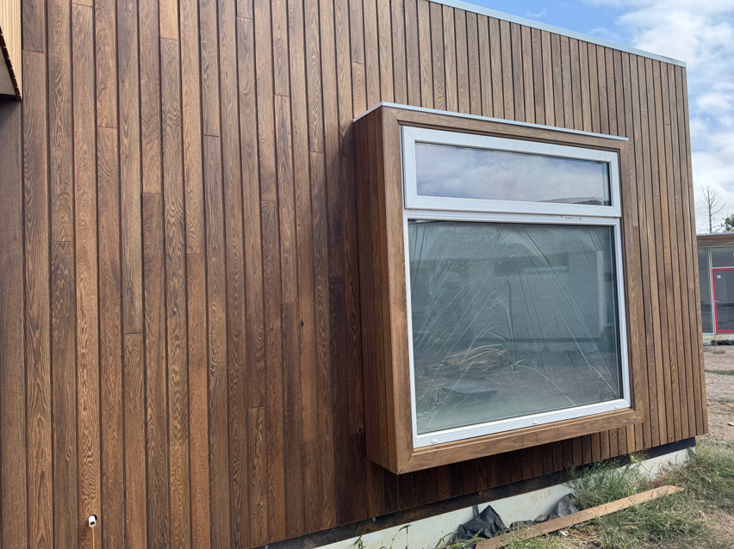
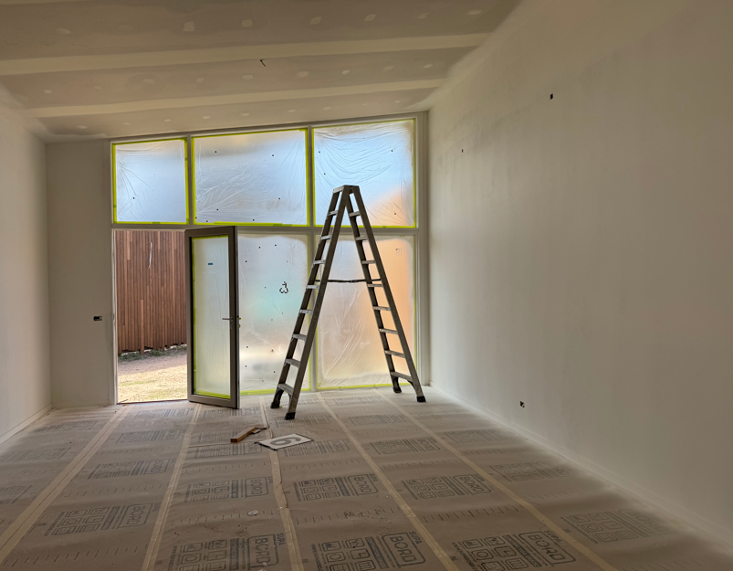
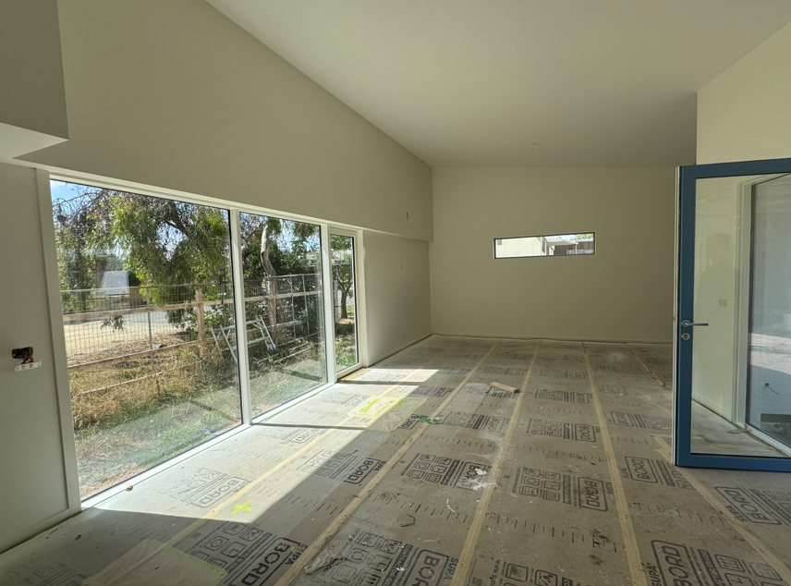
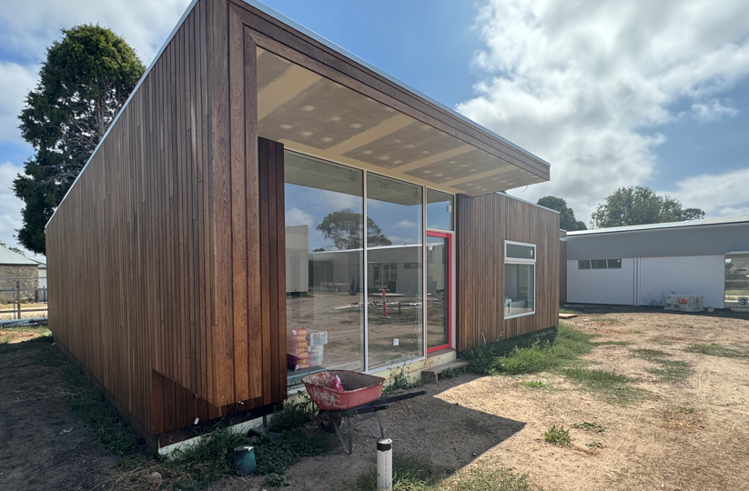
To Date
The Surf Coast Shire Council agreed to sell 3,100m2 of land located at 42 Harding Street, Winchelsea, to Winanglo Inc. for a nominal fee of $1.
Engaged architect to design 10 independent units.
Winchelsea Community Bank contributed a further $1million to fund the
project. Total $1.5m to date.
Loan funds obtained via the Bendigo Bank for the remaining expenses
Cultural heritage plans commenced September 2022
Construction works commenced March 2023
Completion forecasted by May 2025.

Slide 9

Finance
CFS committed $500,000 towards the establishment of Winanglo Inc, feasibility assessments and initial costs.
Post planning a further $1million was provided by the Winchelsea Community Bank to make the project viable.
All funding avenues where explored; government funding, banking and philanthropic avenues.
Finance obtained via Bendigo Bank ($3.4 M) for remainder of construction cost.
Lifetime Occupancy rights to be sold at a proposed value $590k x 10 units.
The Retirement Villages Act states that pre-sales cannot be completed until the construction of the village.
We have received written expressions of interest for the purchase of 5 of the 10 available occupancy rights and are optimistic to have filled all units soon after completion.
Notes:
Challenges obtaining finance
No security
No income
Non traditional lend
New entity.

Slide 10
Timeline
JAN 2022
  Land acquisition from Surf Coast Shire at 42 Harding St, Winchelsea
december 2020
  Winanglo Inc. established.
June 2022
  Architect drawings completed, build quoted. CFS committed seed capital of $500,000
January 2024
  Finance acquired.
  Construction work commenced
April 2022
  Cultural heritage works commence of land. Building permit submitted. Finance acquisition commenced.
May 2023
  Building plans quoted and builder obtained.

Slide 11
Post Construction
The initial $1.5million donated from Community Bank Winchelsea provided the essential seed funding to commence this project. Once the units are sold, these funds will be recycled into the next devel;opment. Allowing Winaglo Inc to continue delivering housing solutions.
This approach ensure that the original donation is not depleted but instead reused to kick-start each new project, creating a sustainable funding cycle.
As per the rules of the association, these funds are held and can only be used for the specified purposes (rule 5), which includes advancement of health and social and public welfare in the specified geographic area.

Slide 12

Challenges
Finance -
Securing finance for the project proved exceptionally challenging, as it did not fit within standard lending criteria. As a new entity with no income, no presales, and an asset that fell outside typical financing models, we faced significant hurdles at every stage. Navigating these constraints required persistence from the committee and a proactive commercial lending specialist that could understand the outcomes.
Cultural Heritage –
We recognise and respect the importance of completing cultural heritage works before commencement. However, the process proved to be significantly drawn out and costly, with little guidance or acknowledgement of the time and significant financial commitment required. Clearer direction and support would have greatly assisted in navigating this essential but challenging stage.
Local Council –
Initial enthusiasm and support from council gave us confidence in the process, however the reality of the execution proved far more challenging then anticipated with limited support and cooperation to move forward.

Slide 13
Project 2 – Birregurra Independent Living Units
Initial conversations have commenced with the Birregurra Community to complete a similar project.
In collaboration with the Birregurra Lions Club & Colac Otway Shire.
Land acquisition negotiations commenced.
Conditional on approval of non banking finance.

Slide 14


thank you
winanglo.org.au

