Slide 1
Legislative Assembly Environment and Planning Committee
Inquiry into the supply of homes in regional Victoria
24/2/2025
CABOOLTURE | COLAC | OBERON | TUMUT | YARRAM

Slide 2
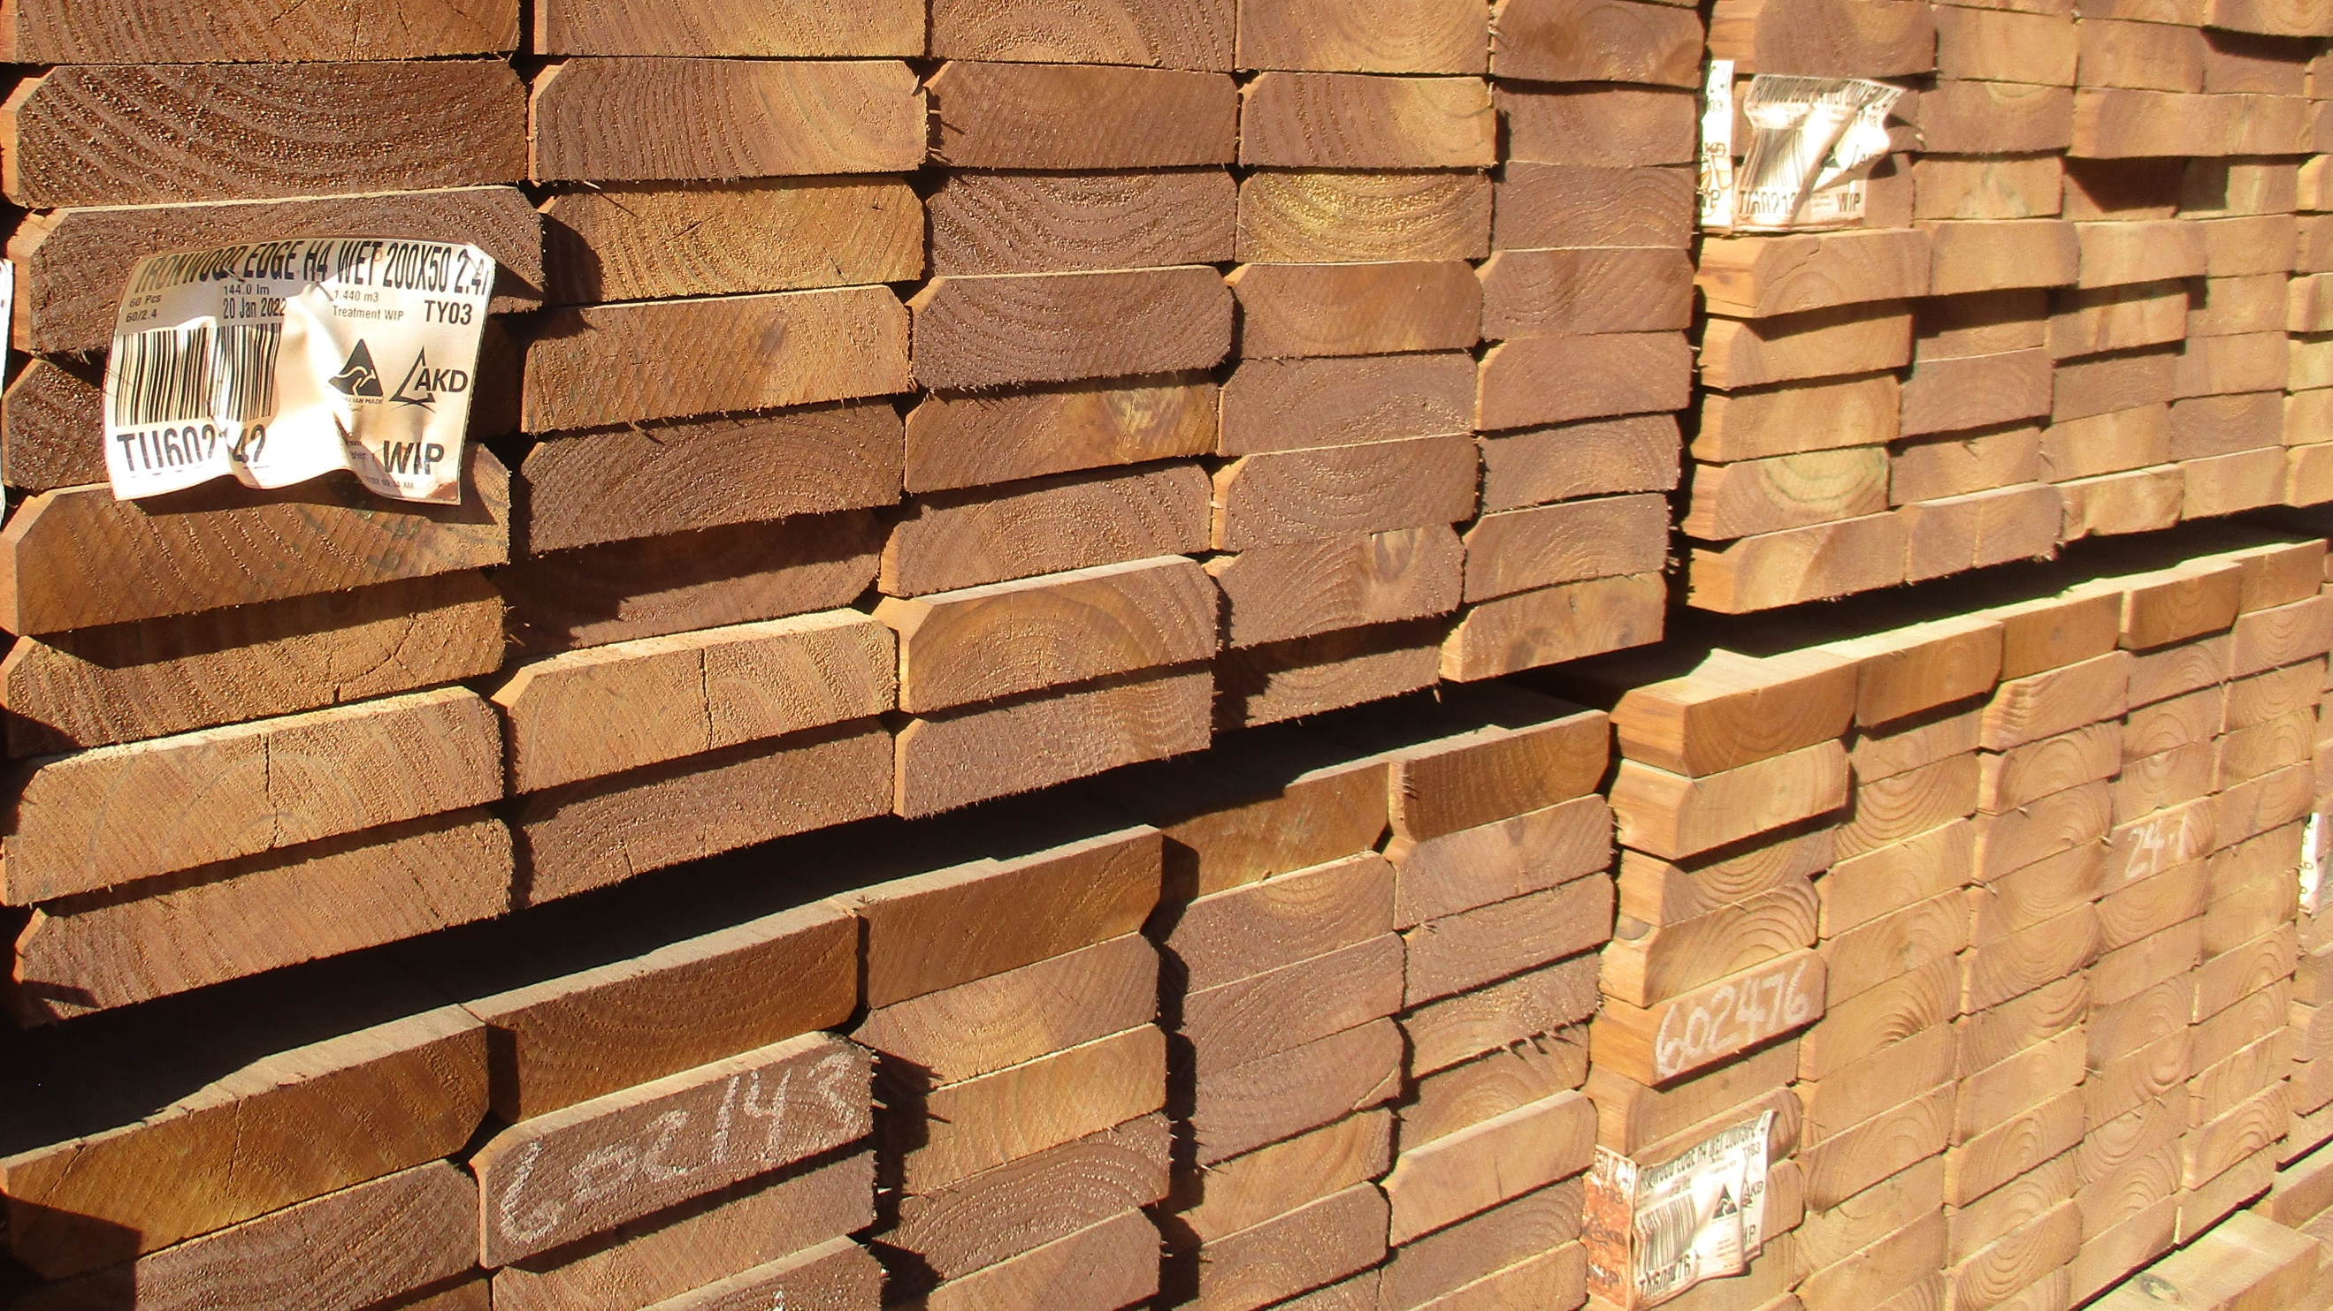
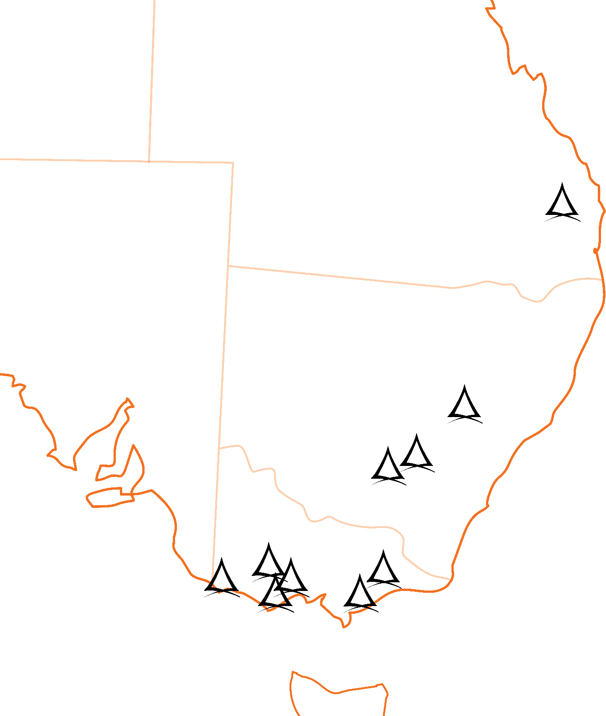

Background.
AKD established in 1955.
Originally 7 shareholders
Hardwood processing
Converted to Softwood in 1964
4 separate Australian Shareholder families
Consistent reinvestment – 75% of NPAT.
Long Term View

Slide 3
Background.
Australasia's largest sawmilling Co.
5 operating sawmills, 1 post & pole operation, 1 woodchip export facility
~1100 employees in three states
Annual sawlog throughput of
~2.0 million cubic metres
~1 million m3 timber sales
20% of market
Largest producer of Structural timber

Slide 4
Background.
AKD is a vertically integrated company
+16,000 ha of softwood plantations
Stump to store
First plantation established in 1972,
NSW expansion in 2021.
15 carbon properties, more to follow
$200m Capital investment 2021-24
Upgrading Sawmills and Plantations

Slide 5
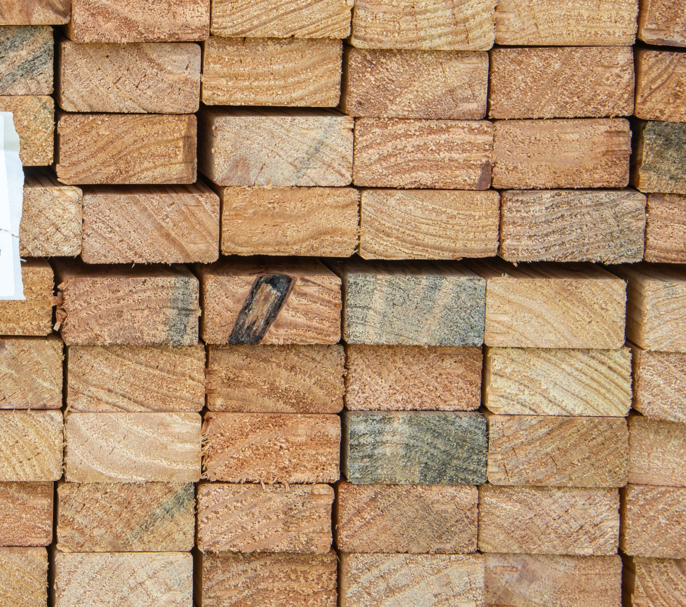
1 .
Tomorrows
Employee
Build leadership and technical capacity. Attract, retain & develop performers.
2 .
Secure the Resource
Underpin our investment & future.
Through ownership and contracts.
3 .
Stable Demand
Timber supply more than a commodity.
Market, product & customer selection.
Building a
Timber
Future
4 .
Sustainable Growth
Activities & outcomes positively driven.
Reputation and Legacy is paramount.
5 .
Business Excellence
World class operational performance. Driven by measurement and assessment.

Slide 6
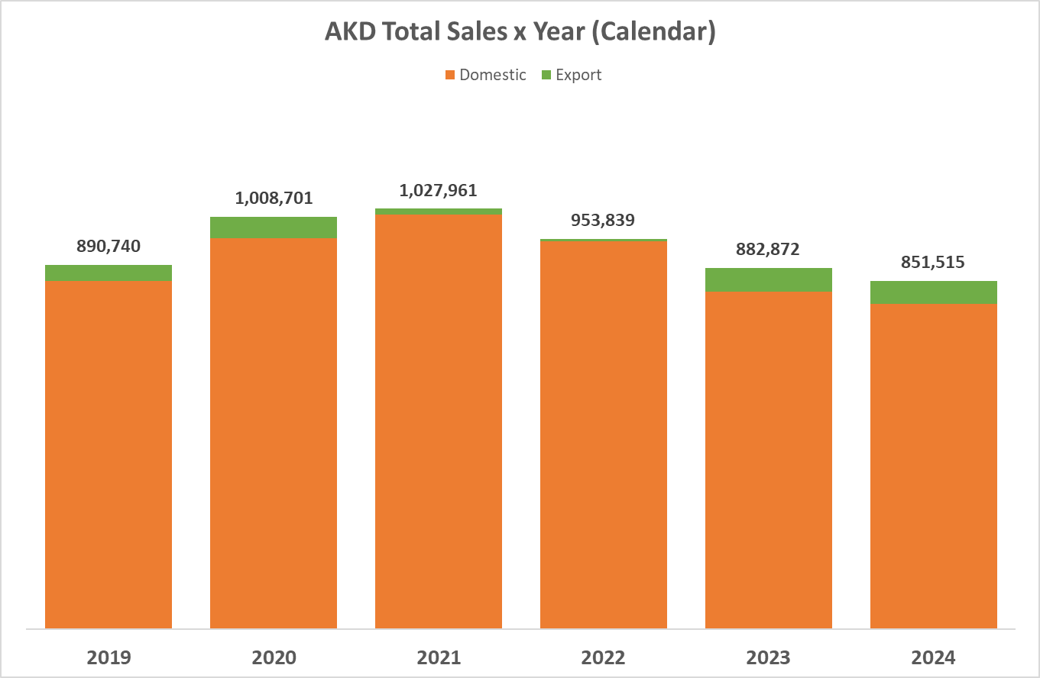
HVP Questions

Slide 7
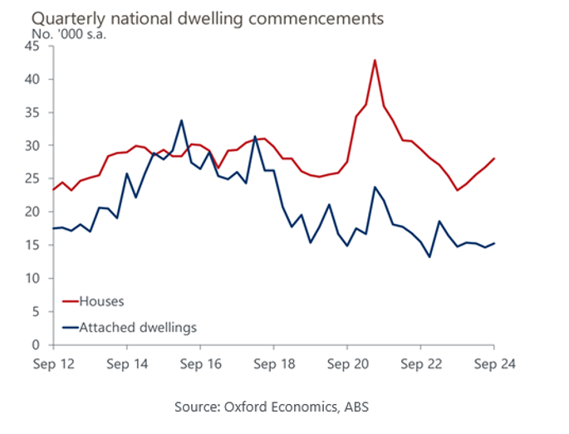
Dwelling Commencements

Slide 8
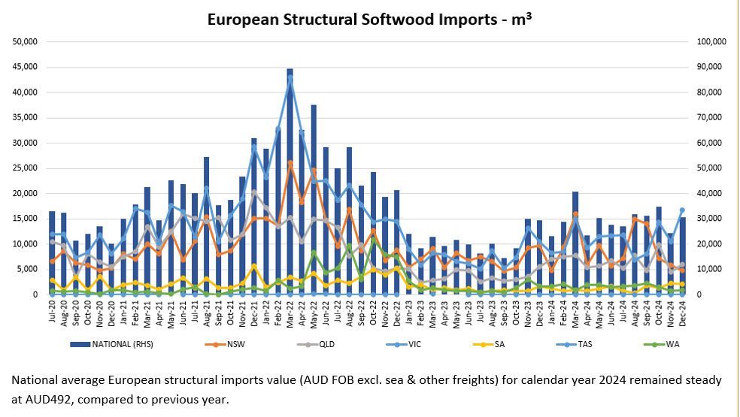
Imported Timber – Supply is not the issue.

Slide 9
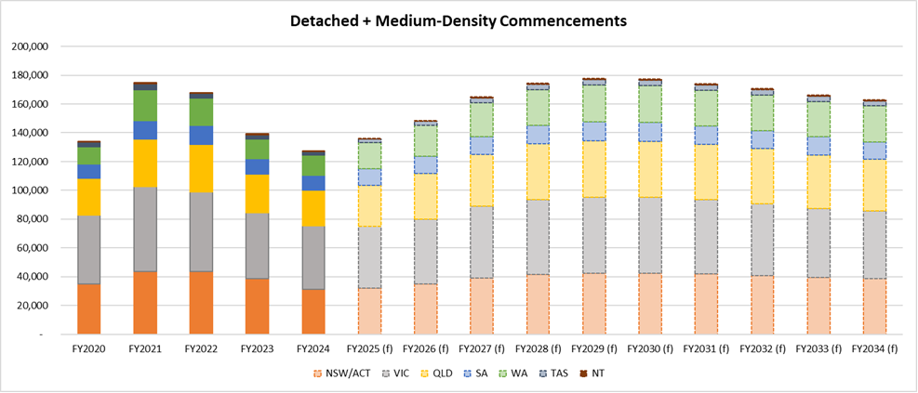
Forecast Commencements

Slide 10
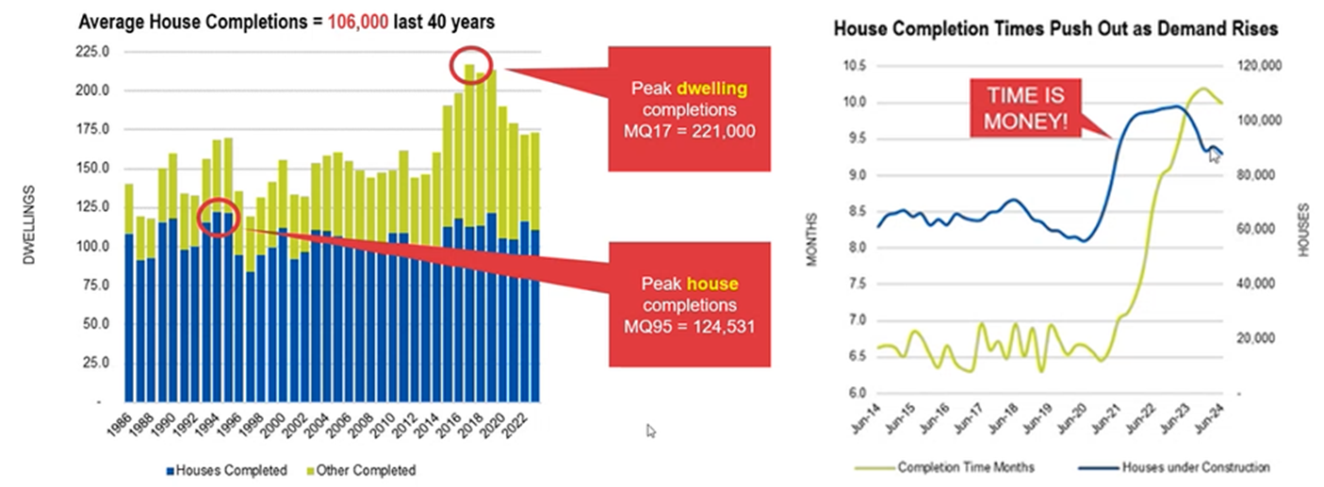
Completions

Slide 11
Regional Housing - What do we need ?
Recognition of the problem
  Cost of living crisis
  Housing crisis – affordability – my first home $98k (1999)
    National crisis – Bi-partisan (too important to be political)
  Population growth at 1.7% - 400-500k per annum.
  Dwelling construction – Australia's economic driver ??
    One in eight - directly
    One in four – indirectly
  Houses cost too much to build
  Regions have similar issues to the Cities
    But have advantages !

Slide 12
Real Action
  Pick 1-3 things that will make a genuine impact.
  Not another report !

Slide 13

Real Action

Slide 14
Real Action
Real action – genuine policy reform
  Houses cost too much to build
  Taxes and regulation as a burden (40% of a house ?).
  Tradespersons skills shortages
    Why be a chippie ? –Melb construction site stories.
  Land – make it available (government intervention)
  3 layers of government – Planning and Consents (incentives)
  Uncertainty with policies – NCC
  Boom & Bust – artificial stimulus creates problems
  Enable a stable market – create confidence.

Slide 15
Real Action
Make housing a priority – be focused
Make land cheaper and available, lots of it.
Tradespeople/Skills
Remove Tax's, reduce regulations, build confidence
Planning Capacity – reduce councils' ability to say “no”.

Slide 16



