Slide 1

BY PARLIAMENT OF VICTORIA

Slide 2
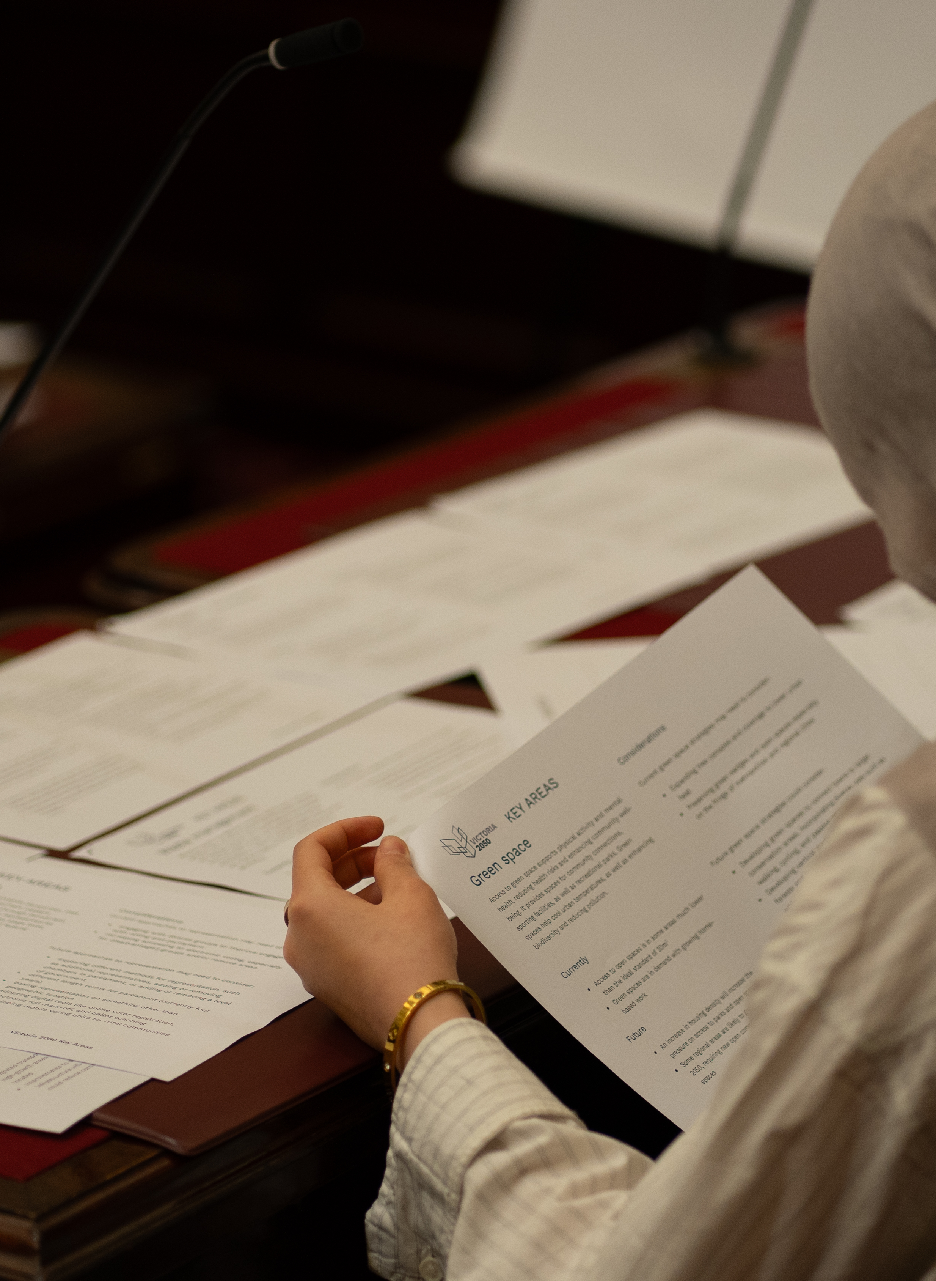
Deciding on your political party
1
2
3
4
5
In your groups read you party card and decide on:
your party name
leader (Premier, Leader of the Opposition or party leader)
minister, shadow minister or spokesperson
party values – these will help your party to make decisions

Slide 3
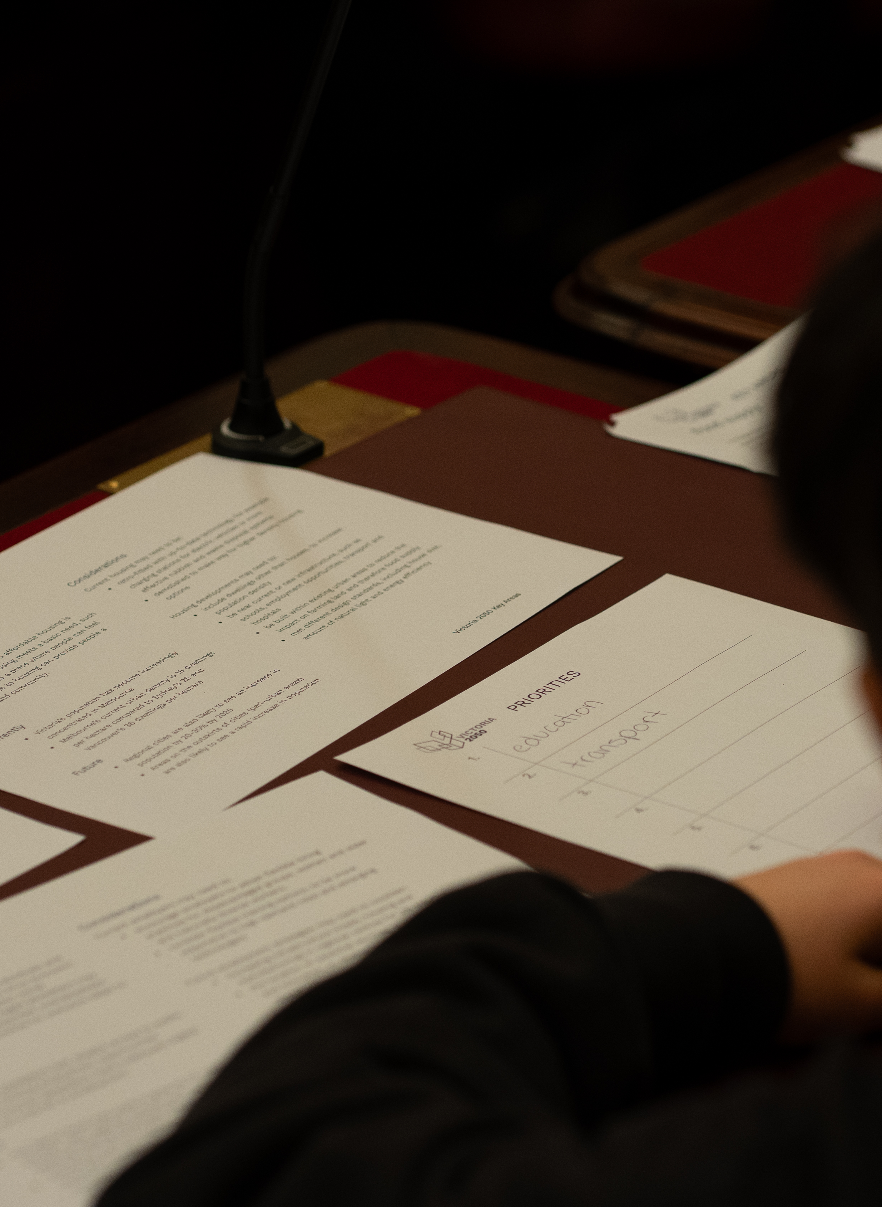
Deciding on the priority areas
1
2
3
4
5
Your party needs to decide on:
Which areas are most important to the future of Victoria = high priority
Which areas are of lower importance to the future of Victoria = low priority
Remember:
to read the area cards and find evidence
write down reasons for your choices
an area of low priority is still important, just may not get allocated extra resources at this time

Slide 4
Passing a bill
1
2
3
4
5
To pass a bill, it needs to:
pass three readings in the Legislative Assembly
Introduction of the bill (first reading)
Debating the bill (second reading)
Voting on the bill (third reading)
Task:
Government to introduce the bill
The bill is the preferred high / low priority areas
All parties debate the bill, using their party’s preferred priorities
pass three readings in the Legislative Council
Introduction of the bill (first reading)
Debating the bill (second reading)
Voting on the bill (third reading)
Task:
All members debate the bill
Suggest, debate and vote on amendments
Committee of the Whole (stage between second and third readings)

Slide 5
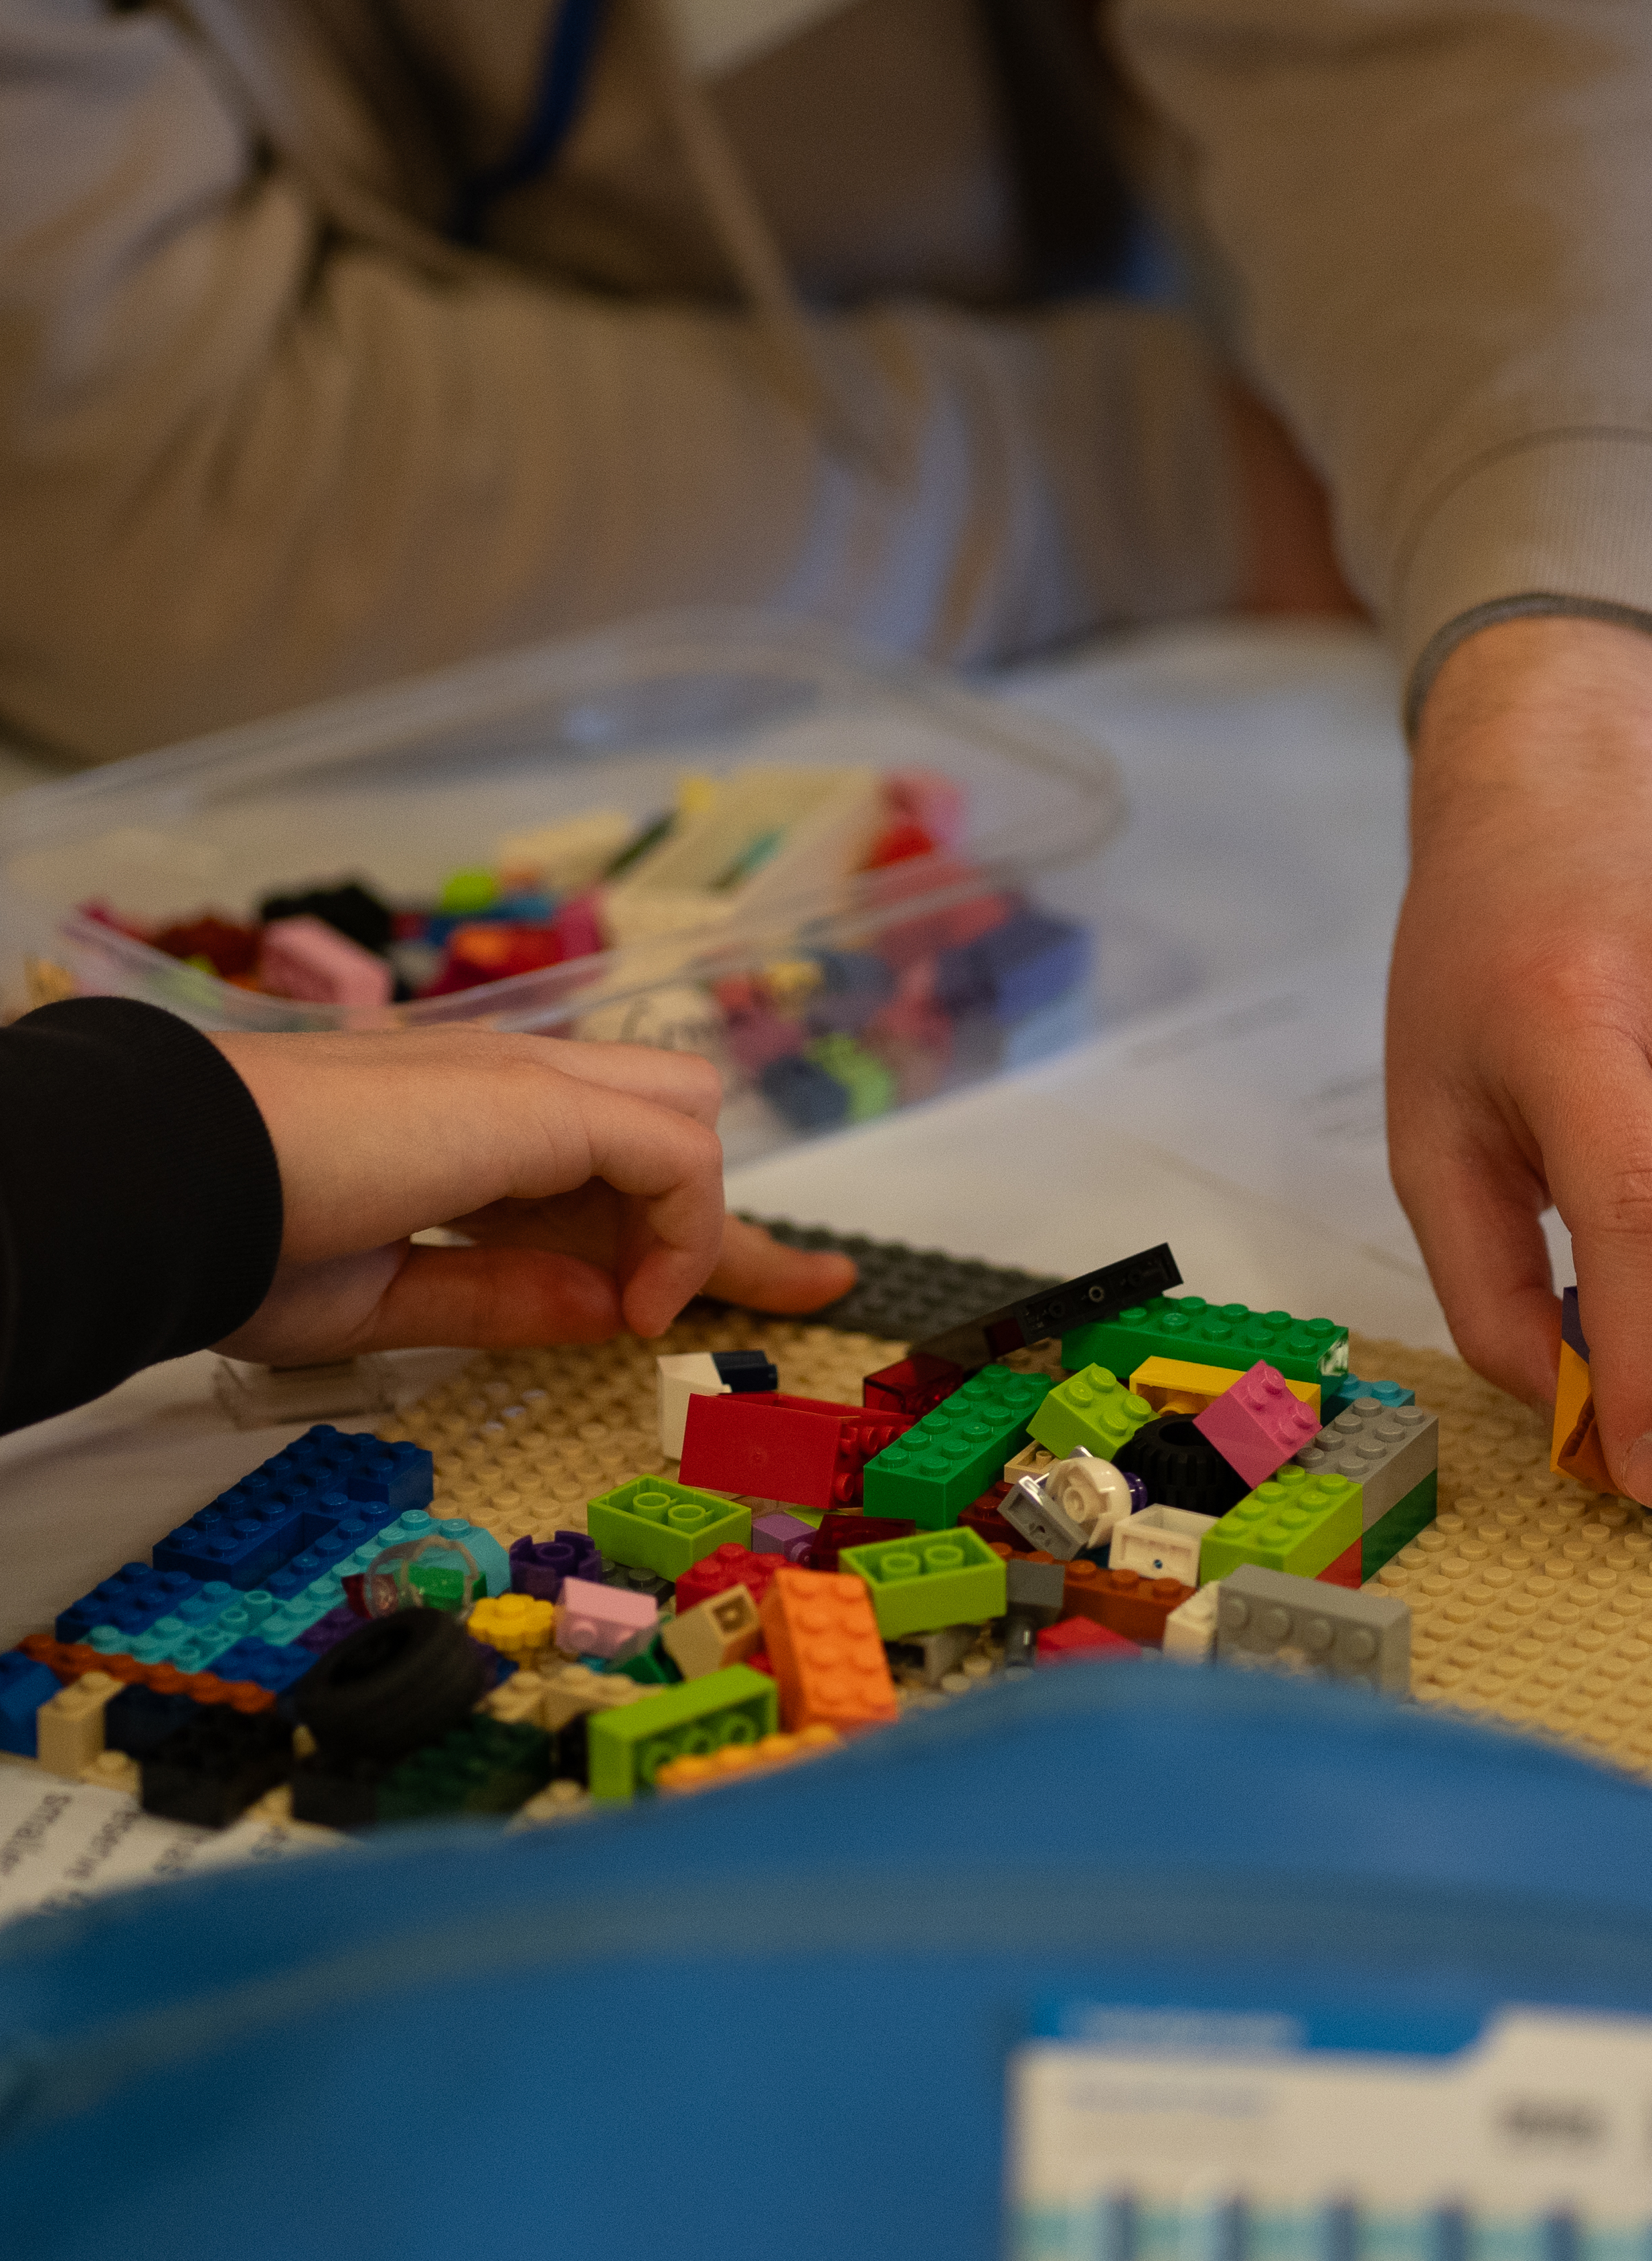
Design challenge
1
2
3
4
5
Read your design challenge carefully, including:
what you must do
what you can do
what you must not do
Remember:
Use the appropriate information on the Priority area cards and design challenge to help you
Think of innovative and creative solutions
Limited resources doesn’t mean limited solutions
More resources might mean selecting a focus

Slide 6
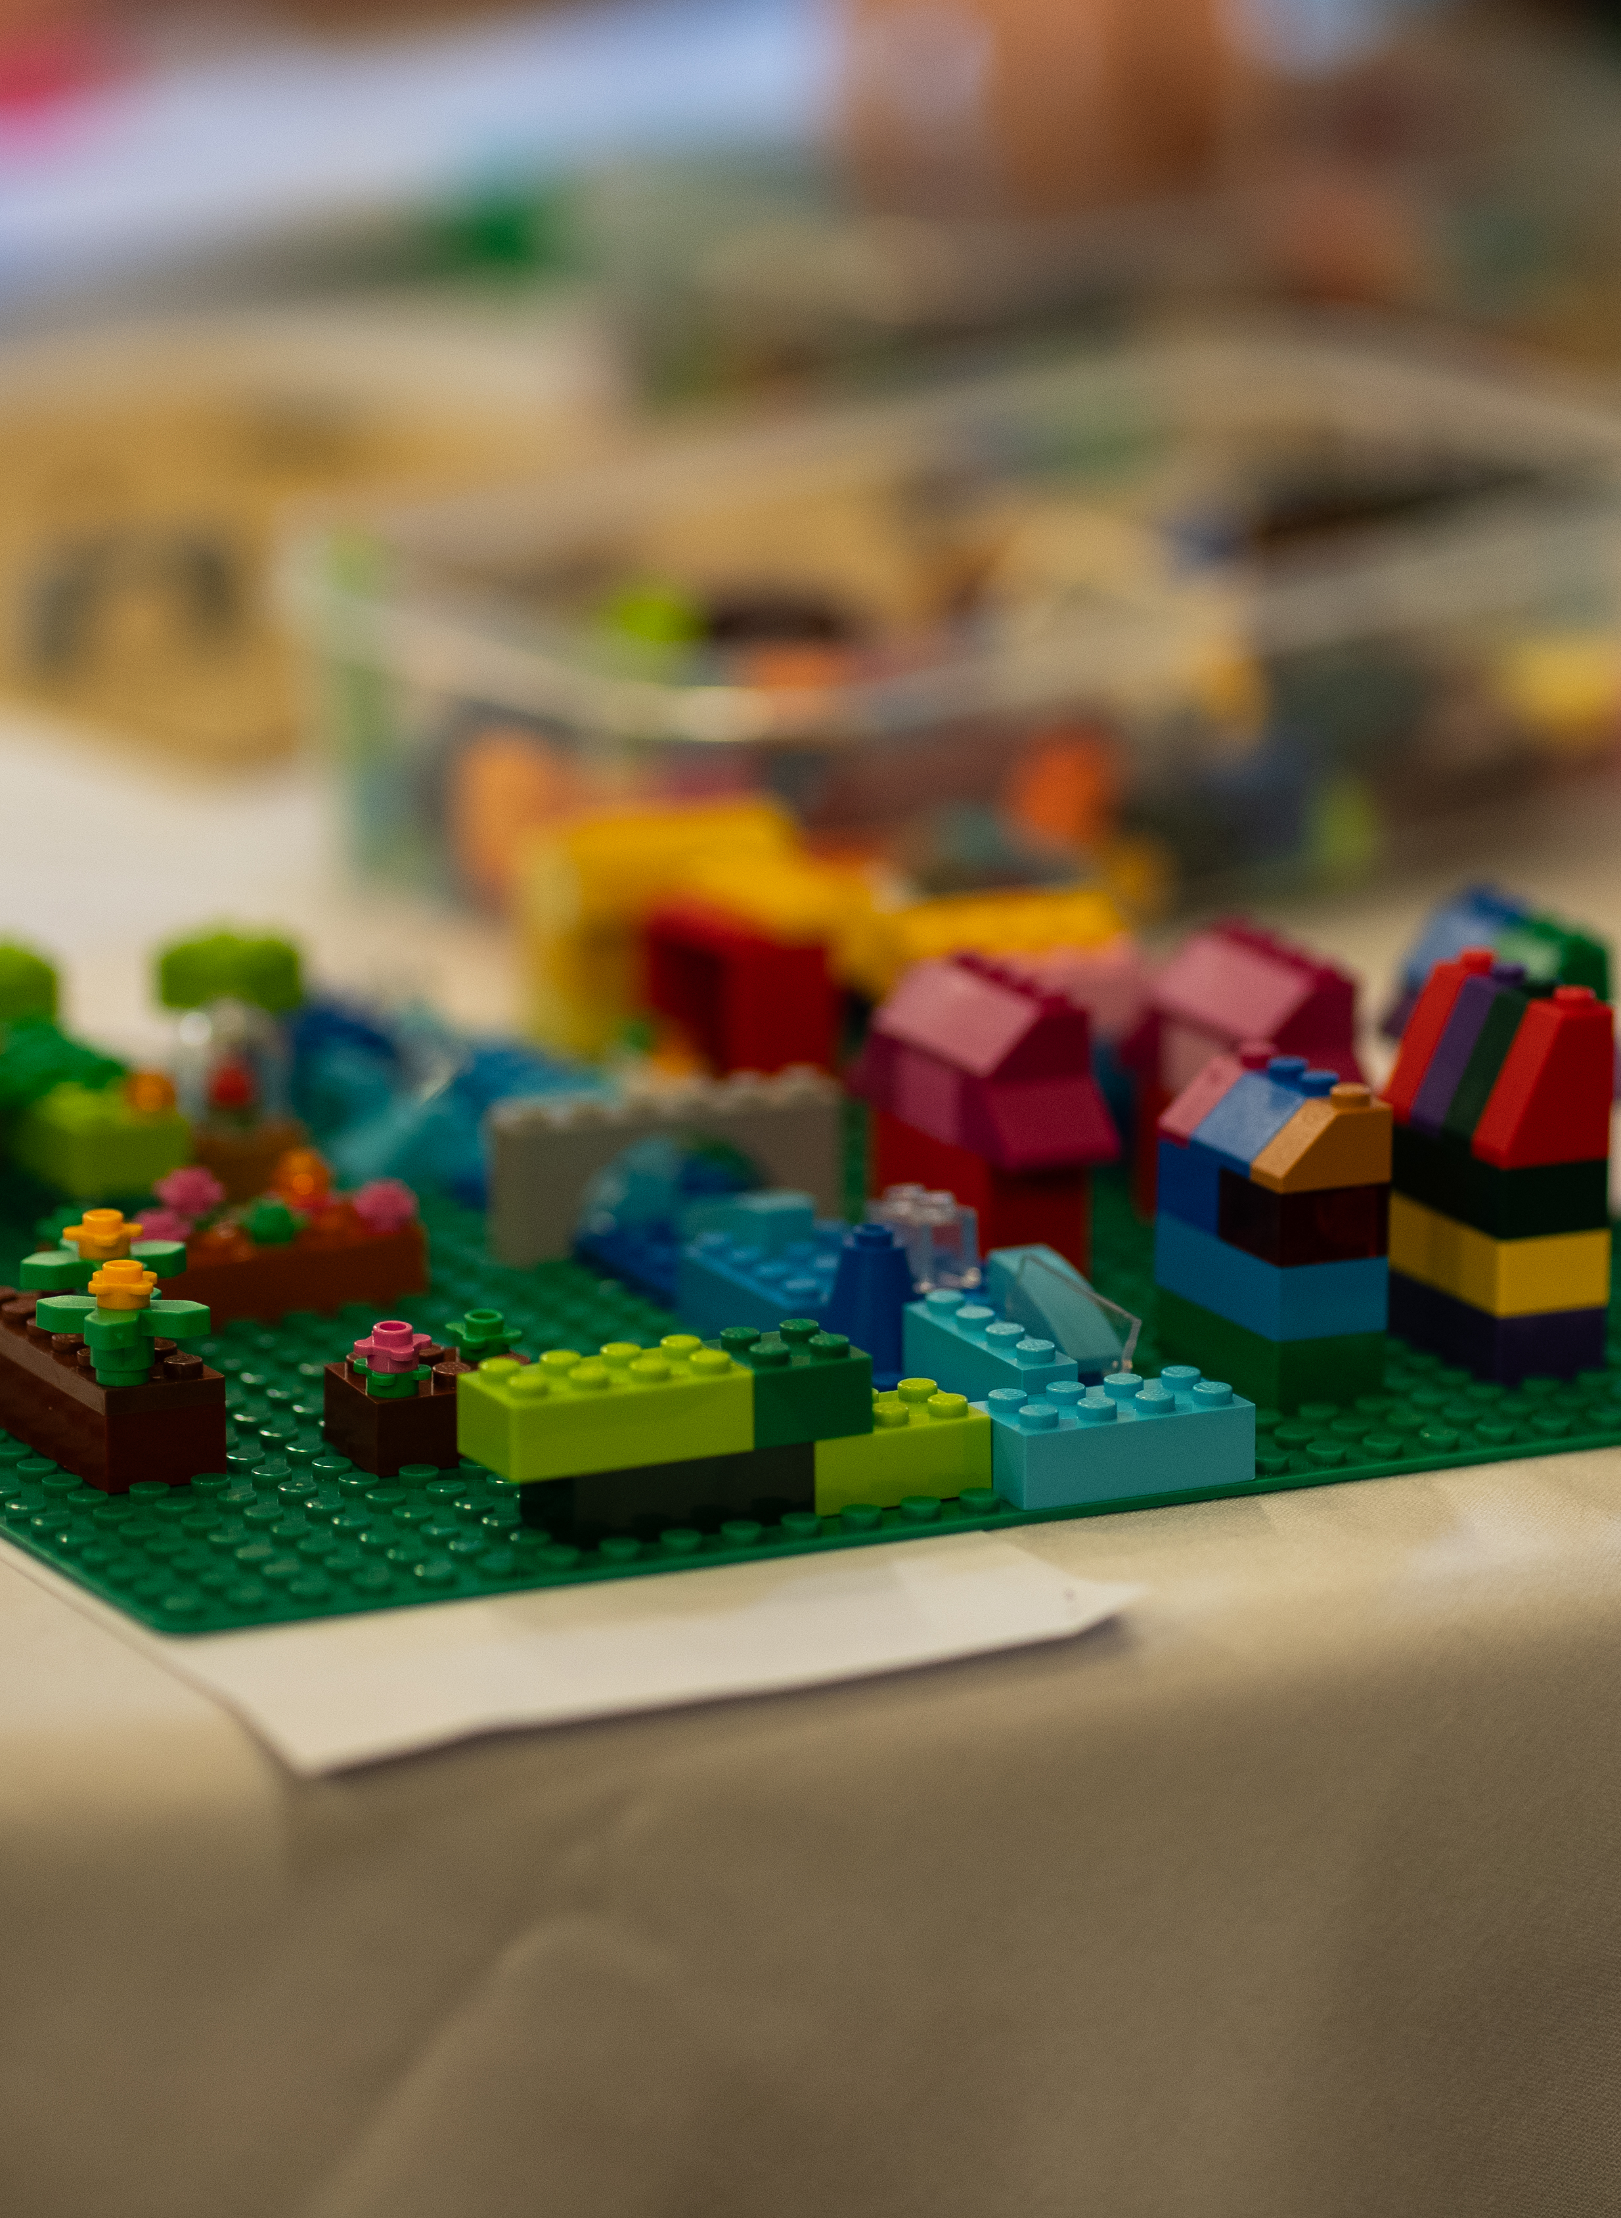
Reflecting on the design challenge
1
2
3
4
5
How does your artefact reflect Victoria in the year 2050?
What sort of future does it suggest?
What does it suggest about how people live?
What does it suggest about the industry or service area you were working on?
Have a look at the other artefacts
What sort of future do these suggest?
What do they suggest about how people live?
What does it suggest about other industry or service areas?
What recommendations would you make to the parliament of the past, based on your observations?

