Slide 1
Inquiry into the Early Childhood Education and Care Sector in Victoria
Commission for Children and Young People
Level 16 / 150 Lonsdale Street, Melbourne
contact@ccyp.vic.gov.au

Slide 2
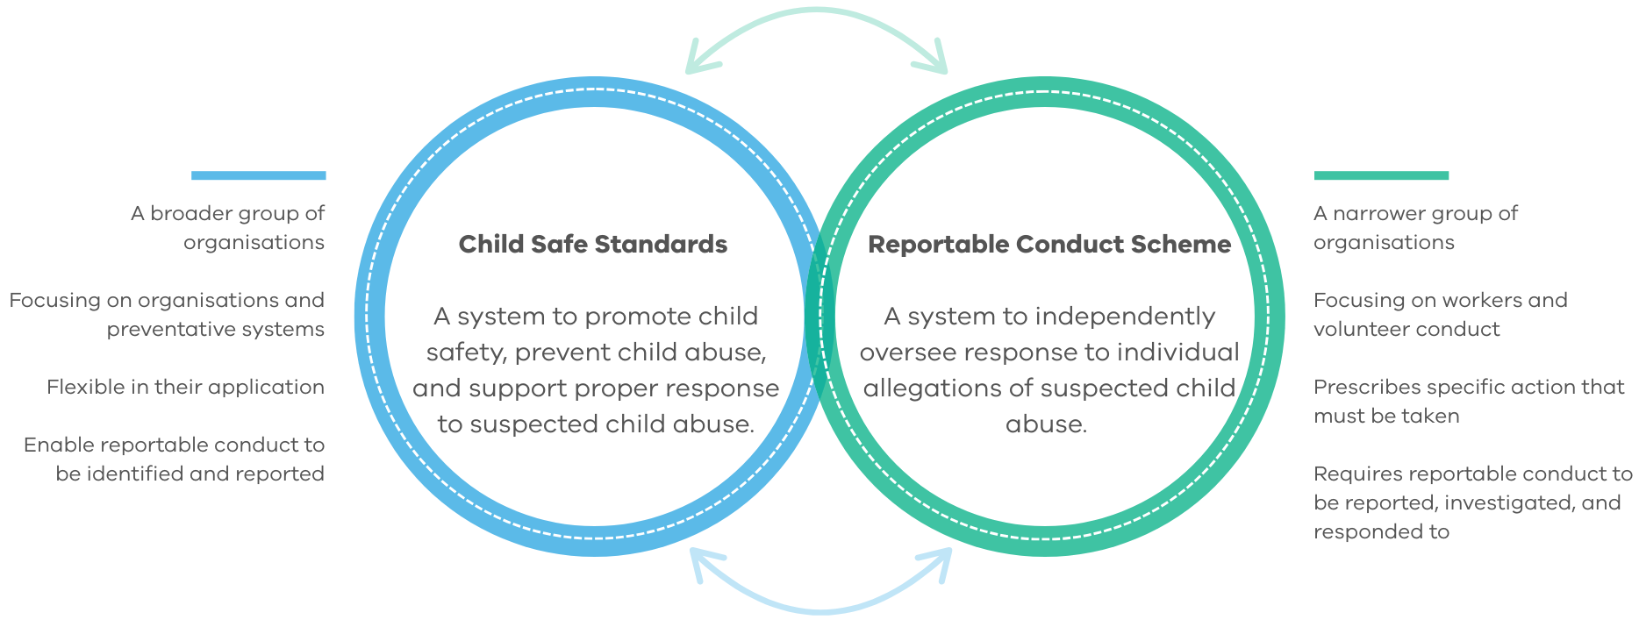
Child safety framework

Slide 3
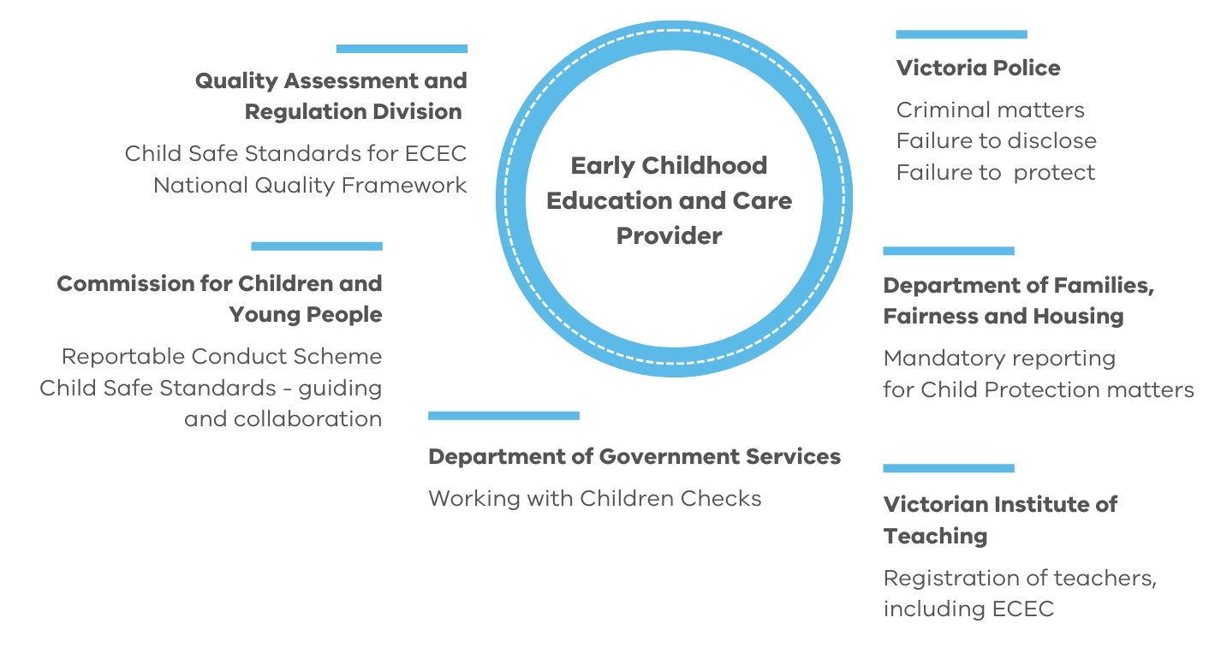
Shape of Victoria’s child safety system

Slide 4
Insights: Reportable Conduct Scheme
Number of mandatory notifications received from all sectors since the beginning of the Scheme
10,353
2,615
Mandatory notifications received from all sectors since the start of the Scheme
Mandatory notifications received from the early childhood education sector since the start of the scheme
18%
178%
Percentage change from 2023-24 (for all sectors)
Percentage change
since the start of the Scheme (2017) (for all sectors)

Slide 5
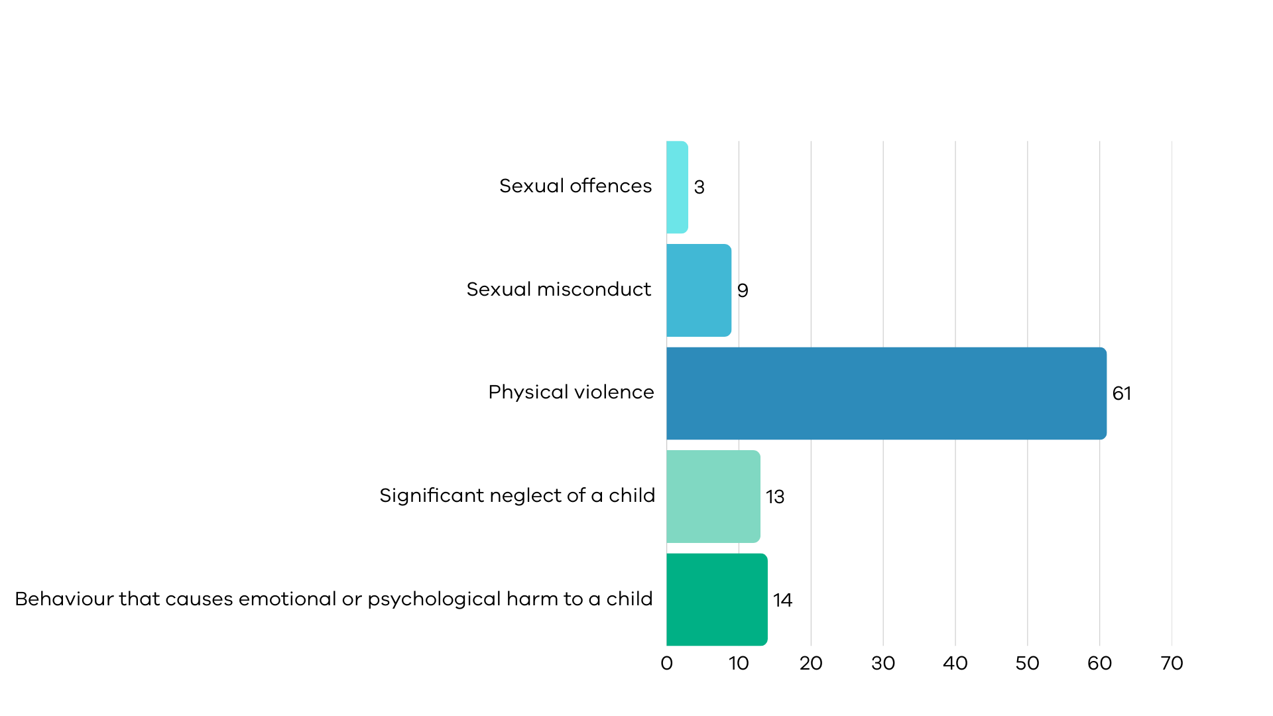
Insights: Early Childhood Education Sector
Proportion of reportable allegations by category in ECEC since the start of the scheme (%)
Conduct category for substantiated allegations and substantiation rates in ECEC since the start of the Scheme
Category | Number | Substantiation rate
Physical violence | 567 | 26%
Significant neglect | 187 | 41%
Significant emotional or psychological harm | 78 | 15%
Sexual misconduct | 44 | 15%
Sexual offences | 11 | 14%
Sexual offences
Sexual misconduct
Physical violence
Significant neglect of a child
Behaviour that causes
emotional or psychological harm

Slide 6
Evolution of the child safety system
Victoria’s mandatory Child Safe Standards commenced
Victorian Government review of the Child Safe Standards
concluded, addressing recommendations from the Royal Commission
Victorian Government review of the Reportable Conduct Scheme
concluded
Betrayal of Trust Inquiry
tabled in Parliament
2013
2015
2016
2017
2018
2019
2020
2021
2022
2023
2014
2024
2025
Victoria’s Reportable Conduct Scheme commenced as recommended by the Royal Commission and Betrayal of Trust Inquiry
Rapid Child Safety Review
concluded
Royal Commission into Institutional Responses to Child Sexual Abuse
conducted
Stronger Child Safe Standards and new regulatory framework
commenced

