Slide 1
PUBLIC HOUSING
RENEWAL PROGRAM
Legal and Social Issues Committee Inquiry
Public Hearing
15 February 2018

Slide 2

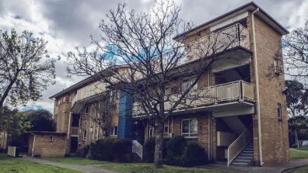
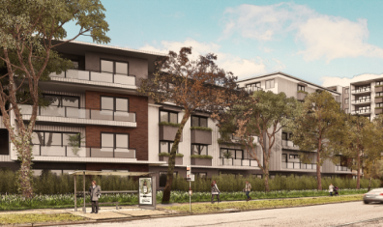
Agenda
Context
Public Housing
Dwelling numbers
How we are engaging with estate tenants
Development process / model
Program Objectives
Community housing
What it means for people

Slide 3


Social Housing & Homelessness Demand
“Housing is the foundation for financial, social and emotional security, and for better health and wellbeing”
2015-16
105,287 people
2011-12
86,150 people
36,013 (Dec. 2017) new applicants on the Victorian Housing Register;
~17,194 are in urgent need of housing
Family violence is a reason cited by 39% of people who access homelessness services
Over 100,000 people presented for homelessness services in 2015-16

Slide 4
Homes for Victorians
The Public Housing Renewal Program is just one part of the Homes for Victorians strategy to respond to housing affordability, homelessness and demand for social housing
$1b Social Housing Growth Fund
$1.1b Financial Support for Social Housing Sector
$185m Public Housing Renewal
$152m Family Violence Housing Blitz
$120m Social Housing Pipeline
$132m Homelessness Support (incl $45m Homelessness & Rough Sleeping Action Plan)
$33m Private Rental Assistance
~6,000 new social housing dwellings
~2,500 ageing public housing dwellings renewed
Assist 19,000 people who are homeless or at risk of homelessness

Slide 5
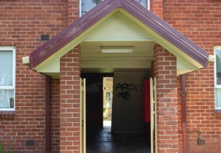
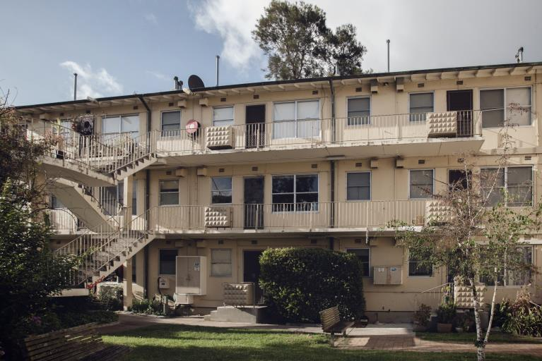
Public Housing
Supply vs Demand
~83,600 social housing dwellings, comprised of:
    ~64,600 public housing
    ~19,000 community housing
  36,000 applicants on Victorian Housing Register
  Plus over 7,000 current tenants on the transfer list
  Increasing demand from priority cohorts, including people with disabilities and the aged
Ageing & Inappropriate Housing
Estates built in the 1950s and 1960s
    Walk-ups are inappropriate for aged/disability access
    Outdated design (external laundries, dark/unsafe areas)
    Expensive to maintain due to age
    Poor energy & water efficiency – expensive for tenants

Slide 6
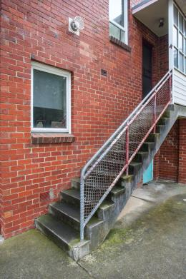

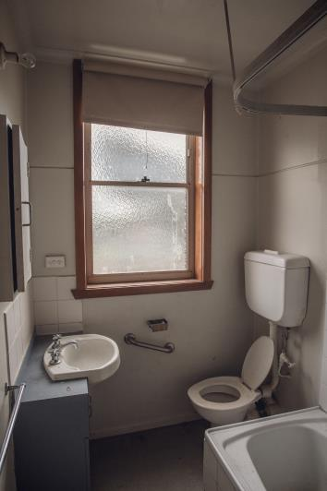
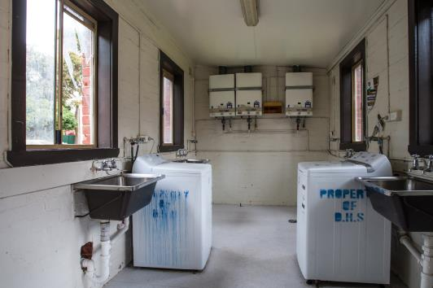
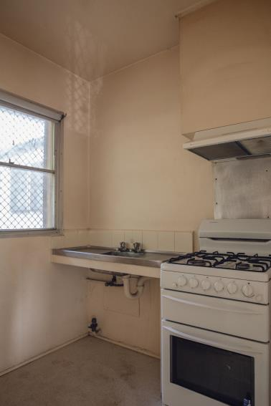
Current housing
Brighton
Heidelberg
Brighton
Ascot Vale
North Melbourne
Heidelberg
Flemington

Slide 7
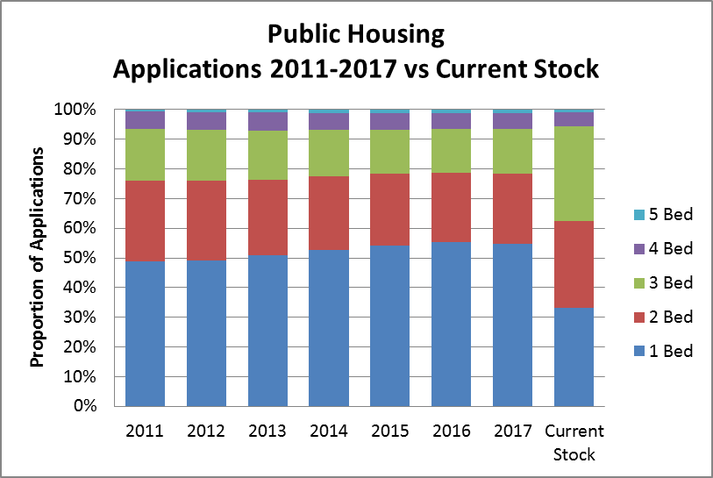
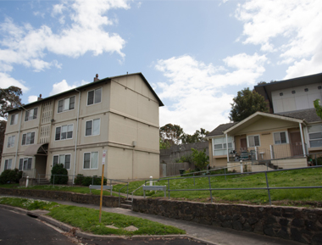
Auditor General Report
    Misalignment: Supply, configuration & location of housing is not aligned to current and future demand (80% demand for 1 or 2 bed dwellings)
    Ageing stock: 60% of stock is over 30 years old
    Financial sustainability: postponing renewal is an unsustainable strategy
    The Public Housing Renewal Program is an important, necessary and substantial response to these issues

Slide 8
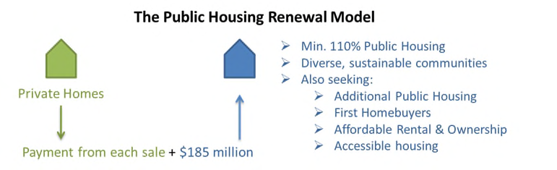
Proposed Development Process / Model
DHHS provides land, some funding and clear objectives and outcomes to be delivered
State receives new public housing + growth
DHHS is seeking innovative solutions to deliver more public housing sooner, which may include variations of development models
Proposals considered on their merits against objectives

Slide 9
Value for Money
We anticipate delivering at least 1,778 new public homes with $185M funding, which is significantly more than the alternatives, delivering renewal, growth and retains existing locations

Slide 10








Program Objectives
  Retain, replace and grow social housing
  Well located homes
  Additional affordability and community benefits
  Reduce tenants’ living costs
  High quality design including accessible dwellings
  Tenure blind housing
  Align overall housing profile
  Leverage government land and capital to attract development partners

Slide 11
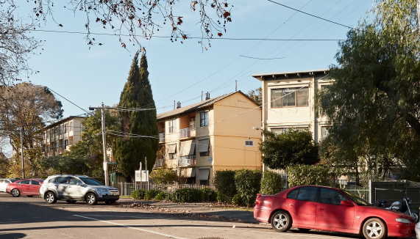
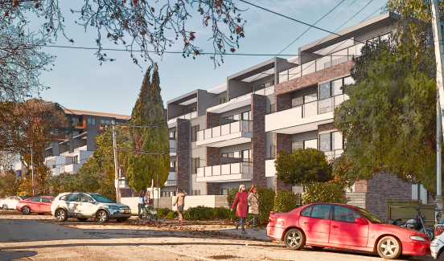
Dwelling Numbers
More homes = more households assisted
Demand for smaller households – 80% of applicants and majority of existing estate residents are eligible for one or two bedroom homes
Large-scale opportunity to realign public housing with known demand and reduce average age of stock
Includes options to allow larger households to return

Slide 12


Tenant Engagement and Relocation Process
Minister for Housing’s Pledge: All existing tenants have the right of return; will have no reduction in security of tenure; and, will have their rent capped at 25% of their household income.
Completed
Commenced and ongoing
✓
✓
Town planning consultation process to understand community and feedback on plans
30+
Tenant relocation Information sessions
Mail out &
door knocks
1 on 1 interviews
to find suitable homes
Offers of suitable home
DHHS pays relocation costs and provides support after tenant moves

Slide 13

Community Housing
Community housing sector growth is a key objective under Homes for Victorians
The PHRP is a separate initiative, but is seeking innovation. Developers may include community housing in their bids, which will be assessed on their merits
If any of the redeveloped properties are ultimately managed by community housing, the Minister’s pledge guarantees returning tenants will:
  have the choice to return
  continue to pay no more than 25% of their income on rent
  have no reduction in their security of tenure

Slide 14
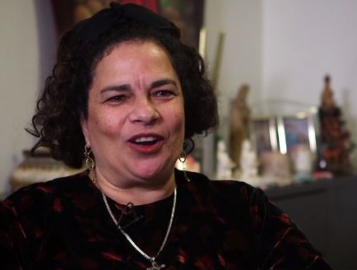
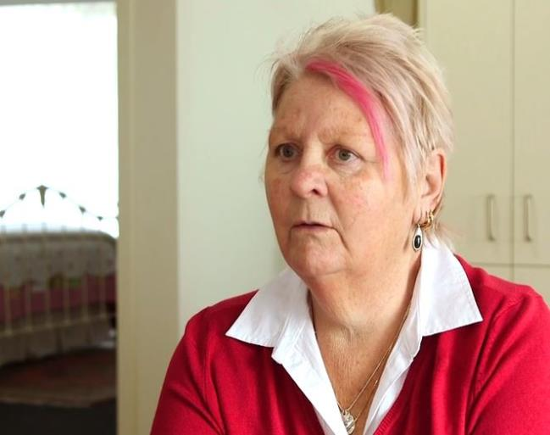
People
Mervat
Kerry
To view their stories: https://vhhsba.vic.gov.au/housing-and-infrastructure/public-housing-renewal-program

