Slide 1
How a law is made & Representation within Parliament of Victoria
Slide deck
December 2021
education@parliament.vic.gov.au

Slide 2
How a law is made

Slide 3
How a law is made
People have ideas for a new law
The idea is written into a draft law called a bill
The bill is presented to one of the Houses of Parliament and has its First Reading, when the title of the Bill is announced
All MPs get a copy of the bill and can debate it. This is called the Second Reading
The Third Reading is when the bill is voted on. If the majority of MPs vote yes, the bill passes and it goes to the other house

Slide 4
How a law is made
The three readings take place in the other house
If the bill is passed by a majority of MPs in the second house, it becomes an Act and goes to the Governor
The Governor, as a representative of the Queen, gives Royal Assent as final approval of the Act (law)
The Act becomes a law from the date of commencement (start date).

Slide 5
How a law is made resources
How laws are made – resource can be used when exploring laws and rules. https://www.parliament.vic.gov.au/education/springboard-featured-resources/4715-how-a-law-is-made-grades-3-and-4
Recent inquiries- maybe useful in looking at how community perspectives are brought into the law making process.
Inquiry | Committee | Status (July 2021)
Inquiry into the use of school buses in rural and regional Victoria https://www.parliament.vic.gov.au/eic-lc/article/4616 | Economic and Infrastructure Committee | Committee conducting public hearings
Inquiry into environmental infrastructure for growing populations https://www.parliament.vic.gov.au/epc-la/inquiries/inquiry/968 | Environment and Planning Committee | Committee report being prepared
Inquiry into the increase in Victoria’s road toll https://www.parliament.vic.gov.au/eic-lc/article/4296 | Economic and Infrastructure Committee | Committee report tabled on 18 February 2021
Inquiry into homelessness in Victoria https://www.parliament.vic.gov.au/lsic-lc/article/4662 | Legal and Social Issues Committee | Interim Government response available
Inquiry into the Domestic Animals Amendment (Puppy Farms and Pet Shops) Bill 2016 https://www.parliament.vic.gov.au/images/stories/committees/SCEI/Domestic_Animals_/EIC_58-06_Report_Text_only.pdf This is the Bill referred to in the ‘How laws are made’ education resource. https://www.parliament.vic.gov.au/education/springboard-featured-resources/4715-how-a-law-is-made-grades-3-and-4 | Economic and Infrastructure Committee | Committee report tabled on 6 December 2016

Slide 6
Representation

Slide 7
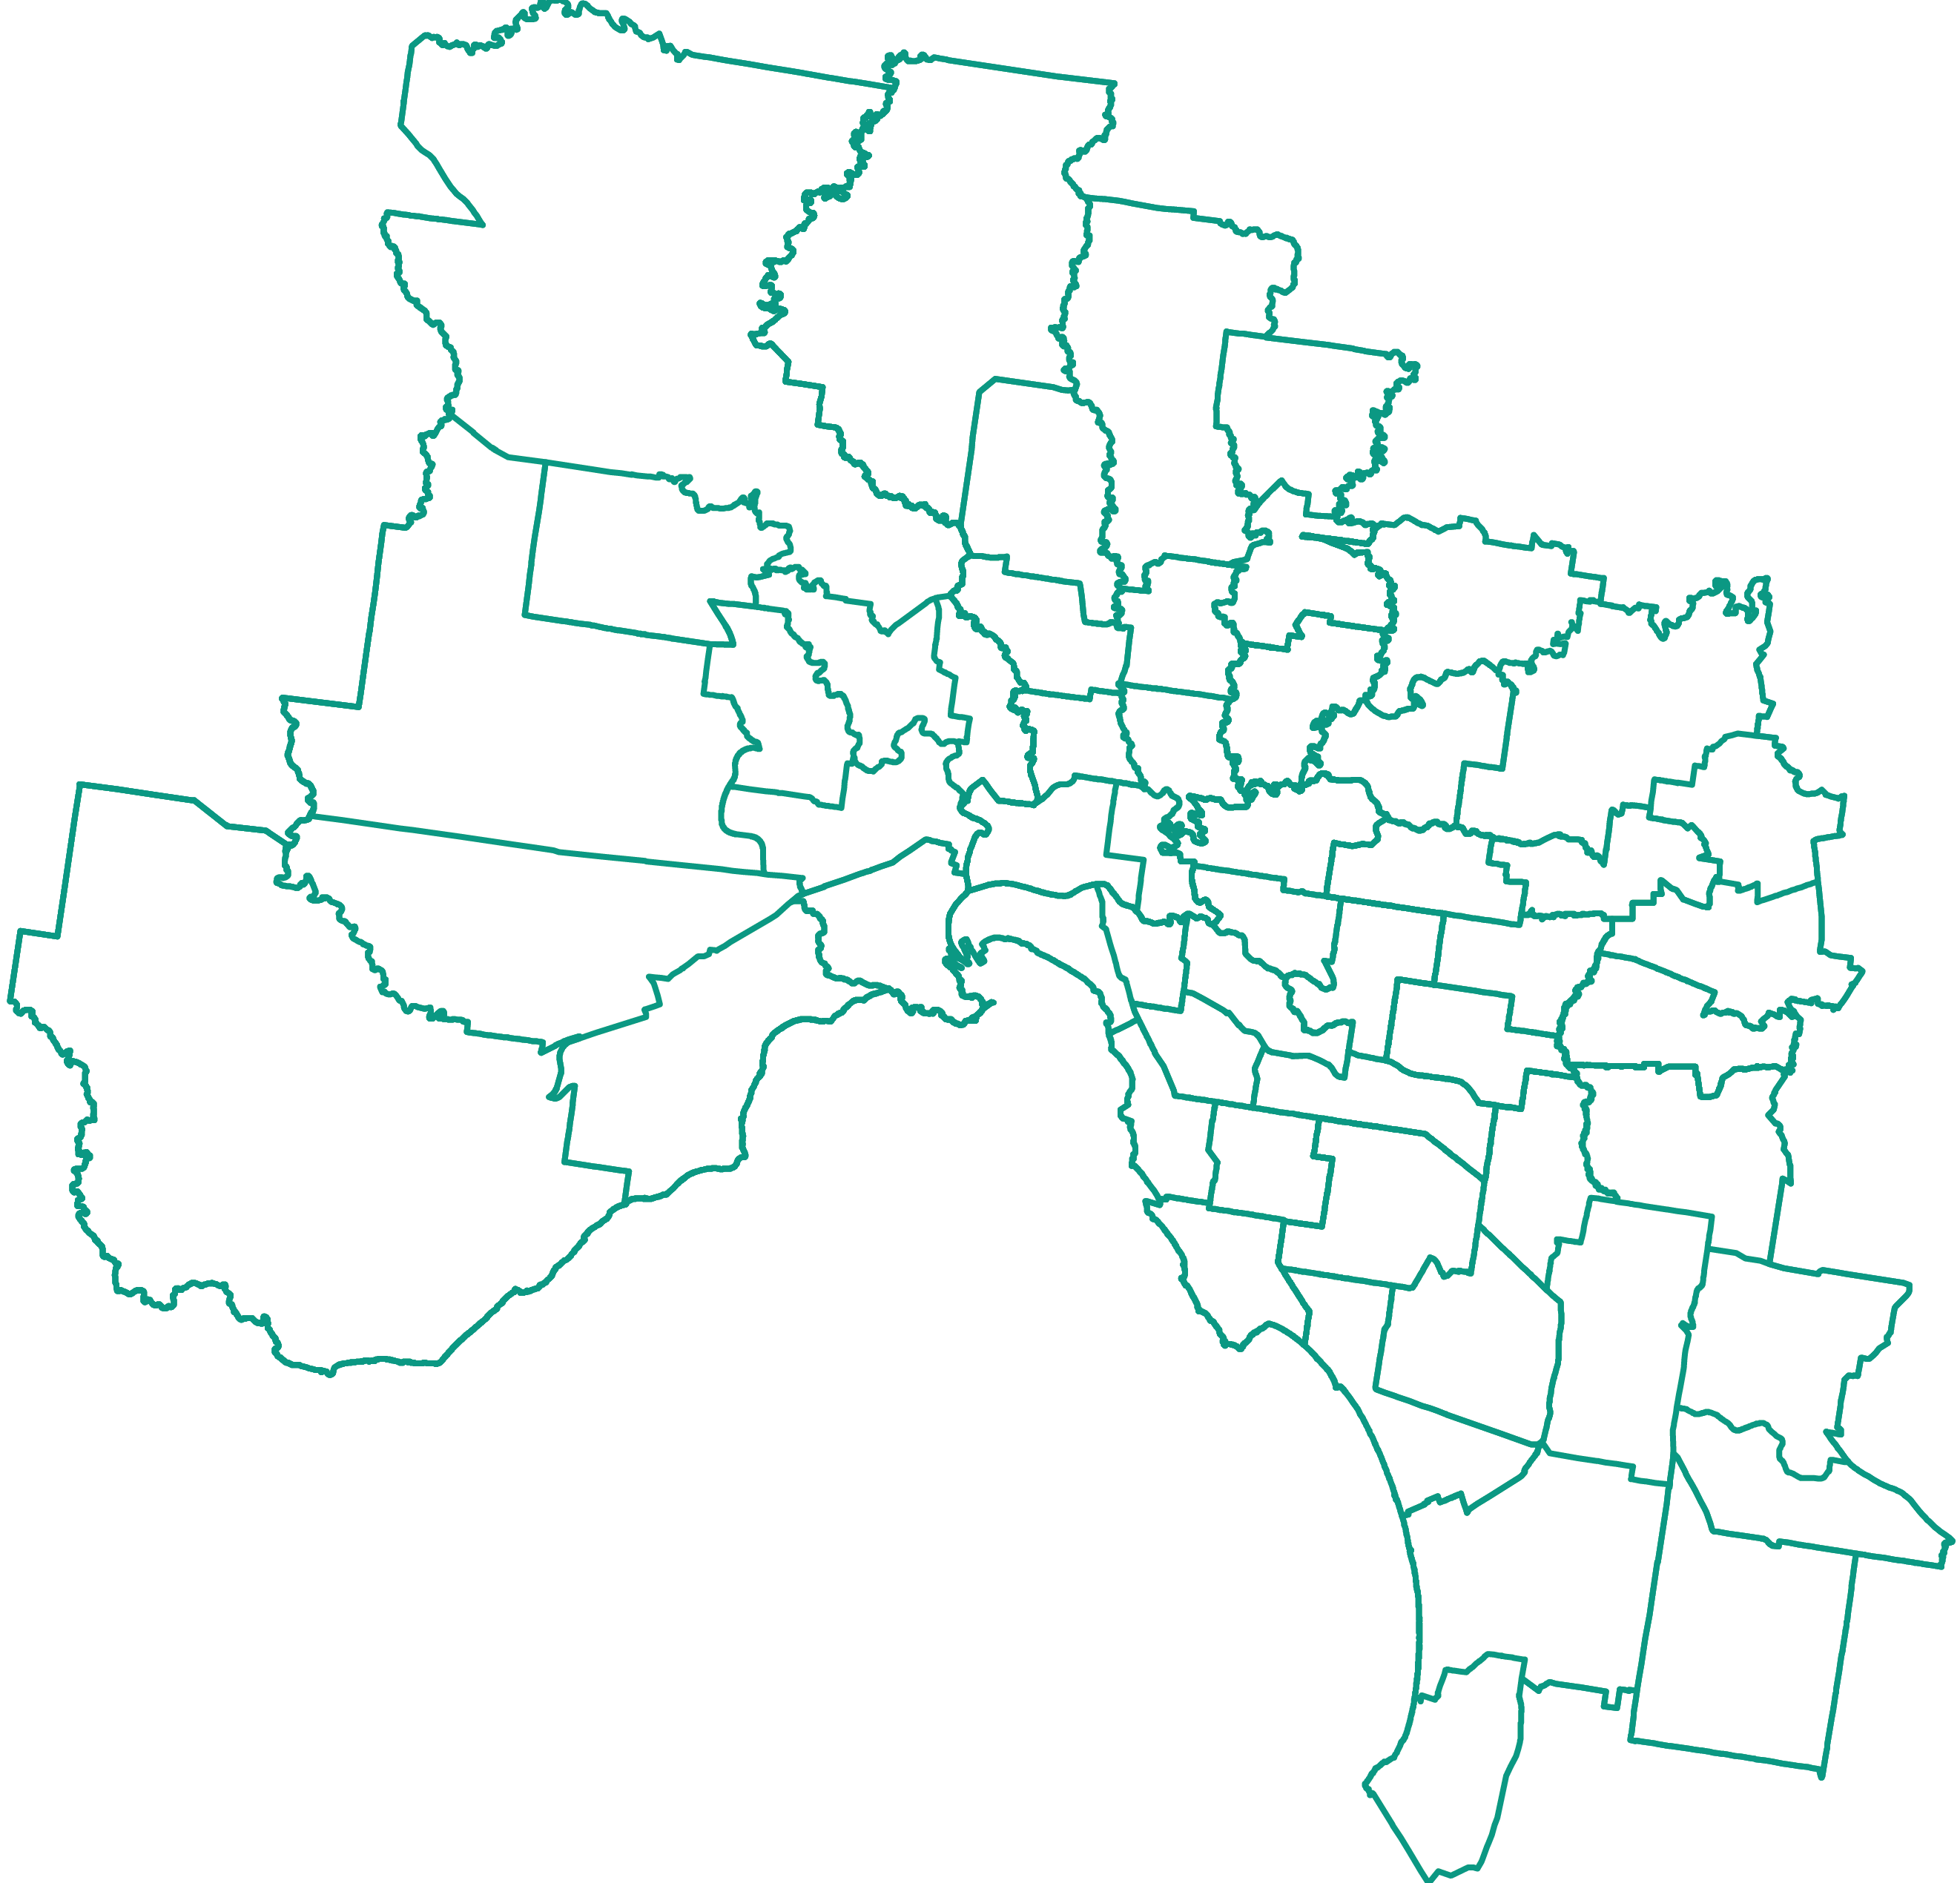
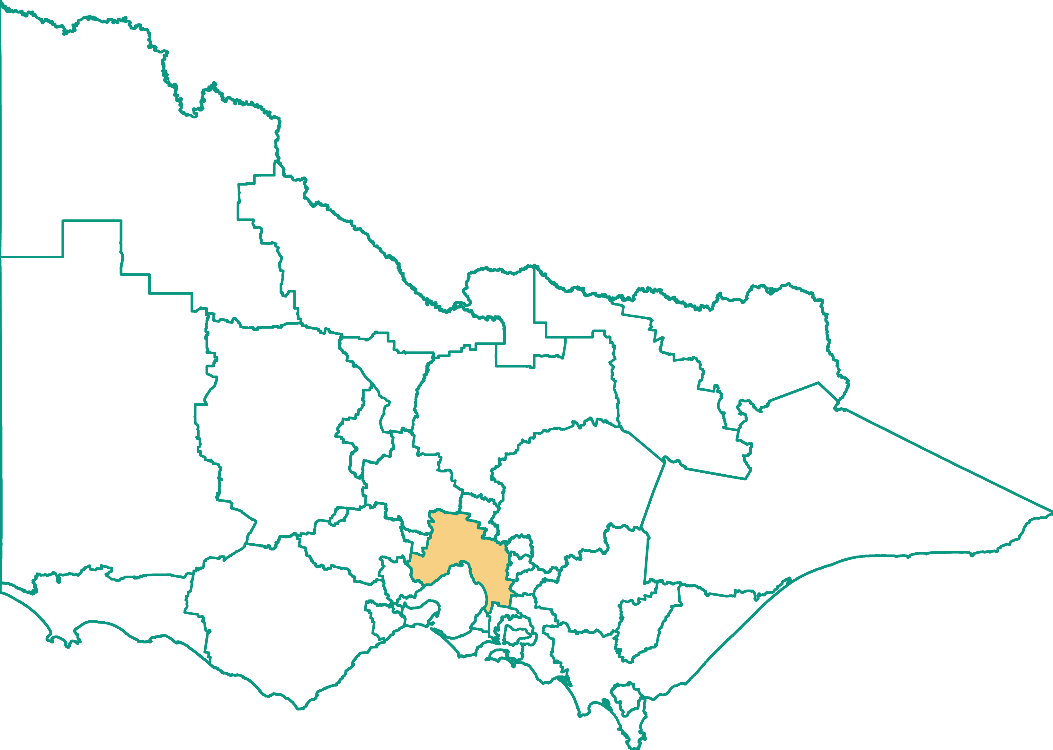
Electorates: 88 districts in the Legislative Assembly
88
Metropolitan
There is one elected Member in each of the 88 Legislative Assembly districts
Regional

Slide 8
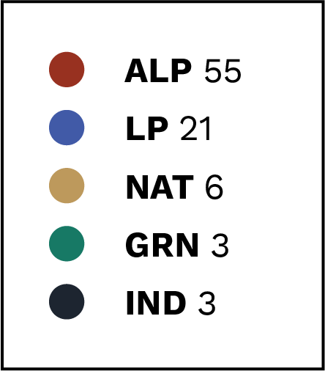
Legislative Assembly
Notes:
Representation of MP parties in the 59th Parliament (current as of November 2021)
Labor (ALP), Liberal (LP), National (NAT), Greens (GRN), Independent (IND)

Slide 9
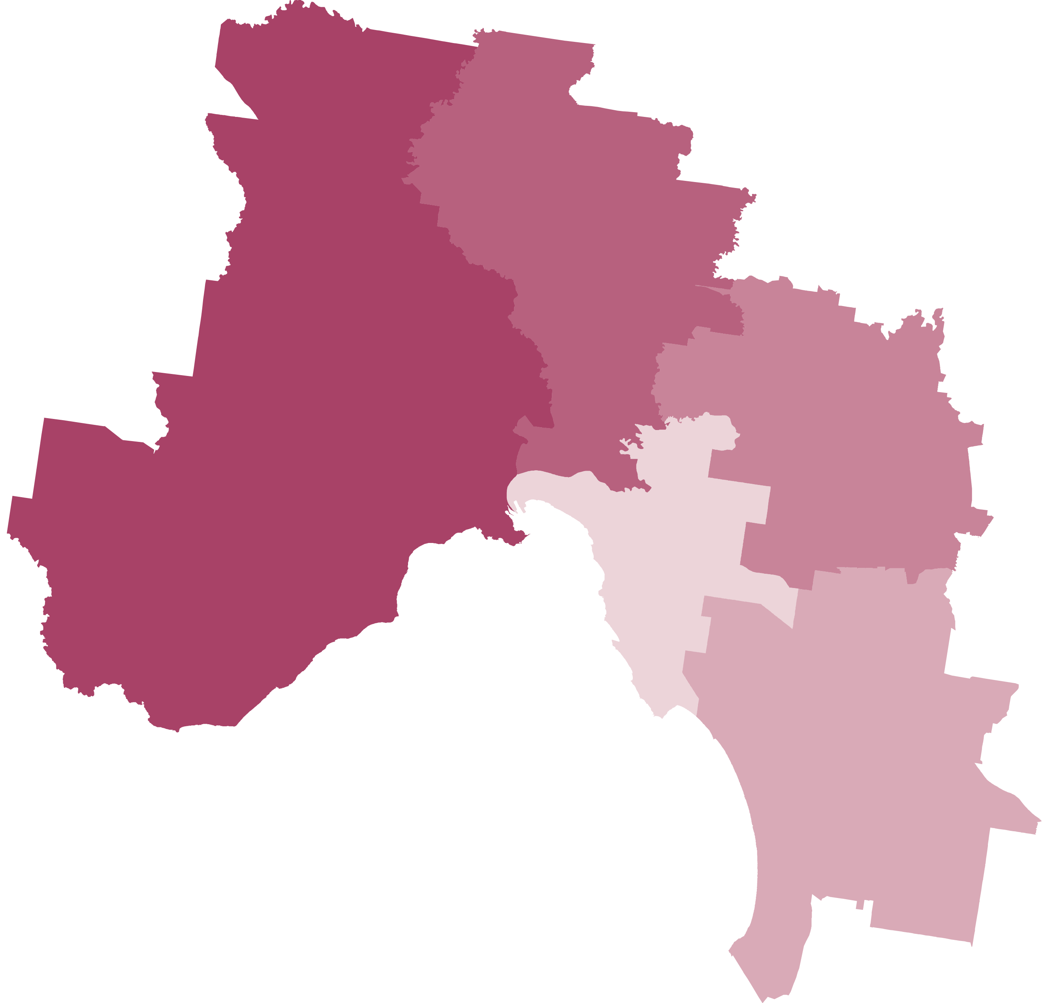
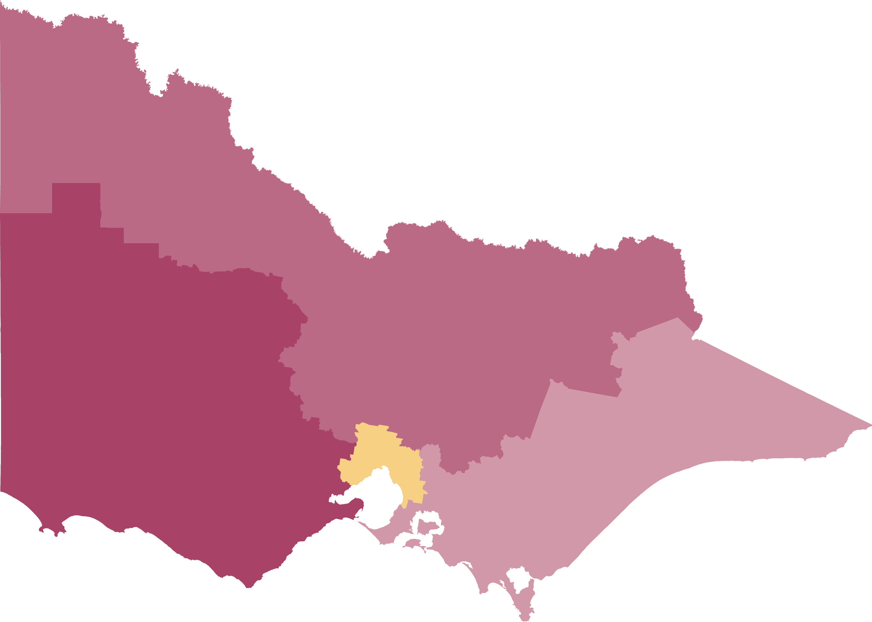
Electorates: 8 regions in the Legislative Council
40
Metropolitan
There are five elected Members in each of the 8 Legislative Council regions
Regional

Slide 10
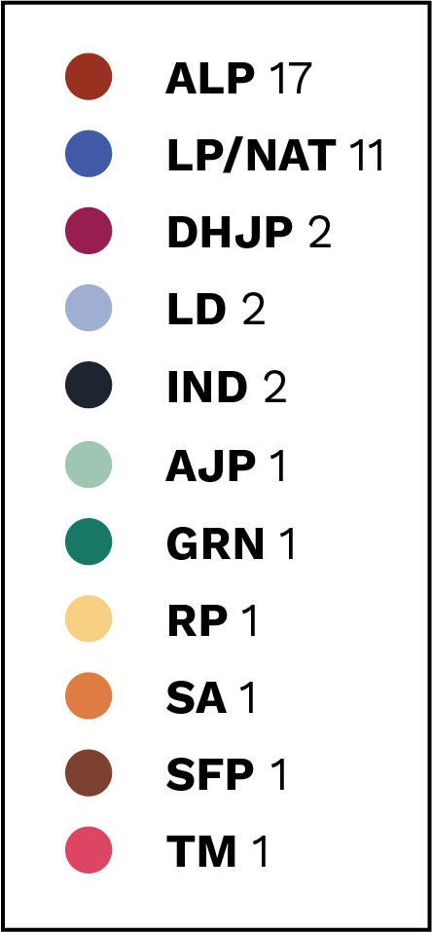
Legislative Council
Notes:
Representation of MP parties in the 59th Parliament (current as of November 2021)
Labor (ALP) Liberal (LP) National (NAT) Justice (DHJP) Liberal Democratic (LD) Animal Justice (AJP) Greens (GRN) Reason (RP) Shooters, Fishers, Farmers (SFP) Sustainable Australia (SA) Transport Matters (TM) Independent (IND)

