Slide 1
2020-21 Public Accounts and Estimates Committee
Budget Estimates Hearing
The Hon. Jill Hennessy MP
Attorney-General
Tuesday 15 December 2020

Slide 2
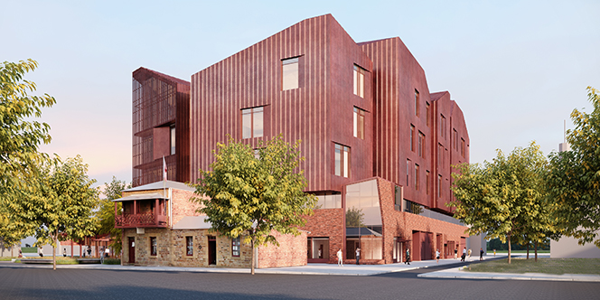
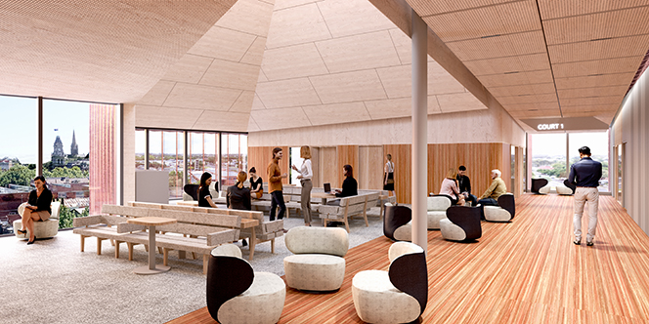

2020-21 PAEC Hearings: Attorney-General
2018 Election Commitments
  The Victorian Government is getting on with its key election commitments, including:
  Rebuilding Bendigo Law Courts
  Criminalising wage theft
  Introducing new workplace manslaughter offences
  Introducing a new ‘homicide by firearm’ offence
  Bendigo Law Courts

Slide 3

2020-21 PAEC Hearings: Attorney-General
2020-21 Budget Initiatives
  Output initiatives
 | $43.6 m | building capacity in our justice system and helping to reduce delays caused by coronavirus (COVID‑19)
 | $8.3 m | additional legal assistance services and information and communications technology upgrades
 | $5.9 m | delivering forensic medical services to police and courts
 | $5.8 m | Royal Commission into the Management of Police Informants
 | $3.9 m | ensuring young and disadvantaged Victorians have access to community legal services

Slide 4

2020-21 PAEC Hearings: Attorney-General
2020-21 Budget Initiatives
  Output initiatives
 | $3.0 m | supporting community legal centres
 | $2.5 m | continuation funding for the Office of the Public Advocate
Whole of government – Aboriginal Affairs – BP3 pg 10.
 | $20.2 m | over two years for enabling economic recovery and development through Traditional Owners’ Corporations, including: $11.3 million – Dja Dja Wurrung Clans Aboriginal Corporation $8.9 million – Traditional Owner corporations
 | $25.1 m | to progress agreements under the Traditional Owner Settlement Act 2010

Slide 5
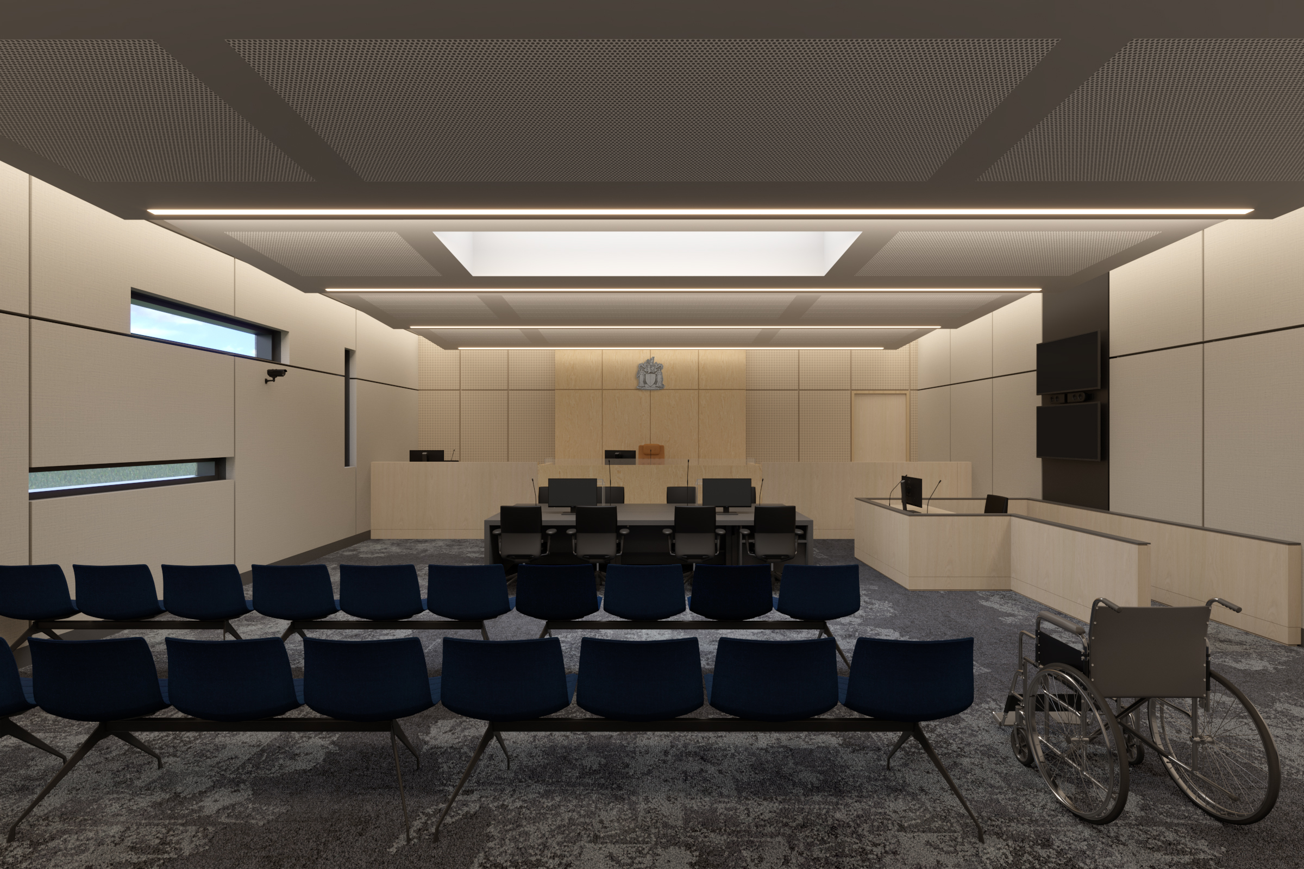
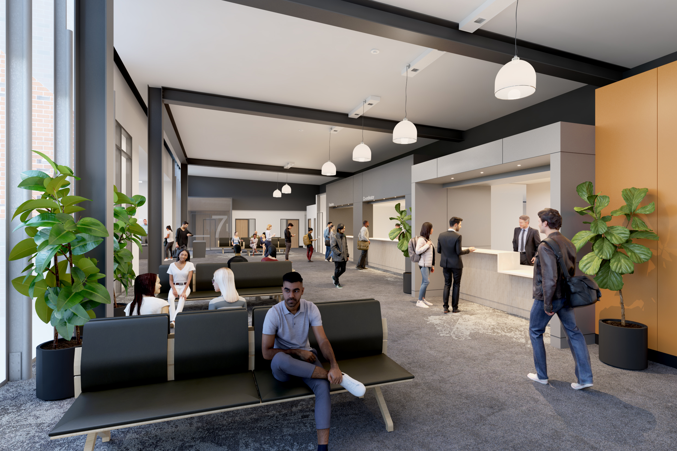
2020-21 PAEC Hearings: Attorney-General
2020-21 Budget Initiatives
  Court Services Victoria – output initiatives
 | $28.3 m | in output funding which includes: $8.8 million for Sunshine Law Courts Redevelopment; $8.2 million for Court response to coronavirus (COVID‑19); $3.5 million for Implementing youth control orders and intensive bail orders
  Sunshine Law Courts

Slide 6
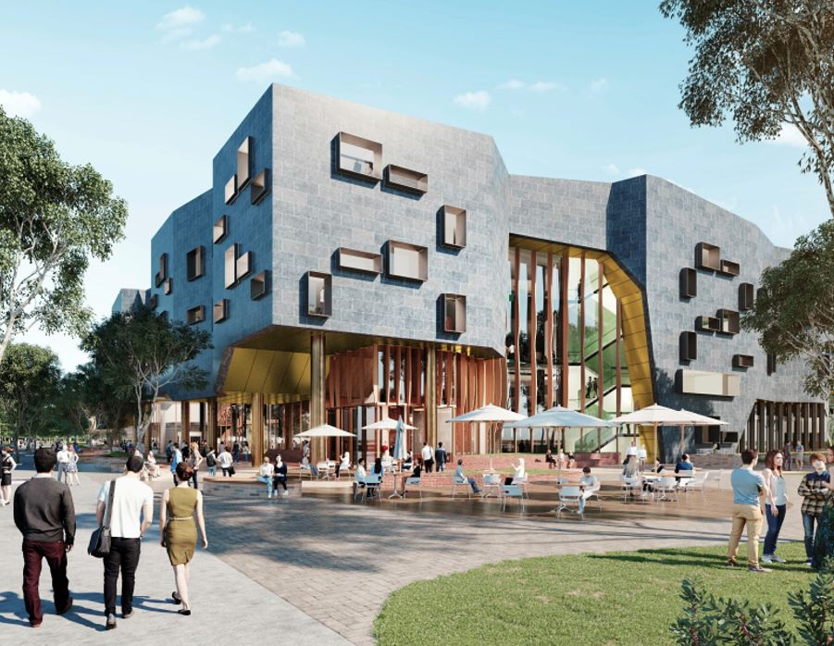
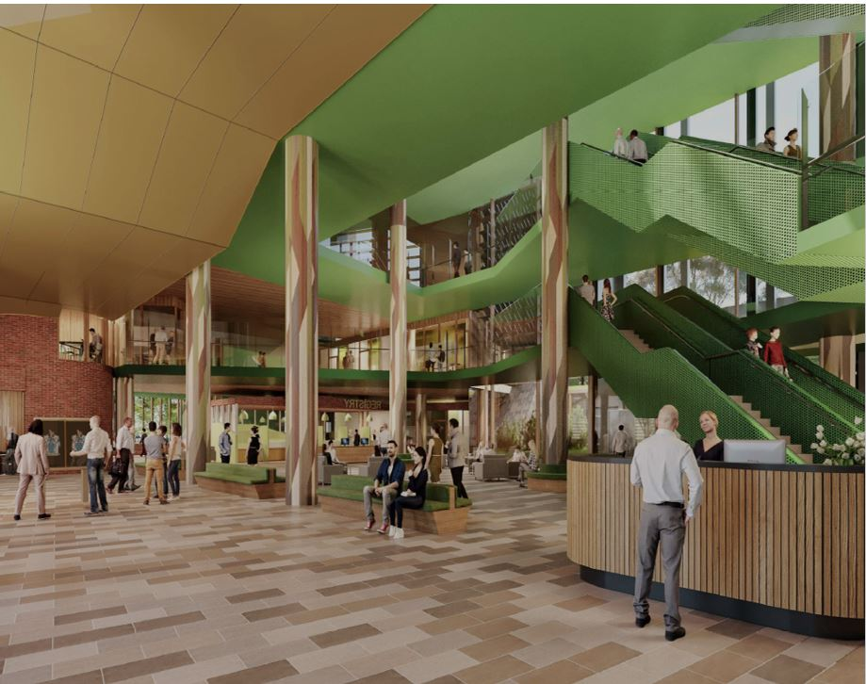
2020-21 PAEC Hearings: Attorney-General
2020-21 Budget Initiatives
  Court Services Victoria – asset initiatives
  Court Services Victoria
  Output initiatives
 | $311.8 m | in asset funding which includes: $271.1 million for New Wyndham Law Court; $16.3 million for Sunshine Law Courts Redevelopment; $12.5 million for Court response to coronavirus (COVID‑19)
  New Wyndham Law Court

Slide 7
2020-21 PAEC Hearings: Attorney-General
2020-21 Budget Initiatives
  Independent integrity bodies – under Parliament
 | $36.5 m | in output initiatives which includes: $27.1 million funding for IBAC: Meeting demand and community expectations; $6.3 million for Funding for Victorian Inspectorate; and $3.1 million for Securing a sustainable Ombudsman for Victorians

Slide 8
Thank you.

